Slide 1
CEMA HEALTH INFORMATION MANAGEMENT SYSTEM DESIGN
By Edimon Ombati Abobo

Slide 2
System Requirements
The requirements for this system include:
Creation of a health program – e.g., TB, Malaria, HIV, etc.
Registration of a new client in the system.
Enrollment of a client in one or more programs.
Search for a client from a list of registered clients.
View a client’s profile, including the programs they are enrolled in.
Expose the client profile via an API, so that other systems can retrieve this information.

Slide 3
Development Approach
Stack selection
DBMS Selection
System initialization
Installation of dependencies
Creation of authentication
User management design
Program management
API development

Slide 4






Stack & DBMS Selection
Front-end : HTML, CSS, JS, Bootstrap
These are simple and easy to implement and deploy even in production.
Backend : Laravel
Laravel is one of the best frameworks to use especially in building management systems. Its API developments is easy.
Database : MySQL
This is a structured database management system suitable for such type of data and easy to scale. It is also available in almost all hosting plans.

Slide 5
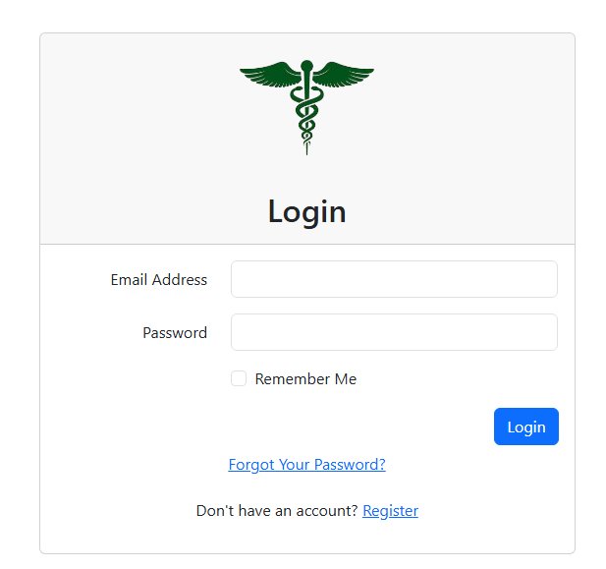
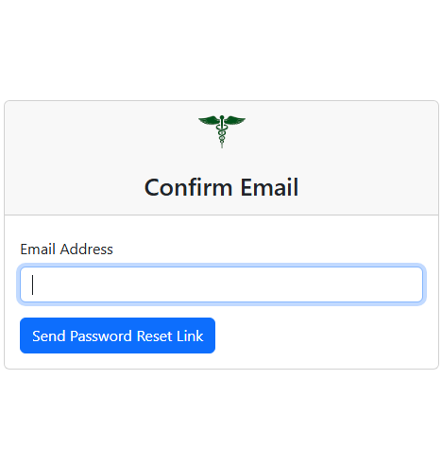
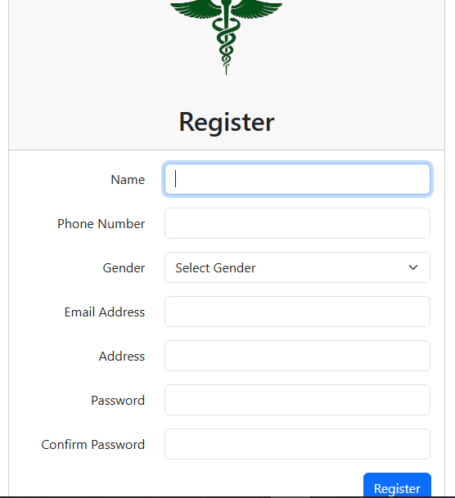
Authentication creation
Creation of the register, login, reset password and other user functions.

Slide 6
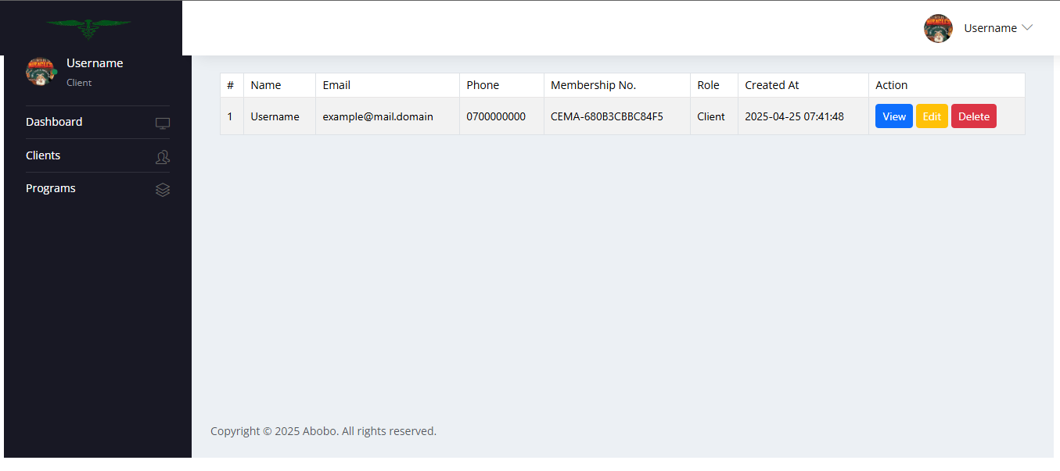
User Management
User registration, update, delete and view functions

Slide 7
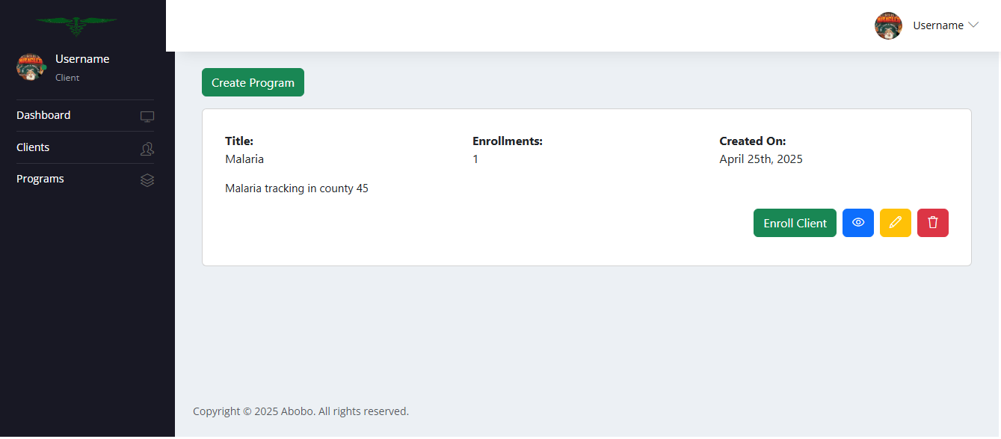
Program Management

Slide 8
User Navigation
Dashboard
View activities summary
Navigate to pages
Login/Register
Clients
Programs
View clients
Modify client Data
View programs
Manipulate program
Enroll member to program
Enroll member to a program

