Slide 1
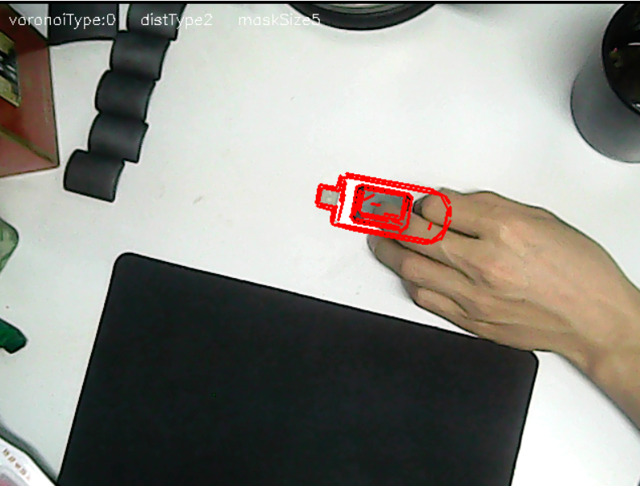
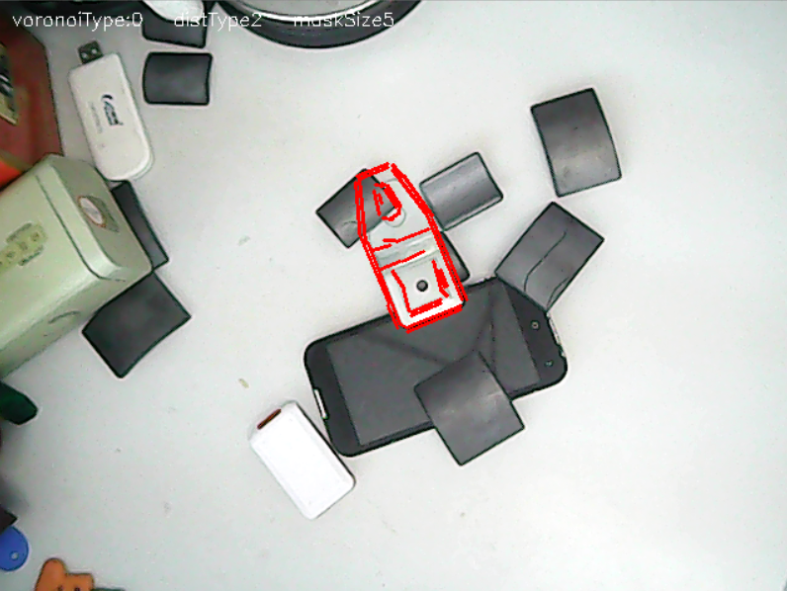
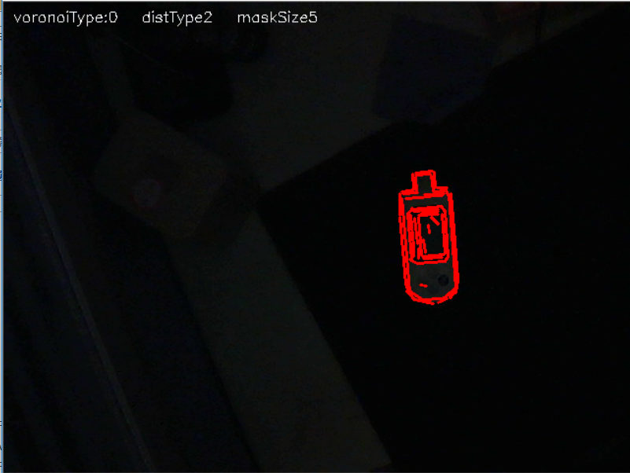
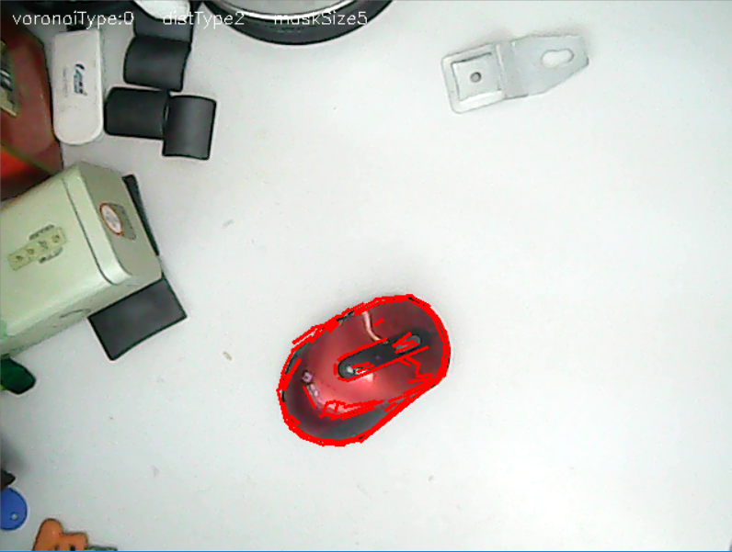
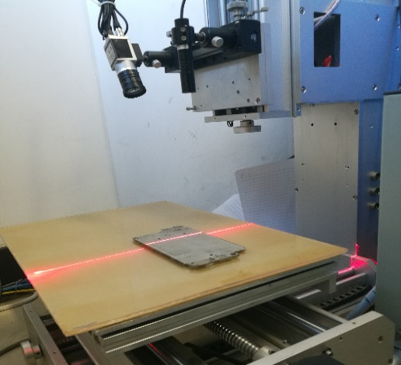
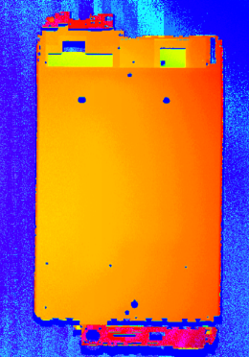
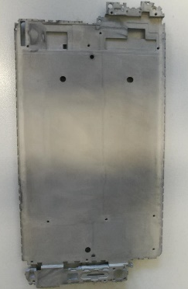
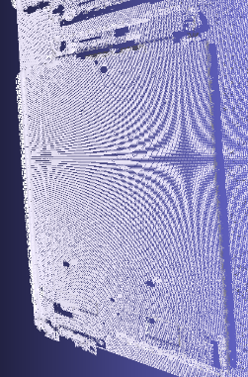
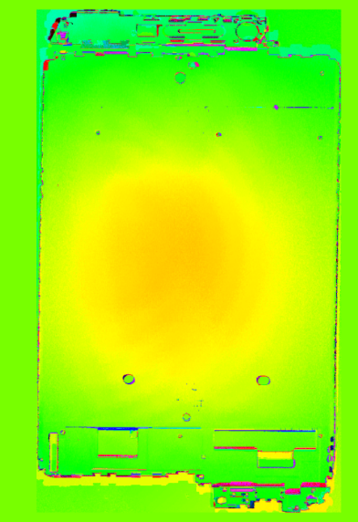
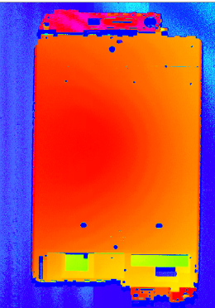
Improved FDCM in Laser Scanning Inspection System for Workpiece Deformation
2017 IEEE International Conference on Robotics and Biomimetics
December 5-8, 2017 Macau, China
Yibin Huang, Yue Guo and Kui Yuan
University of Chinese Academy of Sciences; Institute of Automation, Chinese Academy of Sciences
Introduction
Three-dimensional (3D) inspection based on machine vision is high-precision and efficient. In this paper, a laser scanning system using the triangulation measurement is designed to obtain dense point clouds of the workpiece surface, and the point clouds are projected to two-dimensional (2D) range images. Fast Directional Chamfer Matching (FDCM) is a reliable algorithm for object detection and localization, and it is improved to accelerate the time-consuming 3D registration. Although the author of FDCM greatly improved the directional chamfer matching, it remains very slow in practice. We mainly improved the line fitting process and distance transform in this algorithm, and they greatly accelerate the scanning process. Experimental results show that the scanning system with the improved algorithm can highlight the deformation of the workpiece in real time.
Our algorithm requires no training processes, it only needs a template image. Fig.2 shows that improved FDCM is robust and usable.
2. Laser Scanning Inspection System
The laser scanning inspection system consists of a linear laser projector, a CCD camera and a moving platform.
(a)
(b)
The object on the moving platform is the workpiece to be inspected.
Based on triangulation ranging theory We can obtain the 3D coordinates of the laser stripe; by moving the platform, we rebuild the 3D surface of the workpiece.
The accuracy of the laser scanning inspection system is about 0.04 mm.
A light stripe image can be transformed to 3D data within 2 ms in our case.
Camera
Laser-line
Projector
World coordinate
Z_{W}
Laser
Stripe
(c)
(d)
Workpiece
X_{W}
Fig.2. Improved FDCM is robust and usable.
The target can be detected and localized under the partial occlusion (a), in the cluttered background (b), and in bad illumination (c). It is also suitable for the objects with only a few line segments, for example, the mouse in (d).
O_{W}
Y_{W}
Moving
Platform
Scanning
Direction
4. Registration
The workpiece to be inspected is a very thin metal sheet for a cellphone, and it is easy to be deformed during die casting. By comparing with the standard piece, we know whether the workpiece is qualified. Registration of the workpiece with the flowing steps:
Scan the surface of the workpiece with the laser scanning system.
Project the 3D point cloud to a range image.
Registration the range image with improved FDCM.
Fine registration.
Fig. 1 Overview of the system
3. Improved Fast Directional Chamfer Matching
A. Fast directional chamfer matching
Directional Chamfer Matching (DCM) matches the template and the query image based on the distance and the direction of edges, the cost of matching is related to the distance and angle difference of the edge points. FDCM is an algorithm improved from DCM with the following improvements:
1) Line segments expression: Using line segments rather than points to express the edge image, which is much more concise.
2) Integral distance transform: Integral distance transform accelerates the cost computation because it has only a few arithmetic operations.
3) Region search optimization: If the cost of a location is much larger than the cost of the target location, it is impossible to have a target within a certain nearby region.
However FDCM still cannot work in real time, some steps are of very time-consuming.
B. Improved Fast Directional Chamfer Matching
Replace the line fitting method: The line fitting method is a variance of the RANSAC algorithm, it has many false attempts We replace this method by Line Segments Detector (LSD), which is a fast and robust line extraction algorithm.
Angular Voronoi diagram: In FDCM, the continuous angle is quantified into 60 discrete orientations, 180 times pixel traversal of the query image is required. As a countermeasure, our method only requires an angular Voronoi diagram and a 2D distance transform image. In the angular Voronoi diagram, the angle of a pixel is assigned by the inclination angle of its closest line segment. In the matching process, the angular cost can be computed with Voronoi diagram, and the distance cost can be obtained from distance transform image.
Line based matching：We only searching the locations with the line segment, instead of brute force search. Template lines are rotated and translated to align with one line segment in the query image, and the cost is evaluated to decide whether there is a target. The number of candidate locations drops from millions to thousands (even dozens).
We compare the consumed time of our method and FDCM. Our method runs 24 times faster, as listed in TABLE I. If the background is clean, the processing speed of our method can reach 30 fps.
Reference WorkPiece
Registration
Workpiece
Laser Scanning
Point Cloud
Inspection result
Range Image
The flow chart of the laser scanning inspection system is shown in Fig.3. The deformation of the workpiece can be inspected by computing the distance after aligning the source point cloud to the target point cloud. The inspection result is a difference image, It shows that the middle part is a bulge, and such a deformation is very obvious in the difference image.
Now we compare other methods to our method. The differences of these methods are shown in TABLE II. Our method is fast and is robust to noises. all the inspection steps can be finished within 100 ms.
Fig.3. Flow chart of workpiece inspection
TABLE II Comparison of registration algorithms
Method | Features used | Time (ms) | drawback.
ICP | 1011188 3D points, initial transform matrix | 8650.993 | Time-consuming
NDT | 1011188 3D points, initial transform matrix | 3554.329 | Time-consuming
2D ICP | 6892 2D points, initial transform matrix | 39.374 | Noise sensitivity
SBM | 9698 2D points | 431.824 | Mix direction
SPIE | 4 line segments | 95.101 | Human-computer interaction
This paper | 36 line segments | 86.505 | --
TABLE II Comparison of the running time
Algorithm | Line fitting | Distance transform | Matching
FDCM | 978.834 | 889.371 | 62.448
This paper | 28.755 | 5.456 | 48.464
Paper ID: 59
Contact email: huangyibin2014@ia.ac.cn guoyue2013@ia.ac.cn

