Slide 1
COMPSCI 718
Programming for Industry
Lecture 11 – Swing
Class Discussions

Slide 2
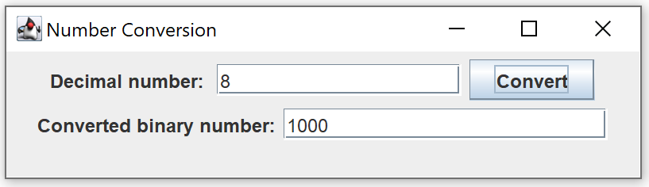
Exercise 1 – Number conversion
Please complete the NumberConversionPanel class in ex1 package so that it can generate a GUI to allow the user to enter a decimal number in a text field and the program will convert it to a binary number by a conversion button.
Example output:

Slide 3
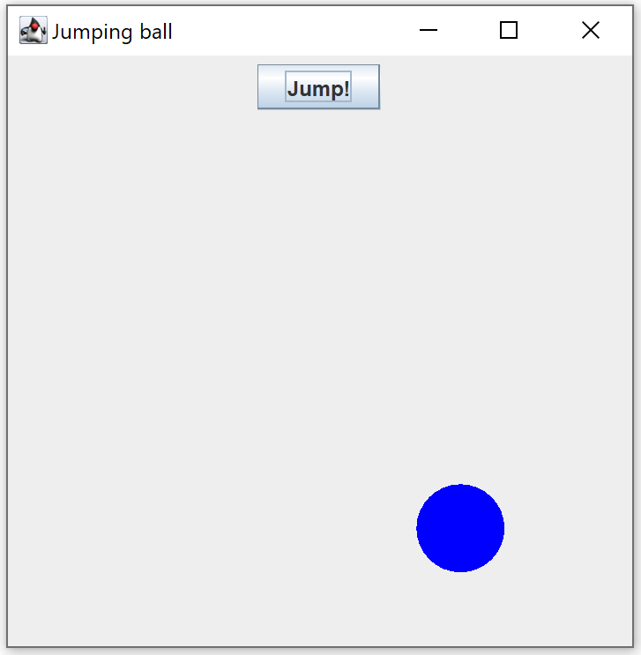
Exercise 2 – Jumping ball
Example output:
Please complete the JumpPanel class in ex2 package so that when the Jump! button is clicked, the blue dot will move to a random place inside the window.

Slide 4
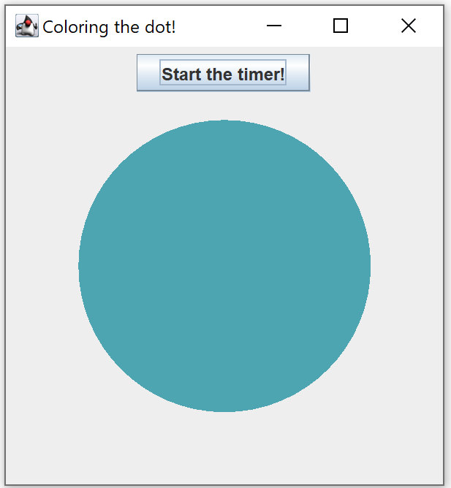
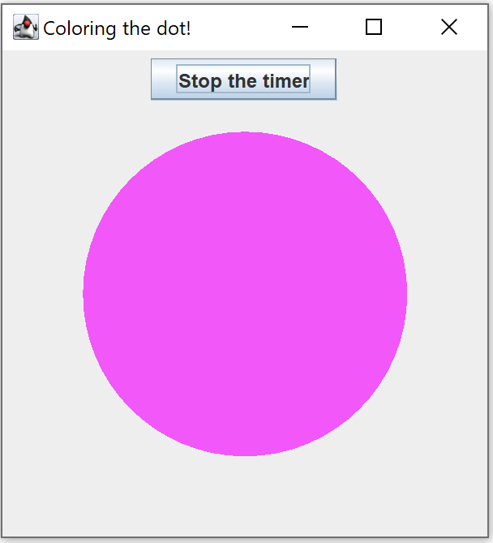
Exercise 3 – Coloring the dot
Please complete the ColorDotPanel class in ex3 package so that when the "Start the timer!" Button is clicked, the circle will change to a new colour every 500ms. The color is randomly decided. While the timer is running, the button changes its display to "Stop the timer". When the user click the "Stop the timer" button, the circle should remain at the last appeared color.
Example output:

