Slide 1
COMPSCI 718
Programming for Industry
Lecture 11 – Introduction to the Swing Framework

Slide 2
GUI: Graphical User Interface
A way for users to interact with a program
Consists of one or more windows
Buttons to click
Areas containing text
Diagrams and images

Slide 3
Creating a graphical window
A JFrame object is a window with a border and a title bar
The visible area of a JFrame object is a Container
We can add components to the JFrame object
import javax.swing.JFrame;
public class MyJFrame extends JFrame{
public MyJFrame() {
setVisible(true);
}
}
Notes:
javax.swing package contains the definition of a JFrame class. This package needs to be imported
extends JFrame: the class has all the functionality of a JFrame object, e.g. a title bar and a border and many instance methods which we can use.
setVisible(true): this ensures that the JFrame object is visible on the screen and is in front of any other open windows

Slide 4
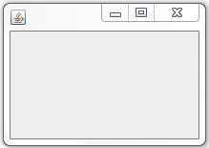
Creating a JFrame object
We create an instance of a JFrame class in our applications
public static void main(String[] args) {
JFrame window = new MyJFrame();
}

Slide 5
Create a window for drawing
To display some drawings inside the JFrame object, we will need to:
Define a JPanel class,
Create an instance of this JPanel class, and
Add the instance of the JPanel to the JFrame

Slide 6
JPanel
JPanel is a component in which we can draw shapes
A JPanel is also a Container to which other components can be added
To add some drawing inside a JPanel, we need to include the paintComponent() instance method
public class MyJPanel extends JPanel {
public MyJPanel() {
}
public void paintComponent(Graphics g) {
super.paintComponent(g);
}
}
Notes:
The header for the paintComponent() method must be exactly as shown in the example
We don’t make a direct call to the paintComponent() method in our code. The method is called automatically by the Java runtime whenever the JPanel area needs to be refreshed, e.g. when the JFrame is first created and displayed, when the user makes a change to the JFrame size

Slide 7
The Graphics object
The Graphics object is supplied by the Java runtime to the paintComponent() method whenever the JPanel object needs to be displayed
The Graphics object can be used to draw things
The first line of the paintComponent() method is always:
super.paintComponent(g);

Slide 8
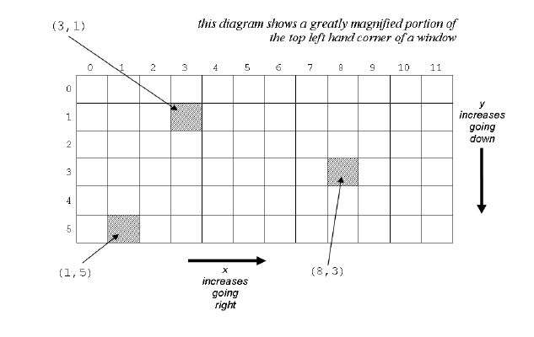
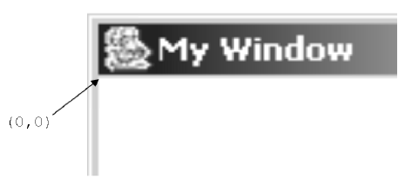
The coordinate system
Every dot which you can control in a JPanel is called a pixel
The top left hand corner of the drawable area of the window is positioned just underneath the title bar and just to the right of the left hand border of the window

Slide 9
A simple Swing app
ExampleOneFrame: Contains the main() method, and a constructor which creates the window and sets some properties (such as location and size).
ExampleOnePanel: Contains the components to be drawn in the window (in this case, just draws an ellipse).
Notes:
CS101 Coursebook Chapter 15
A JFrame object is a window with a border and a title bar. The visible area of a JFrame object is a Container which means that we will be able to add components to the JFrame object
JPanel is a component in which we can draw shapes. A JPanel is also a Container to which other components can be added

Slide 10
ExampleOneFrame – main method
public static void main(String[] args) { SwingUtilities.invokeLater(new Runnable() { @Override public void run() { ExampleOneFrame frame = new
ExampleOneFrame("My Window", 100, 100, 400, 400); frame.setVisible(true); } }); }
i
This code creates a new ExampleOneFrame on the Event Dispatch Thread.
You don’t need to worry much about that until SwingWorker lecture ☺
Notes:
This class only creates an instance of the MyJFrame class
The five parameters for MyJFrame constructor are:
String title – name of the window, which will appear in the title bar
int x – the x position of the top left hand corner of the window. The x position is the distance (in pixels) from the left hand edge of the screen
int y – the y position of the top left hand corner of the window. The y position is the distance (in pixels) from the top of the screen
int width – width of the window in pixels
int height – height of the window in pixels

Slide 11
ExampleOneFrame class
import javax.swing.*; import java.awt.*; public class ExampleOneFrame extends JFrame { public ExampleOneFrame(String title, int x, int y, int width, int height) { setTitle(title); setLocation(x, y); setDefaultCloseOperation(JFrame.EXIT_ON_CLOSE); ExampleOnePanel frameContent = new ExampleOnePanel(); Container visibleArea = getContentPane(); visibleArea.add(frameContent); frameContent.setPreferredSize(new Dimension(width, height)); pack(); frameContent.requestFocusInWindow(); }
/* main method here */
}
Calling built-in methods to set the location and title of the window.
This line tells Swing to quit your Java program when the user closes the window.
Creating the JPanel and adding it to the JFrame
Setting the preferred size of the JPanel, and making the JFrame resize itself to match.
Notes:
We use the JFrame class (from javax.swing package)
The class does the following:
Sets the title of the window using the first parameter
Sets the position and the window size using the parameters
Sets the action for the “close window” icon
Creates an instance of the MyJPanel class, which is used to define exactly what should be displayed in the contents of the window

Slide 12
ExampleOnePanel class
import javax.swing.*; import java.awt.*; /** * A simple JPanel that just draws an ellipse taking up its entire area. */ public class ExampleOnePanel extends JPanel { @Override protected void paintComponent(Graphics g) { super.paintComponent(g); int x = 0; int y = 0; int width = getWidth(); int height = getHeight(); g.drawOval(x, y, width, height); } }
Top-left-hand coordinates of the ellipse
Width and height of the ellipse (getWidth() and getHeight() returns the JPanel’s width and height)
Draw the ellipse using the provided Graphics object

Slide 13
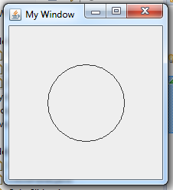
Drawing
The following method is used to produce graphical output inside the window
public void paintComponent(Graphics g) {
super.paintComponent(g);
}
To draw shapes in the window, we can call methods on the Graphics object – e.g. g.drawOval(50, 50, 100, 100)
Notes:
Order is important
The Java runtime system calls the paintComponent() method automatically, whenever the window needs to be refreshed. This happens:
When the window is first created and displayed
When the window is covered and obscured by some other window, and then returns to the foreground
When the window is resized by the user
The Graphics object is supplied by the Java runtime to the paintComponent() method whenever the JPanel object needs to be displayed.
The Graphics class is defined in the java.awt package and therefore we need to import this package whenever we want to use the Graphics object

Slide 14
Drawing
The Graphics class contains many instance methods:
drawLine(int x1, int y1, int x2, int y2)
drawRect(int x, int y, int width, int height)
drawOval(int x, int y, int width, int height)
fillRect(int x, int y, int width, int height)
fillOval(int x, int y, int width, int height)
drawString(String text, int x, int y)
setColor(Color color)
Notes:
Drawing can be done in different colours. You can use the public Color constants defined in the Color class. E.g. Color.BLACK, Color.PINK

Slide 15
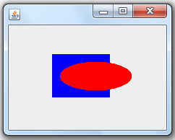
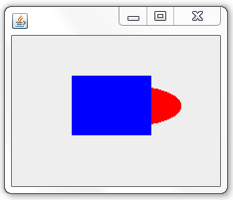
Order of drawing statements
Which output was produced by the following JPanel?
public class MyPanel extends JPanel {
public void paintComponent(Graphics g) {
super.paintComponent(g);
g.setColor(Color.RED);
g.fillOval(70, 50, 100, 40);
g.setColor(Color.BLUE);
g.fillRect(60, 40, 80, 60);
}
}

Slide 16
javax.swing package
The javax.swing package contains the definitions for the JFrame and the JPanel classes
The JFrame is the top-level container. JFrame objects have a ContentPane to which we add the JPanel object
The JPanel objects inherit from the javax.swing.JComponent class, they contain a paintComponent() method
The JPanel objects also inherit from java.awt.Container class, other components can be added to the JPanel objects

Slide 17
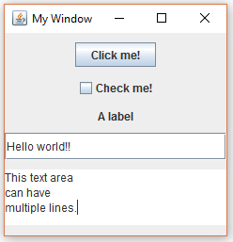
Examples of components
The javax.swing package contains the definition of the basic components:
JButton
JCheckbox
JLabel
JTextField
JTextArea
JPopupMenu

Slide 18
Simple component examples
public class ExampleTwoPanel extends JPanel {
public ExampleTwoPanel() { JButton button = new JButton("Click me!"); this.add(button); JCheckBox checkbox = new JCheckBox("Check me!"); this.add(checkbox); JLabel label = new JLabel("A label"); this.add(label); JTextField textField = new JTextField(30); this.add(textField); JTextArea textArea = new JTextArea(); this.add(textArea); } }

Slide 19
LayoutManager for JPanel
LayoutManagers position the components inside the JPanel
The default LayoutManager for a JPanel is FlowLayout
When the components are added to the JPanel, they are added from left to right, top to bottom
Another example layout is BorderLayout
When the components are added to the JPanel, the components are added NORTH, SOUTH, EAST, WEST, and CENTER
Either construct JPanel with required LayoutManager or
Set new manager using setLayout(mgr)

Slide 20
LayoutManager for JPanel
Several layout managers exist, depending on the kind of layout you’re after.
See: https://docs.oracle.com/javase/tutorial/uiswing/layout/visual.html
GUI builder tools exist, which can help design more complex user interfaces. Knowledge of these is not required for this course, but feel free to experiment! IntelliJ documentation can be found here:
https://www.jetbrains.com/help/idea/designing-gui-major-steps.html

Slide 21
Event-based programs
Programs that display a graphical user interface (GUI) to the user and which wait for the user to do things are called event-based programs
i.e. the user is controlling the order in which things happen
An event-based program waits, listening for events and whenever events occur they are dealt with in some way
Three common types of events:
ActionEvent
MouseEvent
KeyEvent

Slide 22



Example ActionEvent
public class ExampleThree extends JPanel implements ActionListener { private JTextField textField; public ExampleThree() { JButton button = new JButton("Click me!"); this.add(button); button.addActionListener(this); this.textField = new JTextField(30); this.add(textField); } @Override public void actionPerformed(ActionEvent e) { textField.setText("The button was clicked!"); } }
Implementing ActionListener means we can handle Action events.
Use the addActionListener method on a JButton to allow us to respond when it is clicked. Pass it an ActionListener which the button will notify when the user clicks it (in this case, this JPanel is an ActionListener).
When the button is clicked, this actionPerformed method will be called.

Slide 23
ActionEvent – Which component?
The actionPerformed() method defined inside the JPanel class is executed every time an ActionEvent occurs on a component which has previously called the instance method, …addActionListener().
Often we want to do different things depending on which component generated the event.
We can use ActionEvent’s getSource() instance method to determine which component generated the event.

Slide 24

ActionEvent – Which component?
public class ExampleFour extends JPanel implements ActionListener { private JTextField textField; private JButton leftButton, rightButton; public ExampleFour() { this.leftButton = new JButton("Left!"); this.add(leftButton); this.leftButton.addActionListener(this); this.textField = new JTextField(30); this.add(textField); this.rightButton = new JButton("Right!"); this.add(rightButton); this.rightButton.addActionListener(this); } @Override public void actionPerformed(ActionEvent e) { if (e.getSource() == leftButton) { textField.setText("Left!"); } else if (e.getSource() == rightButton) { textField.setText("Right!"); } } }
The text field will display “Left!” or “Right!”, depending on which button was clicked.

Slide 25
paintComponent() method
All the code for drawing inside the JPanel area is put inside the paintComponent() method
We don’t call the paintComponent() method directly because:
The paintComponent() method needs a Graphics object (the parameter to the paintComponent() method) and we don’t know how to create one,
It is better to let the Java runtime decide how to render the right bits of the screen at the right time

Slide 26
repaint() statement
What if we have changed some variable value and we want the paintComponent() method, which uses the variable, to be executed with the new variable value?
We can use the following statement in JPanel:
repaint();
This statement tells the Java runtime to call the JPanel‘s paintComponent() method as soon as possible
(demo: ExampleFive)
Notes:
Only use the repaint() statement inside an event handling method, such as actionPerformed(), to indicate you have updated the properties of the objects or shapes which are to appear on the screen, and you want them to be redrawn
Do not put the repaint() statement inside the paintComponent() method

Slide 27

Timer object
An instance of the Timer class can be used to create some animation in our JPanels
The javax.swing.Timer class allows you to schedule periodic actions. A Timer object continuously fires ActionEvents each followed by a specified delay
A Timer object causes the actionPerformed() to be called repeatedly
(demo: ExampleSix)

Slide 28
Recommended Readings
Principles Of Programming – Chapter 15, 16, 17
Lab examples!
All six examples shown in the lecture are bundled as part of today’s lab materials.
An extra example – example 7 – is also included. This is a “complete” Swing application showcasing many of the classes & methods you’ll need to complete today’s lab exercises.

