Slide 1
RISK AND FRAUD ANALYTICS
REVIEW - 2

Slide 2
CUSTOMER CHURN ANALYSIS IN TELECOM INDUSTRY

Slide 3
TEAM MEMBERS:
ALAGARSAMY N | 19MIA1082
NIRANJAN J | 19MIA1003
VIGNESH N | 19MIA1093
ROSHAN SRINIVAAS S | 19MIA1001
ABINANDHAN KUMAR T S S | 19MIA1062

Slide 4
INTRODUCTION
Customer churn analysis and prediction in telecom sector is an issue now a days because it's very important for telecommunication industries to analyze behaviors of various customer to predict which customers are about to leave the from telecom company, So data mining techniques and algorithm plays an important role for companies in today's commercial conditions because gaining a new customer's cost is more than retaining the existing ones. We have planned to focus on various machine learning techniques for predicting customer churn through which we can build the classification models and also compare the performance of these models.

Slide 5
ABSTRACT
Retaining customers is key to a company's success, especially in an industry as competitive as wireless services.
Acquiring new customers is not only more difficult, but also much more costly to companies than maintaining existing customer relationships.
In this project, we will predict behavior to retain customers at a home phone and internet service provider called Telco.
We'll first use exploratory data analysis to understand the relationships between the features and the target variable and identify factors that are influential in predicting customer attrition.
Using these features, We'll develop a predictive model to help the company proactively reduce their churn rate and use insights from the model to strengthen their customer retention strategies.

Slide 6
LITERATURE SURVEY
[1] M.A.H. Farquad [4] proposed a hybrid approach to overcome the drawbacks of general SVM model which generates a black box model (i.e., it does not reveal the knowledge gained during training in human understandable form).
[2] introduced the hybrid neural networks techniques to predict the customer churners in a CRM dataset provided by American telecom companies. Here, they built two hybrid models by combining two different neural network International Journal of Computer Applications (0975 – 8887).
[3] Wouter Verbeke [6] proposed the application of Ant-Miner+ and ALBA algorithms on a publicly available churn prediction dataset in order to build accurate as well as comprehensible classification rule-sets churn prediction models.

Slide 7
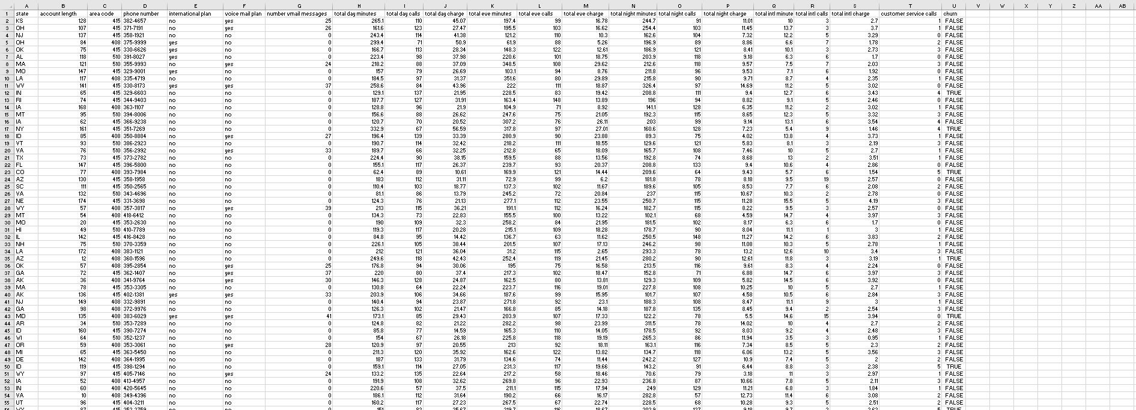
DATASET USED IN OUR PROJECT
SOURCE: https://www.kaggle.com/datasets/becksddf/churn-in-telecoms-dataset

Slide 8
METHODOLOGY
Initially we have explored and Visualized various plots on the data to understand the various relations between the predictor and features in the dataset.
To forecast the churn factor, five machine learning techniques were used: logistic regression, XG Boost, Random Forest, SVM, and ADA Boost. From these three models, we discovered that XG Boost's performance is excellent in comparison to other models, increasing the accuracy of the test results.

Slide 9
CONCLUSION
The purpose of this kind of study in the telecom industry is to assist businesses in increasing their profits.
It is well known that one of the most significant revenue streams for telecom firms is churn prediction.
As a result, the goal of this research was to develop a system that could forecast customer turnover at the telecom business.

Slide 10
REFERRENCE
[1] T.Vafeiadis, K.I. Diamantaras, G.Sarigiannidis, K.Chatzisavvas “Customer churn prediction in telecommunications”, Simulation Modelling: Practice and Theory 55 (2015) 1-9.
[2] Burez J., & Van den Poel, D “Crm at a pay-TV company: Using analytical models to reduce customer attrition by targeted marketing for subscription services”, Expert Systems with Applications 32, 277–288.
[3] S.Parvathavardhini and Dr. S.Manju “Analysis on Machine Learning Techniques” International Journal of Computer Sciences and Engineering (IJCSE), Vol-4(8), pp 59-77 Aug 2016, E-ISSN: 2347-2693.

Slide 11
REFERENCE
[4] M.A.H. Farquad, Vadlamani Ravi, S. Bapi Raju “Churn prediction using comprehensible support vector machine: An analytical CRM application”, Applied Soft Computing 19 (2014) 31–40.
[5] Chih-Fong Tsai, Yu-Hsin Lu “Customer churn prediction by hybrid neural networks”, Expert Systems with Applications 36 (2009) 12547–12553.
[6] Wouter Verbeke, David Martens, Christophe Mues, Bart Baesens “Building comprehensible customer churn prediction models with advanced rule induction techniques”, Expert Systems with Applications 38 (2011) 2354–2364.

Slide 12
THANK YOU

