Slide 1
Foundation of data analyTiCS
J COMPONENT
TEAM MEMBERS:
MOHAMMED IMRAN Z | 19MIA1047
VIGNESH N | 19MIA1093
T.S.S. ABINANDHAN KUMAR |19MIA1062

Slide 2
TWITTER SENTIMENTAL ANALYSIS
Course Name: Foundation Of Data Analytics
Course Code: CSE3505
Slot: F1
Type of project : C
Dr.R.Priyadarshini

Slide 3
ABSTRACT
People now have a new avenue through which to share their ideas and opinions thanks to social media.
An estimated 2.95 billion individuals utilize this medium globally, creating a huge platform for the exchange of ideas.
Sentiment analysis, often known as opinion analysis, is the technique of gathering textual data and identifying the author's feelings.
This kind of analysis is used for a variety of purposes, such as figuring out how consumers feel about a given brand, product, or marketing campaign; assessing how well-known a company's name is on social media platforms; and assessing how citizens feel about various policy changes, political candidates, and other topics.

Slide 4
INTRODUCTION
Sentiment analysis is the process of locating and categorising the emotions represented in a text source.
When analyzed, tweets may produce a significant quantity of sentiment data. These statistics help us understand how individuals feel about a range of issues.
Therefore, in order to calculate the consumer perspective, we need to create an automated machine learning sentiment analysis model.
It is challenging to apply models to them since they include both relevant data and non-useful characteristics (referred to collectively as noise).
we create a machine learning pipeline using three classifiers (Logistic Regression, Bernoulli Naive Bayes, and Sentiment140) in order to assess the sentiment of the tweets in the dataset.

Slide 5
objective
Our project's objective is to assess the sentiments on a topic that are taken from Twitter and decide whether they are good, negative, or neutral.
Twitter sentiment analysis allows you to keep track of what's being said about your product or service on social media, and can help you detect angry customers or negative mentions before they they escalate.
Whatever the nomenclature, sentiment analysis's objective is the same: to ascertain a user's or audience's impression of a target item by studying a sizable volume of text from several sources.
Depending on our objectives, we can study texts at various degrees of depth.

Slide 6
PROBLEM STATEMENT
The goal of tweet sentiment analysis is to find the positive, negative, or neutral sentiment part in the twitter data.
Sentiment analysis can help any organization to find people's opinions of their company and products.
We will apply sentiment analysis on twitter dataset.

Slide 7
DATASET DESCRIPTION
In this project, we attempt to put into practise a Twitter sentiment analysis model that aims in overcoming the difficulties associated with determining the sentiments of tweets. The dataset's essential specifics are as follows:
The Sentiment140 Dataset, which was made available, comprises of 1,600,000 tweets that were retrieved using the Twitter API. The dataset's numerous columns include:
target: the polarity of the tweet (positive or negative)
ids: Unique id of the tweet
date: the date of the tweet
flag: It refers to the query. If no such query exists then it is NO QUERY.
user: It refers to the name of the user that tweeted
text: It refers to the text of the tweet

Slide 8
ALGORITHMS TO BE USED
We will employ three distinct models in this project, as follows:
SVM (Support Vector Machine)
Logistic Regression
Bernoulli Naive Bayes
The rationale for selecting these models is that we want to test every classifier on the dataset, from the simplest to the most complicated, and then see which performs the best.

Slide 9
LITERATURE REVIEW
[1] (Kaur, 2015) describe regarding geographic area flood information set collected from twitter and realize the opinion of individuals. They used Naive Bayes formula for the classification of information and result they got 67% accuracy. They need collected several resolution from the individuals that are useful for each government and non-government organization to handle such scenario in an exceedingly higher manner. These strategies simpler than lexicon-based formula.
[2] (Paul, 2017) describe regarding the ultimate match of Indian premier league sport event 2015. Objective of this paper to research standardity {the recognition} of IPL match and that player are popular and that team is dominate. They need used Hadoop and Map cut back artificial language. They got result like MS Dhoni is most talked regarding player and metropolis Indians team fairly dominated. This technique gave higher result.
[3] (Mittal, 2016) describe the requirement and impact of the sentiment analysis on on-line platform. They need additionally bestowed a listing of sentiments of emotions, interjections and comments that are extracted from posts and standing updates. They need got result to knowing whether or not {the on-line the web the net} reviews and posts are being useful to client or not and that on-line websites being most popular by the purchasers.
[4] (Anto, 2016) describe the merchandise rating mistreatment sentiment analysis. In promoting of any product the producer can get the proper result from the client feedback. After got feedback they&#39;ll changes to his product in step with the feedback. Some users continually fail to convey their feedbacks. Objective of this paper is to avoid the problem of providing feedbacks and supply the technique which might provide automatic feedback on the premise of information collected from twitter. They used the technique SVM and got result eightieth accuracy. This system offer quick and valuable feedback.

Slide 10
Novelty/findings
We will be trying other models and fine tune it for better accuracy, so that we can make better prediction among the results.
We will also be creating a dashboard for wider representation of data, this can increase the understanding of data using tableau software.
We will overcome with more insights on the data.

Slide 11
Project pipeline
The various steps involved in the Machine Learning Pipeline are :
Import Necessary Dependencies
Read and Load the Dataset
Exploratory Data Analysis
Data Visualization of Target Variables
Data Preprocessing
Splitting our data into Train and Test Subset
Transforming Dataset using TF-IDF Vectorizer
Function for Model Evaluation
Model Building
Conclusion

Slide 12
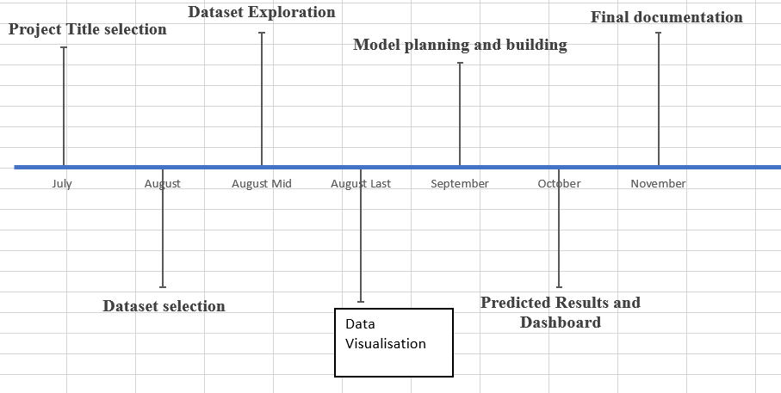
PROJECT TIMELINE

Slide 13
conclusion
For many businesses and even individuals, using sentiment analysis to extract the emotion has become a crucial task.
Sentiment analysis is a new and quickly growing area of the decision-making process.
Our project's objective is to assess the sentiments on a topic that are taken from Twitter and decide whether they are good, negative, or neutral.
One of the key aspects of this field is the development of methods for document-level sentiment analysis.
People have recently begun expressing their thoughts online, which has boosted the demand for opinionated online content analysis for a variety of practical purposes.
There is a tonne of study on text sentiment detection in the literature. However, there is a great deal of room for improvement in these current sentiments.

Slide 14
REFERENCES
[1] R. Parikh and M. Movassate, “Sentiment Analysis of User- GeneratedTwitter Updates using Various Classi_cation Techniques",CS224N Final Report, 2009.
[2] Agarwal, B. Xie, I. Vovsha, O. Rambow, R. Passonneau, “Sentiment Analysis of Twitter Data", In Proceedings of the ACL 2011Workshop on Languages in Social Media,2011 , pp. 30-38.
[3] Dmitry Davidov, Ari Rappoport." Enhanced Sentiment Learning Using Twitter Hashtags and Smileys". Coling 2010: Poster Volumepages 241{249, Beijing, August 2010.
[4] Pablo Gamallo, Marcos Garcia, “Citius: A Naive-Bayes Strategyfor Sentiment Analysis on English Tweets", 8th InternationalWorkshop on Semantic Evaluation (SemEval 2014), Dublin, Ireland, Aug 23-24 2014, pp 171-175.
[5] Meng, Xinfan, et al. "Cross-lingual mixture model for sentimentclassification." Proceedings of the 50th Annual Meeting of theAssociation for Computational Linguistics Volume 1,2012.

Slide 15
THANK YOU

