Slide 1
TACKLING COMPLEX SCIENTIFIC QUESTIONS USING LARGE LANGUAGE MODEL

Slide 2
GUIDE Dr RAJESH R
DONE BY
T S S ABINANDHAN KUMAR
19MIA1062

Slide 3
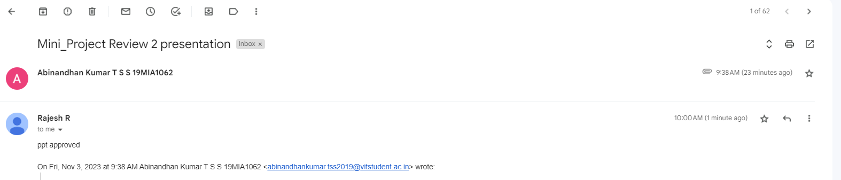
GUIDE APPROVAL

Slide 4
PROJECT OUTLINE
INTODUCTION
LITERATURE REVIEW
SCOPE AND PROBLEM STATEMENT
RESEARCH CHALLENGES
RESEARCH OBJECTIVE
METHODOLOGY
RESULTS AND DISCUSSION
SNAP SHOT OF GUIDE APPROVAL
REFERENCES

Slide 5
INTRODUCTION
In the swiftly advancing field of natural language processing (NLP), capitalizing on the capabilities of large language models represents a significant transformative shift. It provides unparalleled potential in comprehending and producing human language. This undertaking seeks to extend the frontiers of NLP with a specific emphasis on a crucial domain: resolving intricate scientific queries. By melding cutting-edge NLP methodologies with a state-of-the-art language model, our goal is to bring about a fundamental change in how complex scientific questions are approached.

Slide 6
LITERATURE REVIEW

Slide 7
“Language Models are Unsupervised Multitask Learners”
Theme of this paper: - The paper discusses the limitations of current machine learning systems that are trained on single task datasets and highlights the need for more general systems that can perform multiple tasks without the need for manual labeling of training data. - The paper proposes unsupervised multitask learning as a solution to this problem and presents the impressive performance of language models on various natural language processing tasks achieved through this approach. - The paper also discusses the potential applications of language processing systems that can learn to perform tasks from naturally occurring demonstrations.
Gaps: - While the paper presents a compelling case for unsupervised multitask learning, it does not discuss the potential limitations or challenges of this approach. - The paper focuses primarily on natural language processing tasks and does not explore the potential applications of unsupervised multitask learning in other domains. - The paper does not discuss the ethical implications of using language processing systems that can learn from naturally occurring demonstrations, such as the potential for bias or misuse of these systems.

Slide 8
"Language Models are Few-Shot Learners"
Few-Shot Learning: The paper introduces the concept of few-shot learning in the context of language models. It demonstrates the models' ability to generalize and perform tasks with only a few examples as input.
Prompt Engineering: The authors emphasize the importance of designing effective prompts to guide the language model's behavior. They show that well-crafted prompts play a crucial role in achieving accurate and desired outputs.
Generalization across Tasks:The paper highlights the models' capability to generalize knowledge across a diverse set of tasks, ranging from translation to question answering. This suggests a high level of versatility in language models.
Capability to Reason and Solve Problems: The paper showcases the models' ability to perform reasoning and problem-solving tasks, which are traditionally considered as requiring explicit rules or specialized training.
Continual Learning and Lifelong Learning: While the paper demonstrates impressive few-shot learning capabilities, the concept of continual learning (learning over an extended period) and lifelong learning (learning over a lifetime) is an emerging trend. Future research could focus on how these models adapt and learn over time.
Ethical and Bias Considerations: With the increasing use of language models in real-world applications, addressing ethical concerns and biases in AI systems is crucial. Future research could delve into methods for reducing biases and ensuring fairness in model outputs.
Real-Time and Low-Latency Applications: Many industry applications require real-time or low-latency responses. Investigating techniques to make these models more efficient and faster in their predictions is an important consideration.

Slide 9
“Evaluation of ChatGPT for NLP-based Mental Health Applications”
Natural Language Understanding: Evaluating ChatGPT's ability to understand and respond to nuanced language related to mental health issues, including emotions, symptoms, and concerns.
Ethical Considerations: Discussions around the ethical implications of using AI chatbots for mental health support, including issues related to privacy, confidentiality, and potential biases in responses.
User Experience: Assessing the user experience and user satisfaction when interacting with ChatGPT for mental health-related conversations.
Integration with Healthcare Services: Exploring how ChatGPT can be integrated into existing mental healthcare services and systems, and its potential role in complementing human mental health professionals.
Long-Term Impact: Investigating the long-term impact of using AI chatbots in mental health care, including whether they can lead to sustained improvements or if there are limitations in their effectiveness.
Privacy and Security: Addressing concerns related to data security, privacy, and the potential misuse of sensitive information in mental health applications.
Cultural and Linguistic Sensitivity: Ensuring that ChatGPT is culturally and linguistically sensitive to a diverse range of users and their unique mental health needs.

Slide 10
“Towards Automated Urban Planning: When Generative and ChatGPT-like AI Meets Urban Planning”
Generative AI in Urban Planning: The use of generative AI models, such as GPT-like models, in the context of urban planning to automate or assist in various aspects of city planning and design.
Conversational AI in Urban Planning: The application of ChatGPT-like conversational AI systems to engage with stakeholders, answer questions, and facilitate communication in urban planning processes.
Data Integration: How AI models can integrate and analyze diverse datasets related to urban environments, such as demographic data, transportation data, environmental data, and more.
Regulatory and Legal Frameworks: Discussing the legal and regulatory frameworks necessary for the integration of AI into urban planning and ensuring compliance with relevant laws.
Scalability and Generalization: Exploring the scalability of AI-driven urban planning solutions and their ability to generalize across different cities and regions.
Community Acceptance: Analyzing public perceptions and acceptance of AI-driven urban planning initiatives, and strategies to build trust among stakeholders.
Sustainability and Resilience: Evaluating how AI can contribute to sustainable and resilient urban development, especially in the face of environmental challenges and climate change.

Slide 11
A Comprehensive Survey of AI-Generated Content (AIGC): A History of Generative AI from GAN to ChatGPT
Techniques and Algorithms: Surveying the different techniques, algorithms, and architectures employed in generative AI, and their evolution over time, potentially including comparisons between GANs and models like ChatGPT.
Ethical and Social Implications: Considering the ethical considerations and societal impacts associated with AI-generated content, such as issues related to copyright, authenticity, and potential misuse.
User Interaction and Experience: Exploring how users interact with and experience content generated by AI systems, and how it is received and perceived in various contexts.
Bias and Fairness in AI-Generated Content: Investigating potential biases in the output of generative models and methods for mitigating these biases, particularly in ChatGPT-like models where responses are generated based on learned patterns from training data.
Regulation and Governance: Considering the regulatory frameworks that may need to be established to govern the creation and use of AI-generated content, particularly in areas with legal and ethical implications.
Continual Learning and Adaptation: Examining the extent to which generative models can adapt to evolving contexts and domains, and how they might benefit from continual learning techniques.

Slide 12
Accelerating the integration of ChatGPT and other large‐ scale AI models into biomedical research and healthcare
Application of ChatGPT in Biomedical Research: Exploring how ChatGPT, and potentially other large-scale AI models, can be utilized in the field of biomedical research for tasks like literature review, data analysis, and medical information retrieval.
Healthcare Support and Information Delivery: Investigating the potential for AI models like ChatGPT to provide assistance in healthcare settings, such as answering patient queries, offering medical advice, or aiding in telemedicine consultations.
Integration Challenges: Discussing the technical and operational challenges associated with integrating large-scale AI models like ChatGPT into existing biomedical research and healthcare workflows.
Bias and Fairness in Healthcare Applications: Investigating potential biases in the output of AI models in healthcare and biomedical contexts, and methods for ensuring fairness and equity in treatment recommendations.
Patient-Centered Care: Considering how AI models can be designed and used to prioritize patient well-being, safety, and satisfaction, and how they can enhance the patient-provider relationship.
Legal and Ethical Frameworks for Healthcare AI: Discussing the legal and regulatory frameworks necessary for the responsible and ethical deployment of AI models in healthcare, including compliance with healthcare regulations and data protection laws.

Slide 13
Distinguishing Human Generated Text From ChatGPT Generated Text Using Machine Learning
Text Attribution and Verification: Investigating methods and techniques for distinguishing between text written by humans and text generated by models like ChatGPT. This could involve the use of machine learning algorithms for classification.
Machine Learning for Text Analysis: Exploring the application of machine learning techniques in the field of natural language processing, particularly in the context of differentiating between human and AI-generated text.
Authentication and Trustworthiness: Addressing the need for reliable mechanisms to verify the source of text content, which is crucial for maintaining trust in online communication and content generation platforms.
Robustness to Advanced AI Models: Considering how the proposed method for distinguishing text may need to adapt to increasingly sophisticated AI models beyond ChatGPT, as the landscape of AI-generated content evolves.
Generalization Across Different Domains: Investigating the extent to which the proposed machine learning approach can be applied to different domains and types of content, beyond the specific context of distinguishing human and ChatGPT-generated text.

Slide 14
“Awareness and acceptance of ChatGPT as a generative conversational AI for transforming education by Ghanaian academics: A two-phase study”
Focus Area: The primary area of interest in this study is the potential role of ChatGPT in transforming education, with a specific emphasis on the perspectives of academics in Ghana.
Two-Phase Study Design: The research is structured into two phases, implying a sequential approach to data collection and analysis. This method allows for a more in-depth understanding of the perceptions and attitudes over time.
Target Population: The study specifically targets academics in Ghana, indicating that the research aims to gather insights from professionals actively involved in the educational sector.
Transformation of Education: The research is concerned with understanding how the integration of ChatGPT can potentially lead to changes and improvements in the educational landscape.
Location Specificity: The focus on Ghanaian academics suggests that the research recognizes the importance of considering cultural, social, and contextual factors in technology adoption within specific regions or countries.
Implications for Educational Technology: The findings of this study may have significant implications for the field of educational technology, particularly in terms of introducing AI-driven conversational tools into the educational environment.

Slide 15
ChatGPT for Higher Education Professional Development: A Guide to Conversational AI
Guidance and Recommendations: The paper likely provides guidance and recommendations on how educators, institutions, and professionals can effectively integrate ChatGPT into their educational practices and professional development initiatives.
Potential Benefits and Challenges: It is likely that the paper discusses both the potential benefits and challenges associated with the adoption of ChatGPT in higher education. This may include considerations related to effectiveness, ethical implications, and technological limitations.
Practical Insights: Given the emphasis on providing a guide to conversational AI, the paper may offer practical insights, use cases, and implementation strategies for educators and professionals looking to incorporate ChatGPT into their practices.
Implications for the Future of Education: The research may have broader implications for the future of education and professional development, highlighting the role of AI-driven conversational tools in enhancing learning experiences and career advancement.

Slide 16
ChatGPT for Computational Social Systems: From Conversational Applications to Human-Oriented Operating Systems
Potential Benefits and Implications: The paper may discuss the potential benefits and implications of employing ChatGPT within computational social systems. This might include considerations related to user engagement, community dynamics, or the augmentation of digital social experiences.
Human-Centered Design: The mention of "human-oriented operating systems" suggests an emphasis on designing systems that prioritize the user experience and aim to enhance human interactions within digital environments.
Ethical and Societal Considerations: Given the focus on computational social systems, the paper may address ethical and societal implications, such as issues related to privacy, security, inclusivity, and the impact of AI on digital social behavior.
Technology Integration and Interoperability: The paper might discuss aspects related to integrating ChatGPT with other technologies or systems within computational social environments, and how it complements or interacts with existing digital platforms.
Potential Future Developments: The research may speculate on potential future developments in the integration of conversational AI like ChatGPT within computational social systems and how this could shape the digital landscape.

Slide 17
Theory of Mind May Have Spontaneously Emerged in Large Language Models
Main Theme of this paper:
The main theme of this paper is the investigation of Theory of Mind (ToM) capabilities in large language models, particularly focusing on GPT-3 models.
The authors explore whether ToM-like ability has spontaneously emerged as a byproduct of the models' improving language skills, and if so, what implications this may have for artificial intelligence and our understanding of human cognition.
As of my last knowledge update in January 2022, the emergence of ToM in large language models was a significant development, suggesting that AI systems may be approaching a level of understanding and imputation of unobservable mental states in a manner comparable to human children.
This has potential implications for AI applications in various domains that require an understanding of human intentions, beliefs, and emotions.

Slide 18
Theory of Mind May Have Spontaneously Emerged in Large Language Models
GAPS:
Generalization to Other AI Models: The study primarily focuses on the GPT-3 models. It would be interesting to see if similar results can be replicated in other large language models or AI architectures.
Evaluation of Real-World Applications: The paper discusses potential applications of ToM-like abilities in AI systems, such as in self-driving cars and virtual assistants. Future research could delve deeper into how these capabilities could be practically applied and tested in real-world scenarios.
Ethical and Social Implications: Understanding ToM in AI models raises important ethical questions about the potential for these systems to better interact with humans. This could involve considerations of privacy, consent, and trust in AI.
Robustness and Transferability: It would be important to assess how well the ToM-like abilities of these models generalize across different tasks, contexts, and datasets. Ensuring robustness and adaptability in real-world scenarios is crucial.
Examination of Causality: While the paper provides evidence of the models' performance, it may be beneficial to investigate the underlying mechanisms that lead to this emergent ToM-like ability.

Slide 19
ChatGPT and a New Academic Reality: AI-Written Research Papers and the Ethics of the Large Language Models in Scholarly Publishing
Themes:
AI-Generated Content in Academia: The article may discuss the rise of AI-generated content and its impact on academic research. This could include considerations of quality, reliability, and potential advantages and drawbacks.
Ethical Considerations: It is likely that the article discusses the ethical implications of using AI to generate academic content. This could involve issues of authorship, intellectual property, and the role of human researchers in a world with increasingly sophisticated AI.
Quality and Rigor: The article might address concerns about the quality and rigor of AI-generated research papers. It could explore whether AI-generated content meets the same standards of peer-review and academic credibility as traditionally authored work.
Technological Advancements: The paper may discuss the capabilities and limitations of current large language models like ChatGPT. It might also explore how rapidly evolving AI technologies are influencing academic publishing.
Accessibility and Inclusivity: The article might touch on how AI-generated content could potentially democratize access to academic research by automating parts of the research process. However, it could also address potential biases and accessibility issues related to AI-generated content.

Slide 20
ChatGPT and a New Academic Reality: AI-Written Research Papers and the Ethics of the Large Language Models in Scholarly Publishing
Gaps (Potential Topics Not Addressed):
Regulation and Guidelines: The article may not cover the legal and regulatory frameworks, if any, that govern the use of AI-generated content in academia. This could be a significant gap, especially considering the potential legal and ethical challenges associated with AI-generated work.
User Training and Responsibility: The paper may not discuss the need for researchers and academics to be educated about AI-generated content. Understanding its capabilities and limitations could be crucial for responsible use.
Long-term Implications: The article may not delve deeply into the long-term consequences of widespread use of AI-generated content in academia. This could include effects on research culture, citation practices, and academic career trajectories.
Public Perception and Trust: The article might not cover how the use of AI-generated content affects public trust in academic research. This could be an important aspect, especially if there are concerns about transparency and authenticity.

Slide 21
Chatting about ChatGPT: How may AI and GPT impact academia and libraries?
Main Theme:
Introduction to ChatGPT and GPT Technology: The article provides an overview of ChatGPT, explaining its technological basis in GPT, emphasizing its capabilities in performing various language-based tasks, and positioning it as a powerful tool in the field of natural language processing and artificial intelligence.
Interview with ChatGPT on Academic and Library Impact: The article conducts an interview with ChatGPT to discuss its potential impact on academia and libraries. It highlights various benefits including improving search and discovery, reference services, cataloging, metadata generation, content creation, and even the possibility of using ChatGPT for writing scholarly papers.
Comparison with Other AI Models: The article briefly compares GPT-3 and ChatGPT with other state-of-the-art language models like BERT, RoBERTa, and XLNet, highlighting their respective strengths and applications in natural language processing tasks.
Implications for Research and Scholarship: The article discusses how ChatGPT can be used to enhance research and scholarship in academia. This includes tasks like literature review assistance, text generation, data analysis, language translation, automated summarization, and question answering.
Applications in Libraries: The paper explores how ChatGPT can be employed in libraries to improve services, such as search and discovery, reference and information services, cataloging, metadata generation, and content creation.
Ethical Issues in Academic Libraries: The article raises ethical concerns related to using ChatGPT in academic library settings, including issues of bias, privacy, security, autonomy, informed consent, transparency, and intellectual property.

Slide 22
Chatting about ChatGPT: How may AI and GPT impact academia and libraries?
Gaps (Potential Topics Not Addressed):
User Training and Guidelines: The article doesn't explicitly discuss the importance of educating users (researchers, librarians, etc.) about the capabilities and limitations of ChatGPT. This could be essential for responsible and effective use.
Regulatory Considerations: The article does not delve into the potential legal and regulatory frameworks that might govern the use of AI-generated content in academic and library settings.
Long-term Societal and Academic Impact: The article might not extensively cover the broader and longer-term implications of widespread use of AI-generated content on academic research culture, citation practices, and the role of human researchers.
Inclusion of Diverse Perspectives: The article doesn't explicitly mention the need for diverse input in the development and deployment of AI tools like ChatGPT to mitigate biases and ensure inclusivity.
Integration with Existing Library Systems: The article does not explore the challenges and considerations in integrating ChatGPT with existing library systems and workflows.

Slide 23
Study and Analysis of Chat GPT and its Impact on Different Fields of Study
Main Theme:
1. Alternatives to ChatGPT: The article briefly introduces various alternatives to ChatGPT, such as rule-based chatbots, retrieval-based chatbots, GANs, and hybrid approaches.
How to Use ChatGPT: The authors provide a step-by-step guide on how to utilize ChatGPT, from creating an account to initiating conversations.
Impact on Different Fields: The article discusses the impact of ChatGPT on diverse fields like academics, cybersecurity, customer support, healthcare, software development, jobs, information technology, consulting, and research.
Future of ChatGPT: The article touches upon the potential future developments of ChatGPT, suggesting increased sophistication, application in education and healthcare, and transformation of human-machine interaction.

Slide 24
Study and Analysis of Chat GPT and its Impact on Different Fields of Study
Gaps and Further Discussion:
Detailed Use Cases: While the article provides an overview of the impact of ChatGPT on various fields, it could benefit from specific examples or case studies showcasing real-world applications.
Ethical Considerations: The article touches upon potential biases in ChatGPT's responses, but a deeper discussion on the ethical implications of using such technology, especially in critical domains like healthcare and customer support, would add value.
Comparative Analysis: It would be beneficial to see a comparison between ChatGPT and some of the alternatives mentioned. This could help readers understand the strengths and weaknesses of each approach.
Citation of Sources: The article could benefit from more specific citations, especially when mentioning statistics or specific claims.
Incorporation of User Feedback: Given that the article discusses the iterative nature of ChatGPT's training, it would be interesting to know how user feedback is integrated into its learning process.

Slide 25
Towards Human-Bot Collaborative Software Architecting with ChatGPT
The main theme of the paper is the exploration of how ChatGPT, a language model developed by OpenAI, can be utilized in collaborative software architecting.
This indicates a shift towards incorporating artificial intelligence (AI) tools like ChatGPT into the software development process to enhance collaboration between human developers and automated systems.

Slide 26
Towards Human-Bot Collaborative Software Architecting with ChatGPT
Potential Gaps:
Comparison with Traditional Approaches: There could be a comparison between the outcomes of the collaborative approach using ChatGPT and traditional software architecting methods. This might include evaluating efficiency, accuracy, and creativity in generating architectural solutions.
Security and Privacy Concerns: The paper could touch on potential security and privacy concerns associated with integrating AI into the software development process, particularly if sensitive or proprietary information is involved.
User Training and Familiarity: It may discuss the training required for users to effectively work with ChatGPT, and whether developers need to adapt their processes to accommodate the AI tool.
Real-world Case Studies: The paper may provide case studies or examples of real-world applications where ChatGPT has been used in collaborative software architecting, demonstrating its effectiveness or identifying areas for improvement.

Slide 27
THEMES DISCOVERED IN THE REVIEW
Interdisciplinary Research: Investigate how the model can be used to bridge gaps between different scientific disciplines. For example, can it generate insights that integrate knowledge from biology, chemistry, and physics?
Natural Language Processing (NLP) in Scientific Communication: Explore how NLP models can be applied to improve the clarity and accessibility of scientific literature, especially for non-experts.
Data Extraction and Analysis: This theme focuses on extracting meaningful information from large volumes of scientific text or data. You could explore methods for data preprocessing, feature extraction, and statistical analysis to derive insights from scientific literature.
Machine learning : Exploring different machine learning models such as supervised, unsupervised, semi-supervised and also reinforcement models to test how AI reacts with these models.
Human-in-the-Loop Approaches: Explore how human experts can collaborate with the model to achieve better results. This could involve methods like active learning or iterative feedback loops.

Slide 28
SCOPE OF THE PROJECT
The scope of this project encompasses the exploration and application of large language models (LLMs) in the domain of complex science questions. It involves leveraging the capabilities of advanced NLP models to address challenging scientific queries, thus contributing to the advancement of scientific research and knowledge acquisition. The project will delve into the characterization of LLMs, focusing on their performance and adaptability to complex scientific tasks. Additionally, it will investigate methods such as quantization and knowledge distillation to optimize the deployment of these models on less powerful hardware, making them more accessible and cost-effective for a wider audience.

Slide 29
PROBLEM STATEMENT
In the rapidly evolving landscape of Natural Language Processing (NLP) and artificial intelligence, the utilization of Large Language Models (LLMs) has become a focal point of research. While these models have exhibited remarkable capabilities, existing NLP benchmarks are often insufficient to effectively evaluate their true potential. Moreover, there is a critical need to harness the power of LLMs for addressing complex scientific questions, a domain where precise understanding and interpretation of language is paramount.
The problem at hand revolves around two main challenges:
Characterization of Large Language Models (LLMs): As LLMs continue to advance, it is imperative to comprehensively understand their strengths, weaknesses, and specific capabilities. Many established NLP benchmarks, designed for earlier models, have been found to be trivial for current state-of-the-art models. This necessitates the development of novel and more demanding tasks to effectively evaluate and push the boundaries of these powerful language models.
Hardware Optimization through Quantization and Knowledge Distillation: While the potential of LLMs is immense, their resource-intensive nature poses a practical challenge, particularly for deployment on less powerful hardware. This project aims to explore methods such as quantization (reducing the precision of model parameters) and knowledge distillation (transferring knowledge from a larger model to a smaller one) to effectively shrink language models without compromising their performance, thereby enabling their efficient execution on more modest hardware configurations.

Slide 30
RESEARCH CHALLENGES
Task Formulation and Benchmark Creation
Model Understanding and Characterization
Data Collection and Preprocessing
Fine-tuning and Transfer Learning
Evaluation Metrics and Criteria
Hardware Optimization Techniques
Scalability and Efficiency
User Interface and Interaction Design

Slide 31
RESEARCH OBJECTIVE
The research objective of the project is to leverage large language models (LLMs) for addressing complex scientific questions. This involves characterizing the capabilities of LLMs and creating challenging benchmarks to push the boundaries of these models. Additionally, the project aims to explore techniques like quantization and knowledge distillation to make LLMs more accessible on less powerful hardware. The focus is on formulating tasks that accurately reflect the complexity of real-world scientific queries and developing fine-tuning strategies for domain-specific adaptation. Evaluation metrics will be defined to measure the model's performance, accounting for scientific accuracy and relevance. Ethical considerations will guide the mitigation of biases in model outputs, especially in the context of scientific knowledge. The research will also investigate scalability and efficiency for handling large volumes of scientific data. Ultimately, the project seeks to empower researchers in diverse scientific domains with a powerful tool for extracting valuable insights from textual data.

Slide 32
METHODOLOGY
DATA EXPLORATION
1.1 LENGTH ANALYSIS 1.7 LEXICON DIVERSITY ANALYSIS
1.2 WORD FREQUENCY ANALYSIS 1.8 PART-OF-SPEECH ANALYSIS
1.3 TF-IDF VECTORIZATION AND COSINE SIMILARITY 1.9 SYNTACTIC ANALYSIS
1.4 N GRAM ANALYSIS 1.10 TOPIC MODELLING
1.5 SENTIMENTAL ANALYSIS
1.6 NAMED ENTITY RECOGNITION ANALYSIS

Slide 33
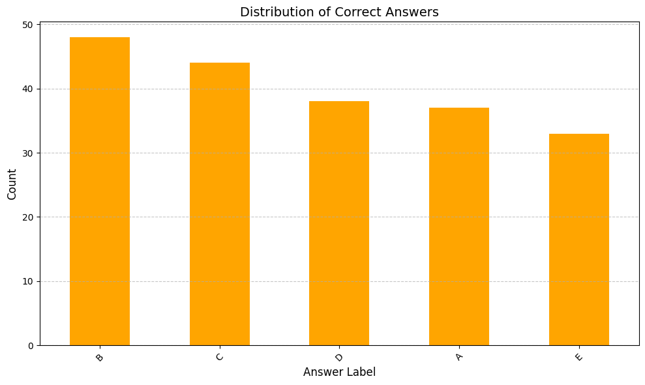
RESULTS AND DISCUSSION

Slide 34
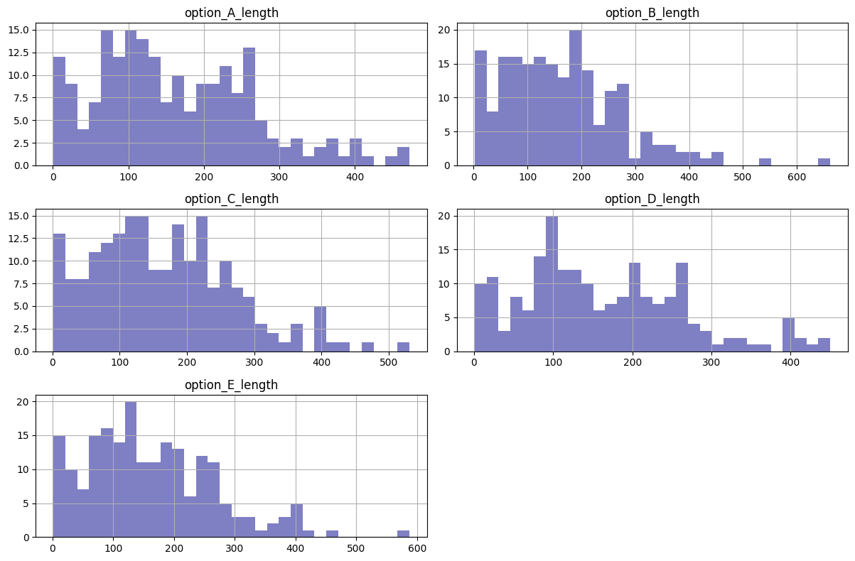
Experimental results

Slide 35
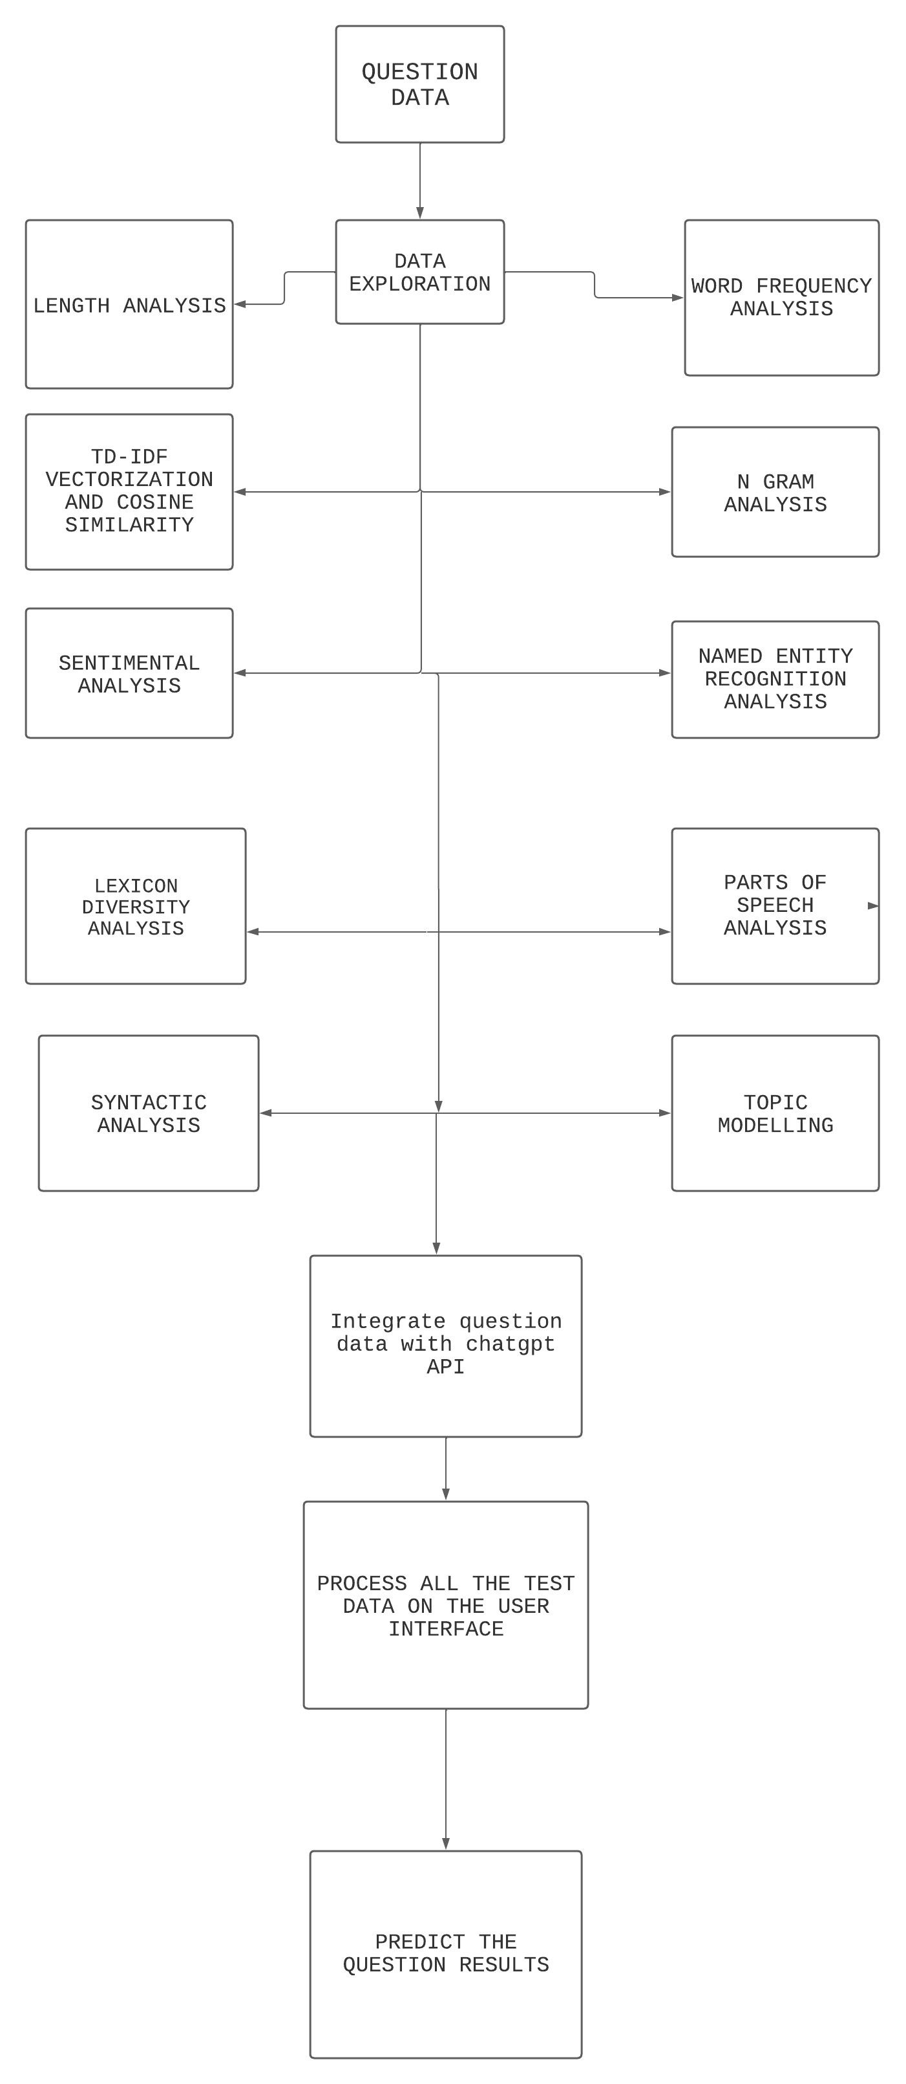


Slide 36
REFERENCE
[1] Language Models are Unsupervised Multitask Learners Alec Radford * 1 Jeffrey Wu * 1 Rewon Child 1 David Luan 1 Dario Amodei, Ilya Sutskever.
[2] Language Models are Few-Shot Learners Tom B. Brown∗ Benjamin Mann∗ Nick Ryder∗ Melanie Subbiah∗ Jared Kaplan† Prafulla Dhariwal Arvind Neelakantan Pranav Shyam Girish Sastry Amanda Askell Sandhini Agarwal Ariel Herbert-Voss Gretchen Krueger Tom Henighan Rewon Child Aditya Ramesh Daniel M. Ziegler Jeffrey Wu Clemens Winter Christopher Hesse Mark Chen Eric Sigler Mateusz Litwin Scott Gray Benjamin Chess Jack Clark Christopher Berner Sam McCandlish Alec Radford Ilya Sutskever Dario Amodei
[3] Evaluation of ChatGPT for NLP-based Mental Health Applications, Bishal Lamichhane, lamichhane.bishal@gmail.com
[4] Towards Automated Urban Planning: When Generative and ChatGPT-like AI Meets Urban Planning, DONGJIE WANG, University of Central Florida, USA CHANG-TIEN LU, Virginia Tech, USA YANJIE FU, University of Central Florida, USA.
[5] A Comprehensive Survey of AI-Generated Content (AIGC): A History of Generative AI from GAN to ChatGPT, YIHAN CAO∗ , Lehigh University & Carnegie Mellon University, USA SIYU LI, Lehigh University, USA YIXIN LIU, Lehigh University, USA ZHILING YAN, Lehigh University, USA YUTONG DAI, Lehigh University, USA PHILIP S. YU, University of Illinois at Chicago, USA LICHAO SUN, Lehigh University, USA.
[6] Accelerating the integration of ChatGPT and other large‐ scale AI models into biomedical research and healthcare Ding‐Qiao Wang1 | Long‐Yu Feng1 | Jin‐Guo Ye1 | Jin‐Gen Zou2 | Ying‐Feng Zheng1

Slide 37
THANK YOU

