Slide 1
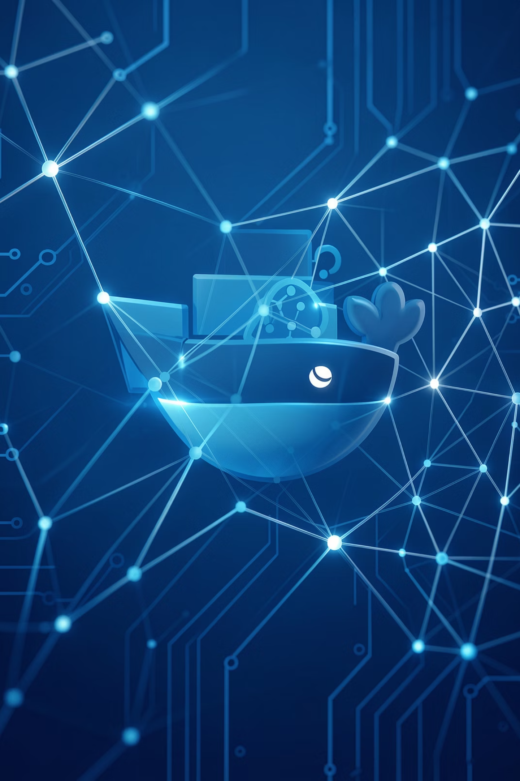
AI-Powered Docker Monitoring Assistant
Team
ALPHA BUILDERS

Slide 2

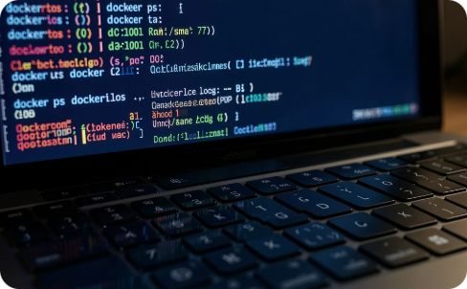
Problem Statement
Modern applications run inside Docker containers that must remain healthy and modern IT environments, applications are commonly deployed and managed using Docker containers to ensure scalability, portability, and efficient resource utilization. However, monitoring container health, identifying failures, and troubleshooting issues typically require users to interact with command-line tools and execute complex Docker commands. This process demands technical expertise and can be challenging for non-technical users, beginners, and support teams.
When containers become unhealthy, stop unexpectedly, or repeatedly restart, users must manually inspect container status, logs, and health information through terminal-based commands. This approach is time-consuming, difficult to learn, and often delays issue detection and resolution.

Slide 3


Our AI-Powered Solution
Allow users to ask questions in plain English. The system maps intent to safe Docker SDK calls, gathers data, and returns concise diagnostics, root-cause hypotheses and suggested next steps.
Natural Language Examples
System Actions
"Show unhealthy containers"
"Why is redis-cache restarting?"
"Show logs for nginx from last 30 minutes"
Understand intent and entities
Retrieve structured container data via Docker SDK
Generate AI insights and remediation steps

Slide 4
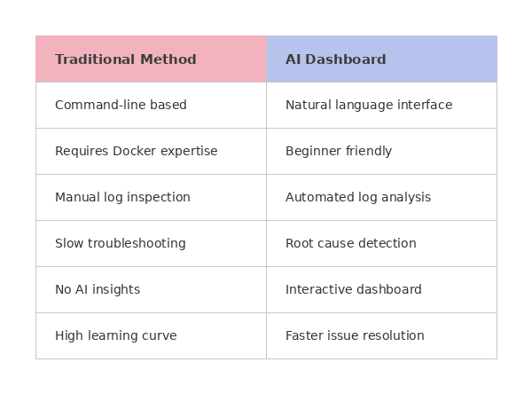
Traditional Method VS AI Dashboard

Slide 5
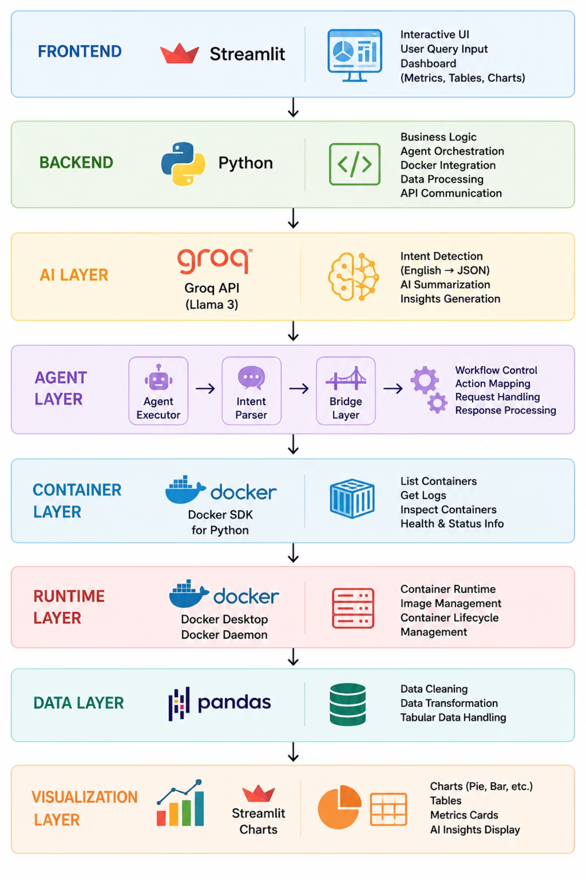
Technology Stack

Slide 6

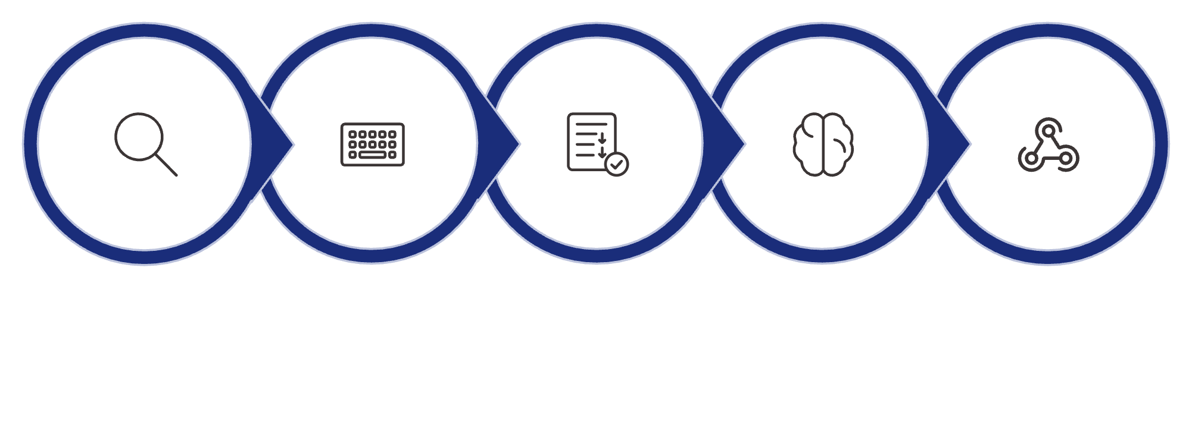
How the System Works
A step-by-step view from user intent to dashboard—visualised as a numbered workflow so engineers can trace data flow and responsibility at each stage.
1. Query
2. Capture
3. Executor
4. LLM
5. Intent
Each step represents a clear handoff: frontend → orchestration → execution → analysis → presentation. This makes debugging, auditing and optimisation straightforward.

Slide 7
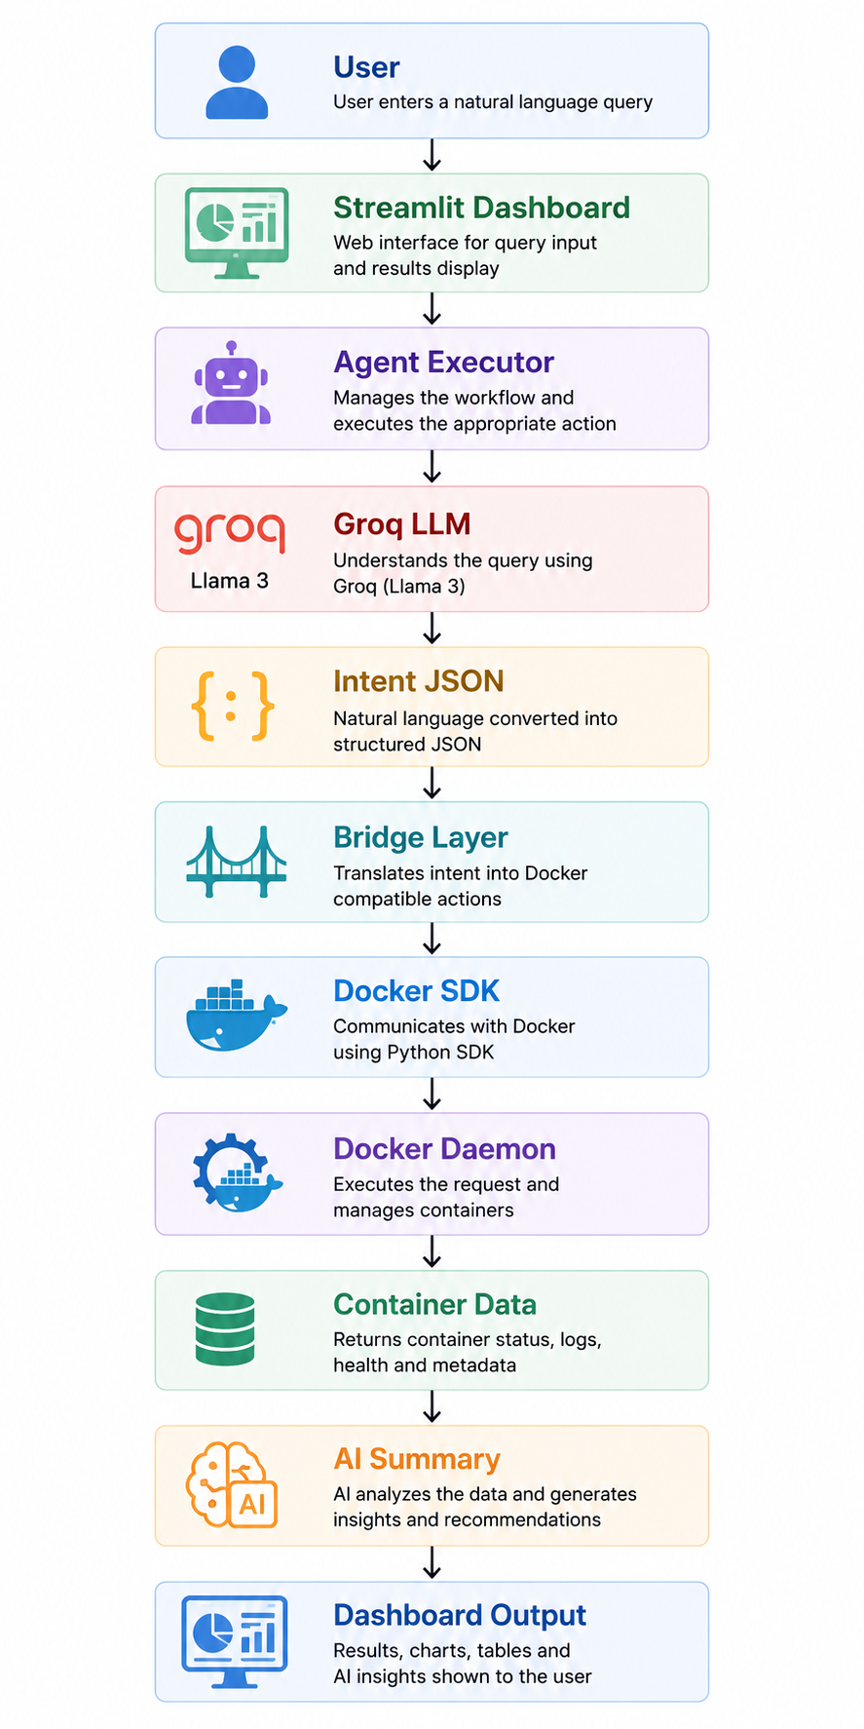
System Workflow

Slide 8
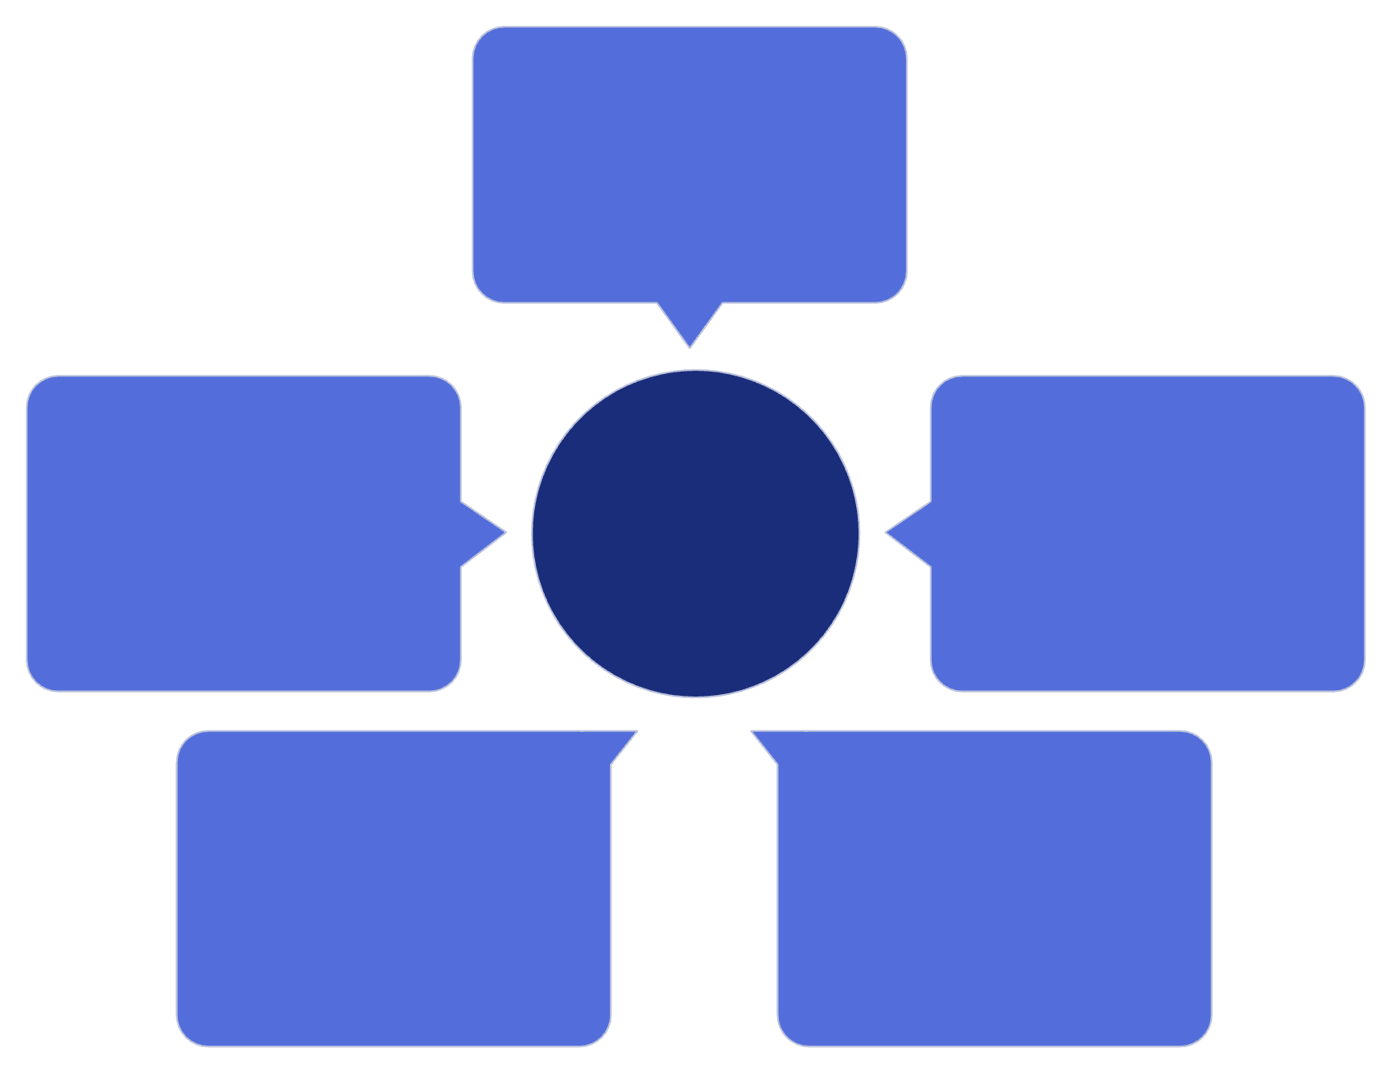
Understanding Docker Architecture
Docker CLI
User commands sent
Containers
Docker Request Flow
Docker SDK
Runtime instances
Client libraries (API)
Images
Docker Daemon
Managed artifacts
Handles requests
The diagram above summarises how components interact:
Docker CLI
Docker SDK
Docker Daemon
User-facing commands and quick tasks.
Programmatic client libraries (Python) that expose container operations as structured APIs.
Service that manages images, containers and networking.

Slide 9

Complete System Architecture
Dashboard
Agent Executor
Bridge Layer
Docker SDK
Component roles (brief):
Streamlit Dashboard
Agent Executor
Bridge Layer
User interface for queries, interactive logs and suggested fixes.
Manages LLM prompts, tool calls, and multi-step reasoning loops.
Validates intent JSON, enforces permissions, rate-limits SDK calls.
Docker SDK & Daemon
AI Summary
Fetches container metadata, logs and runtime metrics.
Structured findings, root-cause hypotheses and remediation steps returned to the dashboard.
Next steps: security hardening, multi-host orchestration (K8s integration), evaluation on real incident scenarios.

Slide 10
Agent Loop Architecture
Why an agent loop? It enables resilient, autonomous workflows that can adapt, retry and reason—critical for an automated monitoring & remediation hackathon prototype.
01
02
03
Understand Query
Execute Action
Check Results
LLM interprets user intent and extracts actionable parameters.
Agent invokes Docker SDK or external APIs to perform the task.
Validate outputs, logs and status codes against expected outcomes.
04
05
Retry if Needed
Generate Response
Backoff and retry logic triggered for transient failures.
Compose a concise, human-friendly summary with recommended next steps.
Automation
Error handling
Reduces manual operator load for routine container tasks.
Structured retries and fallbacks improve reliability.
Decision making
Intelligent execution
Contextual reasoning enables safer, targeted actions.
Combines LLM intent with system-level operations for faster outcomes.

Slide 11

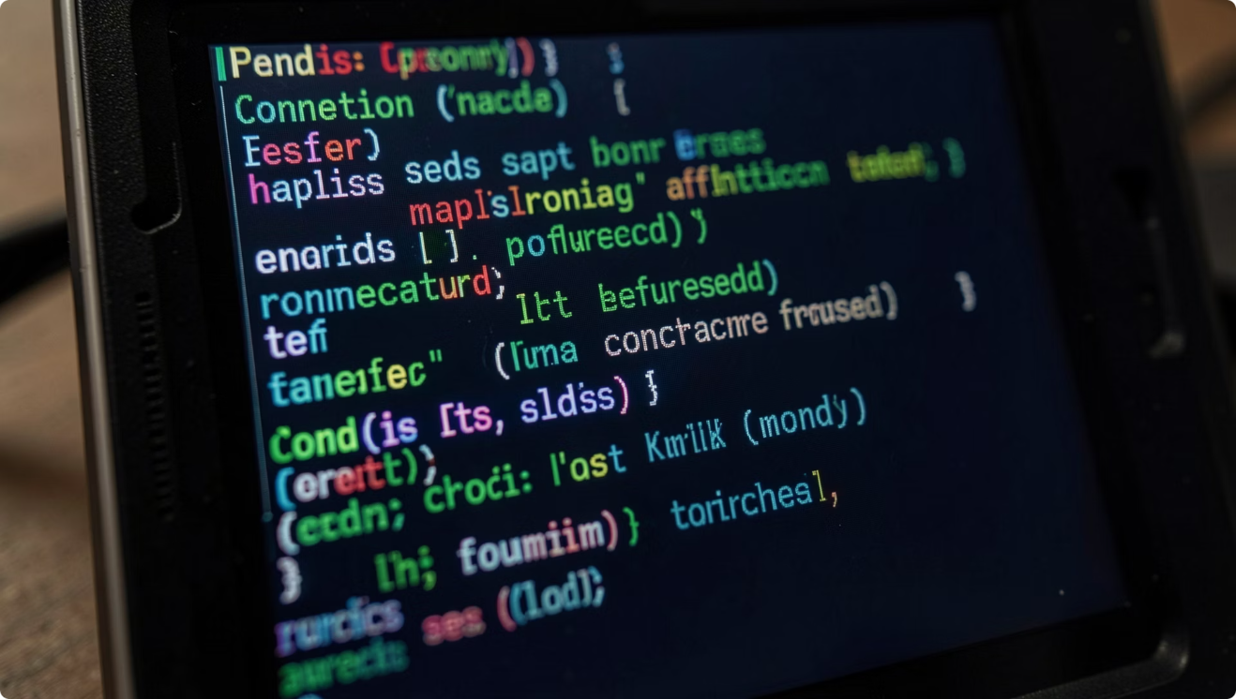
AI-Based Root Cause Analysis
From raw logs to actionable guidance—an automated pipeline that extracts evidence, infers causes, and recommends fixes.
Retrieve Logs
Analyze Logs
Generate Explanation
Recommend Fix
Example: “Why is redis-cache unhealthy?”
Retrieve Logs — fetch container stdout/stderr and system logs
Analyze Logs — pattern-match errors and stack traces
Generate Explanation — produce human-readable cause
Recommend Fix — actionable remediation steps
Example Output: Likely Cause — Database connection failure. Evidence — "connection refused" messages observed. Recommended Action — Verify PostgreSQL availability and network bindings.

Slide 12
Project Outcome — Results, Future Scope & Conclusion
A compact synthesis of achievements, roadmap opportunities, and the project's core value proposition for DevOps teams.
Natural Language Monitoring
AI-Powered Insights
Docker Integration
Users query infrastructure in plain language—no CLI required.
Log analysis and root-cause summaries produced automatically.
Direct control and data retrieval via Docker SDK and daemon.
Agent Loop
External API Integration
Autonomous, retry-capable execution with validation steps.
Supports calls to monitoring APIs and third-party services.
Future Scope
Kubernetes monitoring and cluster-level orchestration
Predictive failure detection using historical telemetry
Slack notifications and email alerts for rapid ops response
Multi-host monitoring with secure agent tunnels

Slide 13
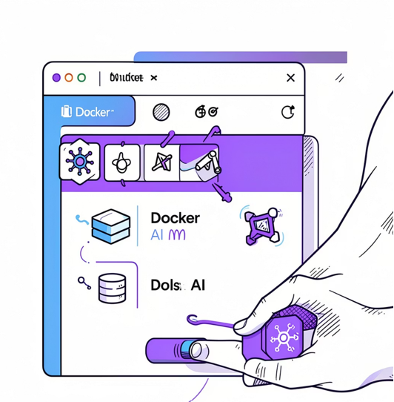
THANK YOU
Public website link : https://docker--project.streamlit.app/
Github link : https://github.com/abinandhuk007/ai-docker-health-dashboard

