Slide 1
🔗 Blockchain-Based Supply
Chain Tracker
Tracking products using Ethereum & QR Codes
By:
Abinash Behera
(230301120453)

Slide 2
Introduction
• Supply chain management ensures product traceability.
• Traditional systems are centralized and prone to fraud.
• Blockchain provides transparency, immutability, and decentralization.

Slide 3
Problem Statement
• Lack of real-time product verification.
• Risk of counterfeit products.
• Difficulty in tracking product history.
• Centralized databases can be tampered.

Slide 4
Project Objectives
1. Build a decentralized supply chain tracker on Ethereum.
2. Generate QR codes for each product.
3. Enable users to scan QR codes and fetch product details.
4. Provide a user-friendly frontend using React.
5. Ensure secure storage of product data on blockchain.

Slide 5
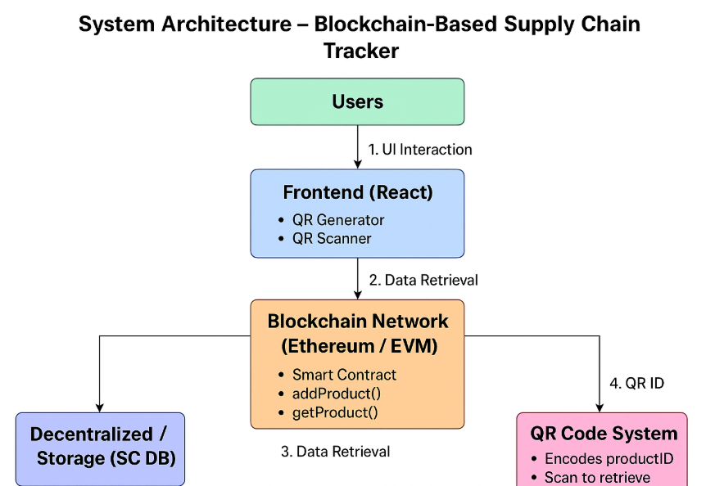

Slide 6
Tools & Technologies
Frontend: React.js, HTML/CSS, JavaScript
Blockchain: Ethereum (Sepolia testnet)
Smart Contract: Solidity
Wallet: MetaMask
QR Code: qrcode.react
Deployment: Netlify

Slide 7
Smart Contract Overview
• Functions:
- addProduct(productID, name, location) → Add product
- getProduct(productID) → Fetch product details
• Products stored as struct: {name, location, timestamp}
• Immutability ensures products cannot be modified.

Slide 8
Frontend Overview
• Connect wallet using MetaMask.
• Add product with ID, name, location.
• Generate and download QR code.
• Scan QR code to fetch product details.

Slide 9
QR Code Feature
• Every product has a unique QR code.
• Users can download or copy QR code.
• Scan the QR code to verify product on blockchain.

Slide 10
QR Scanner Feature
• Click Open Scanner to scan QR codes.
• Fetch product details in real-time.
• Display: ID, Name, Location, Timestamp.

Slide 11
Demo Flow
1. Connect MetaMask wallet.
2. Add product → generates QR code.
3. Download/Copy QR code.
4. Scan QR code → fetch product details.

Slide 12
Deployment
• React frontend deployed on Netlify.
• Ethereum smart contract deployed on Sepolia testnet.
• Users interact via MetaMask.

Slide 13
Advantages
• Transparency: Everyone can verify product data.
• Immutability: Data cannot be tampered.
• Decentralized: No central authority.
• Secure: Smart contracts ensure data integrity.

Slide 14
Limitations
• Requires MetaMask and Ethereum network.
• Gas fees on mainnet (use Sepolia for testing).
• Internet required for scanning QR code.

Slide 15
Future Enhancements
• Add multi-user roles (Manufacturer, Distributor, Retailer).
• Integrate mobile-friendly QR scanner.
• Track product history across supply chain.
• Integrate with IPFS to store detailed product data.

Slide 16
Conclusion
• Blockchain ensures secure, transparent supply chain.
• QR codes make product verification simple.
• Demonstrates practical blockchain adoption.

