Slide 1
Title Slide
Blockchain-Based Student Record System
By: Swornapriya Patra
Suchismita Priyadarsini

Slide 2
Introduction
• A decentralized application (DApp) for storing student records
• Uses Ethereum blockchain for transparency & security
• Eliminates tampering and centralized risks

Slide 3
Objectives
• Secure student record storage
• Enable add, update, delete, view operations
• Blockchain transparency with smart contracts

Slide 4
Tech Stack
• Frontend: React.js
• Backend: Node.js, Express
• Smart Contract: Solidity
• Blockchain: Ethereum Sepolia
• Wallet: MetaMask

Slide 5
Smart Contract
• addRecord(id, name, marks)
• getRecord(id)
• updateRecord(id, name, marks)
• deleteRecord(id)
• getAllStudentIds()

Slide 6
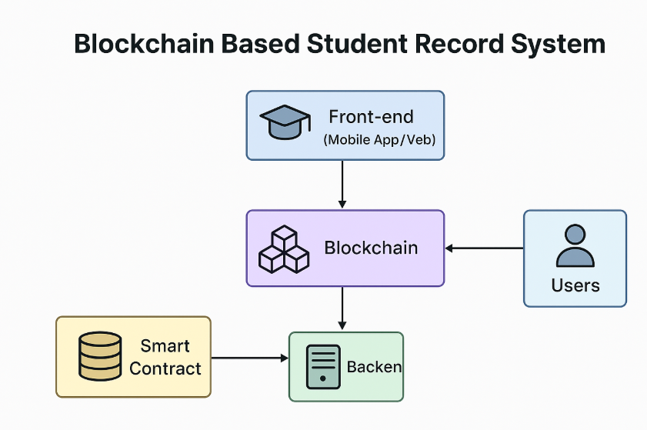
Architecture
User → Frontend → Backend → Smart Contract → Blockchain

Slide 7
Frontend Features
• Connect wallet
• CRUD operations
• View records in table
• Export to Excel

Slide 8
Backend Responsibilities
• API endpoints for smart contract interaction
• Record CRUD handler
• RPC and Wallet provider

Slide 9
Workflow
1. Connect wallet
2. Enter student details
3. Perform CRUD operations
4. Data stored on blockchain

Slide 10
Advantages
• Security
• Transparency
• No tampering
• Distributed storage

Slide 11
Conclusion
A secure and decentralized way to store and manage student records.

