Slide 1
Project
Chess Network Analysis

Slide 2
Data Collection
Collected information 1000-Top Rated (Based on current rating) Active Chess Players
The fields extracted are :
Rank
Gender
Name
Rating
Title
FIDE ID
Nationality
Number of games
Year of Birth

Slide 3
Assumptions/Methods Used While Scraping
The current rating of the players have been considered while finding the top 1000 players
Only the active players are included in the top 1000.
Active Players :- Players who have at least played a single official game on or after 2019

Slide 4
Creating Edges
A tuple was created for each pair of players in the network
Ex:- (player1,player2)=?
It stores the following :
(number of matches won by player1 against player2) - (number of matches won by player2 against player1)
This was converted as a directed edge network by reversing the direction of edges for negative values and keeping this absolute difference as edge weight

Slide 5
Edges In the Temporal Network
Each edge has an weight (as discussed previously) and an interval associated to it
The intervals are of the form {Year}-{Year+1}. Years are from 2010-2022
For example, an edge between A and B with weight 20 and time interval 2015-2016
Implies that of all the matches which were played between 2010-2015(end of 2015/start of 2016) between A and B, A won 20 more matches than that of B.
So, for each interval, matches are included cumulatively starting from 2010.
Note:- If A and B win equal number of matches in an interval, edge weight will be 0 i.e. there will be no edge between them

Slide 6
Edge Attributes
Edge Attributes -
1. Number of matches :- This represents matches played between the 2 players
within the time period
2. Win Difference :- No. of matches won by source Node against the target - No.
of matches won by target Node against the source
3. Adjusted Win Difference :- (Win Difference)/No. Of Matches

Slide 7
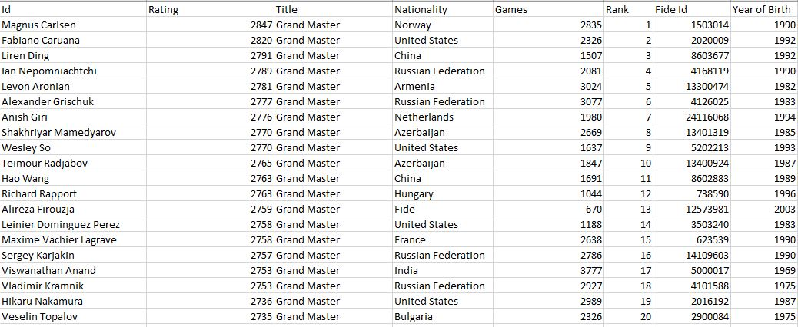
NodeList

Slide 8
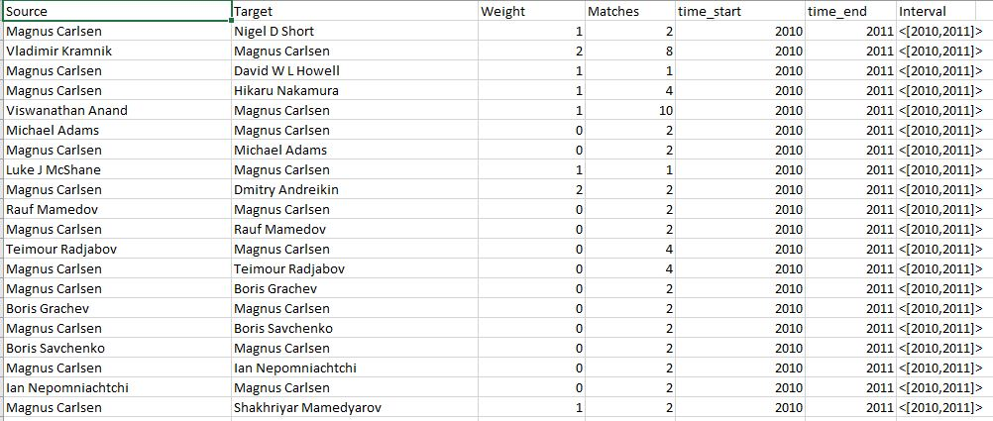
Edge List

Slide 9
Network Statistics
No of nodes – 1000
No of Edges – 39969 (Throughout the timeline)
Average Degree – 39.969
Average Weighted Degree – 50.224
Network Diameter – 6
Average Path Length – 2.41
Average Clustering Coefficient - 0.137
No. of Strongly Connected Components - 14
No. of Weakly Connected Components - 4

Slide 10
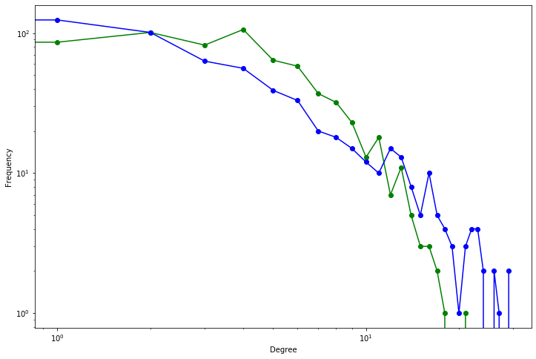
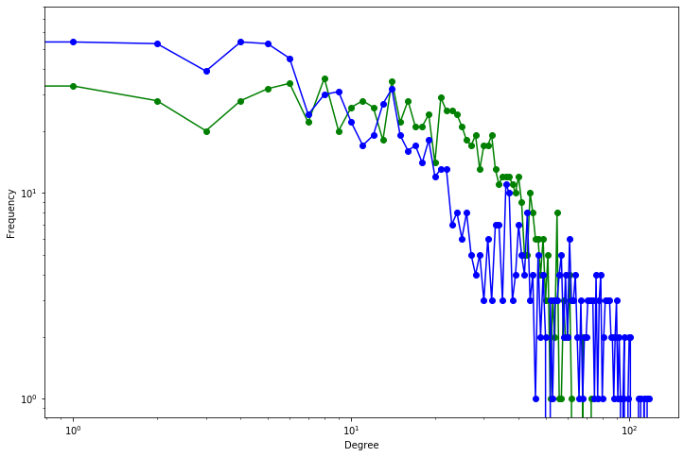
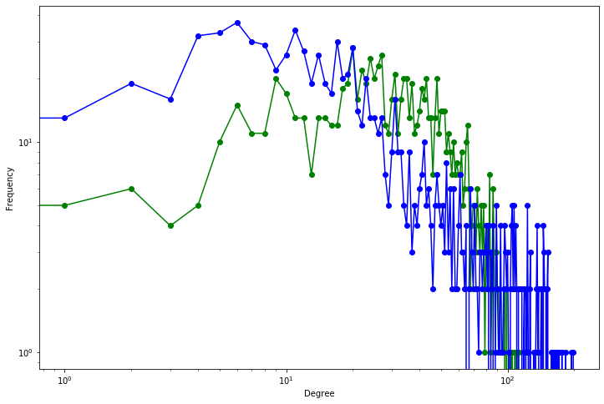
Degree Distribution
2010
2015
2021

Slide 11
Fitting Power Law to the degree distribution
Approximated Power Exponent, γ=1.25 (2021)
Approximated Power Exponent for out-degree, γ_{out} = 1.323 (2021)
Approximated Power Exponent for in-degree, γ_{in} = 1.29 (2021)
However, in 2010 , γ=1.75
Inferences
Scale-free nature (Becoming more random)
Closer to Anomalous Regime
Small World Property

Slide 12
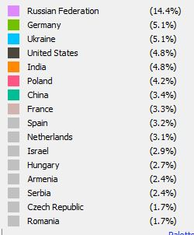
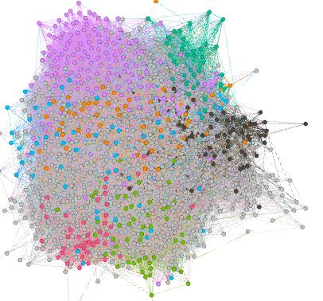
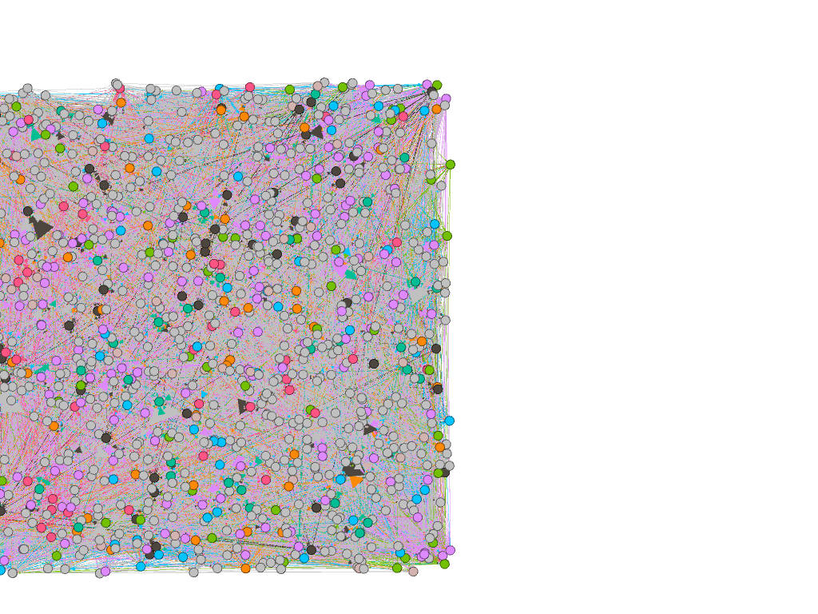
Node Attributes - Nationality

Slide 13
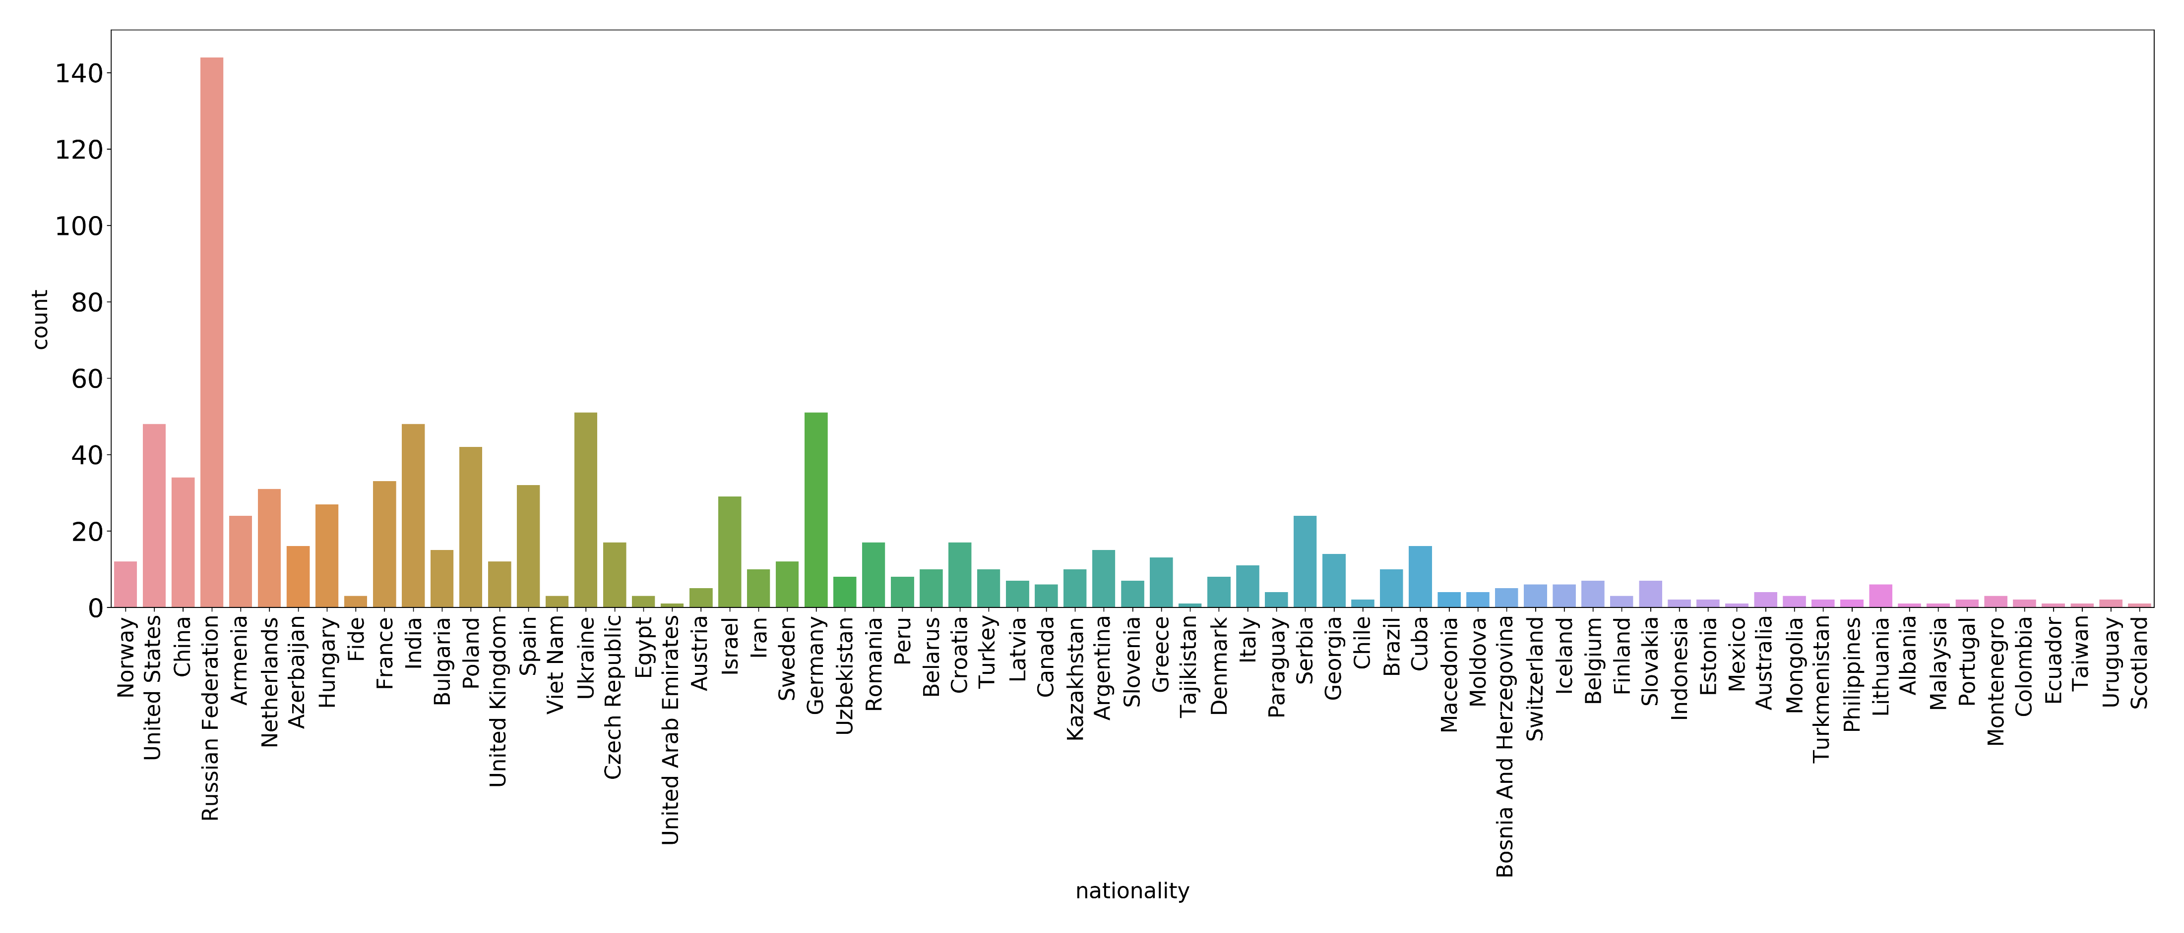
Node Attrubutes - Nationality

Slide 14
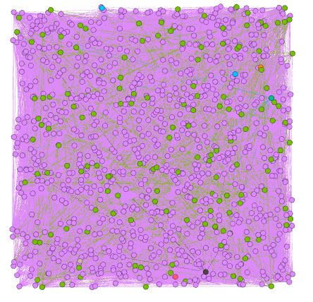

Node Attributes - Title

Slide 15
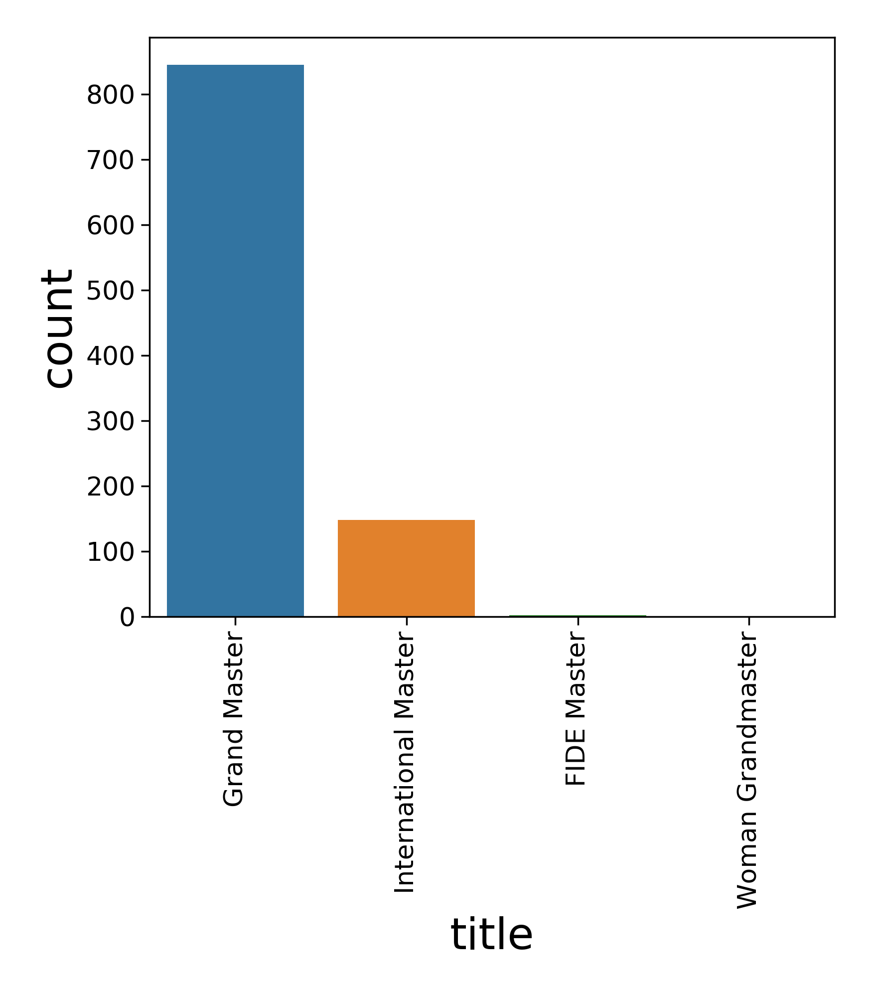
Node Attributes - Title

Slide 16
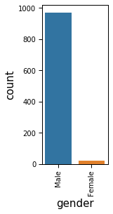
Node Attributes - Gender
Most players out of the top 1000 are males suggesting some form of male domination in elite chess

Slide 17
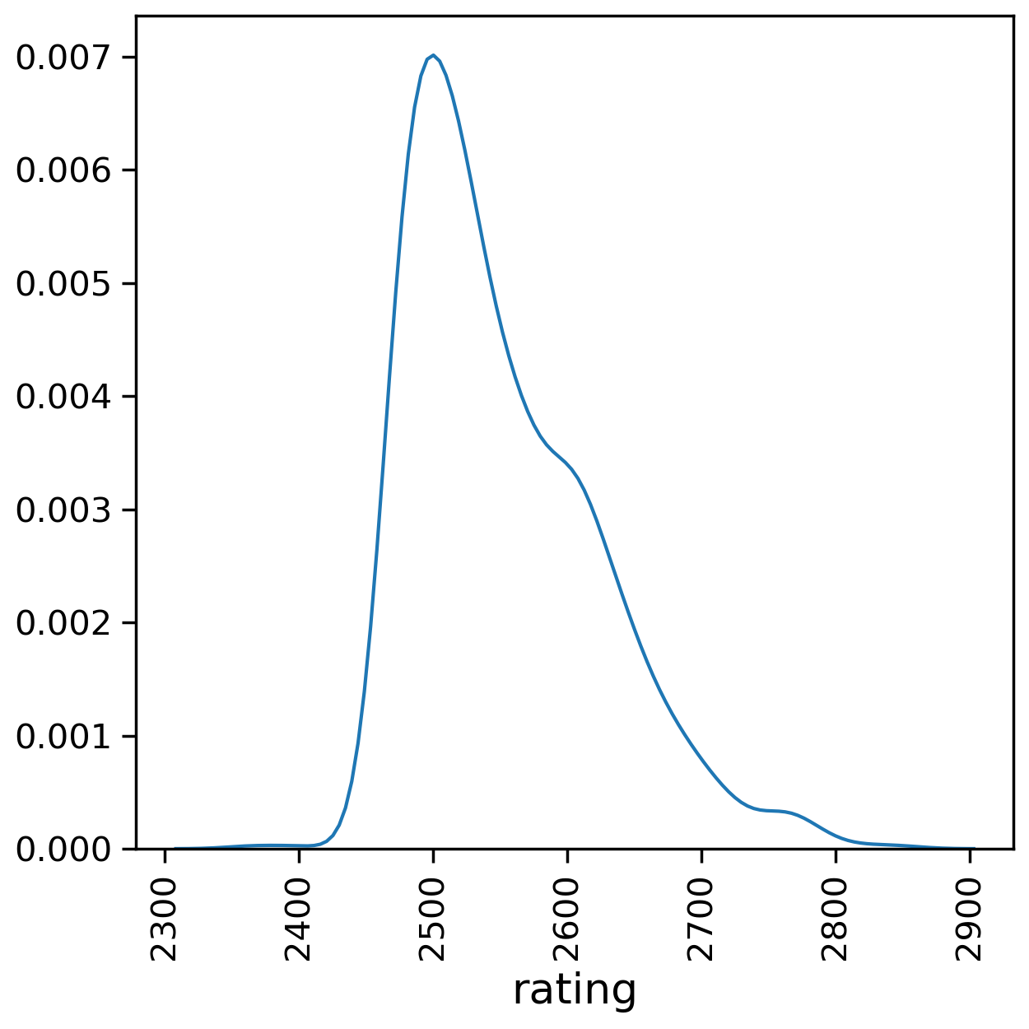
Node Attributes - Rating
Lowest Rating - 2364
Highest Rating - 2847
Average Rating - 2552.93

Slide 18
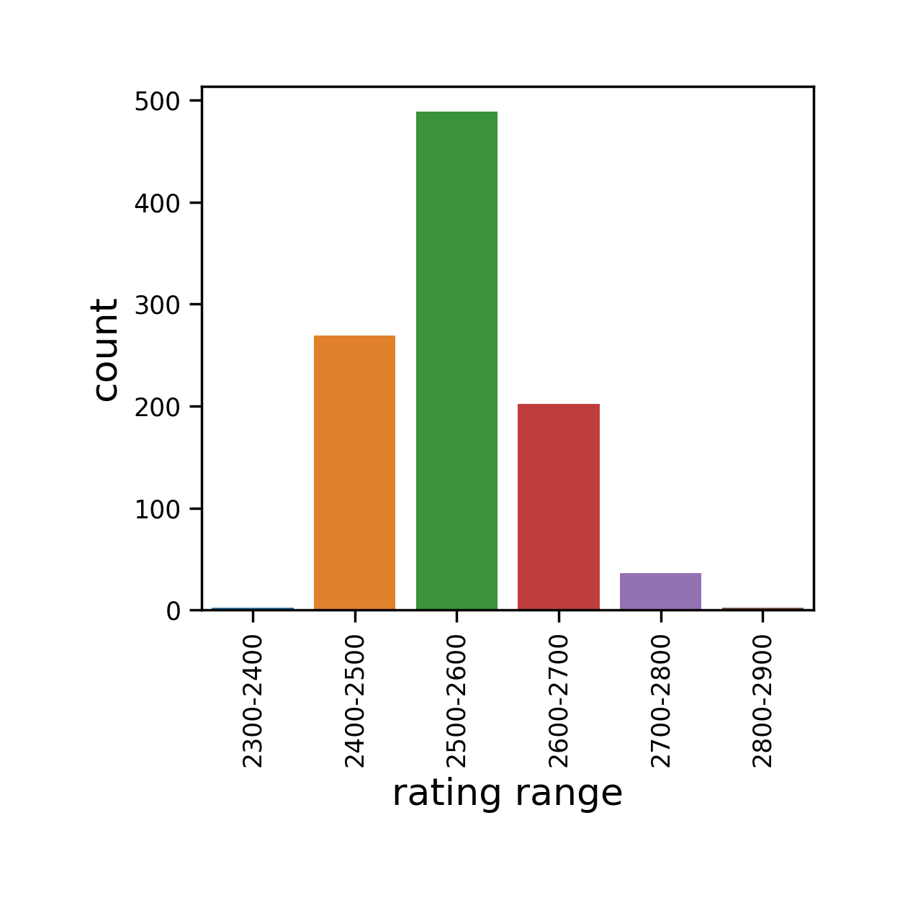
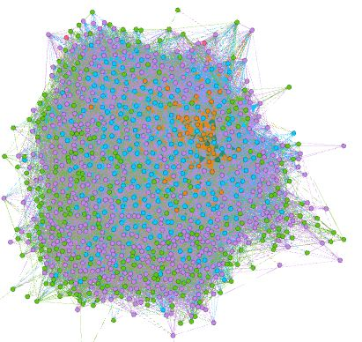
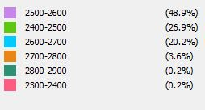
Node Attributes – Using Ranges for Rating

Slide 19
Degree Centrality
Degree Centrality measures (for Out-Degree) were done on the following circumstances:
Without Weights
Using Win difference as weight
Using Number of Matches played as weight
Using Win Difference / No. of Matches as weight

Slide 20
Without Weights
Top Five Nodes (in 2021)
David Navara - 2697
Anton Korobov - 2683
Maxim Matlakov - 2688
Maxime Vachier Lagrave - 2758
Ian Nepomniachtchi – 2789

Slide 21
Using Win difference as weight
Top Five Nodes (in 2021)
Magnus Carlsen - 2847
Hikaru Nakamura - 2736
Maxime Vachier Lagrave - 2758
Ian Nepomniachtchi - 2789
David Navara - 2697

Slide 22
Using Number of Matches played as weight
Top Five Nodes (in 2021)
Magnus Carlsen - 2847
Hikaru Nakamura - 2736
Maxime Vachier Lagrave – 2758
Levon Aronian - 2781
Ian Nepomniachtchi - 2789

Slide 23
Using Win difference / Matches as weight
Top Five Nodes (in 2021)
David Navara - 2697
Igor Kovalenko - 2643
Anton Korobov - 2683
Arkadij Naiditsch - 2649
Rauf Mamedov - 2654

Slide 24
BetweenNess Centrality
Top Five Nodes in 2021
Arkadij Naiditsch - 2649
Igor Kovalenko - 2643
Romain Edouard - 2611
Alexandr Fier - 2565
Marin Bosiocic - 2601

Slide 25
Degree and BetweenNess Centrailty
Observations
Some players like Arkadij Naiditsch and Igor Kovalenko have a high betweenness centrality as well as a high degree centrality with (Win difference/Matches) as weight
These players are moderately rated but have defeated some high rated players
They have played few matches with high rated players but have an upper hand

Slide 26
Eigen vector centrality
Keeping Weight/No. of Matches as Win Difference
Vahap Sanal - 2571
Valentin Dragnev - 2564
Mikhail Al. Antipov - 2609
Pavel V Tregubov - 2560
Tal Baron - 2522
Keeping Weight as Win Difference
Boris Savchenko - 2552
Pavel Potapov - 2481
Mikhail Al. Antipov - 2609
Vahap Sanal - 2571
Dmitry Bocharov - 2533

Slide 27
Eigenvector Centrality
Keeping Number of matches as weight
Anish Giri - 2776
Boris Gelfand - 2676
Shakhriyar Mamedyarov - 2770
Alexander Grischuk - 2777
Leinier Dominguez Perez - 2758

Slide 28
Eigenvector centrality
Unexpected results - Moderately rated players had high eigenvector centrality
Possible Explanation – These players are not expected to beat high rated players but since they have done so, they have higher eigenvector centrality
Inference - These players have performed better than expectations.
PageRank Gives similar results

Slide 29
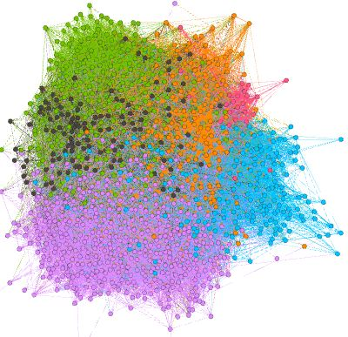
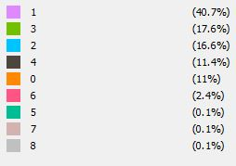
Community Detection

Slide 30
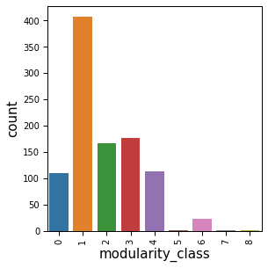
Size of various Communities

Slide 31
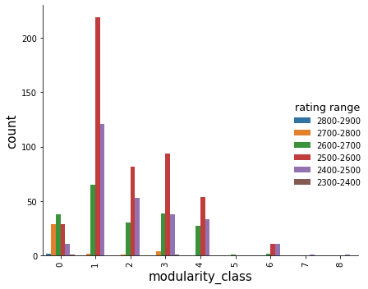
Distribution of Ratings in various communities

Slide 32
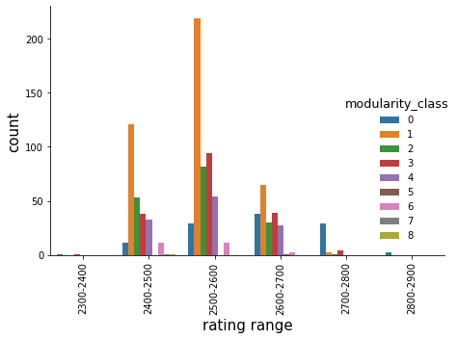
Communities Inside Rating Groups

Slide 33
Inferences
Community 0 consists of high rated players most rated between 2700-2900
Community 1 is the largest community consisting of 2400-2600 rated players in abundance
Community 5,7 and 8 are trivial in size consisting of a single individual each
Rest of the communities contain moderately rated players

Slide 34
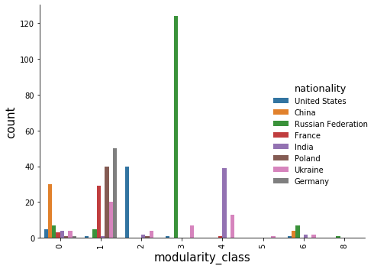
Nationalities Inside Communities

Slide 35
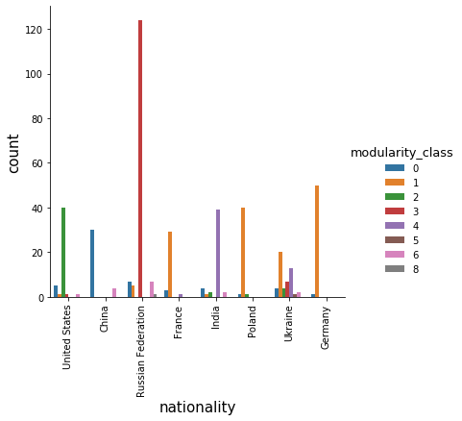
Nationalities Inside Community Structure

Slide 36
InfeRences
The abundant nationality present in communities :
Community 0 - China
Community 1 - Mixture of various nationalities such as France, Poland , Germany and many more
Community 2 – United States
Community 3 – Russian Federation
Community 4 - India

Slide 37
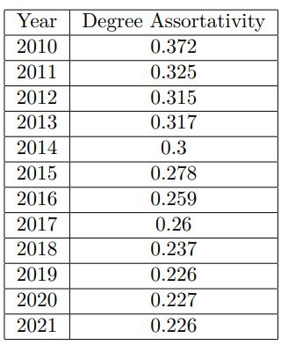
Assortativity Analysis - Degree
Degree Assortativity decreases with each passing year
Its magnitude is still significant even in 2021
Suggests that players play/beat opponents who have similar track record/experience
May not necessarily mean players play with others having similar rating

Slide 38
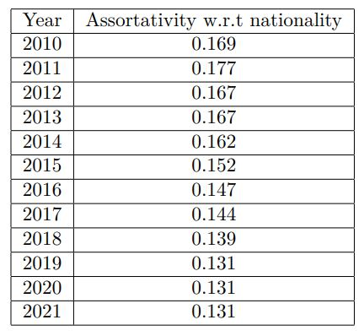
Assortativity Analysis - Nationality
Dwindles with time
Similar trends like degree assortativity
Indicates players tend to have opponents of the same nationality more often than not
More stable with time than degree assortativity

Slide 39
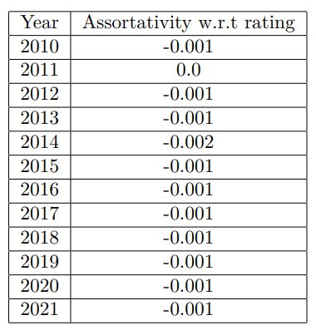
Assortativity Analysis – Ratings
Little or no correlation between rating of paired opponents
One major factor – Ratings are continuous unlike other categorical variables like nationality
Players might play with opponents having a range of ratings, not only close to theirs
Also, nationality doesn’t change usually but ratings change with time

Slide 40
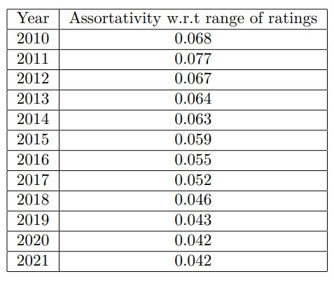
Assortativity Analysis – Discretized Rating Groups
Better Assortativity than what was obtained by considering rating as continuous
Still lower than nationality assortativity
Represents some degree of correlation between range of ratings of ooponents
Relatively Stable with time

Slide 41
Conclusion And future work
We studied centrality measures, communities inside the networks, their correlation with certain node attributes and analysed the assortativity of node attributes
Future work could be done to use the data as a time series model to predict future matches based on current network embeddings

Slide 42
References
FIDE Chess Network
Gephi Visualization
Community Detection in Gephi
https://365chess.com/

