Slide 1
Cortex – A8

Slide 2
Introduction :
The ARM Cortex – A8 is a 32 bit processor core, implementing the ARM v7-A architecture was designed by ARM Holdings and introduced in the year 2005.
Cortex-A8 is a dual-issue superscalar design (microprocessor design that makes it possible for more than one instruction at a time to be executed during a single clock cycle).
It was the first cortex design to be adopted on a largse scale in consumer devices.

Slide 3
Key Features of the Cortex – A8 :
Frequency ranges from 600MHz to 1 GHz
Superscalar dual-issue microarchitecture
NEON SIMD(Single Instruction, Multiple Data) instruction set.
13-stager integer pipeline and 10-stage NEON pipeline
Thumb-2 instruction set encoding
Advanced Branch prediction unit with >95% accuracy
Integrated Level 2 cache
Consumer applications requiring 2000 Dhrystone MIPS

Slide 4
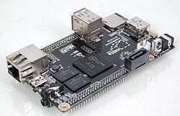
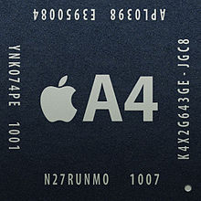

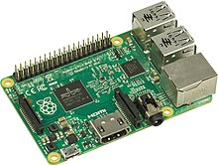
Some SoC’s that use ARMv7 Architecture
Allwinner A1X
Apple A4
Samsung Exynos 3110
Raspberry Pi 2

Slide 5
Instruction set Architecture :
The ARM architecture is a load/store architecture .
Some special attributes include instructions capable of both shift and alu operations in the same instruction, the ability to use the program counter as a general purpose register.
The ARM integer register file includes 16 32bit registers. 13 of these registers are general purpose.
The remaining three special purpose registers are the stack pointer, a link register, and the program counter.
The classic floating point and new NEON media instructions both use a second register file that contains 32 64bit registers.

Slide 6
Pipeline :
dual-issue superscalar processor
13-stage main pipeline
This main pipeline can be broken into three decoupled, parts: Fetch, Decode, and Execute
Individual pipeline stages within each part are simply numbered: F1, F2, D0, D1 etc
The two Fetch stages at the front of the pipeline are responsible for predicting the instruction stream, fetching instructions from memory, and placing the fetched instructions into a buffer for consumption by the Decode pipeline.
In addition to the main pipeline, there is a 10 stage pipeline for the NEON SIMD execution engine

Slide 7
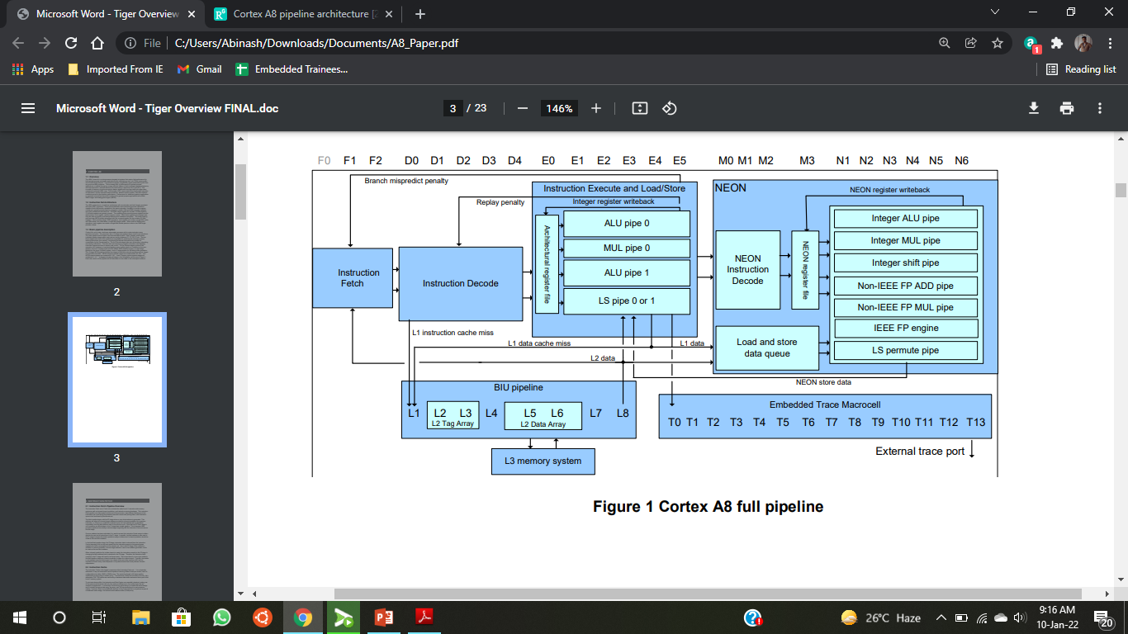
13-stage integer pipeline 10-stage NEON pipeline

Slide 8
Instruction Fetch
The Instruction Fetch unit (I-Fetch unit) includes the entire Level-1 Instruction side memory system as well as dynamic branch prediction, and instruction queuing hardware.
The fetch pipeline begins with the F0 stage where a new virtual address is generated. This address can either be a branch target address provided by a branch prediction for a previous instruction, or if there is no prediction made this cycle, the next address will be calculated sequentially from the fetch address used in the previous cycle.
Once an address has been calculated, it is used to access the Instruction Cache arrays to obtain data for the next set of instructions in the F1 stage. In parallel, the fetch address is also used in the F1 stage to access the branch prediction arrays to determine if a branch prediction should be made for the next fetch address.
In the final fetch pipeline stage, the F2 stage, instruction data is returned from the Instruction Cache and placed into the instruction queue for future consumption by the decode unit.

Slide 9
Instruction Cache
The Instruction Cache is the largest component of the Instruction Fetch unit. It is a physically addressed, 4-way set associative cache capable of returning 64bits of data per access, and it is configurable to be either 16KB or 32KB in size.
The cache line length is 64 bytes and line replacement is done using a random policy. The Instruction Cache also includes a 32-entry, fully associative TLB.
TLB misses are serviced by a hardware table walk mechanism that is part of the Level 2 memory system

Slide 10
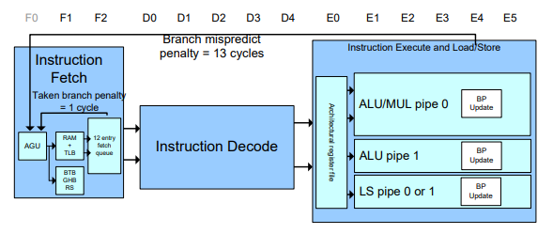
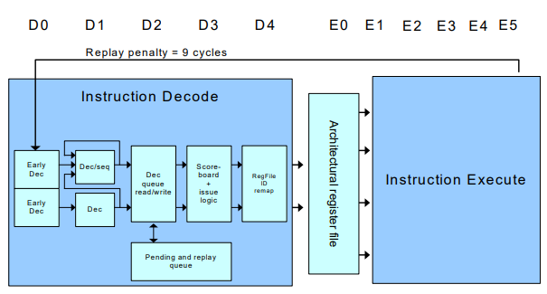
Instruction fetch pipeline
Instruction decode pipeline

Slide 11
Memory System Pipeline
The Cortex A8 memory system consists of the integer load/store pipeline, the Level-1 Data Cache, the level-2 Data Cache, and the bus interface unit.
All data memory transfers are handled by the memory system including all NEON and floating point load and store operations.
All Instruction Cache misses are also handled by the level 2 cache and bus interface unit.
The Load-store pipeline runs in parallel with the two ALU pipelines in stages E1 – E3. In the E1 stage, the memory address is generated in the AGU from the base and index register. In the E2 stage, the address is applied to the cache arrays.
In the case of a load operation, data is returned for formatting and forwarding in the E3 stage.
In the case of a store operation, the store data is formatted and ready to be written into the cache in the E3 stage. The penalty is two cycles if forwarding to a multiply, shift, or address calculation, and the penalty is zero cycles in the case of forwarding to a subsequent store instruction.

Slide 12
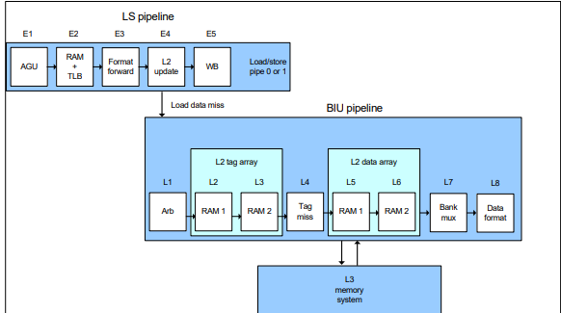
Memory system pipeline

Slide 13
NEON Pipeline
The NEON unit processes the Advanced SIMD instruction set that consists of 32-bit SIMD integer and floating point instructions that can operate on 128-bit, 64-bit, 32-bit, 16-bit, or 8-bit data values.
These instructions were added to greatly accelerate processing of media-style workloads such as audio and video filters and codecs.
The NEON unit also executes all ARM floating point instructions from the pre-existing VFP instruction set.
It makes sense for the NEON unit to execute both the new Advanced SIMD instructions and the pre-existing VFP floating point instructions since they share the same register file and load/store instructions.

Slide 14
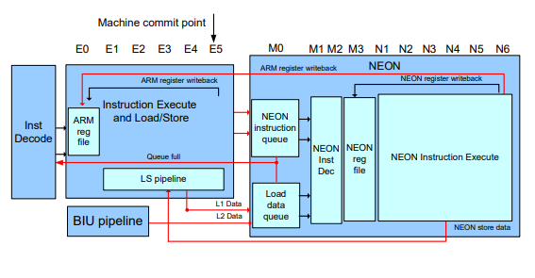
NEON engine interface

Slide 15
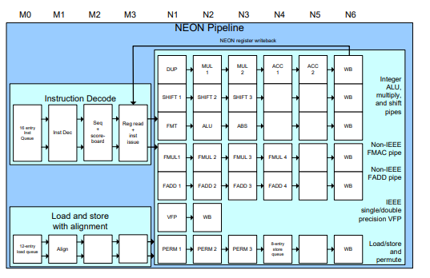
NEON has 4 decode stages, M0-M3, and 6 execute sages, N1-N6. The four decode stages in M0-M3 are very similar in structure and design to the four decode stages, D0-D4, seen in the main pipeline. The first two stages are used to decode the instruction resource and operand requirements and the later two stages are used for instruction scheduling

Slide 16
Thank You ….

