Slide 1
KGDB

Slide 2
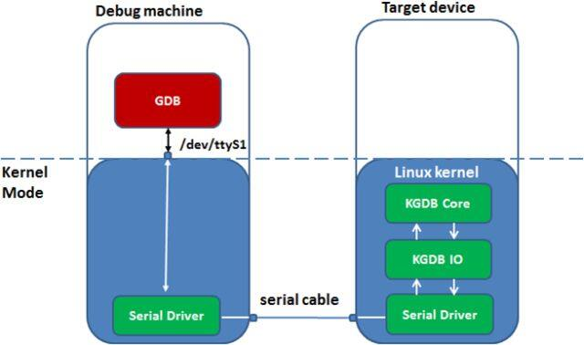
KGDB Stands for Kernel GDB.
User space programs can be debugged remotely using the combination of gdbserver on the target machine and gdb on the host machine/development machine. But you cannot use the same setup for debugging kernel, as gdbserver is still running as a user space application on the kernel which we want to debug. To solve this program, KGDB comes into picture. KGDB acts as a gdbserver inside the server.

Slide 3
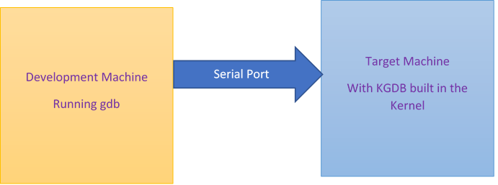
Setup :
A typical KGDB setup requires two machines connected by serial cable.
Host/Development Machine: Runs gdb and performs debugging
Target Machine: Runs kgdb and is the machine to be debugged

Slide 4
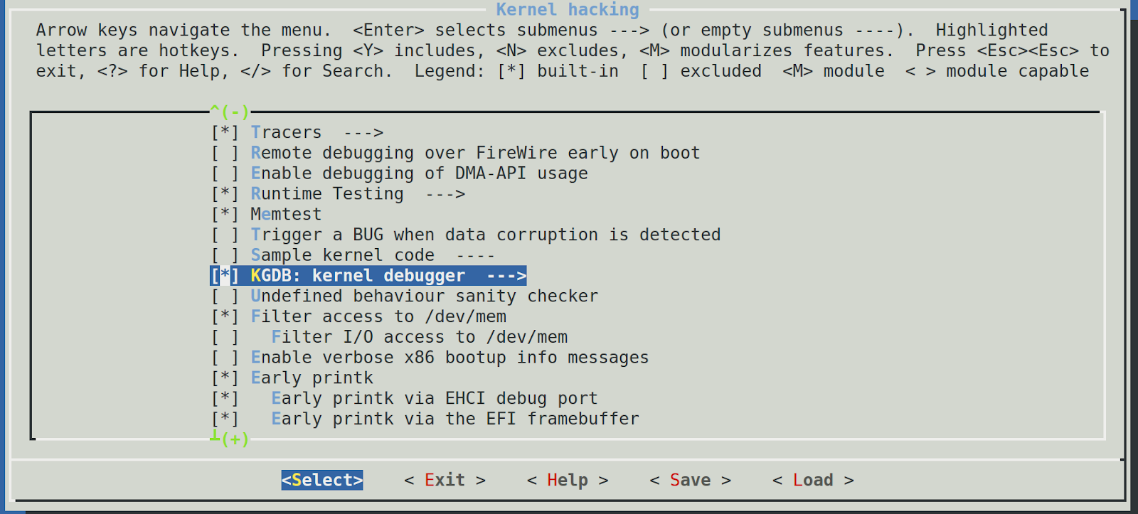
Setup on Target VM :
1. Build and install the latest Linux kernel on the target VM machine, make sure you add the following kernel configurations.

Slide 5
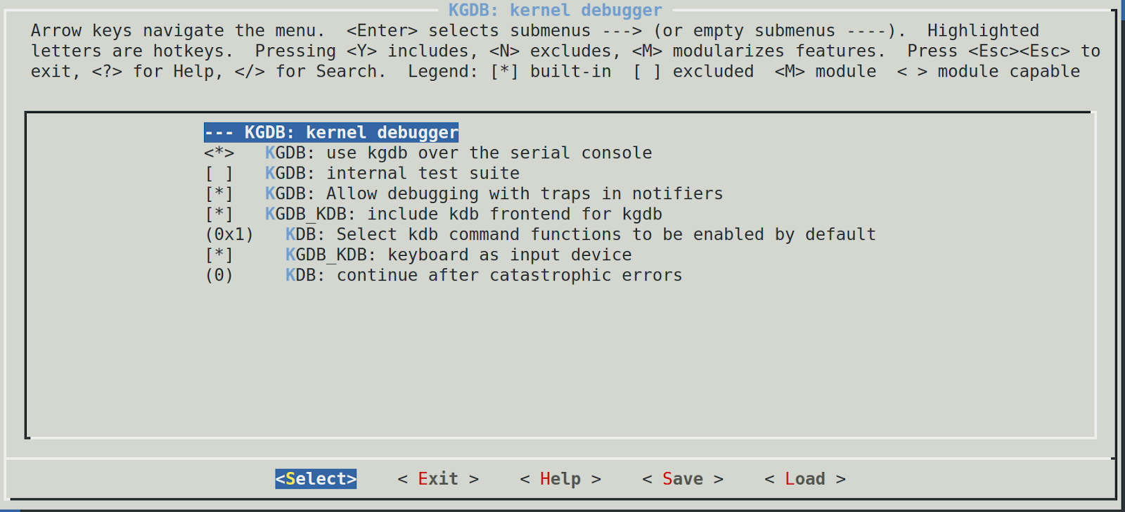

Slide 6
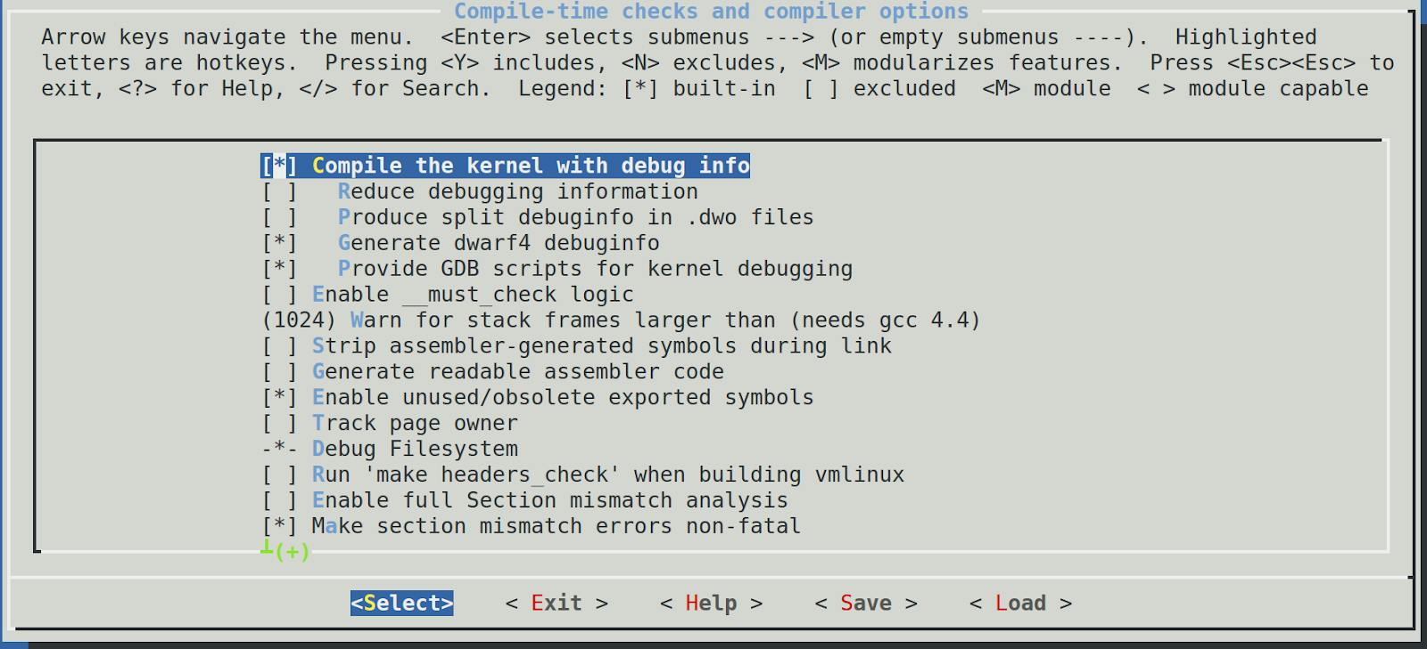
Configure CONFIG_KGDB and CONFIG_KGDB_SERIAL_CONSOLE

Slide 7
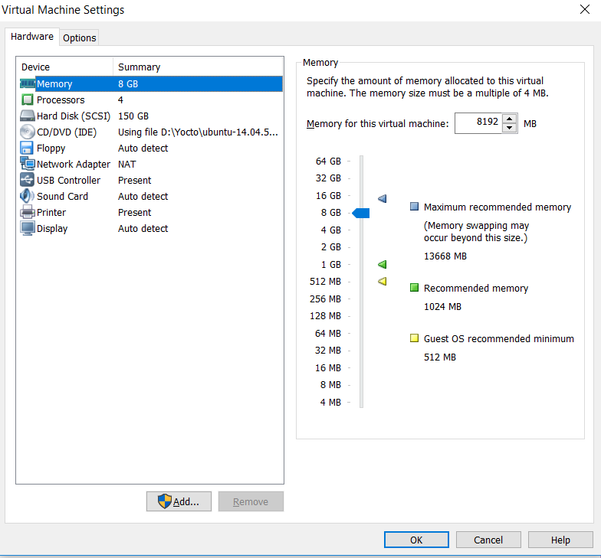
2. Copy the vmlinux image from this target VM to the development VM
3. Establish serial communication between two virtual machines
To establish the serial communication :
Step1: Open Virtual Machine Settings and click on Add

Slide 8
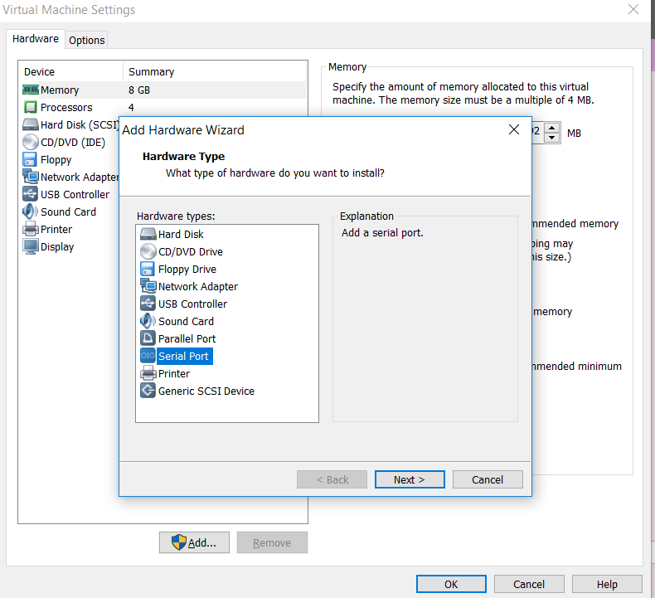
Step 2 : Select "Serial Port" and Click On Next

Slide 9
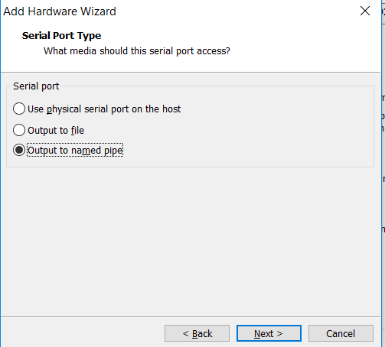
Step3: Select "Use Named Pipe"

Slide 10
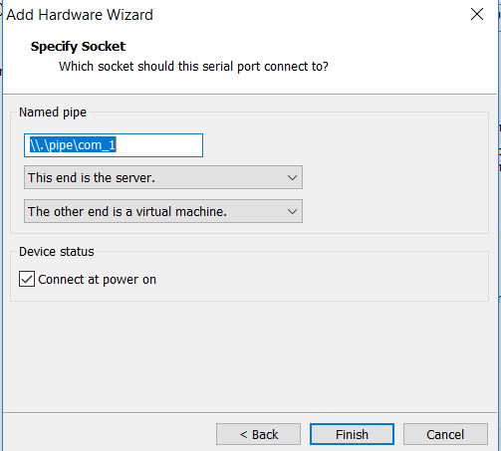
Step 4: You will observe the named pipe of the form \\.\pipe\<namedpipe>. Keep the settings as it is i..e, the named pipe: \\.\pipe\com_1 ( it will be ttyS1 in Linux) and click on Finish

Slide 11
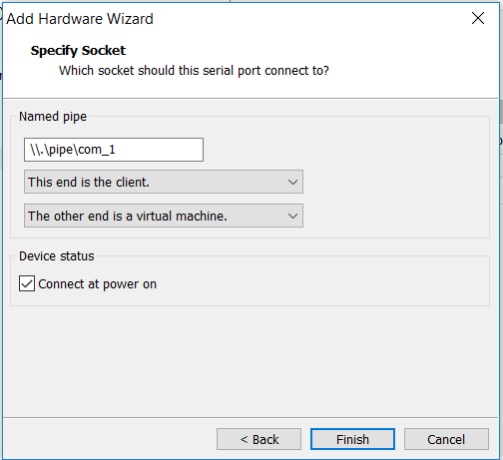
Steps on the Second Virtual Machine:
Perform the same steps 1 to 4 i.e from slide 7 to 10 and select “This end is client”

Slide 12
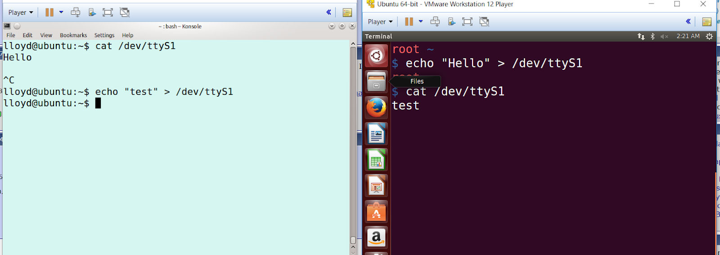
Testing the serial connection between VMs:
1. Power on the two VMs
2. On First VM : cat /dev/ttyS1 and the other VM: echo "hello" > /dev/ttyS1

Slide 13
4. Append the following command -line to kernel command line in grub
kgdbwait kgdboc=ttyS1,115200 sysrq_always_enabled
kgdbdoc tells the kernel to use ttyS1 serial port and 115200 baud rate
kgdwait tells the kernel to wait until the debugger is attached
sysrq_always_enabled enabling the sysrq

Slide 14
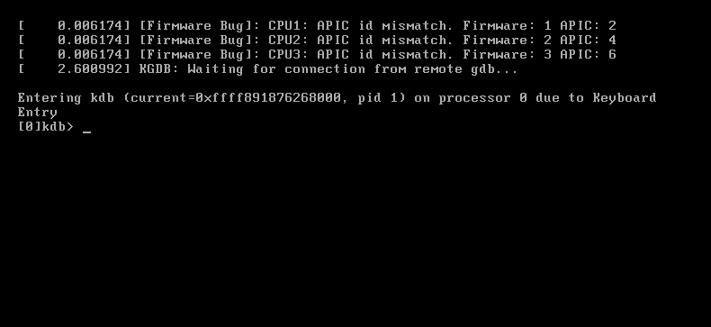
5. Reboot the machine and you will observe that the target VM is freezed after grub bootloader stage.

Slide 15
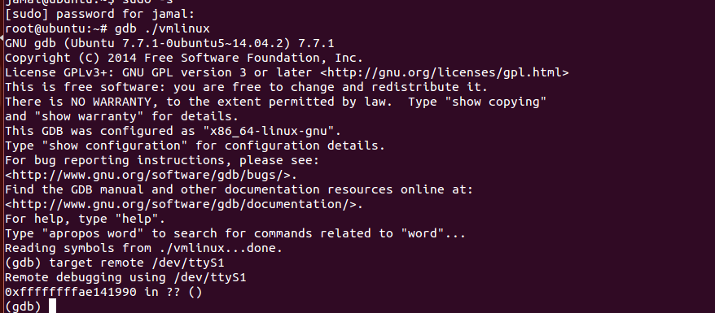
Setup on Host/Development Machine
1. Run the following commands:
gdb vmlinux
target remote /dev/ttyS1
continue

