Slide 1
AI-Squad
Abinash Pun
Nov-18, 2022

Slide 2
Business Problem
In cafeteria, a person with food in plate comes to camera and speaks: => charge them automatically
Steps for solving problem
Detect the food (amount and kind) in plate: Already Done
Identify the person
Face
Detect Face
Recognize the face (samples in data base)
Voice: Key word (?)

Slide 3
Face Recognition Pipeline
Face Detection:
Detect the presence of human face(s)
Alignment
Normalization
Representation (encoding=>embedded in feature space )
Represent image as vectors
Face Recognition
“Whose face is that?”=>Classification in feature space (?)
“face verification” with available images in database
Optional
Additional work before pipeline: Finding out if it is a real person, photo or video

Slide 4
Face Detection
Difficulties/Challenges of Detecting a Face
Occlusion (only a part of face is visible)
Lighting
Skin Color
Pose
Facial Expression
Accessories/Makeup/Facial Hair
Scale of Face

Slide 5

Algorithms of Face Detection (OpenCV library)
Classical
Haar Cascades (2001): Employing the line or edge-detection features
DLib-HOG (2005): Dlib uses the classical Histogram of Gradients (HoG) feature combined with a linear classifier, an image pyramid, and a sliding window detection scheme
Deep Learning based Face Detectors
SSD: Single Shot Multibox Detector
MTCNN: Multi-Task Cascaded Convolutional Neural Network.
Dual Shot Face Detector
RetinaFace
MediaPipe: ultrafast
YuNet
Even if frontal faces are not captured properly
With a model size of less than an MB, it can be loaded on almost any device.
Overall – Balanced speed and accuracy: YuNet and RetinaFace-Mobilenetv1 ( google collab)

Slide 6
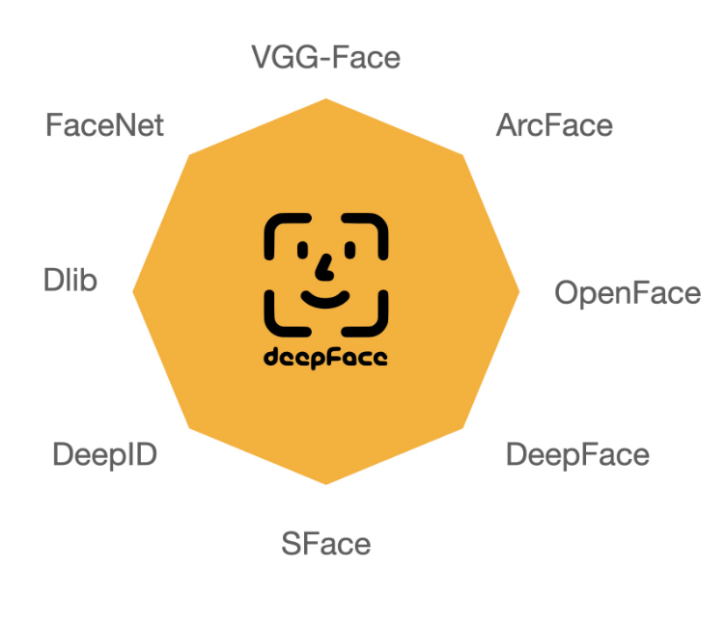

DeepFace
Light weight face recognition and facial attribute analysis (age, gender, emotion and race) framework for python
deepface is mainly based on TensorFlow and Keras.
Provides various face recognition models: VGG-Face, Google FaceNet, OpenFace, Facebook DeepFace, DeepID, ArcFace, Dlib and Sface
Provides interface to use algorithms of OpenCV

Slide 7
References
Face Detection:
https://learnopencv.com/what-is-face-detection-the-ultimate-guide/
Face Recognition:
https://learnopencv.com/face-recognition-an-introduction-for-beginners/
DeepFace:
https://github.com/serengil/deepface
https://viso.ai/computer-vision/deepface/

Slide 8
