Slide 1

SLIIT · FINAL PRESENTATION · R26-IT-152
Tour Ceylon
AI-Based Tourism Safety & Itinerary Platform for Sri Lanka
Four AI modules (emergency safety, itinerary planning, wellness matching and crowd risk) working together on one platform
De Silva D.S.K IT22108654
SOS Emergency Safety
Wanniarachchi P.M.R IT22225092
Itinerary Planner
De Silva D.C.M IT22108586
Wellness Matching
Abinaya R IT22090058
Tourism Risk Intelligence
Supervisor: Mr. S.M.B. Harshanath
Co-supervisor: Prof. Samantha Rajapaksha
Notes:
Good morning, everyone. We are Team R26-IT-152, and our project is Tour Ceylon. It is an AI-based platform for tourist safety and trip planning in Sri Lanka. It has four AI modules: emergency safety, itinerary planning, wellness matching, and crowd risk. Each module is built by one team member, and the modules work together on one platform. I will present the whole project today. I would like to thank our supervisor, Mr. Harshanath, and our co-supervisor, Prof. Rajapaksha.

Slide 2
PP2 COMMENTS AND ACTIONS TAKEN
Every PP2 comment was answered with evidence
De Silva D.S.K
Wanniarachchi P.M.R
SOS Emergency Safety
0.923
Itinerary Planner
6 inputs
“Better validate the result”
“Could not clearly explain how places are suggested from the other inputs”
Random Forest macro-F1 vs 0.783 keyword baseline (5-fold CV)
each mapped to a model; training workbooks, CV metrics, sample itineraries
Action: Added a keyword-rule baseline, 5-fold cross-validation and per-class F1 review
Action: Documented and demonstrated the full decision flow, with each input mapped to the model that uses it
De Silva D.C.M
Abinaya R
Wellness Matching
13
Tourism Risk Intelligence
37%
“Models seemed hardcoded; panel asked to see trained models”
“Better validate the result”
models retrained in a reproducible Colab notebook
lower MAE on unseen sites (0.1232 vs 0.1967 baseline)
Action: Retrained all 13 models from raw data in a Colab notebook; removed hardcoded metrics
Action: Tested on 10 unseen sites, added a mean-predictor baseline, audited the data (issues found and disclosed), verified the live API on 3 sites
Notes:
First, I will show how we answered the PP2 panel comments. For every comment, we added evidence.
For SOS safety, the panel asked us to validate the results. We added a keyword baseline and 5-fold cross-validation. Our Random Forest scores 0.923 macro-F1, compared with 0.783 for the baseline.
For the itinerary planner, the panel asked how places are suggested. We documented the full decision flow, and each input is mapped to the model that uses it.
For wellness matching, the panel wanted to see the trained models. We retrained all 13 models from raw data in a reproducible Colab notebook.
For crowd risk, the panel also asked for better validation. We tested on 10 sites the model had never seen. The error is 37 percent lower than the baseline, 0.1232 compared with 0.1967.

Slide 3
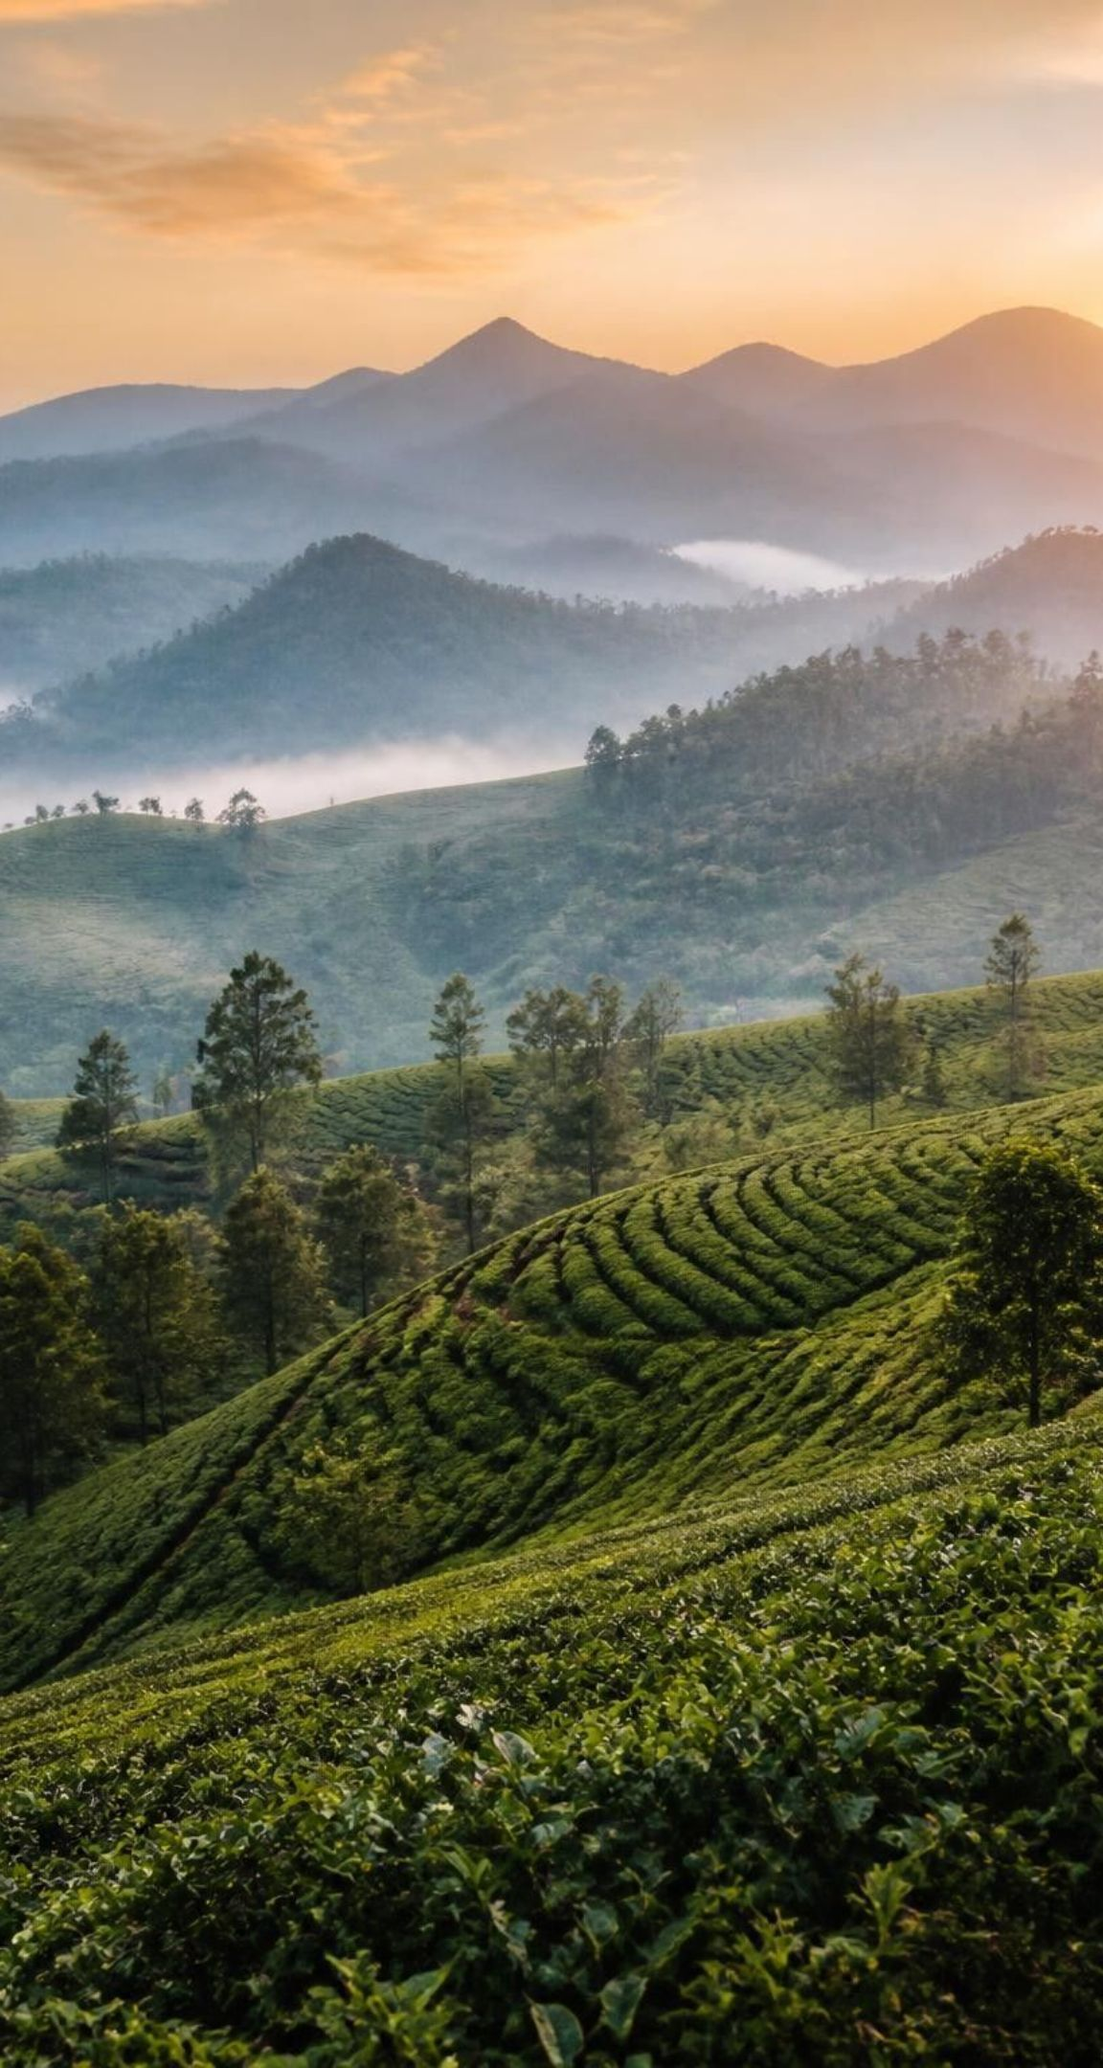




THE PROBLEM
2M+ tourists a year, fragmented support
Emergency help isn't built for tourists
No live GPS location and no multilingual support when something goes wrong
Itineraries ignore crowding
Plans send tourists to over-capacity sites such as Sigiriya and Ella
Wellness providers are unverified
Ayurveda and meditation centres are unregulated and hard to trust
Crowding is managed after the fact
Crowds are dealt with when they happen, not predicted in advance
Existing tools cover one gap each; to our knowledge, none brings all four together for Sri Lanka.
Notes:
Sri Lanka receives over 2 million tourists every year, but tourist support is fragmented. We found four gaps. First, emergency help is not built for tourists. There is no live GPS and no multilingual support. Second, itineraries ignore crowding, so tourists are sent to over-capacity places like Sigiriya and Ella. Third, wellness providers are unverified, so tourists find it hard to trust Ayurveda and meditation centres. Fourth, crowds are managed after they happen, not predicted before. Existing tools solve one gap each. To our knowledge, none solves all four for Sri Lanka.

Slide 4







OUR SOLUTION · INVENTIVE STEP
Four AI modules that feed each other on one platform
Personalised Itinerary Planner
Police Dashboard
Why it's better than existing tools
The traveller sees one plan: visits, hotels, budget
Integrated
Modules feed each other instead of four separate apps
Crowd badge on every visit
Centres become itinerary stops
GPS + incident type
Grounded, not generative
Plans use only a verified catalogue, so no hallucinated places
Crowd Risk
Wellness Matching
SOS Safety
Predicts Low / Med / High crowding
Verified Ayurveda & meditation centres
Voice / tap SOS with live GPS
Explainable
SHAP crowd explanations, per-factor wellness match %, transparent SOS risk rules
One shared backend and dataset
Shared tourist profile · verified attraction & hotel catalogue · one API
Honestly evaluated
Unseen-site holdout, baselines and disclosed limits
Notes:
Our solution is four AI modules on one shared backend. The shared backend holds one tourist profile, one verified catalogue of attractions and hotels, and one API. Crowd risk gives every visit a Low, Medium or High badge. Wellness matching adds verified centres as itinerary stops. SOS sends the location and the incident type to the police dashboard.
We believe this is better than existing tools for four reasons. It is integrated, because the traveller sees one plan, not four apps. It is grounded, because plans use only a verified catalogue, so places are never invented. It is explainable, because we use SHAP and clear rules. And it is honestly evaluated, because we use unseen-site tests, baselines, and disclosed limits.

Slide 5
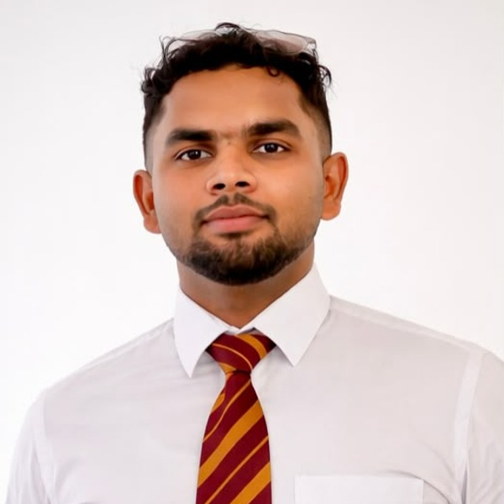




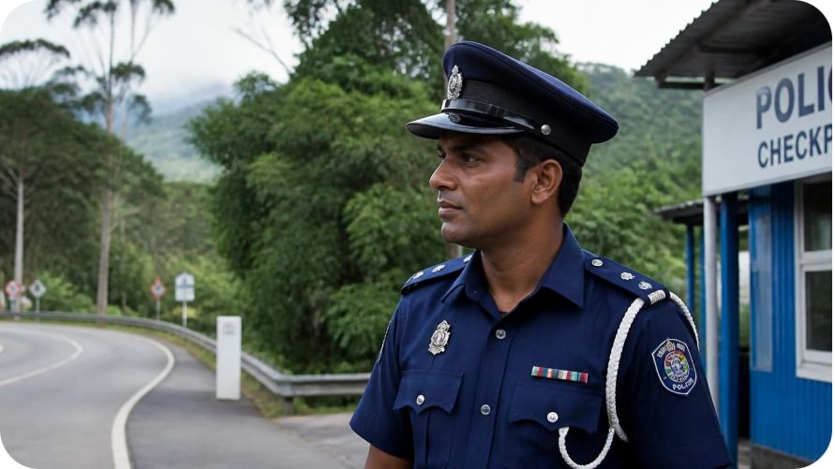
INDIVIDUAL COMPONENT · IT22108654 · De Silva D.S.K
SOS Emergency Safety System
AI-assisted tourist emergency detection and police response platform
1
2
3
4
5
Tourist triggers SOS
Speech to text + translate
Classify the incident
Route to nearest station
Police dashboard
One tap or voice, sent with live GPS location
Whisper speech-to-text; Sinhala / Tamil translation
Random Forest (TF-IDF + lexicon features) picks 1 of 15 incident types
Haversine distance to the closest police station
Live map, acknowledge, status, analytics; separate overstay alert for officer review
How it fits the platform
KEY RESULT
0.923
SOS location and incident type go straight to the police dashboard. It shares the backend and tourist profile with the other three modules.
Random Forest macro-F1 vs 0.783 keyword baseline (5-fold CV, 1,943 messages)
Notes:
The first component is SOS Emergency Safety .It was done by De Silva D S K. A tourist taps or speaks to send an SOS with live GPS. Whisper converts the speech to text, and we translate Sinhala and Tamil. A Random Forest classifies the incident into one of 15 types. Then we use Haversine distance to find the nearest police station. The police see everything on a live dashboard. The result is a macro-F1 of 0.923, compared with 0.783 for the keyword baseline

Slide 6





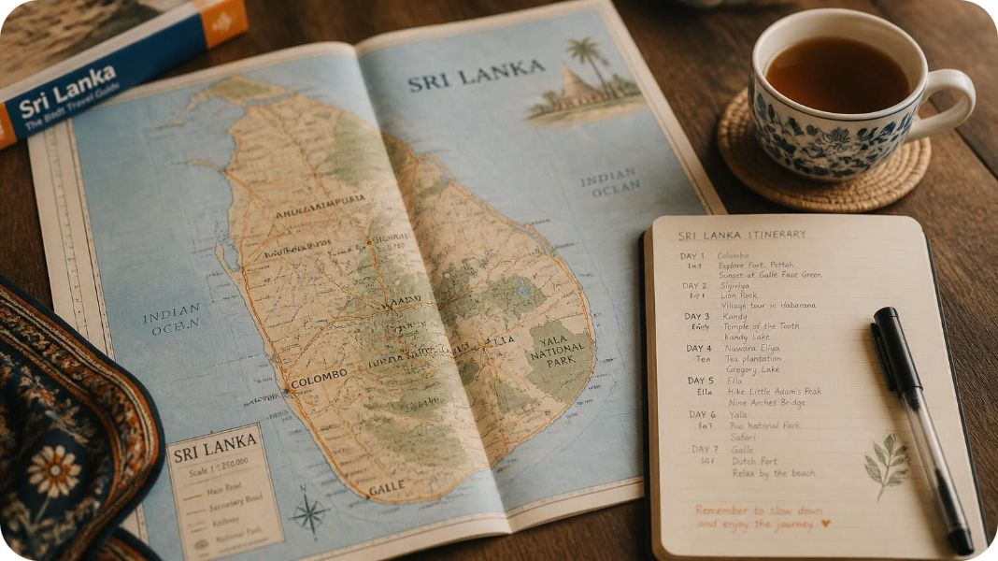
INDIVIDUAL COMPONENT · IT22225092 · Wanniarachchi P.M.R
PMR
Personalised Sri Lanka Itinerary Planner
From a few traveller inputs to a full day-by-day plan with hotels and a budget split
1
2
3
4
5
Traveller inputs
Rank attractions
Schedule visits
Match hotels
Full trip plan
Dates, total budget, free-text experience, comfort level, meal plan
Random Forest ranks attractions by relevance
Random Forest picks visit times with no overlaps
Random Forest scores distance, price, rating, comfort
Arrival, sightseeing and departure days + budget split; export to Excel or PDF
How it fits the platform
KEY RESULT
0.865
Each planned visit shows a Low / Medium / High crowd badge from the risk module's ranking, matched by attraction name.
Attraction ranking NDCG@10 (5-fold CV)
Notes:
The second module is the Itinerary Planner.It was done by Wanniarachchi P M R. The traveller enters dates, budget, the experience they want, a comfort level, and a meal plan. Three Random Forest models then work in sequence. The first ranks attractions, the second chooses visit times, and the third matches hotels. The output is a full day-by-day plan with a budget split. Attraction ranking scores 0.865 NDCG@10. Each visit also shows the crowd badge from our risk module.

Slide 7



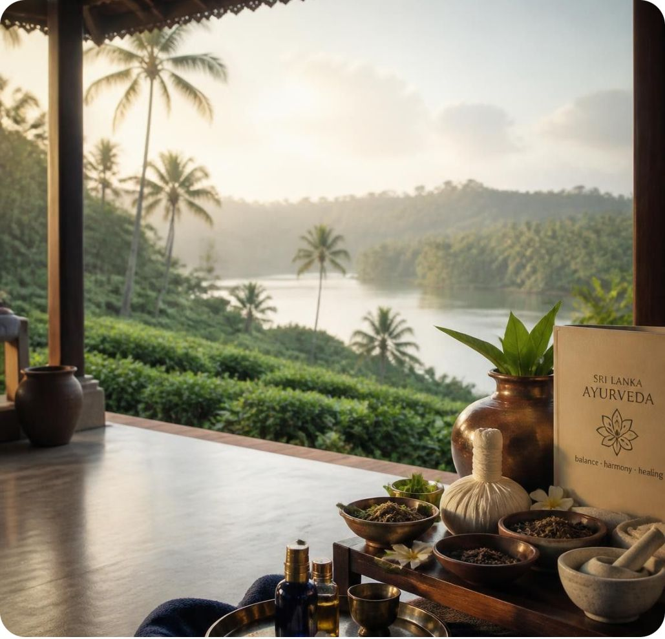
INDIVIDUAL COMPONENT · IT22108586 · De Silva D.C.M
Ayurvedic & Spiritual Wellness Matching
AI-based Ayurvedic and spiritual wellness tourism matching system
1
2
3
4
Predict dosha
Understand symptoms
Screen for safety
Match centres
Random Forest predicts the tourist's dosha
Classifies symptoms written in 5 languages
Screens centre reviews for safety concerns
Recommends the best-matching Sri Lankan Ayurveda / meditation centres
How it fits the platform
KEY RESULT
81%
Verified wellness centres are offered as stops inside the traveller's itinerary.
Dosha prediction accuracy (F1 0.794); 5-fold CV 84.3%
Notes:
“The third module is Wellness Matching. It was done by De Silva D.C.M .It predicts the tourist’s dosha using a Random Forest. It understands symptoms written in 5 languages. It screens centre reviews for safety concerns. Then it recommends the best-matching centres. Dosha accuracy is 81 percent, and cross-validation gives 84.3 percent. The verified centres appear as stops in the itinerary.

Slide 8



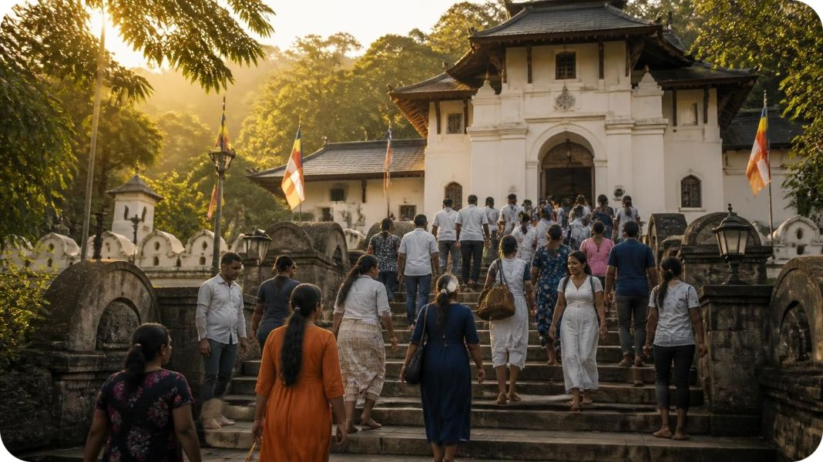
INDIVIDUAL COMPONENT · IT22090058 · Abinaya R
Tourism Risk & Context Intelligence
Predicts how crowded a Sri Lankan tourist site will be on a chosen date, before you go
1
2
3
4
5
Context features
Trained on 197 sites
Two Random Forests
Low / Medium / High
Explained with SHAP
Day, season, holidays & festivals, weather, capacity, site type, district
144,007 simulated daily records (2024 to 2025)
Regressor gives a crowd score; classifier gives the risk level
Risk level plus a recommendation with each prediction
Shows which features drive the model
How it fits the platform
KEY RESULT
37%
The itinerary page loads /api/risk/personalized-ranking and matches attraction names to show a Low / Medium / High crowd badge on each visit.
lower MAE than baseline on 10 unseen sites (0.1232 vs 0.1967)
Notes:
The fourth module is my component, Tourism Risk and Context Intelligence. It answers one question: how crowded will a tourist site be on the date I choose?
The input is context. This includes the day, the season, holidays and festivals, weather, site capacity, site type, and district. I trained the models on 144,007 simulated daily records for 197 sites, covering 2024 and 2025.
I use two Random Forests. The regressor gives a crowd score. The classifier turns it into a Low, Medium or High risk level, with a recommendation. I use SHAP to show which features drive each prediction, so the result is explainable.
The key result is on 10 sites the model had never seen. The error is 37 percent lower than the baseline. In the platform, the itinerary page shows this risk badge on every planned visit.

Slide 9
RESULTS
Every model is tested, not just trained
SOS Safety
Itinerary Planner
Wellness Matching
Crowd Risk
De Silva D.S.K
Wanniarachchi P.M.R
De Silva D.C.M
Abinaya R
0.923
0.865
81%
37%
macro-F1, Random Forest
attraction NDCG@10
dosha accuracy (F1 0.794)
lower MAE on 10 unseen sites
vs 0.783 keyword baseline
5-fold CV
5-fold CV 84.3%
0.1232 vs 0.1967 baseline
Accuracy 0.923 (baseline 0.777)
Medical F1 0.89 on 130 held-out messages
5-fold CV on 1,943 messages
Mood 88.2%, category 76.4%
Top hotel suitable 99.8%
Visit-time step accuracy 52.6%
Ablation: match quality 4.48 vs 3.85
Hotel letter + 2 centre endorsement letters
R² 0.333 (moderate)
Accuracy 77.3% (balanced 57.5%)
Random split (easier): R² 0.849
Notes:
This slide compares all four modules. SOS reaches 0.923 macro-F1. The planner reaches 0.865 NDCG@10. Wellness reaches 81 percent dosha accuracy. Crowd risk has 37 percent lower error on unseen sites.
For crowd risk, I want to be honest about the numbers. On unseen sites, R-squared is 0.333, which is moderate. On a random split, it is 0.849, but that test is easier because the model has already seen those sites. So I report the harder result as the main one.

Slide 10
TESTIMONIALS AND LIMITATIONS
Honest limits, and what comes next
Component | Limitation | Future work
SOS Safety De Silva D.S.K | Developer-written messages, not real distress reports; medical incidents mainly confused with drowning and accident | Real labelled statements and a field test
Itinerary Planner Wanniarachchi P.M.R | Labels generated from catalogues, not real travellers; visit-time model is weak (52.6%) | Real labelled trips
Wellness Matching De Silva D.C.M | Small, expert-informed dataset | Real tourist data
Crowd Risk Abinaya R | Simulated crowd data: the model learns the data's patterns, not real visitor behaviour. Weather, occupancy and flights are not site-specific. Only 10 holdout sites, so estimates are noisy. High-risk precision 0.57 | Real visitor counts, per-district weather, user acceptance test
Notes:
Every component has limits, and each has a next step. SOS uses developer-written messages, not real emergencies, so we need real labelled data and a field test. The planner’s labels come from catalogues, and its visit-time model is weak at 52.6 percent. Wellness has a small dataset, but it has a hotel letter and two centre endorsement letters.
For crowd risk, the main limit is simulated data. The model learns the patterns in the data, not real visitor behaviour. Weather, hotel occupancy, and flights are the same for every site on a date. We also tested on only 10 sites, so the estimates are noisy. Our next step is real visitor counts, district-level weather, and a user acceptance test

Slide 11
TOUR CEYLON · R26-IT-152
Thank you
Questions and discussion
Safer, smarter and less crowded travel in Sri Lanka, on one platform.
Notes:
In summary, Tour Ceylon brings safer, smarter, and less crowded travel to Sri Lanka on one platform. Thank you for listening. We are happy to answer your questions.

