Slide 1
E-learning Management System
Submitted by
Abinaya Biju
MCA S3. Guide:Dr.Annie Julie Joseph
HOD of Computer science

Slide 2
Content..
Introduction
Hardware Requirements
Software Requirements
Modules
Data Flow Diagram
Database design
Conclusion
Future Work
Reference

Slide 3
Introduction
The Internet has digitalized education, and due to COVID-19, the trend of online education has been boosted.
You don’t need to go to any educational institution to learn a skill. You can learn by sitting at home.
This platform is designed to provide an online video learning experience.
Teachers upload videos in playlists, and students can watch, comment, and save videos.
The student dashboard is the main interface where students can access all videos uploaded by teachers.

Slide 4
Introduction
To create a seamless, user-friendly experience that enhances online learning and encourages collaboration between students and teachers.
A dynamic, accessible platform that supports self-paced learning and improves teacher-student communication.

Slide 5
Introduction
Key Features: Video Playlists uploaded by Teachers Comments & Feedback Student Engagement Tracking
Browse Playlists View and Watch Videos Comment on Videos Save and Like Videos

Slide 6
Hardware Requirements
Processor - Intel core i3
RAM- 4 Gb
Hard Disk -10 Gb

Slide 7
Software Requirements
Operating system: Windows 7 or Above
Application Server: Xamp
Front End: HTML ,CSS
Scripts: JavaScript
Back End: PHP
Database: MySQL

Slide 8
Modules
1.ADMIN MODULE:
Add tutor
Contact
2.STUDENT MODULE:
View video
Playlist save
Add Comment
Search course
Likes

Slide 9
Modules
3.TEACHER MODULE:
View comments
Upload video
Likes view
Reply comment
Playlist creating
Content Adding

Slide 10
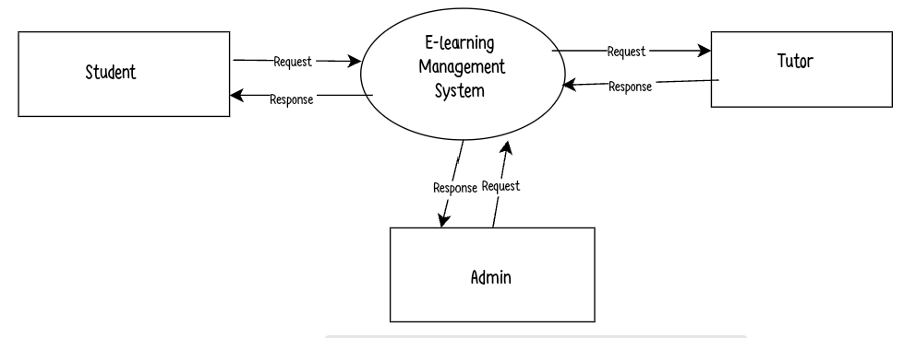
Data Flow Diagram
Level 0 Diagram

Slide 11
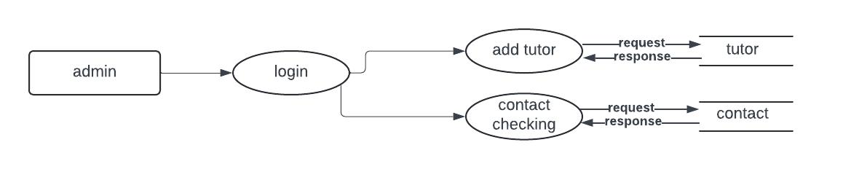
Data Flow Diagram
ADMIN DFD

Slide 12
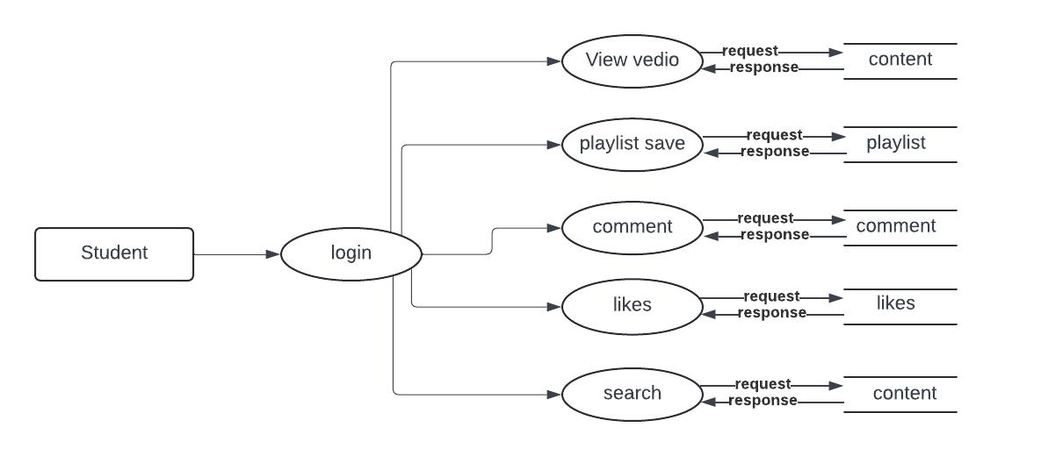
Data Flow Diagram
STUDENT DFD

Slide 13
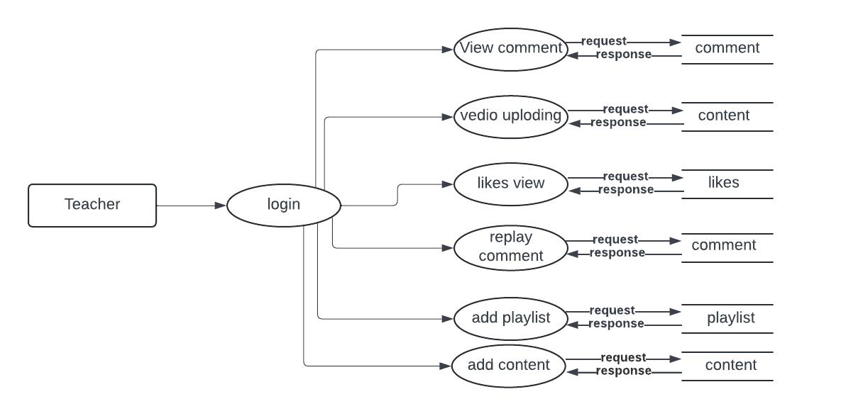
Data Flow Diagram
TEACHER DFD

Slide 14
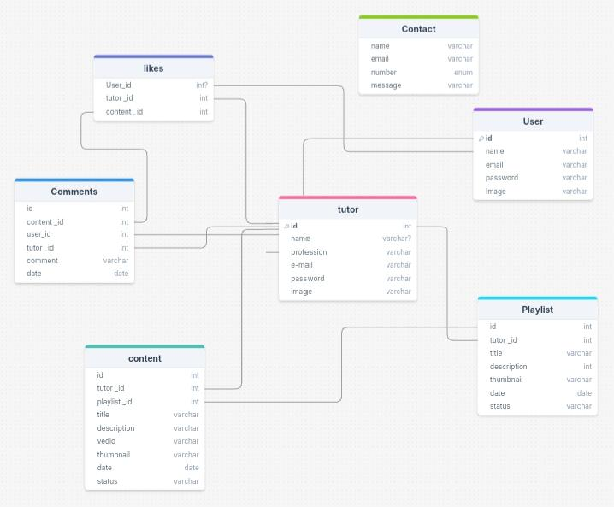
Database Design

Slide 15
Conclusion
This video streaming e-learning system enables teachers to easily upload video playlists, track student views, and receive feedback, while students can watch, comment, like, and save videos for a more interactive learning experience.
The platform streamlines the process for students to access and engage with video content anytime, anywhere.
The platform provides an efficient, user-friendly environment, fostering better communication and engagement between teachers and students, making learning more accessible and convenient

Slide 16
Future Work
Implement AI-powered analytics to track student engagement and learning progress
Add quizzes, polls, and gamification to make video learning more engaging
Integrate live streaming and virtual classrooms for real-time interactions
Enable automatic video transcriptions, translations, and AI-powered summaries
Adopt server less cloud architecture for cost-effective scalability

Slide 17
References
https://youtu.be/QZ6Oz1z7XSU?si=g0PTwPnrm-5wUpYF
https://sist.sathyabama.ac.in/sist_naac/documents/1.3.4/b.sc-cs-batchno-27.pdf

