Slide 1
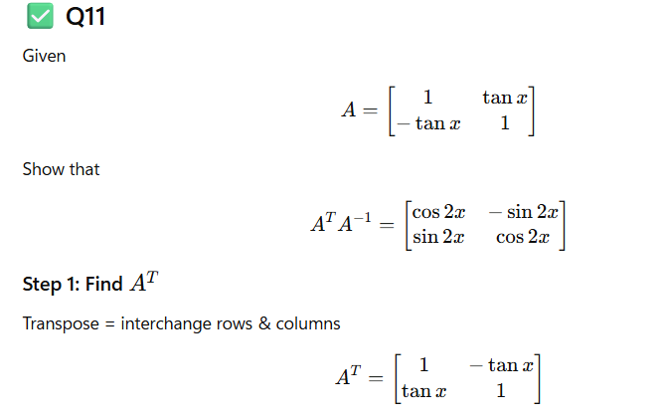

Slide 2
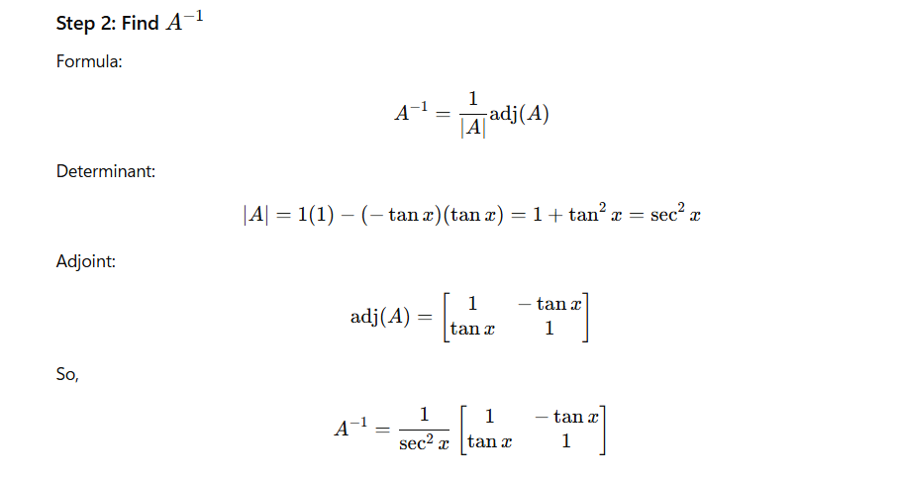

Slide 3
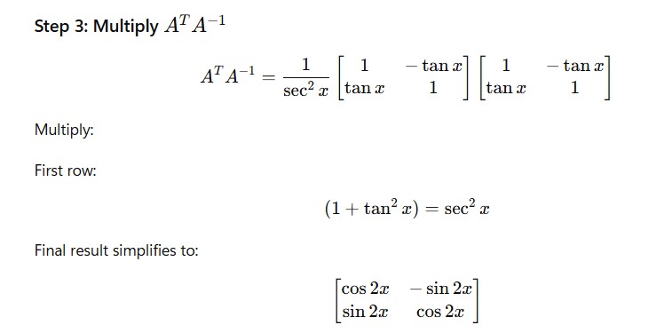
Dossier Ceramics
POTTERY, TABLEWARE & TILES.

Slide 4
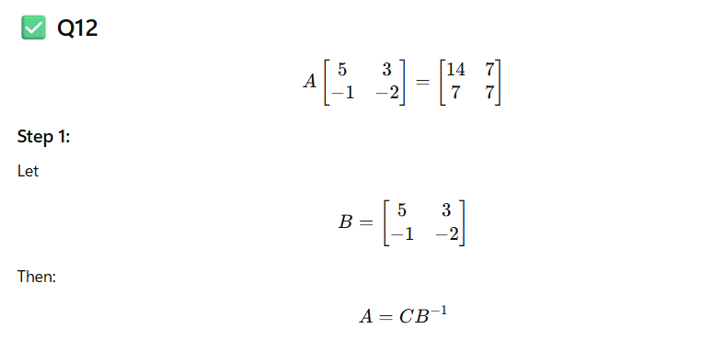
Dossier Ceramics
POTTERY, TABLEWARE & TILES.

Slide 5
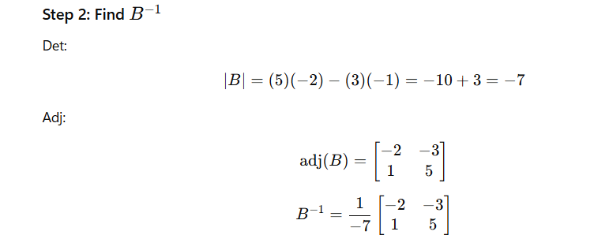
Dossier Ceramics
POTTERY, TABLEWARE & TILES.

Slide 6
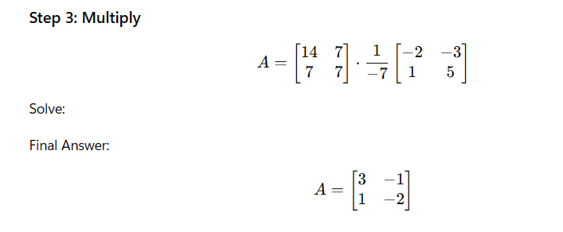
Dossier Ceramics
POTTERY, TABLEWARE & TILES.

Slide 7
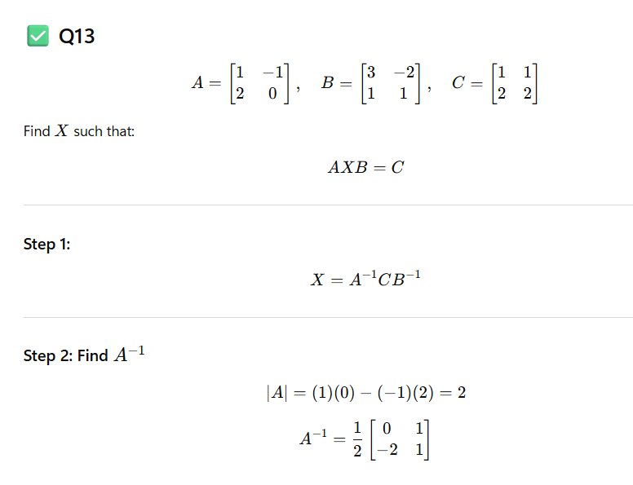
Dossier Ceramics
POTTERY, TABLEWARE & TILES.

Slide 8
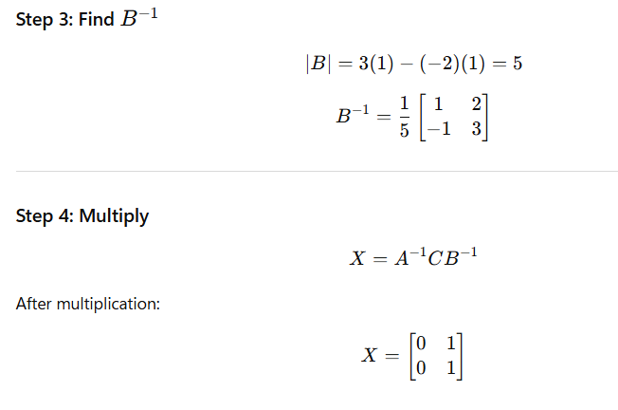
Dossier Ceramics
POTTERY, TABLEWARE & TILES.

Slide 9
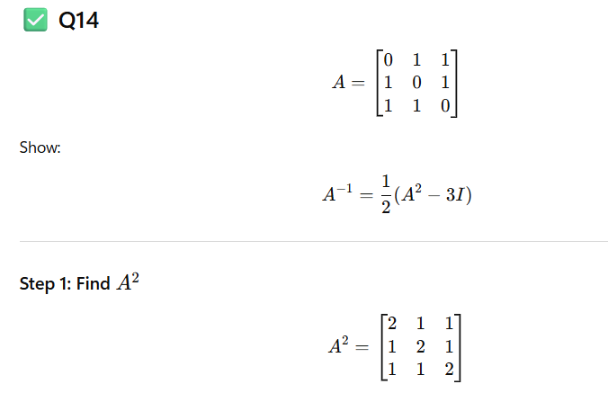
Dossier Ceramics
POTTERY, TABLEWARE & TILES.

Slide 10
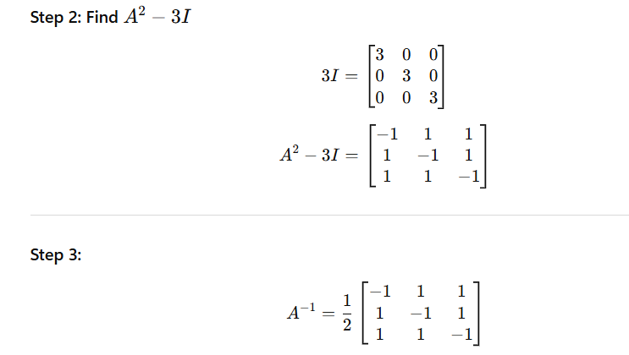
Dossier Ceramics
POTTERY, TABLEWARE & TILES.

Slide 11
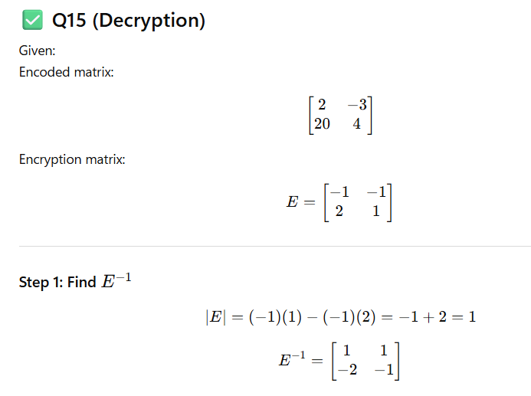
Dossier Ceramics
POTTERY, TABLEWARE & TILES.

Slide 12
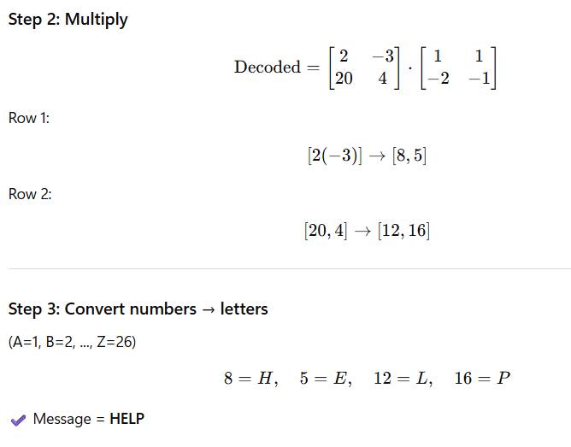
Dossier Ceramics
POTTERY, TABLEWARE & TILES.

