Slide 1



INVERSE OF A NON-SINGULAR
SQUARE MATRIX
Exercise 1.1

Slide 2




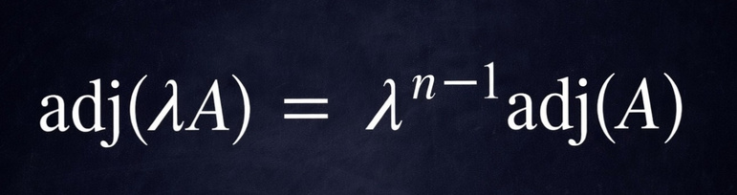
Finding adjoint of the Matrix:
T
*
Adj of matrix=[cofactor of matrix]
We get cofactor of the matrix by eliminating each rows and columns
Transpose T -interchanging the rows and columns
a
b
d
c
A
=
cofactor of A =
c
d
b
a
+
-
+
-
+
Sign conversion:
+
-
+
-
-
2x2
+
-
+
3x3
*
is used when
Y
is given in
the matrix

Slide 3


Finding the inverse of matrix :
-1
/
step 1: check |A| =
0,
then A exists
step 2 : apply the formula -
verifying Orthogonal matrix :
-1
-1
A A = A A = I
T
T
A A = A A = I
-1
T
A = A
3

Slide 4
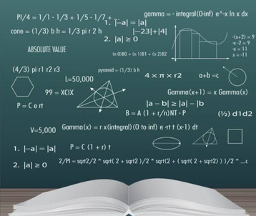
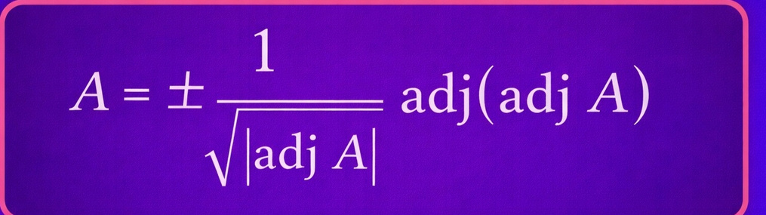


Finding A from adj(A) :
Finding A inverse from adj(A) :
4

