Slide 1
ABINAYA P
Final Project
3/21/2024 Annual Review

Slide 2
PROJECT TITLE
Medical Image Segmentation
3/21/2024 Annual Review

Slide 3


AGENDA
Problem Statement
Project Overview
Who are the end users?
Solutions and value of propositions
WOW factor in the solution
Modelling
Results
3/21/2024 Annual Review

Slide 4

PROBLEM STATEMENT
The manual segmentation of blood vessels in retinal images is a labor-intensive and time-consuming task for ophthalmologists. The process involves meticulous delineation of blood vessels, which is prone to human error and subjectivity. Moreover, the delay in analyzing retinal images can hinder the early detection and timely treatment of various retinal diseases, including diabetic retinopathy and age-related macular degeneration. Therefore, there is a pressing need for automated solutions that can accurately segment blood vessels in retinal images, facilitating faster diagnosis and treatment.
3/21/2024 Annual Review

Slide 5

PROJECT OVERVIEW
Our project aims to address the challenges associated with manual blood vessel segmentation in retinal images by developing an automated solution based on Convolutional Neural Networks (CNNs). By leveraging deep learning techniques, we intend to create a robust and efficient system capable of accurately delineating blood vessels in retinal images. This automated approach will significantly reduce the time and effort required for image analysis, enabling healthcare professionals to make quicker and more informed decisions regarding the diagnosis and treatment of retinal diseases.
3/21/2024 Annual Review

Slide 6

WHO ARE THE END USERS?
The end users of the automated blood vessel segmentation system primarily consist of ophthalmologists, retina specialists, healthcare institutions, and medical researchers. Ophthalmologists and retina specialists heavily rely on accurate retinal image analysis for diagnosing and monitoring various retinal diseases such as diabetic retinopathy and macular degeneration. Automated segmentation aids in faster diagnosis and treatment planning.
Healthcare institutions benefit from streamlined workflows in ophthalmic clinics and hospitals, improving efficiency and resource management. Automated segmentation reduces manual labor and potential errors in image analysis, leading to better patient care.
3/21/2024 Annual Review

Slide 7

YOUR SOLUTION AND ITS VALUE PROPOSITION
Accuracy: By utilizing state-of-the-art deep learning techniques, our system can accurately segment blood vessels in retinal images, reducing the risk of human error and ensuring reliable results.
Efficiency: The automated nature of our solution significantly reduces the time and effort required for blood vessel segmentation, allowing healthcare professionals to analyze images more quickly and efficiently.
Early Detection: By enabling faster analysis of retinal images, our system facilitates the early detection of retinal diseases, which is crucial for initiating timely treatment and preventing vision loss.
Enhanced Diagnosis: With precise blood vessel segmentation, our solution provides healthcare professionals with valuable insights into the structural changes occurring in the retina, aiding in the diagnosis and monitoring of retinal diseases.
Cost-Effectiveness: By automating the segmentation process, our solution helps healthcare facilities save time and resources associated with manual image analysis, ultimately leading to cost savings.
3/21/2024 Annual Review

Slide 8

THE WOW IN YOUR SOLUTION
The "wow" factor in our solution lies in its ability to leverage cutting-edge Convolutional Neural Networks (CNNs) to accurately and efficiently segment blood vessels from retinal images. By harnessing the power of deep learning, our system achieves remarkable precision and speed in identifying intricate structures within the images, surpassing traditional manual segmentation methods.The automation of blood vessel segmentation not only expedites the diagnostic process but also enhances the overall quality of patient care by providing timely and precise insights.
Furthermore, the versatility of our system allows for scalability and adaptation to various retinal imaging modalities and clinical settings. Its potential to revolutionize the field of ophthalmology by enabling earlier detection, accurate monitoring, and personalized treatment strategies for retinal diseases is truly remarkable, making it a standout solution in the medical imaging domain.
3/21/2024 Annual Review

Slide 9
MODELLING
1. Data Collection: Obtain the DRIVE dataset comprising retinal images and manual vessel segmentation masks.
2. Data Preprocessing: Normalize and resize images, convert masks to binary format for pixel-wise segmentation.
3. Model Development: Construct a U-Net architecture for semantic segmentation, consisting of encoder and decoder pathways.
4. Model Training: Split dataset into training and validation sets, employ binary cross-entropy loss, and monitor training progress.
5. Model Evaluation: Assess performance on validation set using metrics like Dice coefficient, Intersection over Union (IoU), and accuracy.
6. Prediction on New Data: Demonstrate model's utility by segmenting blood vessels in new retinal images, showcasing real-world applicability.
7. Tools and Libraries: Utilize Python with TensorFlow and Keras for deep learning, OpenCV for image processing, NumPy for numerical operations, and Matplotlib for visualization.
3/21/2024 Annual Review

Slide 10
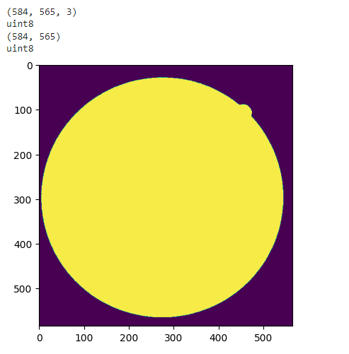
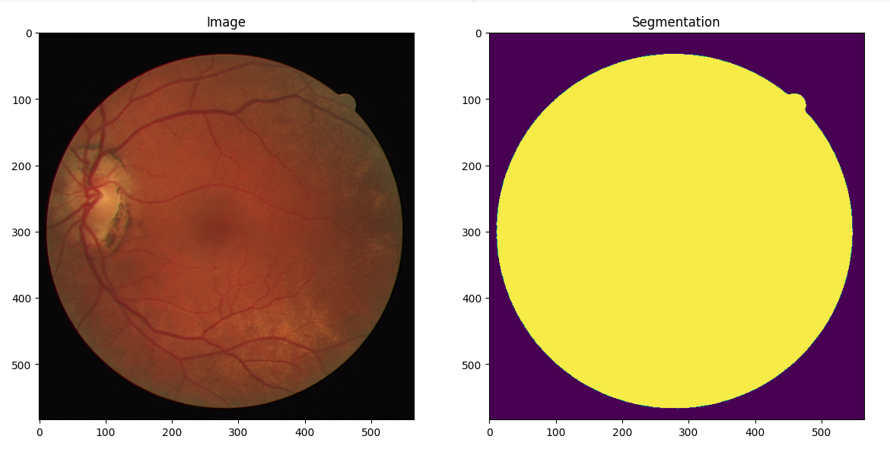
RESULTS
3/21/2024 Annual Review

