Slide 1
Project Title: [ECHO PULSE - SMART CAMPUS INNOVATION]
VIBEAITHON-2025
Team Innovez| Hackathon 2025

Slide 2
Problem Statement
The Living Pulse of a Sustainable Campus
Despite growing awareness of sustainability, most college campuses still struggle with invisible energy and resource wastage.
Smart meters collect raw data, but the insights never reach the people who can make the biggest difference — students, faculty, and staff.
Energy and water are wasted daily due to lights, fans, and ACs left running in empty rooms.
Manual audits and delayed reports prevent timely action on leaks or overuse.
Lack of real-time visibility disconnects individuals from the impact of their actions.
Students are unengaged — sustainability feels abstract, not actionable or rewarding.

Slide 3
Solution Overview
EcoPulse transforms the campus into a living, intelligent ecosystem that senses, learns, and adapts in real time.
IoT Monitoring: Smart sensors track energy, water, and waste across campus facilities.
AI Intelligence: Detects anomalies, forecasts usage, and recommends efficiency actions.
Gamified EcoSphere: Departments compete through eco-scores and Green Leagues.
AR/VR EcoTwin: A 3D digital twin visualizes resource flow and sustainability health.
EcoNudge Chatbot: Provides real-time tips and personalized eco-suggestions.

Slide 4
Desirability (User Need)
Target Users:
Students, faculty, and administrators who engage daily with campus infrastructure.
Pain Points:
No visibility into real-time energy or water use.
Lack of feedback linking actions to environmental impact.
Sustainability feels abstract and unmotivating.
User Need:
A simple, engaging, and data-driven way to visualize and influence campus sustainability.
EcoPulse Solution:
Transforms complex data into live dashboards and eco-challenges, making sustainability visible, interactive, and rewarding for everyone.

Slide 5
Feasibility (Can You Build It?)
Technology Stack:
ESP32 sensors for data collection
Node.js backend with MQTT for real-time updates
Firebase / InfluxDB for data storage
React.js frontend with AR.js for visualization
Python AI models for prediction and anomaly detection
System Workflow:
IoT devices collect and send data to the backend
AI analyzes patterns and detects inefficiencies
Dashboard displays real-time metrics and insights
Team Capability:
Team Innovez skilled in IoT, AI, and web development
Experienced in cloud integration and full-stack prototyping
Feasibility:
Prototype uses simulated live data for demo
Fully buildable and deployable within hackathon duration

Slide 6
Viability (Is It Sustainable?)
Sustainability Model:
Promotes long-term resource efficiency and eco-awareness.
Reduces campus energy and water waste by 30–40%.
Scalability:
Modular IoT design allows easy expansion across buildings or campuses.
Can integrate with existing smart campus or city infrastructure.
Cost Efficiency:
Low-cost sensors and cloud setup minimize implementation expenses.
Uses open-source tools for affordability and flexibility.
Future Potential:
Can be adopted by schools, universities, and corporate campuses.
Offers a scalable model for national smart campus initiatives.

Slide 7
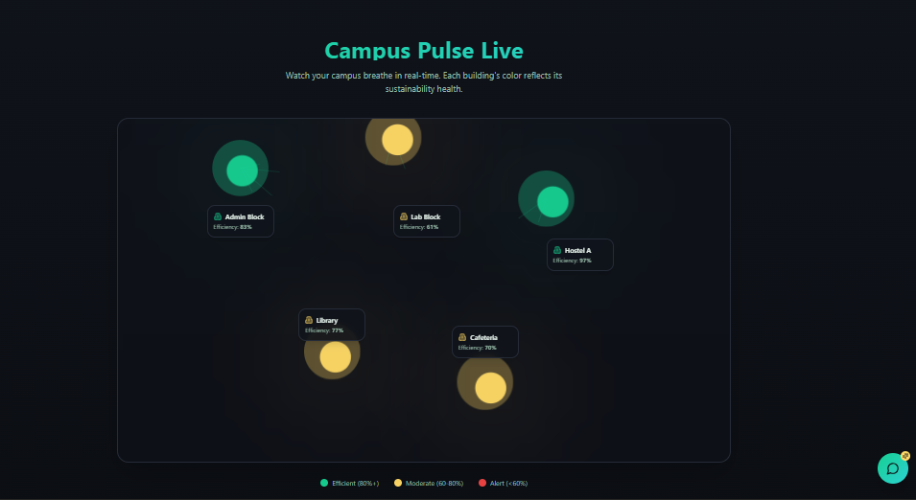
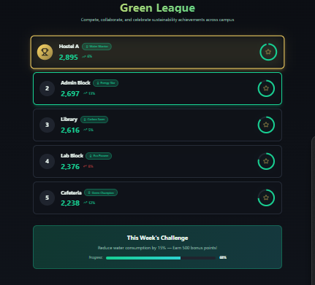
Prototype / Demo

Slide 8
Roadmap
Current Progress:
Built prototype with simulated IoT data and live dashboard.
Designed AI logic for anomaly detection and energy forecasting.
Next 30 Days:
Connect real sensor data to backend.
Test live data visualization and leaderboard features.
Next 60 Days:
Integrate AI EcoNudge chatbot and AR/VR visualization.
Conduct pilot testing in selected campus zones.
Next 90 Days:
Full deployment across campus.
Collect feedback and refine predictive models.
Long-Term Vision:
Expand EcoPulse to multiple institutions.
Evolve into a national-level Smart Campus Sustainability Network

Slide 9
Team & Roles
Name | Role | Skillset / Background
Abinaya R | Backend & Cloud Developer | Develops Node.js APIs, manages Firebase, and ensures secure, scalable data handling
Gayathri T | AI/ML Specialist | Builds predictive models in Python for energy forecasting and anomaly detection
Parkavi B | IoT Systems Engineer | Integrates sensors (ESP32), manages MQTT communication, and real-time data flow.
Shanmugapriya V | Frontend Developer & UI/UX Designer | Designs responsive dashboards using React.js and Tailwind; focuses on user experience.

Slide 10
Ask
Mentorship: Guidance from experts in IoT, AI, and sustainability.
Feedback: Insights on usability, scalability, and engagement features.
Partnerships: Collaboration with universities or smart campus programs.
Funding / Support: Help with IoT hardware and pilot deployment.
Goal: Turn EcoPulse into a scalable, real-world smart campus sustainability model.

Slide 11
Thank You
Team LinkedIn Profiles:
Abinaya R: https://www.linkedin.com/in/abinaya-r-083a1230b/
Gayathri T: linkedin.com/in/gayathri-t-0743982a4
Parkavi B: https://www.linkedin.com/in/parkavi-balachander-a6a1b42a4/
Shanmugapriya V: https://www.linkedin.com/in/shanmugapriya-v-31a778299/
GitHub Profiles:
Abinaya R: https://github.com/abinaya2209
Gayathri T: github.com/Gayathri20-23
Parkavi B: https://github.com/parkavi1512
Shanmugapriya V: https://github.com/shanmugapriya-207
Emails:
Abinaya R: abeenaya2205@gmail.com
Gayathri T: gayathrithirumurugan2006@gmail.com
Parkavi B: parkaviparku12@gmail.com
Shanmugapriya V: shanmugapriyavenkatesh2006@gmail.com

