Slide 1

A smart access control through number plate
Guided by
Mr. P. Paulraj M.E

Slide 2
Abstract
The platform is automated with number plate recognition based on images of vehicles.
This main proposes of a project is automatic gate access controlling system which scans the vehicle plate numbers using a camera

Slide 3
Software Requirements
Python 3.8.6
Tesseract

Slide 4
Existing System
Manual work is required so to overcome these shortcomings
Number plate recognition (NPR) Cameras: Cameras are placed at the entrance and exit points of the building
Image Processing Software: The images captured by the NPR cameras are processed using image processing software.

Slide 5
Proposed System
Database of Authorized Vehicles: The system maintains a database of authorized vehicles and their corresponding license plate numbers.
They are designed to capture images of the number plates of vehicles entering or leaving the premises

Slide 6
ADVANTAGES
Enhanced security
Efficiency
Cost effective
Customizable access
Real time monitoring

Slide 7
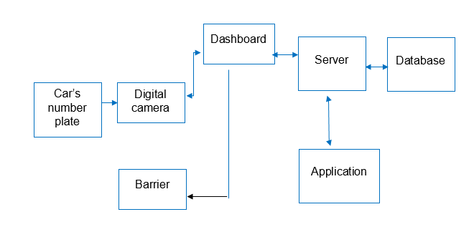
Block Diagram

Slide 8
Modules
Segmentation
Identification
Authentication

Slide 9

Segmentation
This module is responsible for capturing high-quality images of number plates of vehicles entering or exiting the building.
The Image Acquisition module and extracting the license plate information from them.

Slide 10
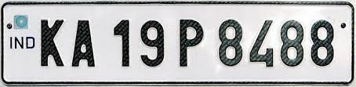
Identification
To recognize and extract the number plate information accurately
This module is responsible for storing the number plate information of authorized vehicles in a database.

Slide 11

Authentication
The system checks whether the vehicle is enter the building by comparing the number plate with a database .
If the vehicle is authorized, the system allows access to the building, for example, by opening gates or barriers.

Slide 12
System Implementation
Software installation: The next step is to install the software components of the system, including the image processing and recognition software, number plate database management software, and notification software, on the processing units

Slide 13
System implemention
Database setup: The database should be set up with the necessary fields to store the number plate numbers, vehicle owner names, and access privileges.

Slide 14
System Implementation
Configuration: Once the software and database are installed, the system needs to be configured according to the building's access control requirements..

Slide 15
System implementation
Testing and calibration: After configuration, the system needs to be tested and calibrated . This includes adjusting the camera angles, lighting, and other parameters to optimize the system’s performance.

Slide 16
System implementaion
Maintenance and updates: Finally, the system requires regular maintenance and updates to ensure that it continues to function efficiently and securely.

Slide 17
Python packages
Pip(Preferred Installer Program)
Numpy(Numerical Python)
Pandas
Open-cv(Open Source Computer Vision)
Tesseract
Imutils(Image Utilization)
Pytesseract

Slide 18
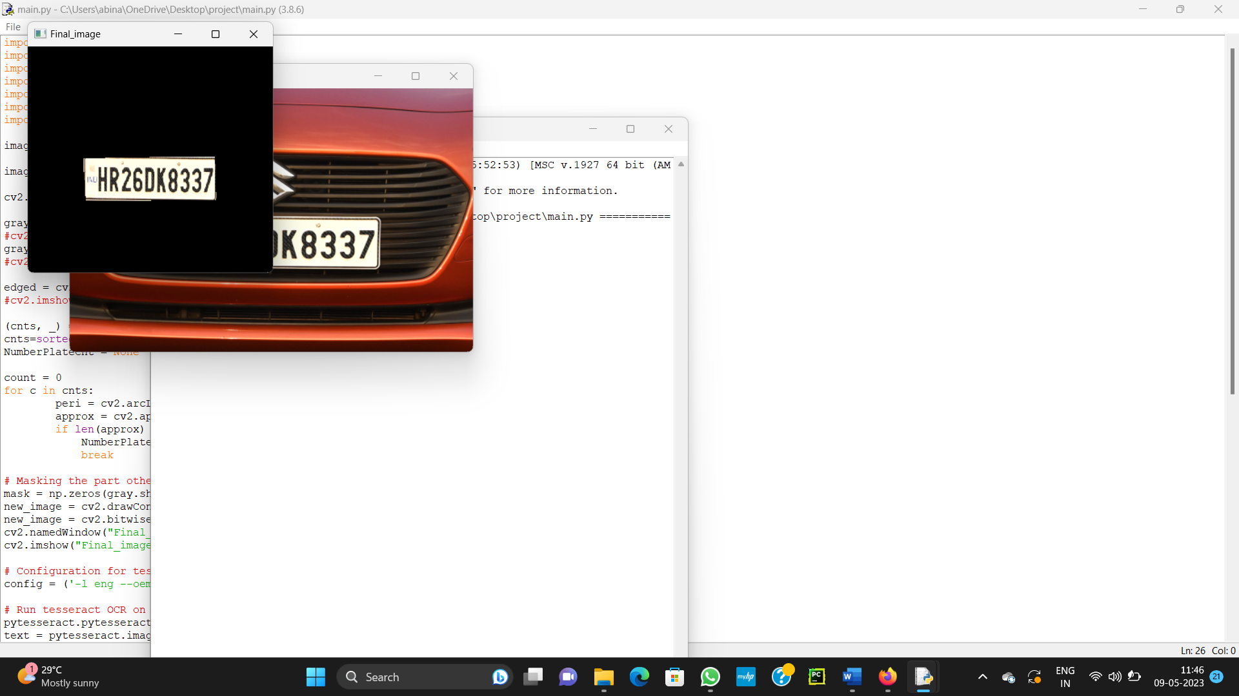
Output of the program

Slide 19
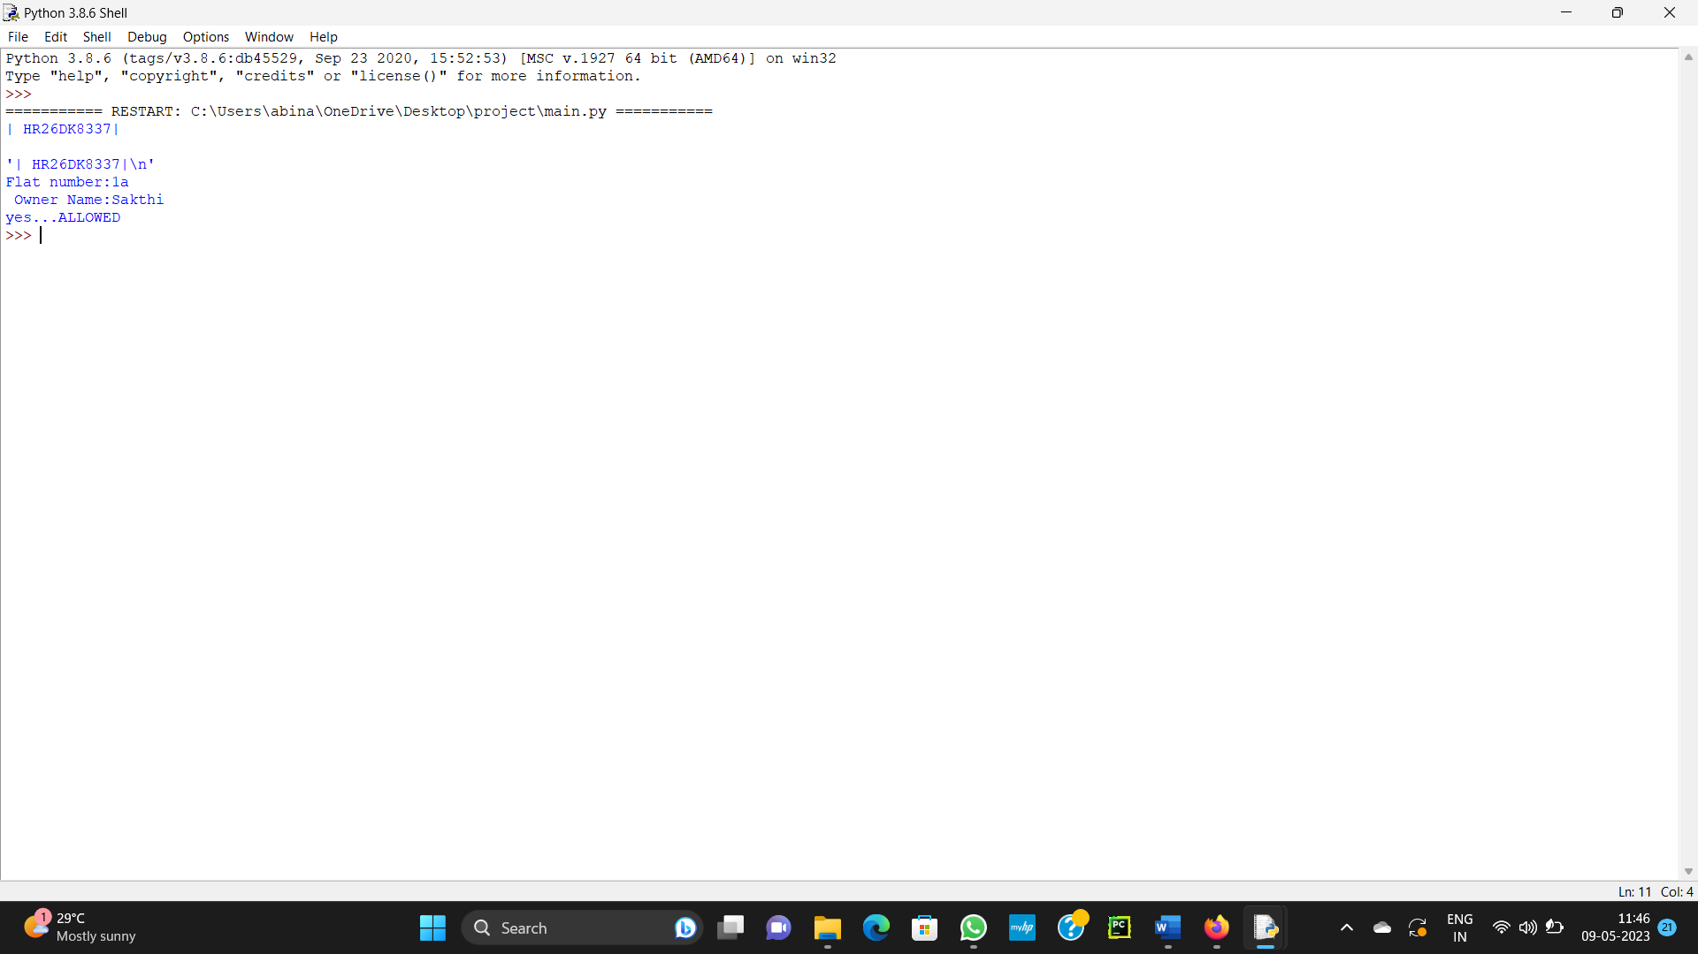
Output of the program

Slide 20
Conclusion
It can be a highly effective way to secure buildings
It eliminates the need for physical security guards to check vehicle access manually

Slide 21
REFERENCE
Smart Parking and Access Control System using ANPR" by R. Nithya and M. Saravanan. This paper provides an overview of a smart parking and access control system that uses automatic number plate recognition (ANPR) technology.

