Slide 1
Library AI Agent
CAPSTONE PROJECT
Presented By:
1. Abinaya Arumugam-Anna University Regional Campus,Coimbatore-AI&DS

Slide 2
OUTLINE
Problem Statement
Proposed System/Solution
System Development Approach
Algorithm & Deployment
Result
Conclusion
Future Scope
References

Slide 3
Problem Statement
In academic environments, students often face difficulties in locating the most relevant learning resources from vast library collections. Manual search is time-consuming and inefficient. The challenge is to build an AI-powered Library Agent that understands student needs, analyzes academic data like course syllabus and topics, and suggests the most suitable books. The system should also handle real-time availability, prioritization of high-demand titles, and assist in reservations or waitlists..

Slide 4
Proposed Solution
The proposed system is a Library AI Agent that:
Uses Natural Language Processing (NLP) to understand student queries.
Analyzes user profiles, course syllabi, and study topics.
Recommends books/resources from the library database.
Tracks real-time book availability and manages reservations or waitlists.
Personalizes recommendations to enhance academic efficiency and engagement.

Slide 5
System Approach
System Requirements:
IBM Cloud (mandatory)
IBM Watson/NLP (Granite)
IBM Cloud Object Storage for dataset handling
Libraries/Tools:
IBM Granite LLM
Watson NLP Services

Slide 6
Algorithm & Deployment
Algorithm:
NLP-based semantic similarity and intent classification
Query processing with IBM Granite
Rule-based & AI-based recommendation ranking
Book prioritization based on availability and demand
Deployment:
Hosted on IBM Cloud Lite
NLP queries handled by IBM Granite or Watson

Slide 7
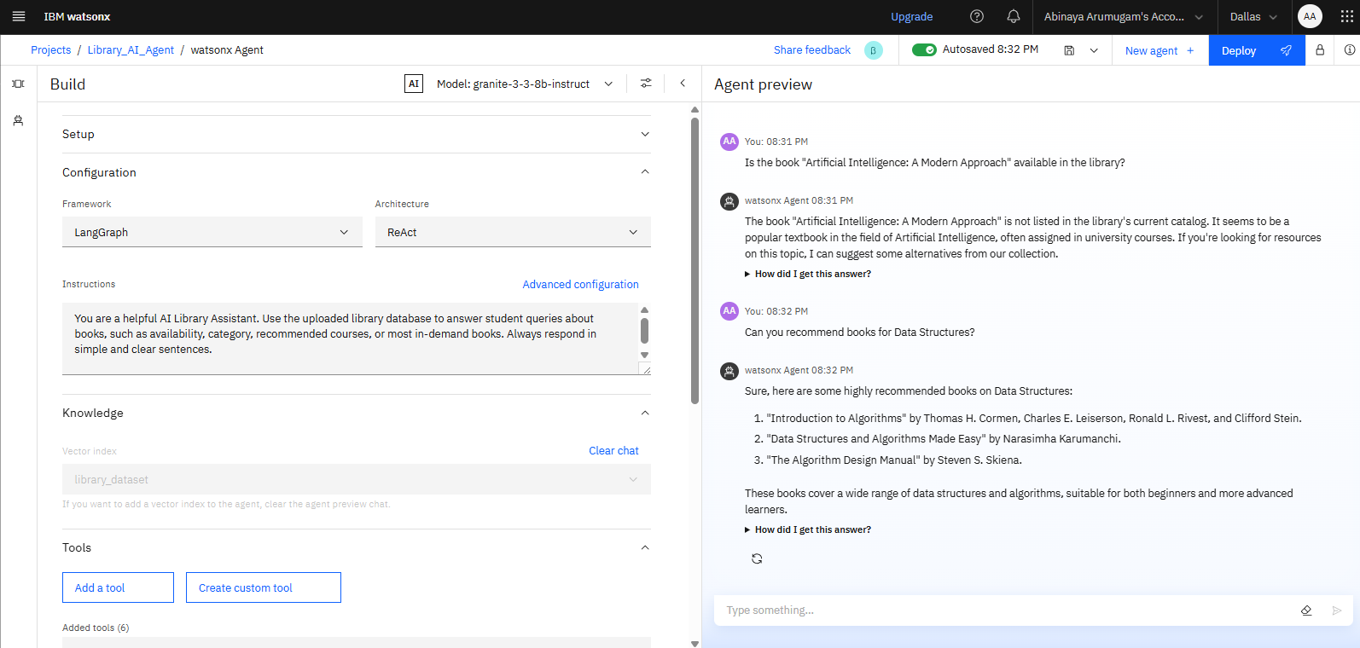
Result

Slide 8
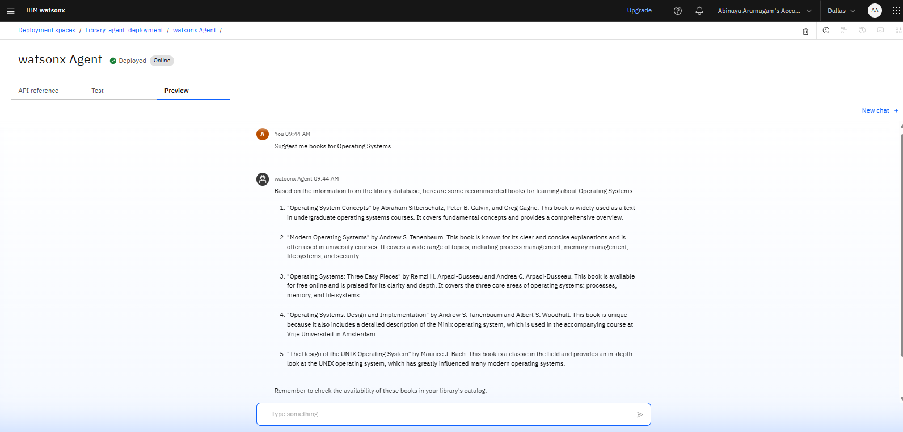
RESULT

Slide 9
Conclusion
The Library AI Agent simplifies book discovery and saves students valuable time by offering personalized recommendations through AI and NLP. It enhances access to academic resources and improves student-library interaction. This solution demonstrates how combining AI, NLP, and cloud technologies can effectively address real-time educational challenges and boost learning efficiency.

Slide 10
Future scope
Multi-language NLP support
Mobile application integration
Voice-command-based search assistant
Integration with e-learning platforms
Expanded to university-wide or inter-library systems

Slide 11
References
IBM Watson NLP Docs
IBM Granite AI Overview
Research on Recommender Systems in Libraries
Smart India Hackathon 2025 Problem Statement PDF

Slide 12
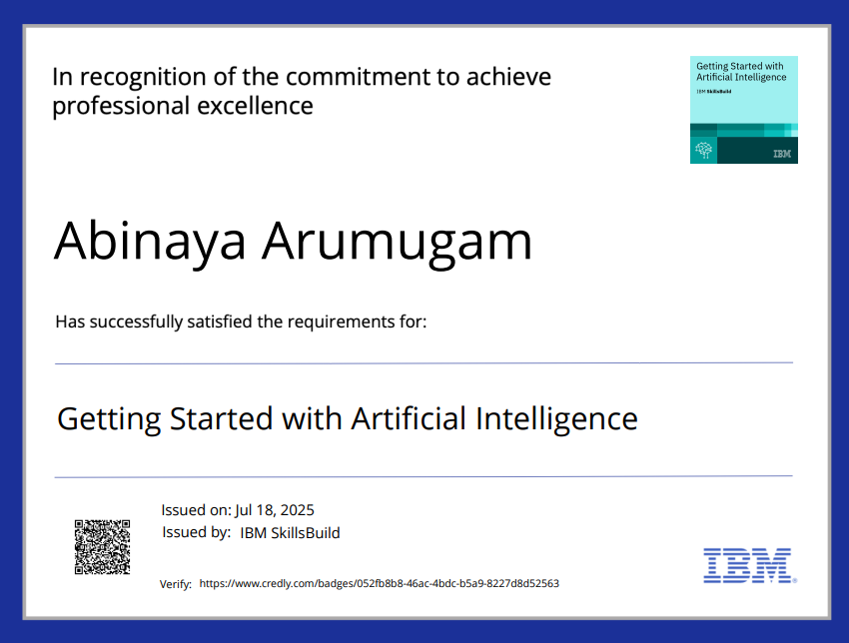
IBM Certifications

Slide 13
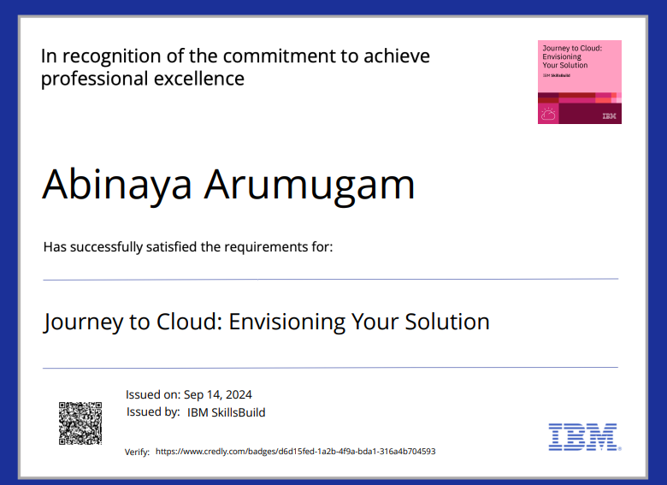
IBM Certifications

Slide 14
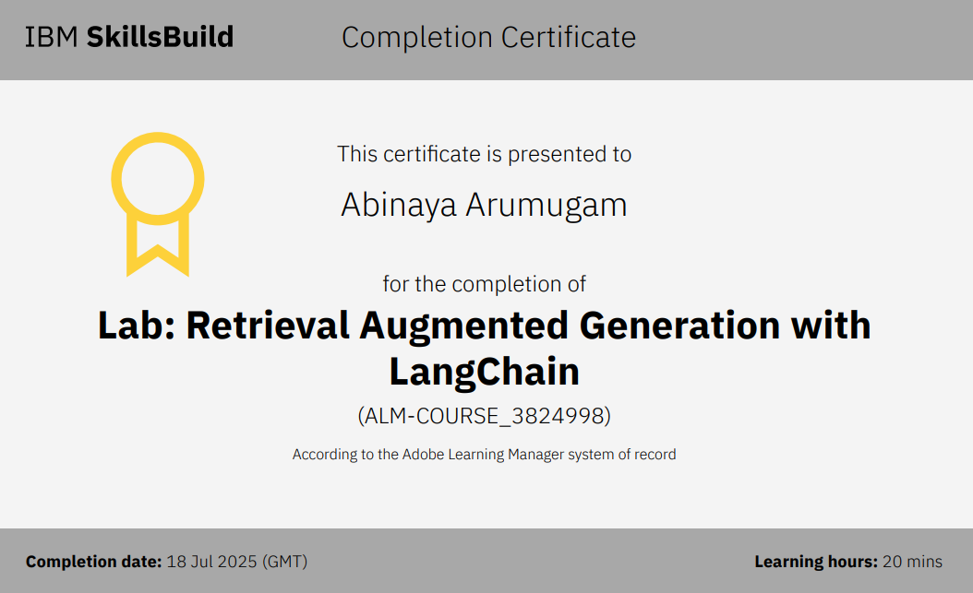
IBM Certifications

Slide 15
THANK YOU

