Slide 1
Employee Data Analysis using Excel
STUDENT NAME: ABINAYA.S
REGISTER NO: 122202129 (asunm1353122202129)
DEPARTMENT: B.COM CORPORATE SECRETARYSHIP
COLLEGE: ANNA ADARSH COLLEGE FOR WOMEN

Slide 2
PROJECT TITLE
Employee Performance Analysis using Excel

Slide 3


AGENDA
Problem Statement
Project Overview
End Users
Our Solution and Proposition
Dataset Description
Modelling Approach
Results and Discussion
Conclusion
3/21/2024 Annual Review

Slide 4

PROBLEM STATEMENT
"To enhance organizational efficiency and employee development, we need a systematic approach to evaluate and analyze employee performance. The goal is to utilize Excel to track key performance indicators (KPIs), identify trends, and generate actionable insights that will support performance management, reward distribution, and targeted training programs."
This concise problem statement highlights the purpose, tool (Excel), and desired outcomes of the performance analysis.

Slide 5

PROJECT OVERVIEW
This project focuses on creating an efficient system for analyzing employee performance using Excel. By systematically capturing and analyzing performance data, we aim to:
Track Performance Metrics: Monitor key indicators to gauge individual and team performance.
Identify Trends and Insights: Discover patterns to inform strategic decisions and improve productivity.
Enhance Decision-Making: Utilize data-driven insights to optimize employee development, reward structures, and overall organizational effectiveness.
Our goal is to leverage Excel’s capabilities to provide a clear, actionable overview of employee performance, supporting informed management decisions and fostering a productive work environment.

Slide 6
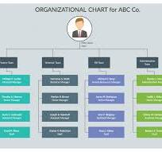

WHO ARE THE END USERS?
HR Managers: For tracking, evaluating, and managing employee performance and development.
Team Leaders/Supervisors: To monitor team performance, provide feedback, and identify training needs.
Senior Executives: For strategic decision-making, resource allocation, and performance-based reward systems.
Employees: To review their performance metrics and set personal development goals.

Slide 7

OUR SOLUTION AND ITS VALUE PROPOSITION
CONDITIONAL FORMATTING - MISSING Automate visual highlights in Excel to quickly identify performance trends and outliers.
FILTER - REMOVE
FORMULA - PERFORMANCE
PIVOT - SUMMARY
GRAPH - DATA VISUALIZATION

Slide 8
Dataset Description
EMPLOYEE = KAGGLE
26- FEATURES
9- FEATURES
EMP ID- NUM
NAME-TEXT
EMP TYPE
PERFORMANCE LEVEL
GENDER - MALE FEMALE
EMPLOYEE RATING - NUM

Slide 9

THE "WOW" IN OUR SOLUTION
PERFORMANCE LEVEL = IFS(Z8>=5,"VERY HIGH",Z8>=4,"HIGH",Z8>=3,"MED",TRUE,"LOW")
3/21/2024 Annual Review
9

Slide 10
MODELLING
DATA COLLECTION
KAGGLE
EDUNET DASHBOARD
FEATURE COLLECTION
1)FIRST NAME
2) LAST NAME
DATA CLEANING
1)MISSING VALUE
2) FILTER OUT
PERFORMANCE LEVEL
1)=IFS(Z8>=5,"VERY HIGH",Z8>=4,"HIGH",Z8>=3,"MED",TRUE,"LOW")
SUMMARY
PIVOT TABLE
ROWS & COLUMN ADDED
VISUALIZATION
GRAPH
PIE CHART
10

Slide 11
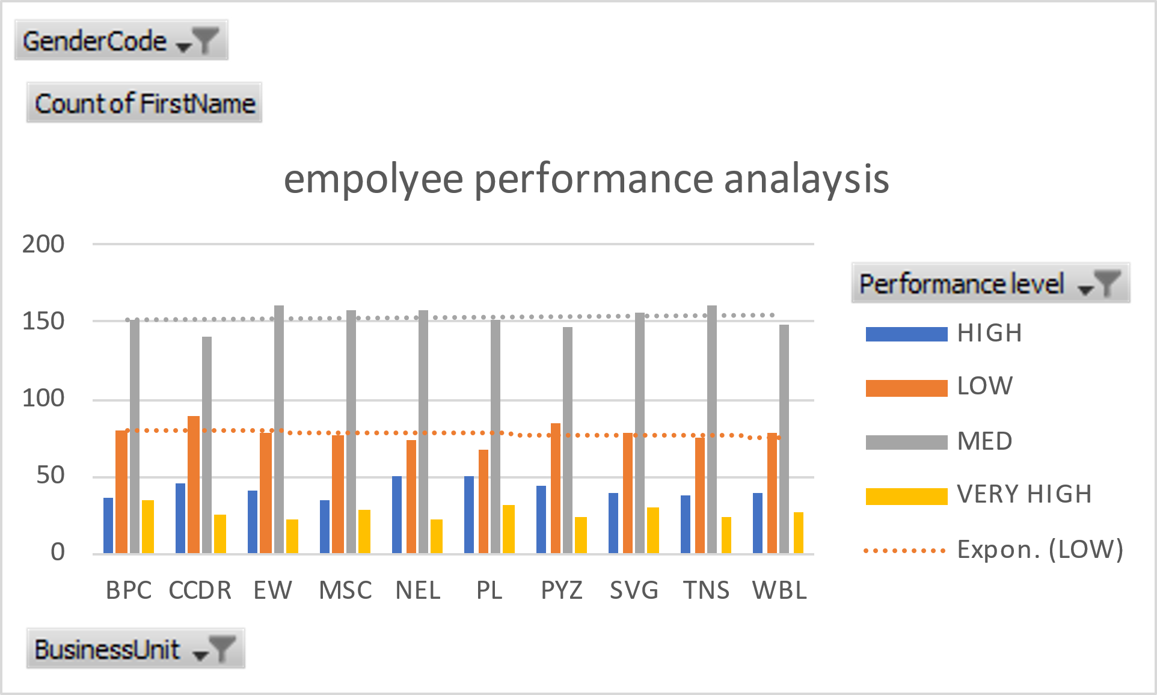
RESULTS
11

Slide 12
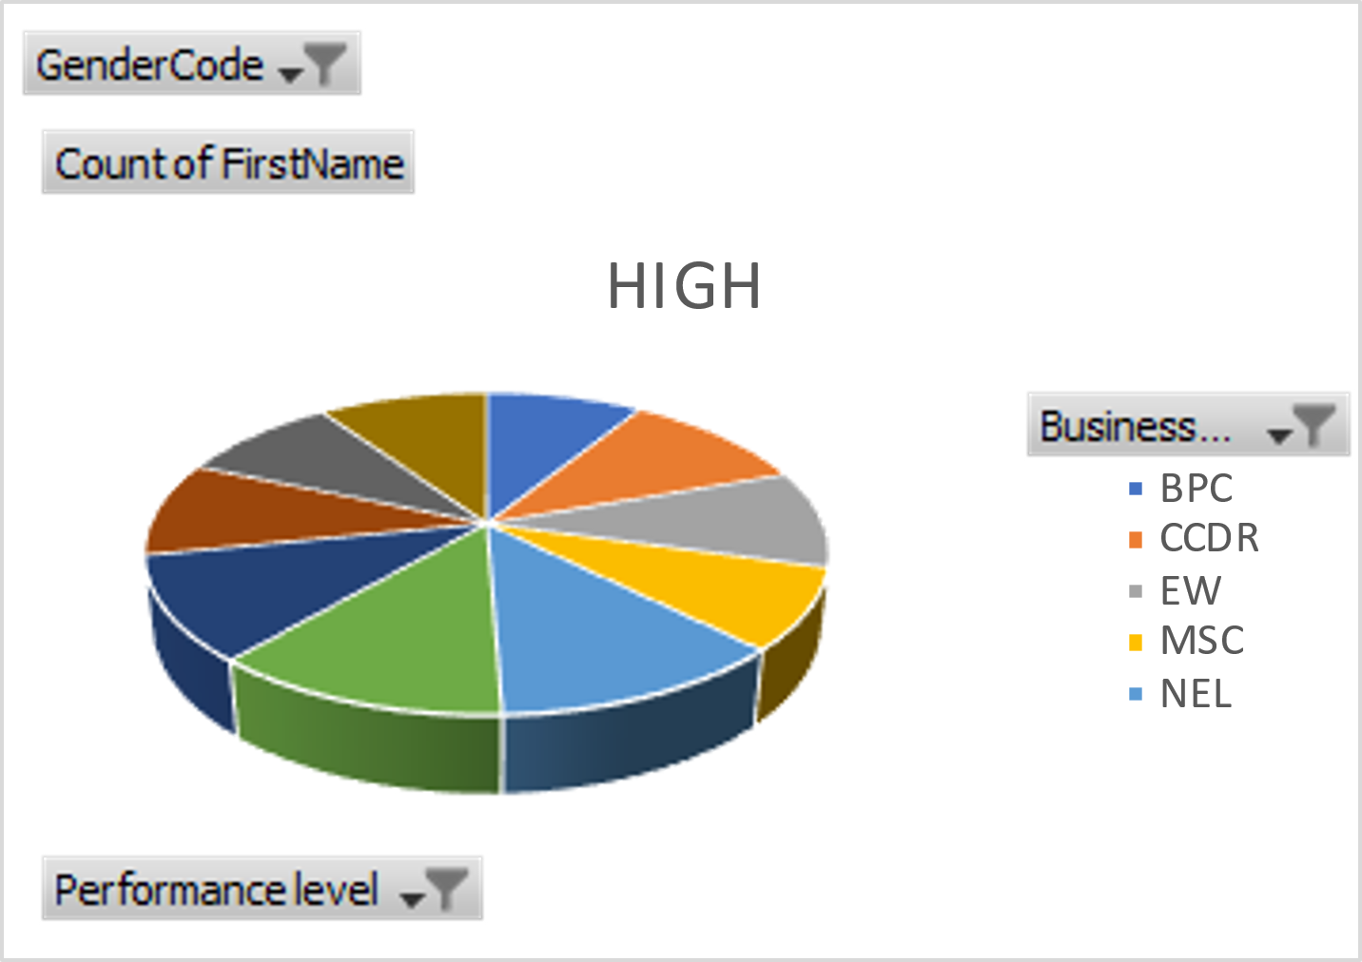
RESULTS

Slide 13
conclusion
Excel provides powerful tools for analyzing employee performance by organizing data, applying filters, and using formulas to calculate key metrics. By leveraging features like pivot tables, charts, and conditional formatting, you can gain insights into productivity, identify strengths and areas for improvement, and make data-driven decisions to enhance overall performance."

