Slide 1

BIG DATA PROJECT PRESENTATION
GUIDED BY PRESENT BY
JANAKIRAMAN ABINAYA.P

Slide 2
Challenges in big data
Capture
Storage
Analysis
Search
Sharing
Transfer
Querying
Updating
Information privacy

Slide 3

Terminologies BIG DATA
Big data is a term for data sets that are so large or complex that traditional data processing applications are inadequate to deal with them.
Volume
Velocity
Variety
Veracity

Slide 4
CHARACTERISTICS OF BIG DATA
VOLUME : Size Of The Data
VARIETY : Type Of Data
VELOCITY : Growth Of Data
VERACITY : Inaccuracy Of Data

Slide 5
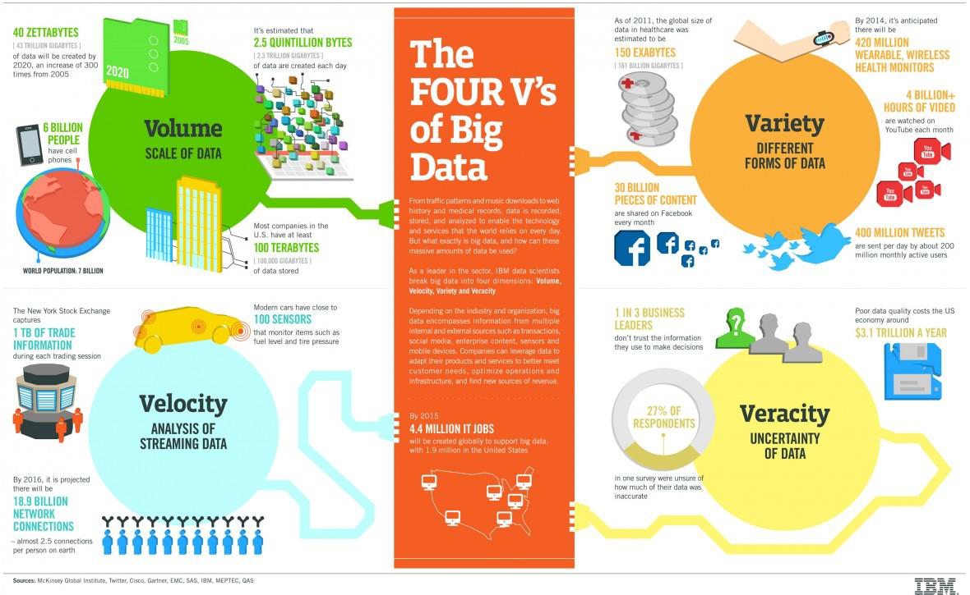

Slide 6


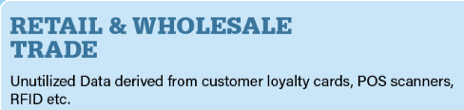


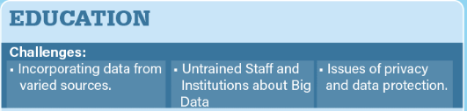





Slide 7
ADVANTAGE OF HADOOP
SCALABLE
COST
FLEXIBLE
FAST
RESILIENT TO FAILURE

Slide 8
TOOLS REQUIRED
MapReduce
Hive
Pig

Slide 9
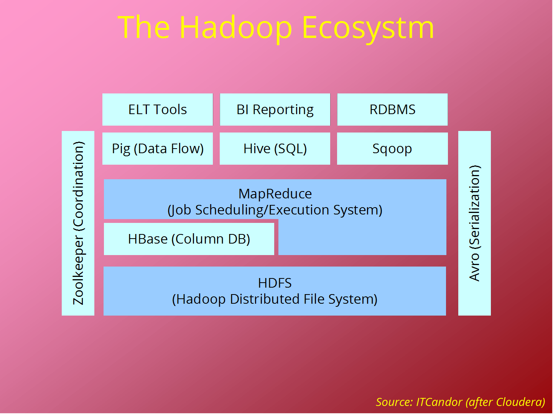

Slide 10
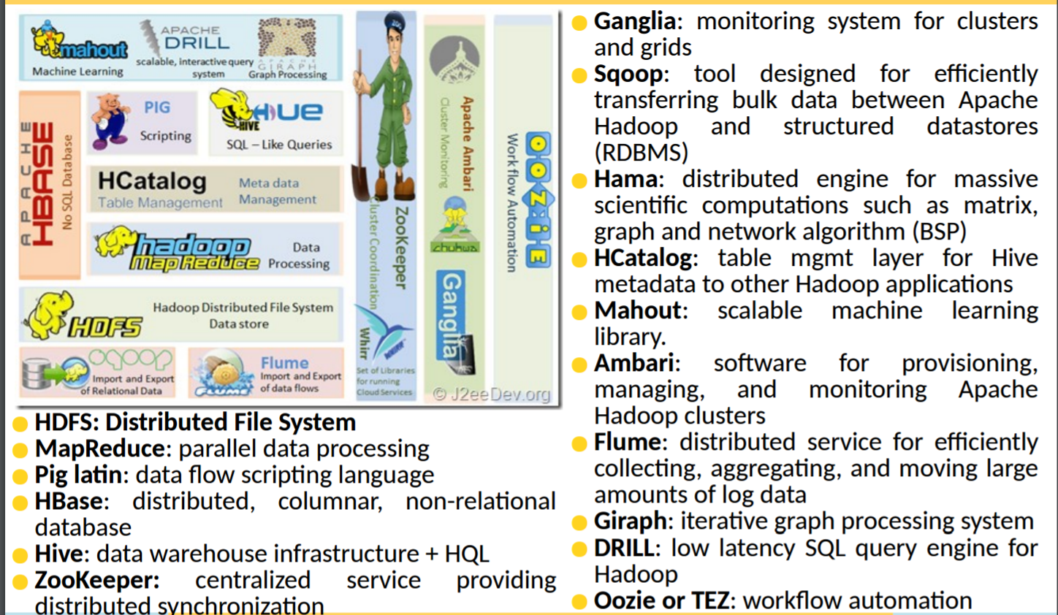

Slide 11



Terminologies HADOOP
Apache Hadoop is an open-source software framework used for distributed storage and processing of very large data sets
It consists of computer clusters built from commodity hardware
All the modules in Hadoop are designed with a fundamental assumption that hardware failures are a common occurrence and should be automatically handled by the framework
Hadoop Components
HDFS(Storage)
Map Reduce
Process/Compute

Slide 12

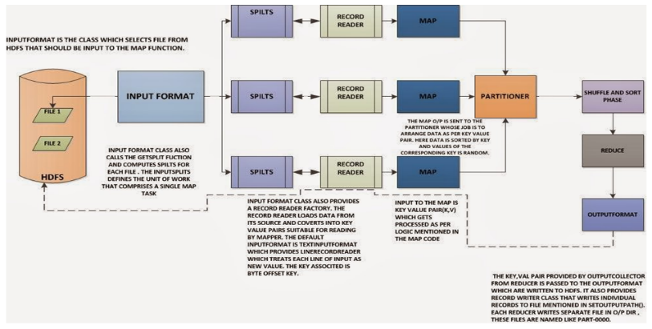
Apache Hadoop – Map Reduce Work Flow

Slide 13
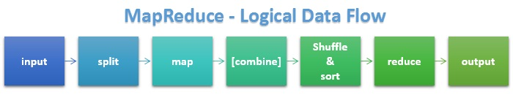
FLOW

Slide 14
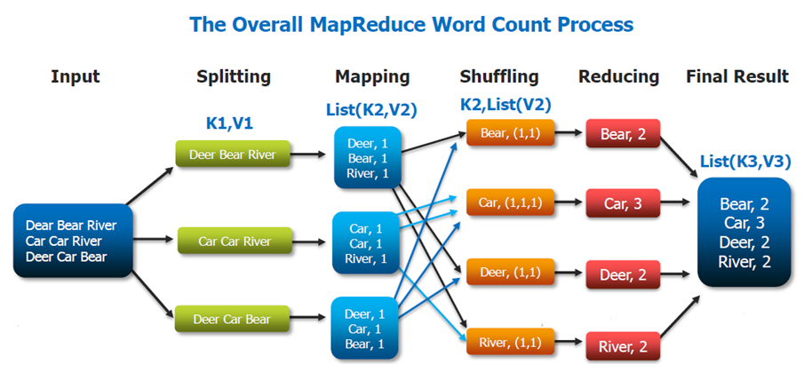
EXAMPLE-WORDCOUNT

Slide 15
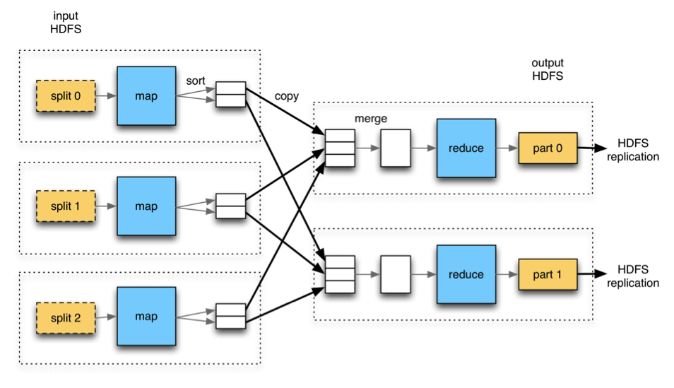
MULTIPLE REDUCERS

Slide 16
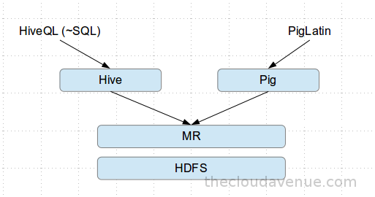

Slide 17
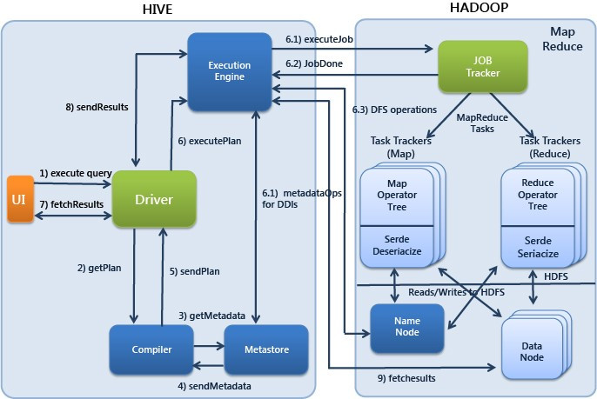
HIVE FLOW

Slide 18
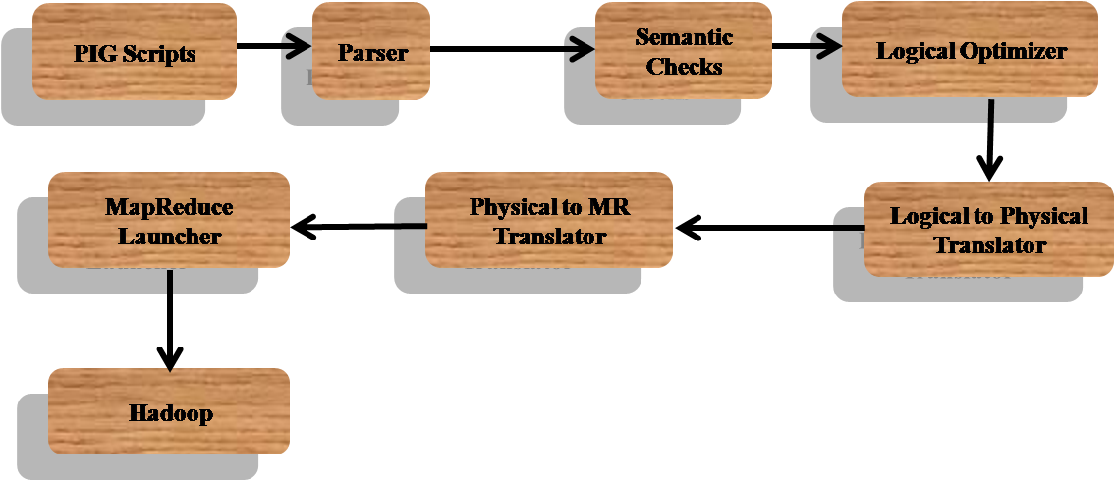
PIG FLOW

Slide 19
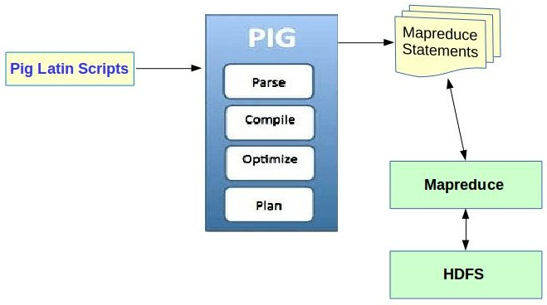
PIG ARCHITECTURE

Slide 20
PROJECT ABSTRACT
Here our current project fully based on H1B visa employer data. This the most common visa status applied for and held by international students once they complete college/higher studies and those who are work in full-time or part-time. Our objective is to perform analysis on the H1B visa applicants between the years 2011-2016.

Slide 21
PROJECT FIELDS
CASE_STATUS
EMPLOYER_NAME
SOC_NAME
JOB_TITLE
FULL_TIME_POSITION
PREVAILINGWAGES
YEAR
WORKSITE
LONGITUDE
LATITUDE

Slide 22
MAPREDUCE
Find the average Prevailing Wage for each Job for each Year (take part time and full time separate) ?
Foreach job and year finding the whether employeee is part time or full time and also finding their Average of their prevailing wages for each case.

Slide 23
PIG SCRIPT
Find the number of applications for each year
EXECUTION SCRIPT:
data = load '/home/cloudera/Desktop/hadoop_project/hadoop_data' using PigStorage('\t') AS
(id:int,case_status:chararray,employer_name:chararray,soc_name:chararray,job_title:chararray,full_time_position:chararray,prevailing_wages:int,year:chararray,worksite:chararray,longitude:double,latitude:double);
new = foreach data generate case_status,year;
groupdata = group new by year;
getcount = foreach groupdata generate group,COUNT(new.case_status);
dump getcount;

Slide 24
HIVE QUERY
Which part of the US has the most Data Engineer jobs for each year?
EXCEUTION QUERY:
select worksite,count(job_title) as cnt,year from h1b_final where job_title == "DATA ENGINEER" and year == "2016" group by worksite,year order by cnt desc limit 5;

Slide 25





