Slide 1
EXCEL DASHBOARD PROJECT
Crop Production in India
11.19B
tonnes produced
An interactive Excel dashboard on production, area, crops and seasons
Abinaya S
Vivekanandha College of Technology

Slide 2
01
What this presentation covers
1
2
3
Problem & Objective
Dataset
Approach
4
5
6
Dashboard
Analysis
Insights
From raw crop records to a dashboard anyone can explore.
Abinaya S · Vivekanandha College of Technology

Slide 3
02
Problem and objective
PROBLEM
Crop records cover many states, crops, seasons and years. As raw data, it is hard to see which states lead, which crops dominate and how output changes over time.
OBJECTIVE
Build an interactive Excel dashboard that turns the raw data into KPIs, charts and slicers, so production and cultivated area can be explored quickly.
Abinaya S · Vivekanandha College of Technology

Slide 4
03
The dataset
State
Year
Season
Where the crop was grown
1997 to 2014
Kharif, Rabi, Whole Year...
Crop
Area (ha)
Production
Name of the crop
Cultivated area
Output in tonnes
Crop Production in India · Agricultural data · Analysed in Microsoft Excel
Abinaya S · Vivekanandha College of Technology

Slide 5
04
How the dashboard was built
1
2
3
4
Prepare
Summarise
Visualise
Interact
Clean and organise the raw data
Build PivotTables for each view
Create charts and KPI cards
Add slicers and finish the layout
Abinaya S · Vivekanandha College of Technology

Slide 6
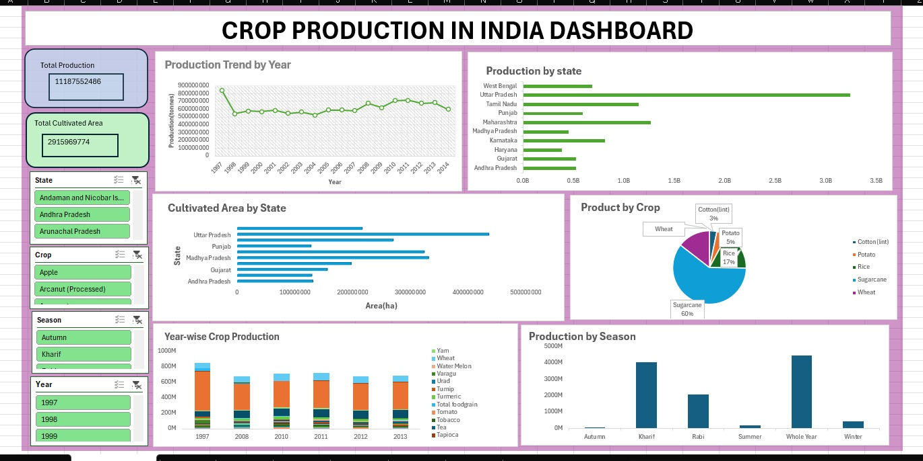
05
The dashboard
Abinaya S · Vivekanandha College of Technology

Slide 7
06
Key numbers and trend
11.19B
Production trend, 1997 to 2014
Output was highest in 1997.
It fell sharply in 1998.
From 1999 onward it stayed fairly steady, with small rises and dips.
Total production (tonnes)
2.92B
Total cultivated area (ha)
Abinaya S · Vivekanandha College of Technology

Slide 8
07
Production by state
Uttar Pradesh
leads with about 3.22B tonnes, nearly 2.5 times the next state, Maharashtra at 1.26B.
Abinaya S · Vivekanandha College of Technology

Slide 9
08
Crops and seasons
Abinaya S · Vivekanandha College of Technology

Slide 10
09
Key insights
Uttar Pradesh
Top state in production and cultivated area
Sugarcane
About 60% share among the five selected crops
1997
Highest yearly output, then a drop in 1998
Whole Year + Kharif
The two seasons that produce the most
Abinaya S · Vivekanandha College of Technology

Slide 11
Conclusion
Raw crop data became an interactive Excel dashboard
KPIs, charts and slicers make exploring easy
Top states, dominant crops and seasonal patterns stand out
Thank You
Abinaya S · Vivekanandha College of Technology

