Slide 1
Digital Portfolio
STUDENT NAME: S.ABINAYA
REGISTER NO AND NMID: 24133091802522004 and autanm309anm30924ucsc004
DEPARTMENT: COMPUTER SCIENCE
COLLEGE: COLLEGE/ UNIVERSITY:JAWAHARLAL NEHRU COLLEGE FOR WOMEN/ANNAMALAI UNIVERSITY

Slide 2
PROJECT TITLE: STUDENT PORTFOLIO

Slide 3


AGENDA
Problem Statement
Project Overview
End Users
Tools and Technologies
Portfolio design and Layout
Features and Functionality
Results and Screenshots
Conclusion
Github Link
3/21/2024 Annual Review

Slide 4

PROBLEM STATEMENT
"Design a digital student portfolio system that allows students to easily collect, organize, and showcase their academic work, projects, and achievements, while providing teachers and parents with a clear view of student progress and areas for improvement, ultimately enhancing student reflection, engagement, and overall learning experience."

Slide 5

PROJECT OVERVIEW
Project Title: Student Portfolio Management System
Objective: Develop a digital platform for students to create, manage, and showcase their academic portfolios, facilitating self-reflection, progress tracking, and collaboration with teachers and parents.
Key Features:
User-friendly interface for students to upload and organize work
Customizable templates for different subjects and projects
Feedback and comment system for teachers and parents
Progress tracking and analytics
Secure storage and access control

Slide 6

WHO ARE THE END USERS?
Students: They would use the portfolio to collect, organize, and showcase their work, track progress, and reflect on their learning.
Teachers: They would use the portfolio to:
Provide feedback and assessment
Track student progress and identify areas for improvement
Use as a tool for parent-teacher conferences
Parents/Guardians: They would use the portfolio to:
Stay informed about their child's progress and achievements
Provide support and encouragement
Administrators: They might use the portfolio system to:
Monitor student progress across classes or schools
Evaluate the effectiveness of curriculum and teaching methods

Slide 7

TOOLS AND TECHNIQUES
Digital Tools:
Google Sites or Google Drive: For creating and storing digital portfolios.
Seesaw: A student-driven portfolio platform for showcasing learning.
Showbie: A platform for students to share work and receive feedback.
Portfolio Gen: A digital portfolio tool for students to showcase their work.
Mahara: An open-source e-portfolio platform.
Techniques:
Reflection and Self-Assessment: Students reflect on their work and set goals.
Rubrics: Teachers use rubrics to assess student work and provide feedback.
Feedback Loops: Regular feedback from teachers and peers.
Organization: Students organize their work chronologically or thematically.
Showcasing: Students showcase their best work or projects.

Slide 8
POTFOLIO DESIGN AND LAYOUT
Design Principles:
Clear Navigation: Easy to navigate and find specific work or sections.
Consistent Layout: Consistent design elements throughout the portfolio.
Visual Hierarchy: Use headings, fonts, and colors to create a clear hierarchy of information.
Simple and Clean: Avoid clutter and focus on showcasing student work.
Digital Portfolio Layout:
Pages or Sections: Organize content into clear sections or pages.
Images and Multimedia: Incorporate images, videos, or audio files to showcase student work.
Hyperlinks: Use hyperlinks to connect to external resources or other sections.
8

Slide 9
FEATURES AND FUNCTIONALITY
Core Features:
Work Upload and Organization: Ability to upload and organize work samples, such as documents, images, videos, and audio files.
Customizable Templates: Pre-designed templates for different types of work or projects.
Reflection and Self-Assessment: Space for students to reflect on their work and set goals.
Feedback and Commenting: Ability for teachers and peers to provide feedback and comments.
Progress Tracking: Visual representation of student progress over time.

Slide 10

RESULTS AND SCREENSHOTS
.
Improved Self-Assessment and Reflection: Students develop critical thinking and self-awareness by reflecting on their strengths and areas for improvement.
Increased Ownership and Motivation: Portfolios create ownership, engaging students with their learning and motivating them to take pride in their work.
Holistic Evaluation: Portfolios provide a comprehensive view of student learning, capturing the process behind the learning, not just the final outcome.
3/21/2024 Annual Review
10

Slide 11
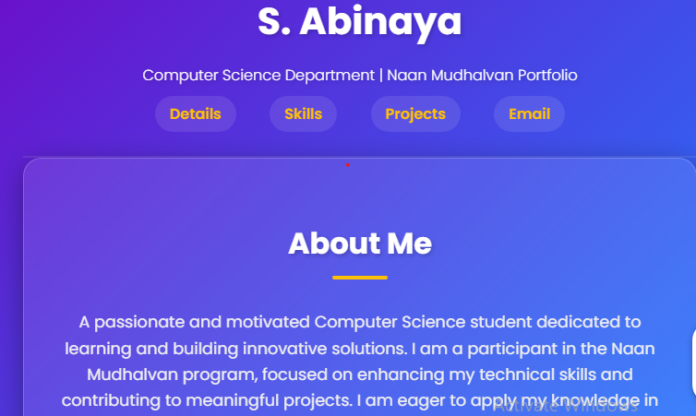
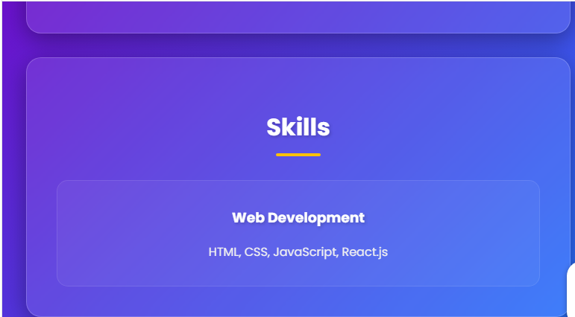
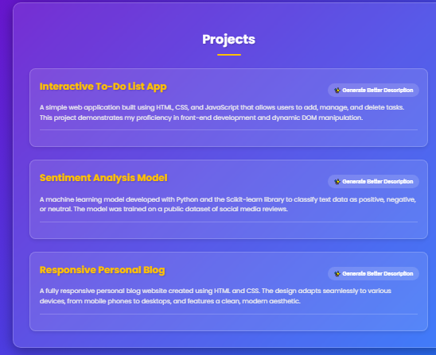
SCREENSHOT

Slide 12
CONCLUSION
"A student portfolio is a powerful tool that showcases learning, growth, and achievement. By collecting and reflecting on their work, students develop essential skills in self-assessment, critical thinking, and creativity. Effective portfolio management enables teachers to provide targeted feedback and support, while also fostering a sense of ownership and motivation in students. As a dynamic and evolving representation of student learning, portfolios have the potential to transform education and empower students to reach their full potential."
12

