Slide 1
Overview
Equations of motion, as given by Newtonian gravity.
Definitions of orbital parameters
Solving the equation
Solar day calculation
Obtaining r.a. and declination
Obtaining altitude and azimuth

Slide 2
I) Equations of motion
In an inertial frame of reference,
Subtracting the two equations,
which is also the equation of motion of earth in the sun’s frame of reference.

Slide 3
II) Orbital parameters
Angular momentum
The angular momentum being conserved indicates that the trajectory of earth w.r.t. sun is in a plane normal to it.

Slide 4
Energy Integral ( )

Slide 5
Eccentricity ( )
Define,
[substituting eq(1) for ]

Slide 6
The following relations hold :

Slide 7
Sense of
rotation
i
Equatorial
plane
North Pole
i (inclination)
Orbital
Plane
v
f
Vernal
Equinox
k
r
f (anomaly)
a
(semi major axis)
ae
e
P
(Perihelion)
Sun
(O, Focus)
Sense of
revolution
Figure (1) : Earth’s orbit and its parameters

Slide 8
III) Solving the equation
The anomaly ( f ) is the angle between position and eccentricity vector.

Slide 9
The eq(4) gives the trajectory of earth’s orbit, which is a conic section in polar coordinates ( r , f ). See fig(2).
This verifies Kepler’s first law.
The position is given as a
function of f. To obtain r(t),
we need f(t) for which we
need position of earth at
some specified time, say the
time of perihelion(f=0) [for
convenience, we’ll take it to
be zero].
Refer to fig (1)
e=0
circle
1>e>0
ellipse
e=1
parabola
e>1
hyperbola
Figure (2) : Possible trajectories of the orbit

Slide 10
The eq(5) gives us f(t) which can be substituted in eq(4) to obtain r(t), the required orbit. To obtain r.a.(t) and declination(t) from the orbit, we only need f(t). Thus, we numerically integrate eq(5) with e, k and u as input constants.
Refer to the area(red triangle) spanned by r and v in fig(1).

Slide 11
Semi major axis ( a )
Earth, a planet, has orbital eccentricity
less than 1 as per eq(4). Distance of earth from sun (r) reaches a minimum when f=0, i.e. perihelion. f=0 also says at this point. Thus, is a constant vector pointing to the perihelion with magnitude equal to the eccentricity of the orbit.
Refer to fig(1),

Slide 12
Period of revolution (T_{rev})

Slide 13
IV) Solar Day calculation
Rotation period of earth w.r.t. distant stars (T_{sidereal} ) is taken to be independent of orbital parameters [=23h 56m].
Figure (3)
t = T_{solar}
Equatorial
plane
t = T_{sidereal}
Orbital
plane
North Pole
i (inclination)
Ɵ_{solar}
Ɵ’_{sidereal}
Ɵ’_{sidereal}
f
Figure (4)
t = 0
α (r.a)
Vernal
Equinox
Observer
Ɵ_{sidereal}

Slide 14
Say e = 0, i = 0
Thus, the analemma is a point on the equator.
Say e = 0, i != 0
Thus, the inclination causes a horizontal spread, as well as a vertical spread [see fig(6)], in the analemma.

Slide 15
Say e !=0, i = 0
Thus, the eccentricity causes a horizontal spread [see fig(5)] and no vertical spread. The analemma is an arc on the equator.
The equation of time is the difference between r.a.(sun) with (e,i)=(0,0) and actual r.a.(sun).
t = T_{solar}
δ
t =nT_{solar}
δ
t = 0
t =(n+1) T_{solar}
Figure (5)
Figure (6)

Slide 16
V) Obtaining ra α and declination δ
Z
Z’
Equatorial
plane
Y’
Orbital
plane
North Pole
ί
L˚
Y
ƒ
Ɵ_{sidereal}
0˚
H
δ
Vernal
Equinox
(X, X’)
Sun
α
Figure (7)

Slide 17
VI) Obtaining altitude a and azimuth A
‘
Z’(Zenith)
Z
North Pole
Y
φ
E
H
δ
N
a
S,Y’
Horizon
A
Equatorial
plane
(W,X,X’)
Figure (8)

Slide 18
Procedure followed
Input :
e, k, G, m_{earth}, m_{sun}, T_{sidereal}, i, φ, L
Calculate µ from G, m_{earth} and m_{sun}
T_{rev}
from e, k, µ as given by eq(8)
Numerically integrate eq(5) for f, using e, k, µ and the time array
Create time array t, elements ϵ [0, T_{rev} ],
in steps of T_{solar}
T_{solar}
from T_{sidereal} and T_{rev} as given by eq(8)
Obtain α, δ from f and i using eq(11)
Obtain H from α, T_{sidereal} , t, L using eq(12)
Obtain a, A from δ, H and φ using eq(13)

Slide 19
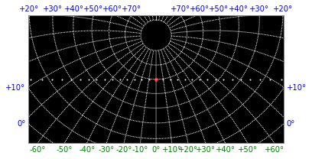
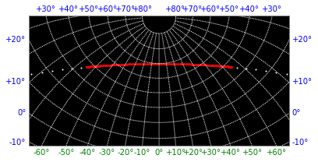
e = 0
i = 0˚
e = 0.4
i = 0˚

Slide 20
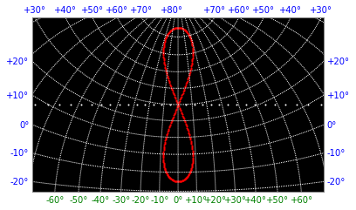
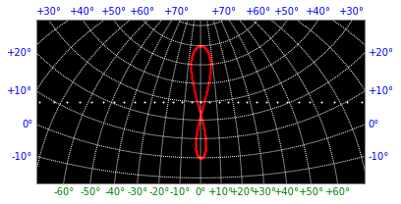
e = 0
i = 45˚
e = 0.0167
i = 30˚

