Slide 1
Agenda
Introduction
Literature survey
Challenges
Dataset description
Methodology
Data analysis
ML model
DL model
Explainable AI
Conclusion
Future Enhancement

Slide 2

Introduction
Autism Spectrum Disorder (ASD) represents a heterogeneous set of neurobiological disorders characterized by defects in social communication and reciprocal interactions, repetitive, as well as stereotypic behaviors.​
When the children are performing their regular day-today activities, some of the self-stimulatory behaviors, such as arm flapping, head banging, or spinning behaviors can be studied by automatically analysing the captured videos.

Slide 3
List of Products similar to this project
Product Name | Features | Additional info related to Industry/research lab
Autism Spectrum Rating Scales (ASRS™)​ https://paa.com.au/product/asrs/ | Multi-informant measure to identify symptoms, behaviors , and associated features of Autism Spectrum Disorders. ​ Paper-and-pencil administration | Published in 2009​
ASdetect​ https://asdetect.org/ | For parents and caregivers of children aged 11 to 30 months, the FREE app ASDetect was launched in 2016 and has been downloaded 90,000 times. | It is based on research by the Olga Tennison Autism Research Centre at La Trobe University, Australia. The early autism detection method used in ASDetect is 83% accurate.
(ADOS®-2) Autism Diagnostic Observation Schedule™, Second Edition​ https://www.massgeneral.org/children/autism/lurie-center/autism-diagnostic-observation-schedulesecond-edition-ados2 | ADOS-2 is widely used by clinicians and researchers to assess autism and is considered a gold standard in the field due to its structured and reliable approach. | The Autism Diagnostic Observation Schedule (ADOS) was first published in 1989. The ADOS-2, which is an updated version of the original ADOS, was released in 2012.

Slide 4
List of Research Labs
Name of the lab | URL | Name of the Professor | Institute | Country
Chukoskie’s lab, the Neurobehavioral Research Lab, focuses on eye-tracking and machine learning techniques to study autism. | https://www.kalasalingam.ac.in/ | Sheril Sophia D'couto & Jawahar Pradeepkandhasamy | Kalasalingam Academy of Research and Education | India
Wong's research at the Stanford University School of Medicine explores autism detection using machine learning approaches. | https://med.stanford.edu/ | Isabella Wong | Stanford University | USA
Calhoun’s lab applies multimodal imaging and machine learning for understanding brain disorders, including autism. | https://research.gsu.edu/ | Vince D. Calhoun | Georgia State University | USA

Slide 5
LITERATURE SURVEY
PAPER | MODEL ARCHITECTURE | DATASET | ALGORITHMS | ACCURACY | CV RESEARCH DONE | DISTANCE RELATED PROBLEMS | GEOMETRIC RELATED PROBLEMS
1. Deep Learning Algorithms to Identify Autism Spectrum Disorder in Children-Based Facial Landmarks by Hasan Alkahtani ^{1,2}, Theyazn H. H. Aldhyani ^{1,3,*} and Mohammed Y. Alzahrani Mohammed Y. Alzahrani ^{1,4} | (CNNs) for effectiveness in image analysis. The architecture consists of several convolutional layers followed by pooling layers, with fully connected layers at the end to classify the presence of ASD based on extracted features from facial landmarks. | They utilized a publicly available dataset from Kaggle, consisting of 2,940 images of both autistic and non-autistic children. This dataset was key to training and validating the models. | (CNNs) for feature extraction. Transfer learning techniques using pre-trained models (like VGG16, ResNet, etc.) to enhance performance. Data augmentation to improve model generalization. | The MobileNetV2 model achieved the highest accuracy, 92%, on the test set, outperforming other models used in previous research. This highlights the effectiveness of using transfer learning in the context of facial landmark-based ASD detection. | The study conducted empirical tests to find the optimal settings for hyperparameters and optimizers in the CNN models, ensuring robust performance for ASD detection. | Distance-related problems is how distances between facial landmarks are used as features in the model, analyzing variations in facial structure or expressions between children with and without ASD. | Geometric-related problems is the angles and ratios of facial landmarks, helping to identify characteristic patterns associated with ASD. This includes the geometric configuration of the face and how it correlates with diagnosed conditions.

Slide 6
PAPER | MODEL ARCHITECTURE | DATASET | ALGORITHMS | ACCURACY | CV RESEARCH DONE | DISTANCE RELATED PROBLEMS | GEOMETRIC RELATED PROBLEMS
2.An Approach to Recognize Human Activities based on ConvLSTM and LRCN Shradha Bhatia; Tushar Chauhan; Sumita Gupta; Sapna Gambhir; Jitesh H. Panchal | ConvLSTM: This model combines Convolutional Neural Networks (CNN) with Long Short-Term Memory (LSTM) networks. LRCN (Long-term Recurrent Convolutional Networks): The LRCN model is another architecture employed in this research. It integrates CNNs for feature extraction with LSTMs for sequence modeling. By utilizing both, the research aims to simplify the model while eliminating the need for complex feature engineering. | UCF101: A dataset with 101 action categories. HMDB51: Contains 51 action categories with videos from various sources. | ConvLSTM is particularly effective for handling spatiotemporal data, making it suitable for recognizing human activities. The LRCN model integrates CNNs for feature extraction with LSTMs for sequence modeling. | The LRCN (Long-term Recurrent Convolutional Networks) model achieved an impressive accuracy of 92%. This indicates that the model was highly effective in correctly predicting human activities based on the data it was trained on | Computer vision techniques are employed to extract relevant features from visual data. The convolutional layers in the CNN component of the LRCN model are responsible for this feature extraction, allowing the model to identify patterns and characteristics associated with different activities . | Distance can impact how activities are perceived. For example, if a camera is positioned too far away from the subject, it may struggle to capture fine details of the activity. The spatial resolution of the data collected can be influenced by distance. Higher distances may result in lower resolution images or video frames, which can hinder the model's ability to extract meaningful features | Spatial Relationships Pose Estimation Scale Variability Perspective Distortion Movement Trajectories Environmental Geometry

Slide 7
PAPER | MODEL ARCHITECTURE | DATASET | ALGORITHMS | ACCURACY | CV RESEARCH DONE | DISTANCE RELATED PROBLEMS | GEOMETRIC RELATED PROBLEMS
3.CNN-LSTM Based Approach for Analyzing and Detecting Stereotypical Motor Movements of Autistic Children in Pre-Meltdown Crisis Fatima Al-Rammah; Marwa Masmoudi; Salma Kammoun Jarraya | VGG16 Backbone: The vision part of the architecture utilizes a VGG16 network that has been pre-trained on the ImageNet dataset. Data Preparation and Model Configuration: The authors empirically tuned the choices regarding data preparation, configuration, and training settings. | MeltdownCrisis Dataset: The primary dataset utilized in this study is referred to as the MeltdownCrisis dataset. This dataset is specifically designed to capture realistic scenarios of autistic children's activities, focusing on two main states: Pre-Meltdown Crisis State: Normal State | The CNN component of the model is responsible for extracting spatial features from video frames. The LSTM algorithm is integrated into the model to capture temporal dependencies in the data. This is crucial for understanding how movements evolve over time, particularly in predicting the onset of a Meltdown Crisis state. The authors conducted empirical tuning of the model configuration, data preparation, and training settings. | The final choices regarding data preparation, model configuration, and training settings were tuned and set empirically to end with a 98% recall and F1 Score, while the best loss value achieved was 0.034. | YOLOv3 is used for object detection, enabling the model to focus on the region around each child in the video frames. After detecting the target region with YOLOv3, Gaussian blurring is applied to the rest of the frame to reduce noise and emphasize the region of interest (ROI). | Spatial Relationships: The paper discusses challenges related to the spatial relationships between key points or body parts during motor movement. Movement Trajectories: The analysis of how distance changes during movement | Pose Estimation: The paper highlights issues with accurately estimating the geometric configuration of the child's body during motor movements. Temporal Variability Background Interference

Slide 8
Challenges
We have collected a dataset of 58 videos and are aiming to do a 3-class classification model (arm flapping, head banging and spinning). Lack of more behavioral based videos as datasets is the current challenge being faced.​
ASD diagnosis continues to be a complicated challenge. The significant parameters include expert knowledge and particular diagnostic tools based on decoding child behavior, parent interviews, long-term follow ups and inspection of symptoms, and manual analysis. These assessments are time-consuming and clinically require arduous processes. Human assessments are subjective and inconsistent.​
Stereotypical self-stimulatory behavior which is considered as a significant clue of this disorder does not comprise any rule or constraint that are common in regular action datasets.​
Most of the available public datasets for diagnosis of ASD centered on emotional involvement, facial expression and eye movement​
To study subjects’ behavior from videos in an uncontrolled natural environment we have collected a novel dataset from children attending the clinical center and willing to take part in our studies.

Slide 9
Problem Statement
​
Develop an automated system for detecting and analyzing self-stimulatory behaviors in children with Autism Spectrum Disorder (ASD) through the analysis of video footage. The system understands the patterns of behaviors such as arm flapping, head banging, and spinning and provides the doctors with a detailed behavior analysis of patients.​
Utilize pose estimation algorithms and motion analysis techniques to extract relevant features from the video frames. Train machine learning models, such as Convolutional Neural Networks (CNNs) and Recurrent Neural Networks (RNNs), to detect and classify self-stimulatory behaviors​
The standard action recognition pipeline of interest point detection, feature extraction, generation of feature descriptors, model training and using it for recognition for a test video is to be followed on the dataset. ​
The well-known Space Time Interest Points (STIP) employed with Harris3D detectors in a Bag Of Words (BOW) framework is to be used to train a 3-class classifier. The three classes are arm flapping, head banging and spinning corresponding to the videos in the dataset.

Slide 10
Motivation
Children with ASD exhibit certain atypical behavioral cues during their regular day-to-day activities. When these atypical behaviors are captured on video over a period, they can be analyzed to identify “red-flags” in the children's behavior and used by clinicians in their diagnosis​
Early Detection: Early and accurate diagnosis of autism can lead to earlier intervention, which is crucial for improving long-term outcomes in children with autism.​
Behavioral Insights: Advanced video analysis can capture subtle and complex behavioral patterns that might be missed during a typical clinical observation, leading to more accurate and nuanced diagnoses.

Slide 11
Dataset Description
A Self-Stimulatory Behavior Dataset (SSBD) of children videos recorded in natural settings. ​
The dataset contains 58 videos with an average duration of 90 seconds per video, grouped under three categories of stimming behaviors: arm flapping, head banging and spinning​
These videos, posted by parents/caregivers in public domain websites, are collected and annotated for the stimming behaviors. These videos are extremely challenging for automatic behaviour analysis as they are recorded in uncontrolled natural settings. A custom dataset can be accumulated by through recorded video sessions of children performing daily activities, including both typical and self-stimulatory behaviors.​
In order to analyse the behaviors and provide alerts to parents / caregivers based on the day-to-day regular activities of children, it is necessary to have the algorithms developed and tested on real-world datasets taken in an uncontrolled settings. ​
Citations related to the dataset: https://rolandgoecke.net/research/datasets/ssbd/

Slide 12
Dataset Description
S.No​ | Data-set name​ | No of Files​ | Resolution​ | Environment​ | Color​ | Image/Video Format​
1​ | SSBD​ | 58​ | 1920 x 1080​ | Indoor and outdoor​ | RGB​ | .mp4​
Present Scope: Videos were flipped horizontally covering the mirror effect and thus increasing the data. Next, temporal augmentations were also considered. Each video is up-sampled with a factor of 1.5 to increase the number of frames within a video. Finally, we down-sample the videos with a factor of 0.5, thus throwing away some information from the video clip. These augmentations will help in generalizing the network. ​
Future Scope: In the future, we plan to increase our dataset by annotating more videos with more action classes. In addition, we want to build a subject-oriented dataset for long-term action tasks, for the development of technology that will be useful to parents/ caregivers and clinicians for early diagnosis.

Slide 13
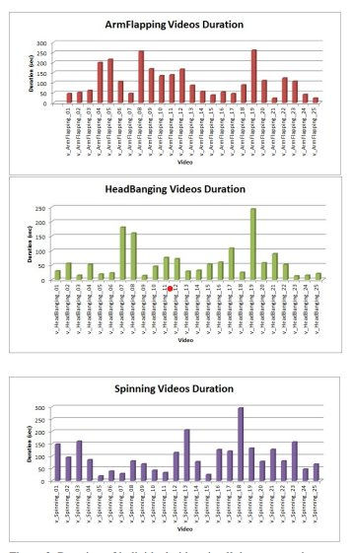
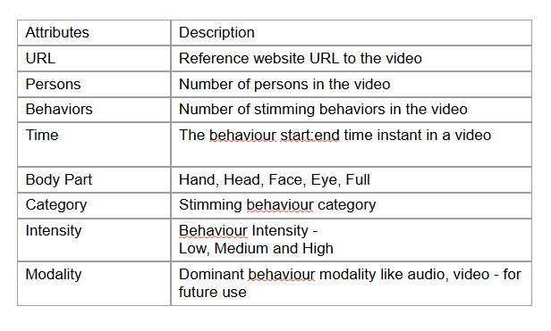
Dataset Analysis

Slide 14
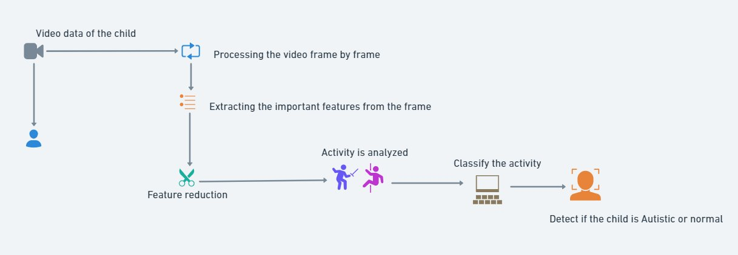
Block Diagram

Slide 15
Block Diagram

Slide 16
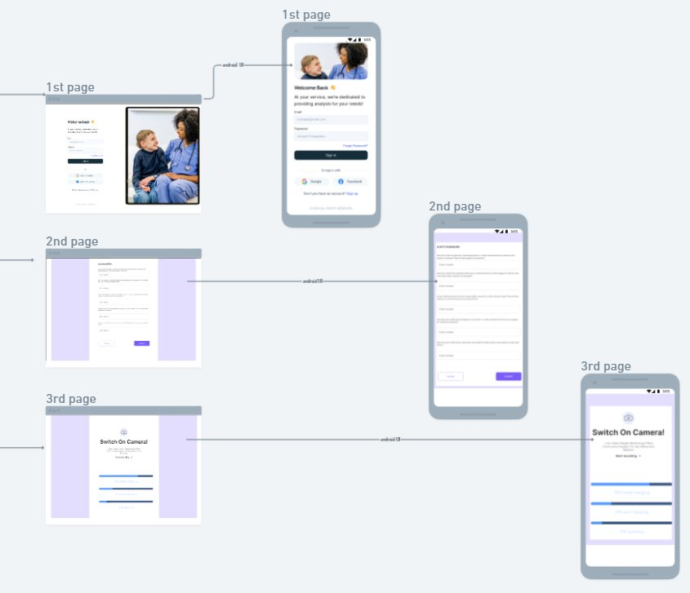
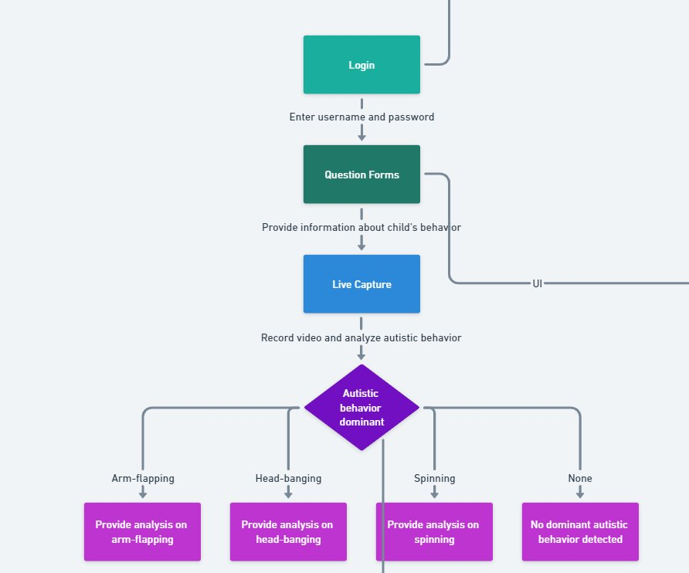
Block Diagram

Slide 17
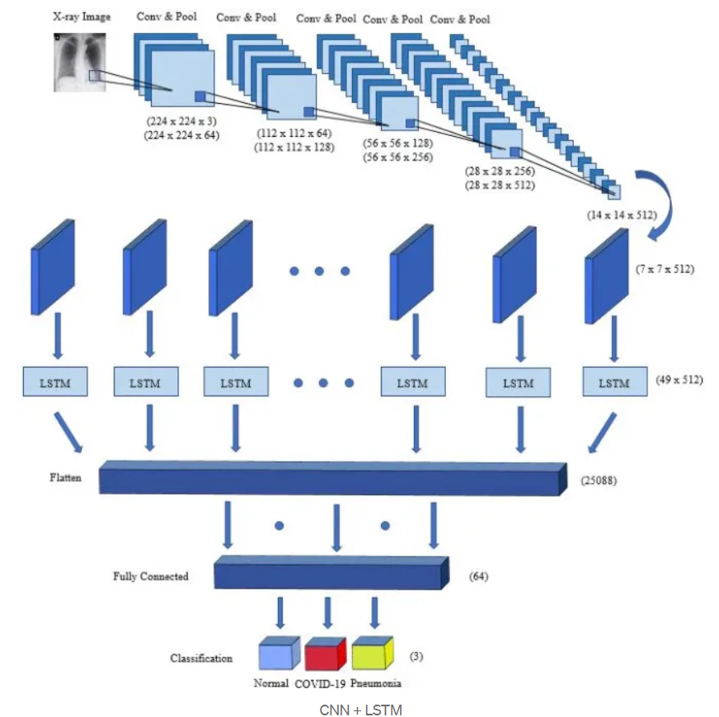
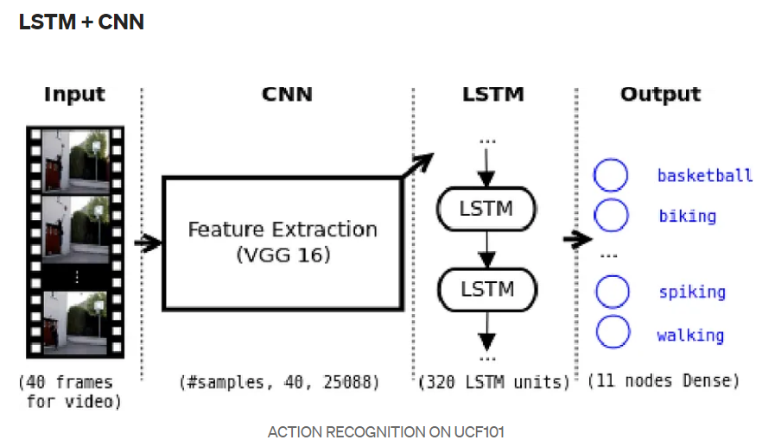
Architecture Diagram

Slide 18
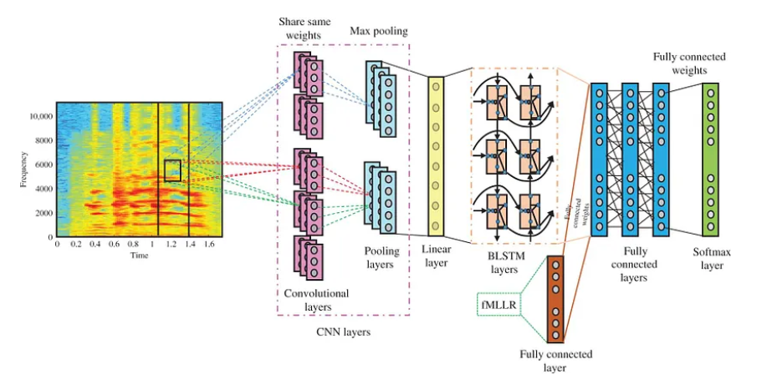

Slide 19
Input Video (Frames)
Preprocessing
(Blurring, ROI)
Feature Extract.
(CNN, Optical Flow)
Output
(Predictions)
Classification (SoftMax Layer)
Temporal Analysis (LSTM)

Slide 20
Algorithm for CNN+LSTM
Input Data:
Let X be a sequence of video frames: X={x1,x2,…,xT}, X={x1​,x2​,…,xT​}. Each frame xT ​ is an image of dimensions heightxwidthxchannels.
Convolutional Layer:
For each frame xtx_txt​, apply convolution operations to extract features: Ft=Conv2D(xt,W,b). Where W is the convolutional filter (weights) and b is the bias.
After convolution, apply an activation function (ReLU): Ft=ReLU(Ft)
Pooling Layer:
Apply max pooling to reduce spatial dimensions: Pt=MaxPool(Ft)
Feature Extraction:
Flatten the pooled output for each frame: Fflattened,t=Flatten(Pt)
Sequence Preparation:
Stack the features from all frames to form a sequence: F={Fflattened,1,Fflattened,2,…,Fflattened,T}. Where F is now a 3D tensor of shape (T,D) with D being the number of features after flattening.

Slide 21
Input to LSTM:
Feed the sequence F into the LSTM. For each time step t:
Compute the LSTM hidden state: ht=LSTM(Ft,ht−1,Ct−1) . Where h_t​ is the hidden state, ht−1is the previous hidden state, and Ct−1 is the previous cell state.
Output Layer:
After processing the entire sequence, the final hidden state h_T​ is used for classification: y=SoftMax(Wout⋅hT+bout). Where Wout and bout​ are the output layer weights and biases.
Loss Function:
Use Categorical Cross-Entropy loss for multi-class classification: L=−∑(i=1 to N) yi log⁡(y^i). Where N is the number of classes, yi​ is the true label, and y^i​ is the predicted probability for class i.
Backpropagation:
Update the weights using an optimization algorithm (e.g., Adam): W←W−η.(∂L/∂W). Where η is the learning rate and W is updated weight.

Slide 22
Experimental Setup
Hyperparameter | Purpose | Values
Learning Rate | How much a model's parameters adjust during each iteration of the optimization algorithm | 0.0001
Batch Size | The number of data samples processed together in one go during training | 32
Epoch | One complete pass through the entire training dataset. | 100
Dropout Rate | Probability of dropping out each unit in the hidden layer | 0.5
Kernel Size | The receptive field of each convolutional operation | (3, 3, 3)
Number of Filter Layers | Performs a linear operation called convolution. | 128, 64
Optimizer | Minimize an error function (loss function) or to maximize the efficiency of production. | adam
LSTM Units | Number of memory units in the LSTM layer | 128
Sequence Length | Number of frames (time steps) fed into the LSTM | 30
Activation Function | Function applied to the outputs of each layer | ReLU
Loss function | loss function to minimise the loss during the training phase | categorical_crossentropy_loss

Slide 23
Performance Measures
Table.No: Performance measures for train
S.No | Measure/Metric | Unit | Purpose
1 | Accuracy | 0.8474 | Overall accuracy of the model
2 | Precision | 0.8531 | Proportion of true positive results in all positive predictions
3 | Recall | 0.7637 | Proportion of true positive results in all actual positives
4 | Sensitivity | 0.6714 | True positive rate; sensitivity to detect positives
5 | Specificity | 0.7896 | True negative rate; ability to detect negatives

Slide 24
Performance Measures
Table.No: Performance measures for test
S.No | Measure/Metric | Unit | Purpose
1 | Accuracy | 0.5556 | Overall accuracy of the model
2 | Precision | 0.4667 | Proportion of true positive results in all positive predictions
3 | Recall | 0.5556 | Proportion of true positive results in all actual positives
4 | Sensitivity | 0.6576 | True positive rate; sensitivity to detect positives
5 | Specificity | 0.6667 | True negative rate; ability to detect negatives

Slide 25
Performance Measures
Table.No: Performance measures for validation
S.No | Measure/Metric | Unit | Purpose
1 | Accuracy | 0.6667 | Overall accuracy of the model
2 | Precision | 0.7000 | Proportion of true positive results in all positive predictions
3 | Recall | 0.6667 | Proportion of true positive results in all actual positives
4 | Sensitivity | 1.0000 | True positive rate; sensitivity to detect positives
5 | Specificity | 0.6667 | True negative rate; ability to detect negatives

Slide 26
Split Ratio of the Dataset
Train Set: 70% of each category
Category 0: 14 videos
Category 1: 13 videos
Category 2: 13 videos
Validation Set: 15% of each category
Category 0: 3 videos
Category 1: 3 videos
Category 2: 3 videos
Test Set: 15% of each category
Category 0: 3 videos
Category 1: 3 videos
Category 2: 3 videos
This will result in a split where each subset has a nearly equal number of videos per action type.

Slide 27
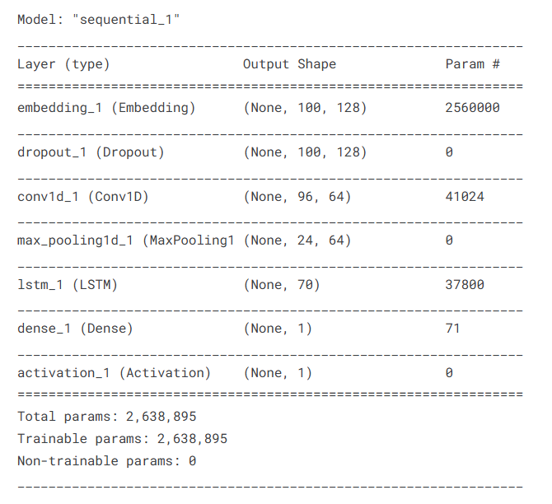

Model
Optimizer – Adam
Activation – Softmax
Loss Function – Categorical cross entropy
Epochs – 100
Regularization – Drop out

Slide 28
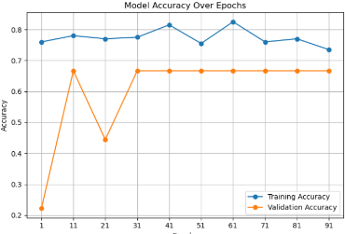
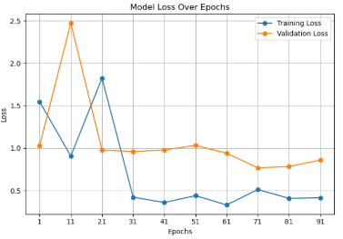
Model
Epochs | Model Accuracy Loss over Epochs
1-10 | The model shows initial training success but struggles with high loss, indicating poor generalization.
11-20 | Training accuracy improves, but the validation accuracy is low, suggesting overfitting issues.
21-30 | A slight drop in training accuracy and increase in loss indicates challenges in learning complexity, with validation accuracy decreasing significantly.
31-40 | Training metrics stabilize, showing some improvement in loss, but validation accuracy remains stagnant at a low level.
41-50 | Notable increase in training accuracy and decrease in loss suggest effective learning, but validation accuracy fails to improve.
51-60 | A decrease in training accuracy and slight rise in loss indicate potential overfitting, with validation metrics remaining unchanged.
61-70 | Training accuracy peaks, but stagnant validation accuracy implies limited generalization ability.
71-80 | Training metrics show fluctuations, with validation loss improving, suggesting better generalization despite no change in accuracy.
81-90 | Training accuracy stabilizes, while validation performance indicates a need for further adjustments to improve generalization.
91-100 | Decreasing training accuracy signals potential overfitting as the model approaches its learning capacity, with validation metrics remaining static.

Slide 29
S.No | Epochs | Training Accuracy | Training Loss | Validation Accuracy | Validation Loss | AUC
1 | 1-10 | 0.760 | 1.546087 | 0.222222 | 1.029918 | 0.574074
2 | 11-20 | 0.780 | 0.905763 | 0.666667 | 2.472422 | 0.686667
3 | 21-30 | 0.770 | 1.823141 | 0.444444 | 0.976443 | 0.888889
4 | 31-40 | 0.775 | 0.422024 | 0.666667 | 0.960491 | 0.814815
5 | 41-50 | 0.815 | 0.359248 | 0.666667 | 0.977141 | 0.814815
6 | 51-60 | 0.755 | 0.440412 | 0.666667 | 1.032807 | 0.814815
7 | 61-70 | 0.825 | 0.330943 | 0.666667 | 0.939077 | 0.814815
8 | 71-80 | 0.760 | 0.511848 | 0.666667 | 0.767481 | 0.851852
9 | 81-90 | 0.770 | 0.408996 | 0.666667 | 0.784202 | 0.850370
10 | 91-100 | 0.735 | 0.414237 | 0.666667 | 0.858051 | 0.814815

Slide 30
S.No | Epochs | Inference
1 | 1-10 | The model is likely underfitting, as both training and validation metrics are low. It needs more training to improve performance.
2 | 11-20 | Training performance improves, but high validation loss and AUC indicate potential overfitting. The model may benefit from tuning to generalize better.
3 | 21-30 | Validation performance improves slightly, suggesting potential fluctuations. A high AUC here shows good separation, but the model might still need adjustments to improve consistency.
4 | 31-40 | Training accuracy and loss stabilize, and validation results suggest the model is improving in generalization. Still, a slight overfitting risk remains.
5 | 41-50 | Consistent performance indicates the model is learning well, but the validation accuracy isn’t improving, possibly indicating a plateau.
6 | 51-60 | The decrease in training accuracy may indicate slight overfitting or fluctuations. Validation performance remains steady, suggesting the model has reached a performance plateau.
7 | 61-70 | Training performance improves, showing effective learning. However, consistent validation accuracy suggests the model may have limited generalization capacity.
8 | 71-80 | improved AUC and lower validation loss show better generalization. This epoch may be optimal in terms of balancing training and validation performance.
9 | 81-90 | Stable performance with consistent validation metrics suggests the model is balanced. Additional tuning might further improve validation accuracy.
10 | 91-100 | Reduced training accuracy might indicate overfitting or saturation in learning. Validation performance is stable, suggesting that the model has reached its capacity.

Slide 31
Model Comparison
Feature/Architecture | CNN+LSTM | 3D CNN | Bag of Words (BoW)
Model Composition | 2D CNN layers followed by LSTM layers for sequence modeling | 3D convolutions (spatial and temporal) | Uses features extracted by CNN, followed by clustering
Temporal Handling | Sequential modeling using LSTMs (effective for long-term dependencies) | Direct temporal encoding via 3D convolution | Aggregates temporal information via histogram counts
Disadvantages | High training time, sensitive to sequence length | Requires substantial computational resources | Limited temporal modeling; may not capture complex patterns
Advantages | Captures both spatial and long-term temporal patterns | Rich spatio-temporal feature representation | Simple, fast, interpretable, and scalable
Accuracy | 0.858051 | 0.9243 | 0.7843

Slide 32
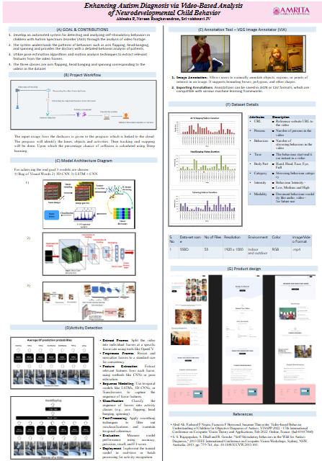
Poster

Slide 33
Explainable AI
1. SHAP (SHapley Additive exPlanations)
SHAP is a game-theory-based approach to explain individual predictions by attributing feature importance scores, called SHAP values, which quantify each feature's contribution to the prediction.
SHAP with DeepExplainer: DeepExplainer was used, which is designed specifically for deep learning models (e.g., those implemented in Keras/TensorFlow). This explainer computes SHAP values that represent the impact of each feature on the output for each class.
2. LIME (Local Interpretable Model-agnostic Explanations)
LIME is another interpretability method but follows a different approach. Instead of explaining the model directly, LIME perturbs the input and trains a local interpretable model (e.g., a linear model) around each prediction to approximate the behavior of the complex model.
Local Approximation: For each test sample, LIME creates variations by perturbing feature values and observes how the model’s prediction changes. Using this, it fits a simple interpretable model (usually a linear regression) on these perturbed samples, approximating the complex model's behavior locally.

Slide 34
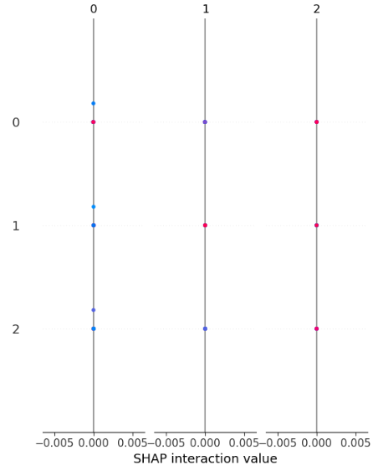
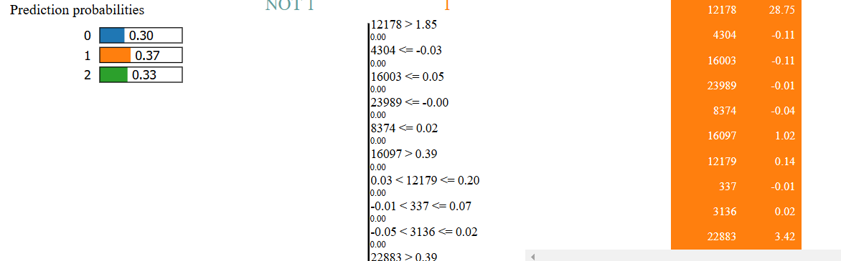
Explainable AI

Slide 35
Conclusion and Future Enhancement
Dataset Expansion: Collecting a larger and more diverse dataset, including various activities across different environments, can improve model robustness. Incorporating data from multiple cameras and angles can help the model generalize better across different contexts .
Real-time: Implementing real-time recognition capabilities could allow for immediate feedback to caregivers and educators, facilitating timely interventions. This would require optimizing the model for speed and efficiency .
Multimodal Data Input: Combining video data with other modalities, such as audio cues or physiological signals (like heart rate or galvanic skin response), could provide a more comprehensive understanding of behaviors and emotional states .

