Slide 1
Problem Statement
Develop an automated system for detecting and analyzing self-stimulatory behaviors in children with Autism Spectrum Disorder (ASD) through the analysis of video footage. The system understands the patterns of behaviors such as arm flapping, head banging, and spinning and provides the doctors with a detailed behavior analysis of patients.

Slide 2
INTRODUCTION
Computer Vision:
A field of artificial intelligence that enables computers to interpret, analyze and understand the visual world. It involves extracting meaningful information from images or videos, allowing machines to recognize patterns, identify objects, track movements and make decisions based on visual inputs.
Deep Learning:
A sub-field in machine learning that uses neural networks with multiple layers (deep neural networks) to automatically learn patterns and representations from data. Deep learning models can learn features directly from raw data, such as images or video, by passing them through several layers of transformations.

Slide 3
Deep Learning in Computer Vision:
Involves using deep neural networks (CNNs) to extract visual features from images or videos. These networks learn hierarchical representations, capturing low-level features (e.g.: edges) in early layers and high-level patterns (e.g.: body poses) in deeper layers.
How it solves this problem:
For the ASD behavior detection problem, a CNN+LSTM hybrid architecture is particularly useful:
CNNs analyze each frame of the video, identifying spatial features such as body position or movement.
LSTMs process the sequence of frames to detect temporal patterns, identifying repetitive behaviors over time.
By combining these approaches, the system can detect, track, and classify self-stimulatory behaviors in children with ASD.

Slide 4
Why use DL in CV:
Deep learning has revolutionized computer vision due to its ability to learn intricate features directly from raw data, such as images or videos. For problems like detecting and analyzing self-stimulatory behaviors in children with Autism Spectrum Disorder (ASD), DL provides several advantages:
Automated Feature Extraction: Deep learning can automatically learn the relevant visual patterns associated with behaviors like arm flapping, head banging, and spinning.
Handling High Dimensionality: Video data is complex, with both spatial and temporal dimensions. Deep learning models like Convolutional Neural Networks (CNNs) and Recurrent Neural Networks (RNNs) are well-suited to handle this complexity.
High Accuracy and Generalization: With enough data, DL models achieve high accuracy, making them effective in real-world applications. They can generalize across different children and video conditions.

Slide 5
How DL Addresses Analytical questions:
Object Detection: Deep learning models such as YOLO (You Only Look Once) can detect the presence of children in each frame of a video. These models are trained to recognize and localize specific objects (children) in images.
Tracking: Once the child is detected, object tracking algorithms (e.g., DeepSORT) are applied to follow the movement of the child across video frames.
Pose Estimation: Pose estimation networks like OpenPose or MediaPipe can be used to detect keypoints (joints, head, arms, etc.), enabling the system to track body parts, which helps in understanding behavior such as arm flapping or head banging.

Slide 6
How DL Addresses Predictive questions:
Action Detection Networks: Deep learning models like CNN+LSTM can identify and classify behaviors associated with autism. For example, repetitive movements such as hand flapping or spinning can be automatically detected as autism-specific actions.
Feature Extraction: Models can automatically extract behavioral features (e.g., repetitive actions, gaze aversion) and correlate these with established severity scales like the Autism Diagnostic Observation Schedule (ADOS).
Attention Mechanisms: Attention layers can be added to the model to highlight specific actions that are most relevant to autism detection, allowing the system to learn which actions are most predictive.

Slide 7
How DL Addresses Research questions:
Detecting Behaviors: Deep learning models (CNN+LSTM) can analyze large datasets of videos to identify common ASD behaviors, like repetitive movements. The models can also adapt to recognize non-verbal cues such as lack of eye contact or specific gestures.
Contextual Understanding: By analyzing sequences of frames, the models can detect not just the actions themselves but the context in which they occur. For instance, they can learn to identify if certain behaviors are triggered by specific stimuli in the environment.
Behavioral Progress Prediction: Through video analysis, deep learning models can track the progression of a child's behaviors over time, offering a predictive tool for understanding how a child’s behavior may evolve with or without intervention.

Slide 8
2. LITERATURE SURVEY
PAPER | MODEL ARCHITECTURE | DATASET | ALGORITHMS | ACCURACY | CV RESEARCH DONE | DISTANCE RELATED PROBLEMS | GEOMETRIC RELATED PROBLEMS
1. Deep Learning Algorithms to Identify Autism Spectrum Disorder in Children-Based Facial Landmarks by Hasan Alkahtani ^{1,2}, Theyazn H. H. Aldhyani ^{1,3,*} and Mohammed Y. Alzahrani Mohammed Y. Alzahrani ^{1,4} | (CNNs) for effectiveness in image analysis. The architecture consists of several convolutional layers followed by pooling layers, with fully connected layers at the end to classify the presence of ASD based on extracted features from facial landmarks. | They utilized a publicly available dataset from Kaggle, consisting of 2,940 images of both autistic and non-autistic children. This dataset was key to training and validating the models. | (CNNs) for feature extraction. Transfer learning techniques using pre-trained models (like VGG16, ResNet, etc.) to enhance performance. Data augmentation to improve model generalization. | The MobileNetV2 model achieved the highest accuracy, 92%, on the test set, outperforming other models used in previous research. This highlights the effectiveness of using transfer learning in the context of facial landmark-based ASD detection. | The study conducted empirical tests to find the optimal settings for hyperparameters and optimizers in the CNN models, ensuring robust performance for ASD detection. | Distance-related problems is how distances between facial landmarks are used as features in the model, analyzing variations in facial structure or expressions between children with and without ASD. | Geometric-related problems is the angles and ratios of facial landmarks, helping to identify characteristic patterns associated with ASD. This includes the geometric configuration of the face and how it correlates with diagnosed conditions.

Slide 9
PAPER | MODEL ARCHITECTURE | DATASET | ALGORITHMS | ACCURACY | CV RESEARCH DONE | DISTANCE RELATED PROBLEMS | GEOMETRIC RELATED PROBLEMS
2.An Approach to Recognize Human Activities based on ConvLSTM and LRCN Shradha Bhatia; Tushar Chauhan; Sumita Gupta; Sapna Gambhir; Jitesh H. Panchal | ConvLSTM: This model combines Convolutional Neural Networks (CNN) with Long Short-Term Memory (LSTM) networks. LRCN (Long-term Recurrent Convolutional Networks): The LRCN model is another architecture employed in this research. It integrates CNNs for feature extraction with LSTMs for sequence modeling. By utilizing both, the research aims to simplify the model while eliminating the need for complex feature engineering. | UCF101: A dataset with 101 action categories. HMDB51: Contains 51 action categories with videos from various sources. | ConvLSTM is particularly effective for handling spatiotemporal data, making it suitable for recognizing human activities. The LRCN model integrates CNNs for feature extraction with LSTMs for sequence modeling. | The LRCN (Long-term Recurrent Convolutional Networks) model achieved an impressive accuracy of 92%. This indicates that the model was highly effective in correctly predicting human activities based on the data it was trained on | Computer vision techniques are employed to extract relevant features from visual data. The convolutional layers in the CNN component of the LRCN model are responsible for this feature extraction, allowing the model to identify patterns and characteristics associated with different activities . | Distance can impact how activities are perceived. For example, if a camera is positioned too far away from the subject, it may struggle to capture fine details of the activity. The spatial resolution of the data collected can be influenced by distance. Higher distances may result in lower resolution images or video frames, which can hinder the model's ability to extract meaningful features | Spatial Relationships Pose Estimation Scale Variability Perspective Distortion Movement Trajectories Environmental Geometry

Slide 10
PAPER | MODEL ARCHITECTURE | DATASET | ALGORITHMS | ACCURACY | CV RESEARCH DONE | DISTANCE RELATED PROBLEMS | GEOMETRIC RELATED PROBLEMS
3.CNN-LSTM Based Approach for Analyzing and Detecting Stereotypical Motor Movements of Autistic Children in Pre-Meltdown Crisis Fatima Al-Rammah; Marwa Masmoudi; Salma Kammoun Jarraya | VGG16 Backbone: The vision part of the architecture utilizes a VGG16 network that has been pre-trained on the ImageNet dataset. Data Preparation and Model Configuration: The authors empirically tuned the choices regarding data preparation, configuration, and training settings. | MeltdownCrisis Dataset: The primary dataset utilized in this study is referred to as the MeltdownCrisis dataset. This dataset is specifically designed to capture realistic scenarios of autistic children's activities, focusing on two main states: Pre-Meltdown Crisis State: Normal State | The CNN component of the model is responsible for extracting spatial features from video frames. The LSTM algorithm is integrated into the model to capture temporal dependencies in the data. This is crucial for understanding how movements evolve over time, particularly in predicting the onset of a Meltdown Crisis state. The authors conducted empirical tuning of the model configuration, data preparation, and training settings. | The final choices regarding data preparation, model configuration, and training settings were tuned and set empirically to end with a 98% recall and F1 Score, while the best loss value achieved was 0.034. | YOLOv3 is used for object detection, enabling the model to focus on the region around each child in the video frames. After detecting the target region with YOLOv3, Gaussian blurring is applied to the rest of the frame to reduce noise and emphasize the region of interest (ROI). | Spatial Relationships: The paper discusses challenges related to the spatial relationships between key points or body parts during motor movement. Movement Trajectories: The analysis of how distance changes during movement | Pose Estimation: The paper highlights issues with accurately estimating the geometric configuration of the child's body during motor movements. Temporal Variability Background Interference

Slide 11
3. FEATURES OF THE DEEP LEARNING ARCHITECTURE
1. Convolutional Neural Network (CNN):
Convolutional Layers: These layers automatically learn spatial hierarchies of features from the input frames. They help in detecting edges, shapes, and patterns relevant to the behaviors.
Pooling Layers: Max pooling or average pooling layers reduce the dimensionality of feature maps while retaining essential information, improving computational efficiency and reducing overfitting.
Activation Functions: Non-linear activation functions (e.g., ReLU) introduce non-linearity into the model, enabling it to learn complex patterns.
2. Long Short-Term Memory (LSTM) Features:
Recurrent Layers: LSTM layers process sequences of data, capturing temporal dependencies between frames. This is essential for understanding the dynamics of motor movements over time.
Memory Cells: LSTMs have memory cells that help retain information across time steps, allowing the model to remember relevant past information while forgetting irrelevant details.
Bidirectional LSTM: Optionally, a bidirectional LSTM can be employed to learn from both past and future frames, enhancing context understanding.
3. Input Features:
Temporal Features: Incorporation of a sequence of frames allows the model to understand the timing and duration of behaviors, which is critical for identifying stereotypical movements.
Spatial Features: CNN extracts spatial features from individual frames, capturing the appearance and configuration of the child’s movements.

Slide 12
4. Output Features:
SoftMax Layer: The final output layer typically uses the SoftMax function to produce a probability distribution over the different behavior classes (e.g., arm flapping, head banging, spinning).
Multi-class Classification: The architecture supports multi-class outputs, enabling the classification of multiple behaviors in a single framework.
5. Training Features
Loss Function: Categorical cross-entropy loss is used to measure the model's performance, guiding the optimization process during training.
Regularization Techniques: Techniques like dropout may be used to prevent overfitting, ensuring that the model generalizes well to unseen data.
6. Preprocessing Features
Data Augmentation: Techniques such as random cropping, rotation, or flipping can be employed to increase the diversity of the training dataset and improve model robustness.
Normalization: Input frames may be normalized to standardize pixel values, improving the convergence speed during training.

Slide 13
4. COMPUTER VISION BASED APPROACH
CNNs:
Extract spatial features from images or frames and perform image classification and feature extraction in video frames to identify behaviors like arm flapping or head banging.
You Only Look Once (YOLO):
Real-time object detection algorithm. Detects and locates the child within a video frame, allowing for focused analysis on specific regions of interest.
Long Short-Term Memory (LSTM) Networks:
Capture temporal dependencies in sequential data.: Analyze sequences of frames to understand the temporal dynamics of motor movements associated with ASD.
Behavioral Analysis using Video Data
Citation: Li, Y., et al. (2020). "Video-based behavioral analysis using deep learning." Pattern Recognition.
Conclusion: The authors proposed a deep learning framework for analyzing behaviors in video data. They demonstrated that their model could effectively distinguish between normal and atypical behaviors, achieving high accuracy. The study concluded that video-based analysis could be a powerful tool for monitoring children with ASD, aiding in early diagnosis and intervention.

Slide 14
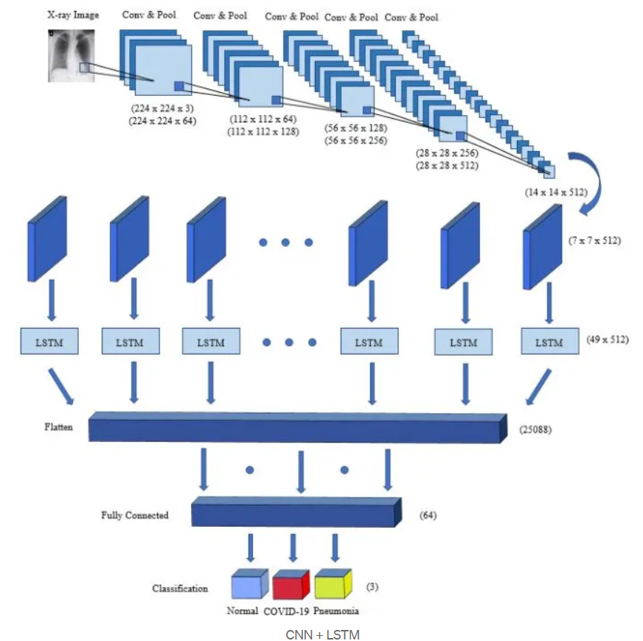
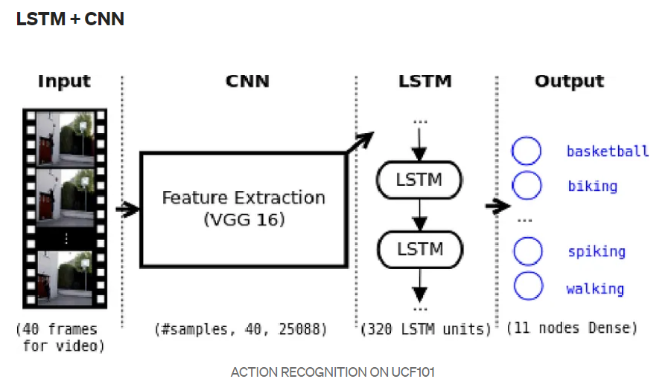
5. METHODOLOGY/APPROACH

Slide 15
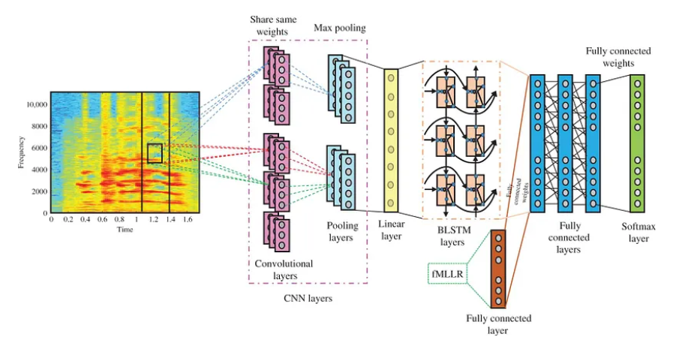

Slide 16
Input Video (Frames)
Preprocessing
(Blurring, ROI)
Feature Extract.
(CNN, Optical Flow)
Output
(Predictions)
Classification (SoftMax Layer)
Temporal Analysis (LSTM)

Slide 17
Algorithm for CNN-LSTM:
Input Data:
Let X be a sequence of video frames: X={x1,x2,…,xT}, X={x1​,x2​,…,xT​}. Each frame xT ​ is an image of dimensions heightxwidthxchannels.
Convolutional Layer:
For each frame xtx_txt​, apply convolution operations to extract features: Ft=Conv2D(xt,W,b). Where W is the convolutional filter (weights) and b is the bias.
After convolution, apply an activation function (ReLU): Ft=ReLU(Ft)
Pooling Layer:
Apply max pooling to reduce spatial dimensions: Pt=MaxPool(Ft)
Feature Extraction:
Flatten the pooled output for each frame: Fflattened,t=Flatten(Pt)
Sequence Preparation:
Stack the features from all frames to form a sequence: F={Fflattened,1,Fflattened,2,…,Fflattened,T}. Where F is now a 3D tensor of shape (T,D) with D being the number of features after flattening.

Slide 18
Input to LSTM:
Feed the sequence F into the LSTM. For each time step t:
Compute the LSTM hidden state: ht=LSTM(Ft,ht−1,Ct−1) . Where h_t​ is the hidden state, ht−1is the previous hidden state, and Ct−1 is the previous cell state.
Output Layer:
After processing the entire sequence, the final hidden state h_T​ is used for classification: y=SoftMax(Wout⋅hT+bout). Where Wout and bout​ are the output layer weights and biases.
Loss Function:
Use Categorical Cross-Entropy loss for multi-class classification: L=−∑(i=1 to N) yi log⁡(y^i). Where N is the number of classes, yi​ is the true label, and y^i​ is the predicted probability for class i.
Backpropagation:
Update the weights using an optimization algorithm (e.g., Adam): W←W−η.(∂L/∂W). Where η is the learning rate and W is updated weight.

Slide 19
6. WHY THIS ARCHITECTURE
CNN-LSTM architecture is chosen for its ability to effectively analyze video data by combining spatial and temporal processing, leading to better understanding and recognition of complex behaviors. This is important in the context of ASD, where understanding subtle behavioral cues is crucial for early detection and intervention.
Convolutional Neural Networks (CNNs) are adept at capturing local patterns in images, such as edges, textures, and shapes. This ability is crucial for recognizing specific behaviors (e.g., arm flapping, head banging) based on visual cues.
Long Short-Term Memory (LSTM) networks are designed to process sequential data, making them suitable for analyzing video frames over time. They capture temporal dependencies and changes in behavior.
LSTMs maintain a memory of past states, enabling them to remember important features over longer sequences, which is crucial for recognizing behaviors that unfold over time.
The combination of CNNs and LSTMs allows for a comprehensive analysis of both spatial and temporal information. While CNNs focus on extracting relevant features from each frame, LSTMs track how those features evolve, providing a richer understanding of behavior.

Slide 20
7. HYPERPARAMETER TABLE
Hyperparameter | Purpose | Values
Learning Rate | How much a model's parameters adjust during each iteration of the optimization algorithm | 0.00001, 0.0001, 0.001, 0.01, 0.1
Batch Size | The number of data samples processed together in one go during training | 16,32,64,128
Epoch | One complete pass through the entire training dataset. | 20,50,100,200
Dropout Rate | Probability of dropping out each unit in the hidden layer | 0.2,0.3,0.4.0,0.5
Kernel Size | The receptive field of each convolutional operation | (3, 3, 3), (5,5,5), (7,7,7)
Number of Filter Layers | Performs a linear operation called convolution. | 32,64,128,256
Optimizer | Minimize an error function (loss function) or to maximize the efficiency of production. | adam, RMSprop, SGD
LSTM Units | Number of memory units in the LSTM layer | 32,64,128,256
Sequence Length | Number of frames (time steps) fed into the LSTM | 10,20,30,40
Activation Function | Function applied to the outputs of each layer | ReLU, Sigmoid, Tanh

Slide 21
Component | Details
Input Layer | Accepts a sequence of 100 frames with a shape of 100×180×180×3(RGB images)
VGG16 (TimeDistributed) | Modified VGG16 without fully connected and SoftMax layers. Input size: 180×180, Pre-trained on ImageNet. Outputs feature maps of shape 5×5×512
Flatten Layer | Flattens the feature maps into a single vector of size 12800.
Dense Layer | Dense layer with 512 units, Activation: ReLU.
LSTM Layer 1 | 512 units, Dropout rate: 0.2, Activation: tanh, Input shape: 100,512 (from VGG16 output).
LSTM Layer 2 | 512 units, Dropout rate: 0.2, Activation: tanh.
Fully Connected Layer | Reduces vector size from 512 to 256 units.
Dropout Layer | Dropout rate of 0.4 to reduce overfitting.
SoftMax Layer (for 3 classes) | Produces a probability distribution across 3 classes (e.g., Arm Flapping, Head Banging, Spinning).
Output | Predicted category of the autistic child’s state (arm-flapping, head-banging, spinning).

Slide 22
8. HYPERPARAMETER TUNING
Grid Search:
Systematically test all possible combinations of hyperparameter values.
Random Search:
Randomly sample hyperparameter combinations, which can be more efficient than grid search.
Bayesian Optimization:
Use probabilistic models to find the best hyperparameters based on previous evaluations.
Hyperband:
Combines random search with early stopping to efficiently allocate resources to promising hyperparameter configurations.
Cross-Validation:
Use k-fold cross-validation to assess the performance of different hyperparameter settings robustly.

Slide 23
Hyperparameter | Purpose | Values
Learning Rate | How much a model's parameters adjust during each iteration of the optimization algorithm | 0.0001
Batch Size | The number of data samples processed together in one go during training | 32
Epoch | One complete pass through the entire training dataset. | 50
Dropout Rate | Probability of dropping out each unit in the hidden layer | 0.5
Kernel Size | The receptive field of each convolutional operation | (3, 3, 3)
Number of Filter Layers | Performs a linear operation called convolution. | 128, 64
Optimizer | Minimize an error function (loss function) or to maximize the efficiency of production. | adam
LSTM Units | Number of memory units in the LSTM layer | 128
Sequence Length | Number of frames (time steps) fed into the LSTM | 30
Activation Function | Function applied to the outputs of each layer | ReLU

Slide 24
9. SETUP PLANNED
Google Colab to be used to build and train the proposed model. This platform is built upon the Jupyter notebook and is prepared to develop machine learning projects because it is supports by libraries like TensorFlow and Keras.
There are extra utilities used to support development through Python. NumPy, for instance, enables us to handle high dimensional data, while Scikit-learn library is employed to prepare the dataset and preprocess its samples.
Colab is works efficiently with a high-capacity P100 GPU, 32 GB RAM, and 128 Disk.
Steps:
Data Collection (Downloading video data and labelling into classes)
Preprocessing (Frame extraction, ROI, Gaussian Blurring, Normalisation)
Model Architecture (CNN+LSTM+O/P layer (softmax))
Training Setup (Data splitting (70:20:10), Loss function (categorical cross entropy))
Evaluation (Model Testing and Error Analysis)
Deployment (Real Time Monitoring and Results )
Ethical Considerations (Privacy and unbiased)

Slide 25




10. PERFORMANCE METRICS
Each metric reflects the model's performance and stability in a specific aspect. Regarding the research aim and the dataset nature, Recall, Precision, and F1 Score will be taken into consideration.
1. Recall: This metric measures the rate of positive samples that are correctly identified by the model.
2. Precision: This calculates the ratio between True Positive (TP) and all positives
3. F1 Score: The F1 Score is the harmonic mean of precision and recall, providing a balance between the two metrics.
4. Categorical Cross-entropy (CE) Loss: The output layer includes the SoftMax function which generates a vector of probabilities associated with each sample as potential output. So, E is used to measure the confidence of each sample output generated by SoftMax.

Slide 26
Why these metrics:
1. Recall:
Recall measures the model's ability to correctly identify positive samples for each behavior. In contexts like ASD, where certain behaviors may be infrequent or critical to recognize, high recall ensures that the model captures as many true instances of each behavior as possible. Missing a significant behavior could have serious implications for monitoring and intervention.
2. Precision:
Precision evaluates how many of the predicted instances for a behavior are actually correct. High precision is essential to avoid false positives, which can lead to unnecessary concern or misdiagnosis. For caregivers and professionals working with individuals with ASD, understanding when a behavior is genuinely present is crucial.
3. F1 Score:
The F1 Score provides a balance between recall and precision. In cases where there's a trade-off (e.g., increasing recall might decrease precision), the F1 Score helps gauge the model's overall effectiveness. This is particularly valuable in ASD behavior analysis, where both identifying behaviors and ensuring accuracy are important.
4. Categorical Cross-entropy (CE) Loss:
Categorical Cross-entropy Loss is suitable for multiclass problems as it quantifies the difference between the true labels and the predicted probabilities. It helps guide the training process by penalizing the model for incorrect predictions, encouraging it to improve over time. This metric is crucial for ensuring that the model learns effectively from all classes.

Slide 27
Why not other metrics:
Accuracy: While accuracy is a common metric, it can be misleading in multiclass problems, especially with imbalanced datasets. For example, if most behaviors are classified as one dominant class, high accuracy can be achieved without effectively identifying the minority classes (e.g., rare behaviors).
Specificity: Specificity focuses on true negatives, which might be less relevant in the context of behavioral detection. For ASD behaviors, the priority is often on detecting the presence of specific behaviors rather than accurately identifying when they are not present.

