Slide 1
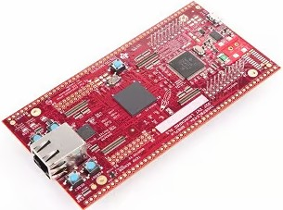
ABINESH S(RA2311004010089)
CEM TASK -1
LAUNCHXL-F28379D Development Kit

Slide 2
Introduction to LAUNCHXL-F28379D
LAUNCHXL-F28379D is a development kit developed by Texas Instruments (TI).
It is built around the TMS320F28379D real-time control microcontroller.
The board provides a platform to program, test, debug, and evaluate the MCU.
It includes onboard USB, debugging, power, headers, and peripheral interfaces.
The board provides access to MCU functions such as GPIO, PWM, ADC, CAN, and encoder interfaces.
It is designed for applications requiring high-speed and real-time control.
The LaunchPad helps developers evaluate the F28379D before developing a custom hardware design

Slide 3
Board Overview & Main Components
The LAUNCHXL-F28379D combines the F28379D MCU with supporting hardware on a single development board.
The TMS320F28379D is the main processing device responsible for executing the user program.
An onboard XDS100v2 debug probe provides programming and debugging support.
The USB interface connects the LaunchPad to a development computer.
Four 20-pin BoosterPack headers provide access to MCU signals and external connections.
The board includes LEDs, push buttons, CAN and encoder interfaces for development and testing.
Power circuitry, jumpers, reset and boot controls support the operation and configuration of the board.

Slide 4
TMS320F28379D Microcontroller
The TMS320F28379D is the main microcontroller mounted on the LAUNCHXL-F28379D board.
It belongs to the TI C2000 family, designed for real-time control applications.
The MCU contains dual C28x CPUs for high-performance processing.
It includes Flash and RAM for storing program code and temporary data.
The MCU provides multiple peripherals for connecting and controlling external hardware.
Important peripherals include PWM, ADC, GPIO, CAN, ePWM, eQEP, and communication interfaces.
These integrated resources allow the F28379D to process inputs, perform calculations, and generate outputs.
The LaunchPad provides convenient access to these MCU resources through its headers and onboard interfaces.

Slide 5
USB, XDS100v2 & JTAG
The board uses a Micro-USB connection to communicate with the development computer.
The LaunchPad has an onboard XDS100v2 debug probe, so a separate programmer is not required.
The XDS100v2 connects the computer to the F28379D through the JTAG interface.
JTAG is used to program the MCU and debug the running application.
Through the debugger, we can run, stop, step through code, and inspect variables.
The USB connection can also provide power to the LaunchPad during development.
Overall path: PC → USB → XDS100v2 → JTAG → F28379D.

Slide 6
Power Supply & Connections
The LaunchPad includes onboard power-management circuitry to provide the required supply rails to the board.
The USB connection can power the board during normal development and programming.
The board provides 5 V and 3.3 V supply connections through its headers for external circuits.
The F28379D MCU operates using its required low-voltage supply rails provided by the board.
Power connections are available through the 20-pin headers and dedicated board connectors.
External peripherals can use the available board supplies, provided their voltage and current requirements are suitable.
Motor or other high-power loads should not be powered directly from the LaunchPad; they require a separate power stage.

Slide 7
Pin Configuration & 20-Pin Headers
The LaunchPad provides four 20-pin headers: J1, J2, J3, and J4.
These headers expose the GPIO pins and peripheral functions of the F28379D to external circuits.
A single MCU pin can support multiple functions through the device's Pin Multiplexing (PinMux).
For example, J4 Pin 40 can provide GPIO0 / ePWM1A, depending on the selected configuration.
J3 provides access to several ADC input channels for connecting analog signals.
The headers also provide power and ground connections for external circuits.
Pin numbers on the LaunchPad headers are not the same as the physical MCU package pin numbers.
The exact pin functions are defined in the TI LAUNCHXL-F28379D User's Guide and F28379D datasheet.

Slide 8
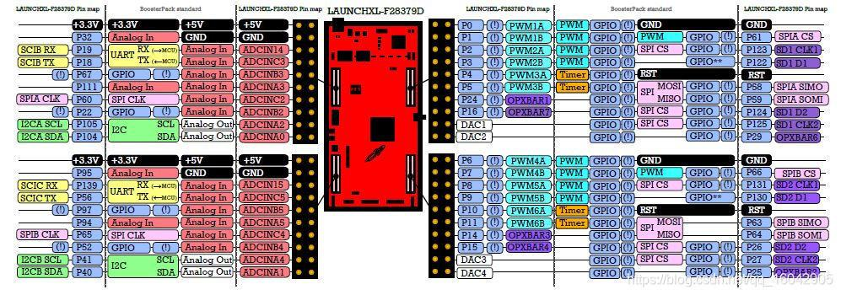
PIN CONFIGURATION

Slide 9
CAN, Encoder, LEDs & Push Buttons
The board provides a CAN interface for communication between the F28379D and other electronic control units.
The CAN peripheral inside the MCU communicates with an external CAN transceiver to connect to the CAN bus.
The board provides an encoder/QEP interface for receiving position and speed-related feedback from an encoder.
Onboard LEDs provide simple visual feedback for program status and debugging.
Push buttons can be configured as user inputs through the MCU's GPIO.
These interfaces allow developers to test communication, feedback signals, and basic control functions directly on the LaunchPad.
They are especially useful when developing and testing embedded control applications before moving to custom hardware.

Slide 10
Board Architecture & Applications
The F28379D MCU acts as the central processing unit of the LaunchPad.
The USB and XDS100v2 provide the connection between the development PC and MCU for programming and debugging.
GPIO, ADC, PWM, CAN, and eQEP provide interfaces for sensing, communication, and control.
The 20-pin headers make many MCU signals available for external circuits and BoosterPacks.
LEDs and push buttons provide simple user interaction and program-status indication.
The board can interface with sensors, encoders, communication networks, and external control circuits.
It is suitable for development and evaluation of motor control, power electronics, digital power, and other real-time control applications.
The LaunchPad can be used as a development platform before designing a custom PCB.

Slide 11
F28379D Key Specifications & Peripherals
The TMS320F28379D is a high-performance microcontroller from the TI C2000 family.
It contains two C28x CPU cores with a CPU clock of up to 200 MHz.
The device provides Flash and RAM memory for storing programs and executing applications.
It includes ePWM and ADC modules for generating control signals and processing analog inputs.
CAN, SPI, SCI, and I²C provide communication with external devices and controllers.
eQEP interfaces support feedback from incremental position encoders.
GPIO pins provide configurable digital inputs and outputs for external hardware.
These features make the F28379D suitable for motor control, power electronics, and real-time control applications.

