Slide 1

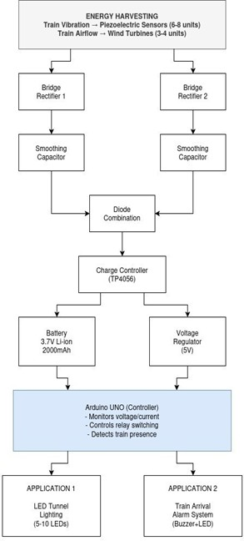
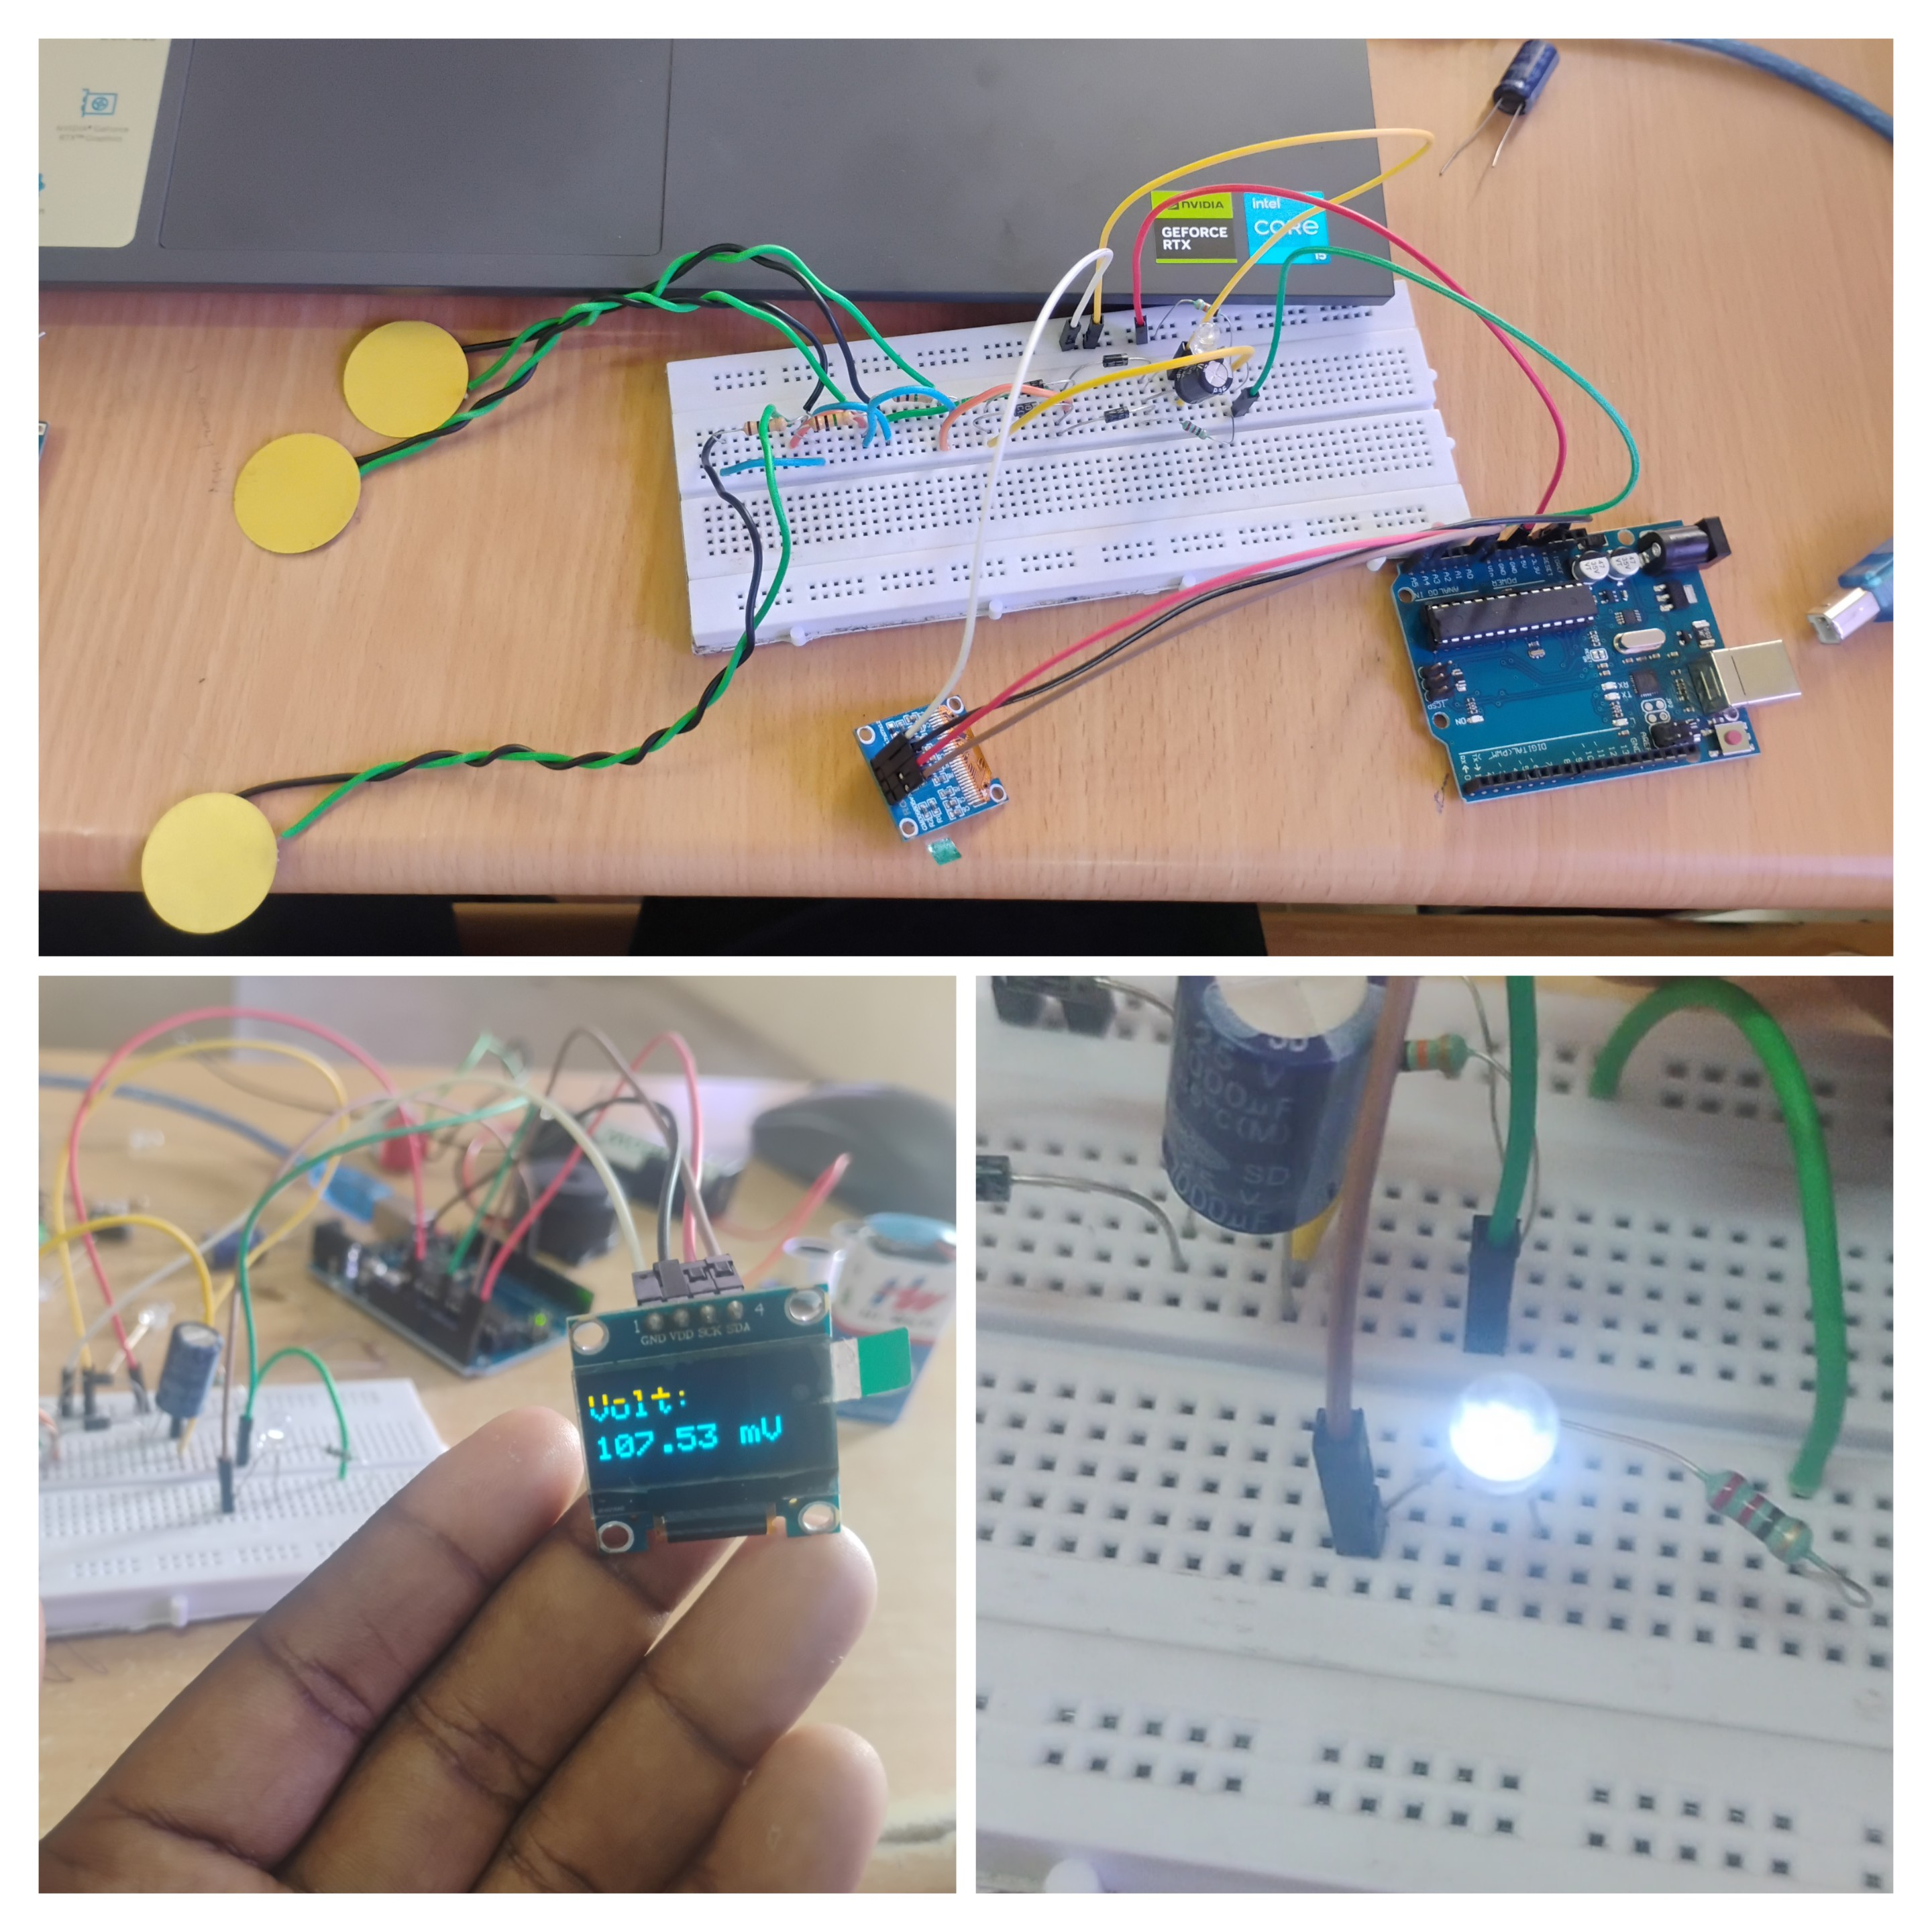
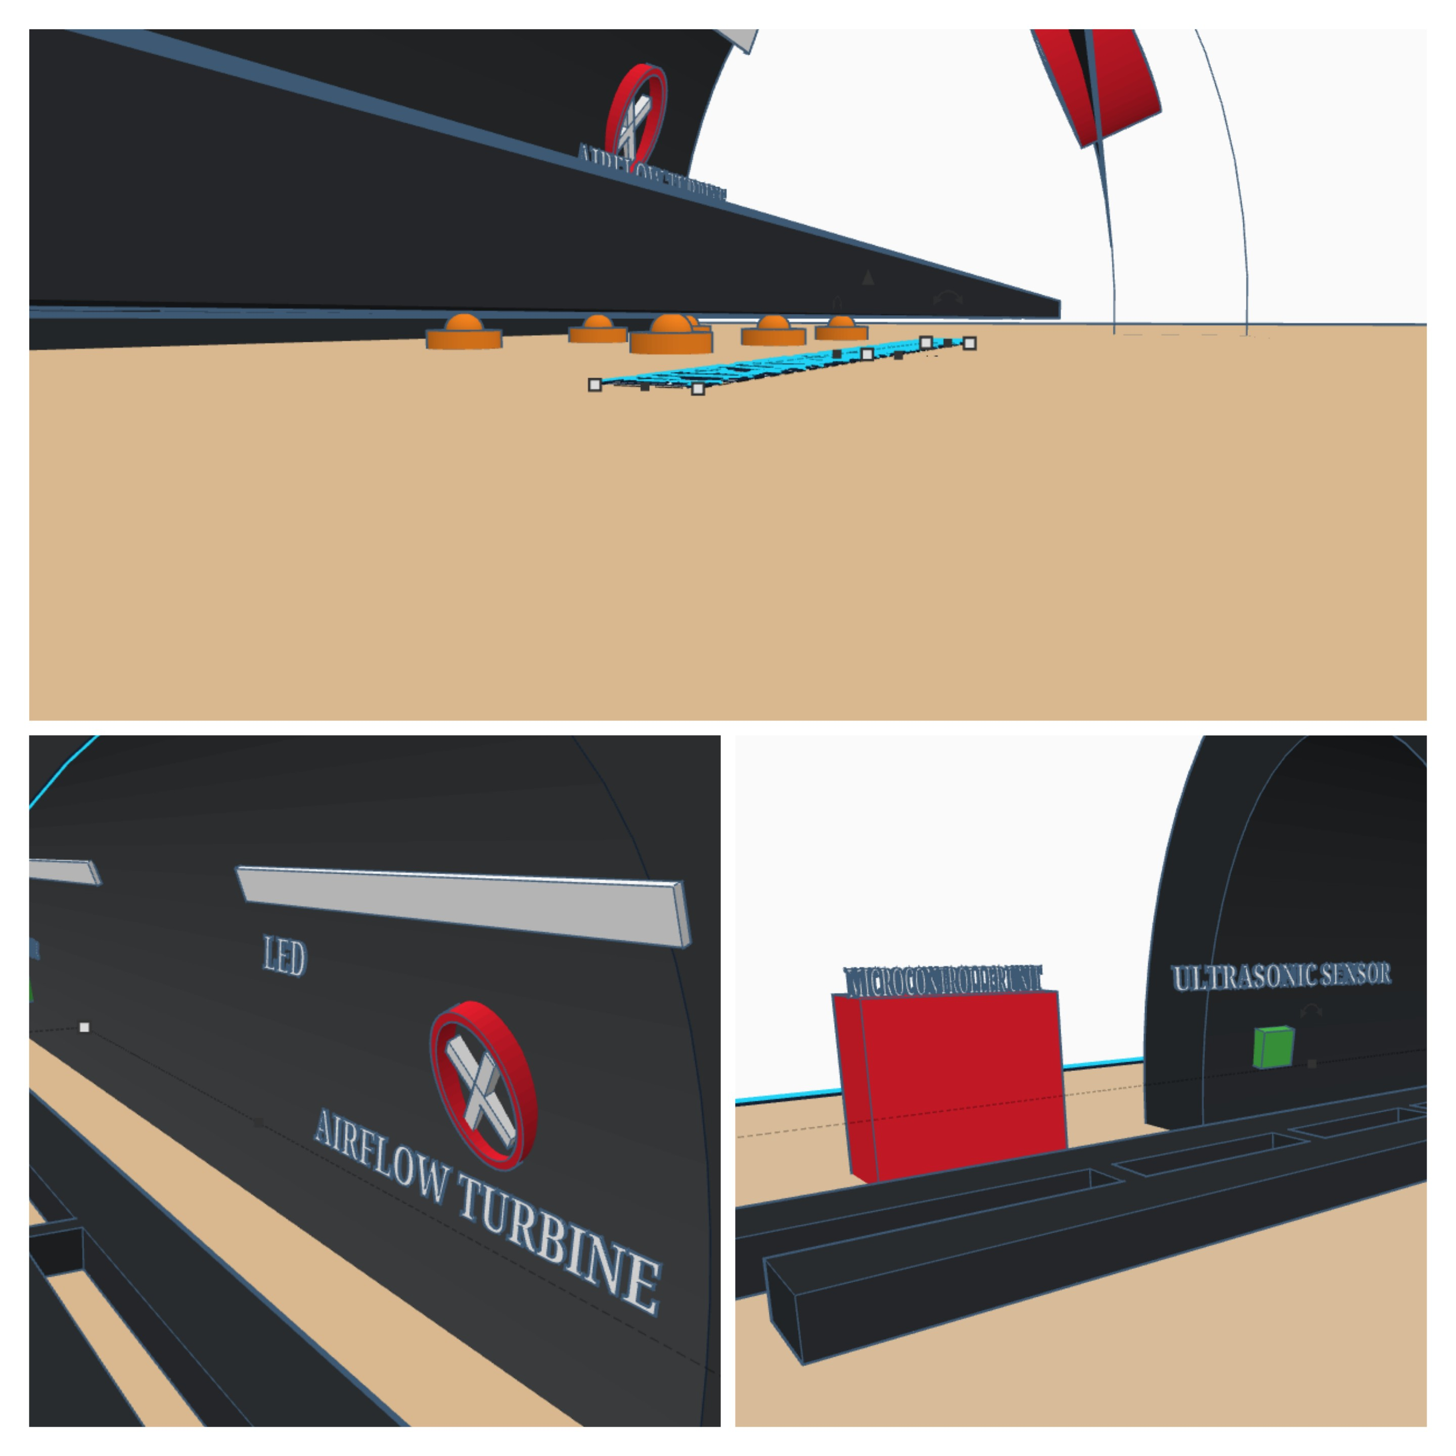
HYBRID ENERGY HARVESTING SYSTEM USING TRAIN-INDUCED VIBRATION AND AIRFLOW IN RAILWAY TUNNELS
Customers / Stakeholders
Railway authorities managing tunnel infrastructure, safety, and lighting Tunnel maintenance teams handling electrical systems and operations Smart city planners focusing sustainable transport and energy
Team Members
DHANUSH S - 2311030
SATHISH KUMAR V - 2311112
AROCKYA ABINESH A -2311123
Mentors
Mrs. E. KIRTHIGA@SRIDEVI ME.,
Assistant Professor
Pain Points/ Problems
Tunnel lighting consumes high electricity from external power grid Existing systems use only single source energy harvesting methods High installation wiring and maintenance costs reduce efficiency
Block Diagram
Prototype Photo
Solution Uniqueness
Hybrid system combines vibration and airflow for efficient generation Self powered tunnel lighting eliminates dependency on external electricity Energy generation triggered only during train movement for efficiency
CAD Model
Results:
Parameter | Piezoelectric Module | Airflow Module | Hybrid System
Voltage (DC) | 0.3V – 3V | 1V – 5V | 2V – 5V
Stability | Low (Vibration dependent) | Medium (Speed dependent) | High (Combined)
Primary Use | Low-power sensing | Battery charging/Lighting | Continuous tunnel power +1

