Slide 1
⚡ API LOGGING FRAMEWORK
Production-Grade Full-Stack Platform for Centralized API Observability
Capture every request & response, monitor performance, and give teams complete visibility — without slowing it down. Built and iterated through 3 real implementations.
🧸 CORE PUFFS
✓ Every Request Logged
✓ Zero-Latency terminate()
✓ Global Middleware
✓ Dual DB Isolation
✓ Role-Based Access
✓ Advanced Filters
✓ AWS Production
🎨 Claymorphism Edition
Laravel Backend API
React Axios
Dual DB PostgreSQL
Sanctum Auth
AWS EC2 + Nginx
🔥 Not a bolt-on library — fully engineered observability layer
💎 Why it matters: Every API outcome 200 • 201 • 400 • 401 • 403 • 404 • 422 • 500 captured via global middleware + terminate() zero-latency.

Slide 2
🧁 TABLE OF CONTENTS — Claymorphism Edition
01
Overview & Problem
Why observability matters
02
Tech Stack
Deliberate choices
03
System Architecture
Request flow & pipeline
04
Modules Deep Dive
Auth RBAC CRUD Logging
05
Log Filter + Dual DB
Query & isolation
06
Deployment & Setup
AWS + Local + Env
07
Engineering Decisions
Trade-offs explained
08
Feature Checklist
Shipped features

Slide 3
🌈 OVERVIEW — What problem does this solve?
🍓 THE PROBLEM — APIs are invisible until break
Developers fallback on: • Scattered var_dump() calls • Generic web-server logs • Expensive third-party APM tools Basic questions unanswered: Who called? What did they send? Why did it fail?
🌿 THE SOLUTION — Full observability layer
Captures, stores, filters, manages logs for EVERY single API request & response — success or failure. ✓ Zero impact response time ✓ Fully engineered, not bolt-on ✓ Iterated through 3 real implementations
👥 TWO ROLES. ONE PLATFORM.
🎓 Professor → Create/update/delete notes; full read; via Student CRUD [WRITE+READ]
👨‍🎓 Student → Read-only notes; Sanctum token auth [READ ONLY]
💡 Differentiator: Not a logging library. It's a production observability layer built to answer who, what, why for every API interaction — with bubbly claymorphism UI!

Slide 4
🧰 TECH STACK — Every tech chosen deliberately
🚀 Backend
⚛️ Frontend
🔐 Auth
🐘 Primary DB
Laravel, PHP
REST APIs, routing, middleware, Eloquent
React, Axios, Bootstrap
SPA client, HTTP, UI
Sanctum
Lightweight revocable tokens
PostgreSQL pgsql
Students, notes, tokens
📊 Logging DB
☁️ Cloud
🌐 Server
🧰 Tooling
PostgreSQL log_pgsql
Isolated api_logs storage
AWS EC2
Production hosting
Ubuntu, Nginx
Reverse proxy + static
Git, Postman, Composer
Version control, testing

Slide 5
🏗️ SYSTEM ARCHITECTURE — Request Flow
CLIENT BROWSER
React → Axios
💎 WHY IT MATTERS — Clay View
Global Guarantee
Registered in Kernel.php $middleware, not api group. Runs on EVERY request incl. 401/403/404.
Zero Latency
terminate() after client response. DB write behind scenes.
Captured Fields
• user & role, method, endpoint, headers • body req/res, IP, UA, status, time ms
✅ All: 200 201 400 401 403 404 422 500
GLOBAL MIDDLEWARE
ApiLoggerMiddleware::handle() start timer ⏱️
SANCTUM AUTH
Validate token, user & role
CONTROLLER
Business logic / validation / CRUD
MAIN DB
PostgreSQL pgsql — students | notes | tokens
RESPONSE ⚡
Sent immediately — ZERO wait
TERMINATE
terminate() AFTER response → log_pgsql api_logs

Slide 6
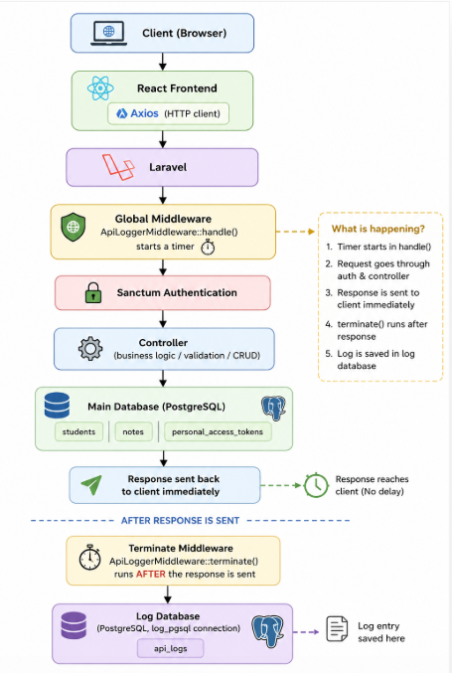
🖼️ ARCHITECTURE DIAGRAM — Visual Flow

Slide 7
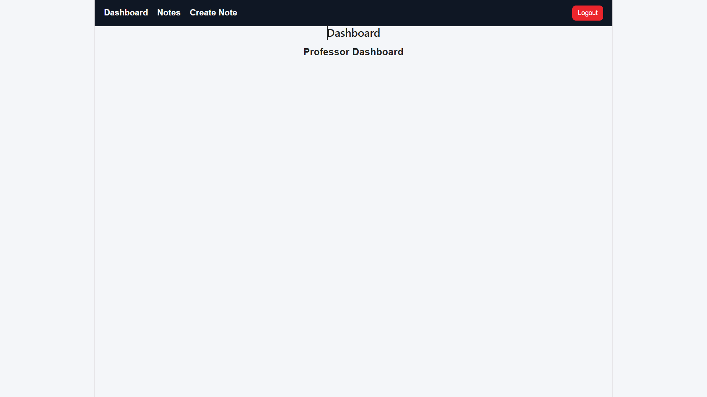
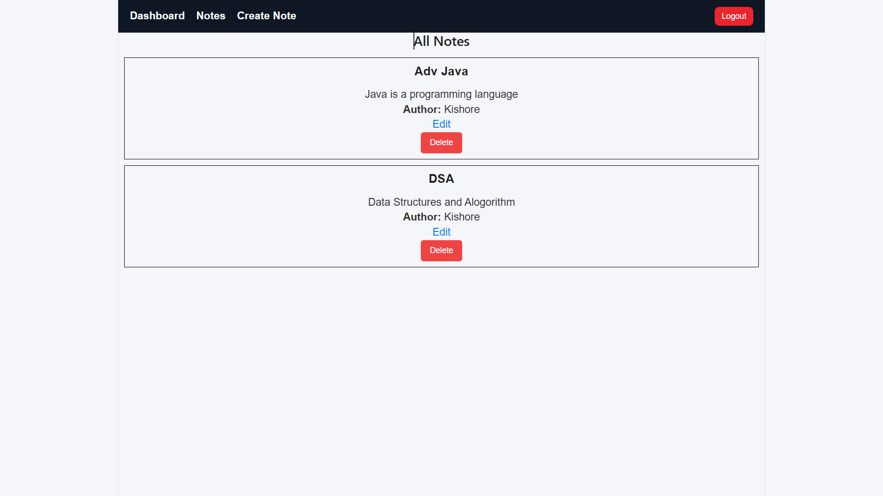

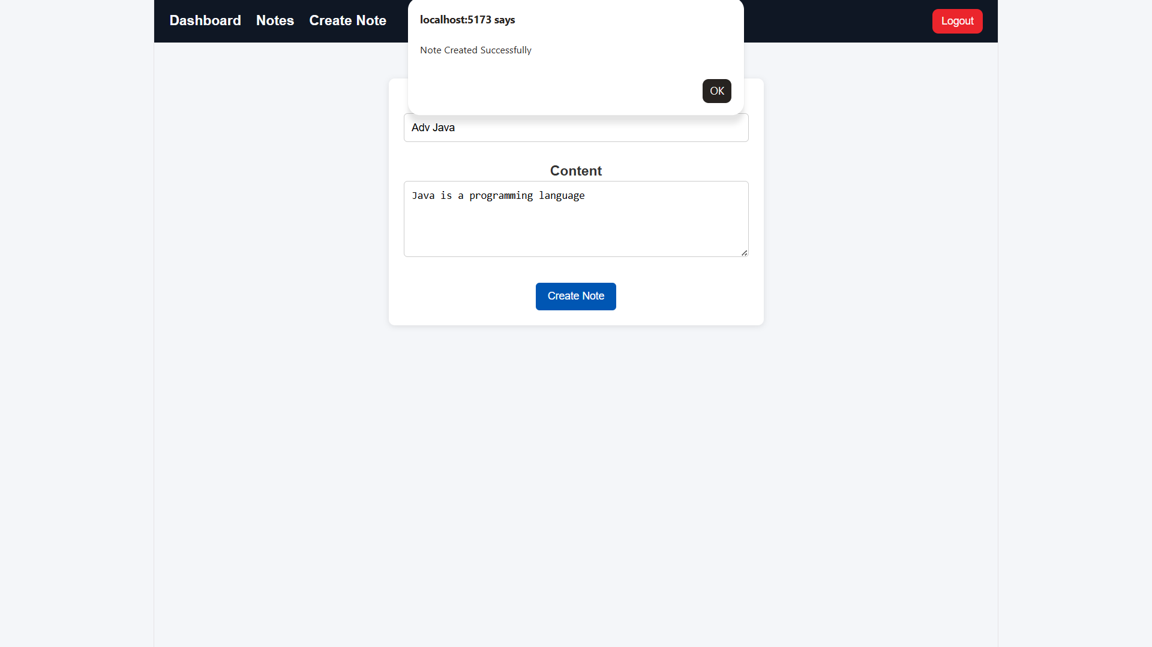
📸 SCREENSHOTS — Visual Walkthrough (Clay Cards)
Student Dashboard
Notes Dashboard
Student CRUD
Create Notes

Slide 8
🧩 MODULES — Feature Puffs
🔐 Auth
🛡️ RBAC
👨‍🎓 Student CRUD
📝 Notes Mgmt
Sanctum tokens, Bcrypt, /me, email alert
Professor vs Student, RoleMiddleware
GET POST PUT DELETE, $fillable
hasMany / belongsTo via user_id
📡 Logging Core
🔍 Filter API
💾 Dual DB
☁️ AWS Deploy
Global + captures all fields
method, status, date, endpoint, user
pgsql + log_pgsql isolation
EC2 + Nginx + Backup vault

Slide 9
📡 API LOGGING MIDDLEWARE — Core Puff
🔥 How Clay Logs Work — Bubbly but Powerful
Captures user, role, method, endpoint, headers, bodies, IP, UA, status, response time.
1️⃣ Global Registration (Puffy Border)
In Kernel.php $middleware, not api group. Groups only after router match → 401/403/404 invisible before. Global = 100% visibility.
2️⃣ handle() — Start Timer ⏱️
Starts microtime, passes request.
3️⃣ terminate() — Zero-Latency Puff
Called AFTER response sent. ApiLog::create() in log_pgsql behind scenes. Zero perceived latency.
✅ Covers 200 201 400 401 403 404 422 500
Kernel.php
$middleware = [ ... ApiLoggerMiddleware::class, ];
Middleware
handle(){ start=microtime() return next(req) } terminate(){ ApiLog::create() }
⚡ Performance Win — Clay Style
Inline in handle(): client waits for DB → slow. terminate(): response first, log after. Same lifecycle, no extra infra, zero latency. Queue evaluated first but needed worker + jobs table → overkill.

Slide 10
🔍 LOG FILTER API + 💾 DUAL-DB — Claymorphism
🔎 Filter Puffs — Paginated
☁️ AWS Deployment — Puffy Cloud
Ubuntu EC2 single instance: • Nginx → React static + reverse proxy to PHP-FPM • Laravel + both PostgreSQL • AWS Backup vault, plan, recovery points Flow: Client → Nginx → React/Laravel → Main DB → Response → Terminate → Log DB
Method
method
GET POST PUT DELETE
Status
status_code
404 500 etc
Date
from / to
Timestamp range
Endpoint
endpoint
Partial URI
User
user_id
By auth user
GET /api/logs?method=POST&status=422&from=2024-01-01 → paginated JSON
🔐 RBAC — Clay Shield
Professor: Full CRUD notes Student: Read-only, Sanctum token Enforced RoleMiddleware + controller checks Form Request + $fillable anti mass-assignment
💾 Dual DB — Why Two? (Clay Isolation)
• pgsql → students, notes, tokens • log_pgsql → api_logs, dedicated ApiLog model • Prevents lock contention, perf isolation • config/database.php two connections

Slide 11
⚙️ LOCAL SETUP — Clay Steps
📋 Prerequisites — Puffy List
PHP 8.1+ • Composer 2.0+ Node 18+ • PostgreSQL 13+ Two DBs: main + logging
1️⃣ Clone
2️⃣ Backend
3️⃣ Frontend
git clone <repo> cd api-logging-framework
composer install cp .env.example .env php artisan key:generate php artisan migrate migrate --database=log_pgsql storage:link php artisan serve
npm install npm run dev → http://localhost:5173
🔑 ENV: DB_*, LOG_DB_* (log_pgsql), SANCTUM_STATEFUL_DOMAINS, MAIL_* for alerts • .env gitignored never commit! Clay secure!

Slide 12
📁 PROJECT STRUCTURE — Clay Tree
api-logging-framework/ ├── backend/ │ ├── app/Http/ │ │ ├── Controllers/ → Auth, Student, Note, Log │ │ ├── Middleware/ │ │ │ ├── ApiLoggerMiddleware.php (global+terminate) 🧸 │ │ │ └── RoleMiddleware.php (RBAC) 🛡️ │ │ └── Kernel.php (registration) │ ├── Models/ │ │ ├── Student.php hasMany Note │ │ ├── Note.php belongsTo Student │ │ └── ApiLog.php uses log_pgsql 💾 │ ├── config/database.php pgsql+log_pgsql │ ├── migrations/ students, notes, api_logs │ └── routes/api.php └── frontend/ ├── src/pages/ Login, Notes, Students, Logs (filter) 🔍 ├── services/api.js Axios + Sanctum token └── vite.config.js
⭐ KEY FILES — Clay Puffs
ApiLoggerMiddleware.php
Global + terminate zero latency
RoleMiddleware.php
Prof vs Student
ApiLog.php
Dedicated log_pgsql
database.php
Two PG connections
LogsPage.jsx
Filterable viewer
api.js
Axios + token

Slide 13
🧠 KEY ENGINEERING DECISIONS — Clay Logic
🌐 Why Global Middleware?
⚡ Why terminate()?
Middleware groups only after router match. 401/403/404 never reached logger → invisible. Global $middleware runs BEFORE routing, BEFORE auth → 100% visibility.
Inline handle() = client waits DB → slow. terminate() AFTER response → behind scenes, zero latency. Same lifecycle, no extra infra.
✅ Complete visibility
✅ Zero-latency UX
📨 Why Not Queue?
💾 Why Two DBs?
Queue = worker + jobs table + complexity disproportionate. Terminable middleware same benefit, simpler.
Log writes every API call = high volume. Isolation prevents lock contention on business tables. Eloquent connection.
✅ Simplicity wins
✅ Performance isolation

Slide 14
✅ FEATURE CHECKLIST — Clay Done
✅
Sanctum Token Auth
Login logout /me Bcrypt email
✅
RBAC Professor & Student
Middleware + controller
✅
Login Alert Emails
On successful sign-in
✅
Student CRUD + Validation
GET POST PUT DELETE $fillable
✅
Notes One-to-Many
hasMany belongsTo user_id
✅
Global Middleware Logging
200 201 400 401 403 404 422 500
✅
Terminate Zero-Latency
Response first log after
✅
Dual PostgreSQL
pgsql + log_pgsql
✅
Log Filter API
Method status date endpoint user
✅
AWS EC2 + Nginx
Ubuntu reverse proxy static
✅
AWS Backup Vault
Disaster recovery
✅
Postman Verified Errors
401/403/404/422/500

Slide 15
🎉 THANK YOU — Claymorphism Edition
API Logging Framework
Production-Grade • Full-Stack • Observability Platform
Laravel • React • PostgreSQL Dual DB • Sanctum • AWS EC2 • Nginx
Built to capture every request & response without slowing it down Global middleware • terminate() zero-latency • dual-database isolation Role-based access • advanced log filters • production deployed
🧸 Soft • Bubbly • Clay • 3D • Pastel • Chunky Borders • Thick Shadows
🚀 Ready for Production • 📊 Complete Visibility • 🔐 Secure & Scalable

