Slide 1
⚡ API LOGGING FRAMEWORK
Production-Grade Full-Stack Platform for Centralized API Observability
Capture every request & response, monitor performance, and give teams complete visibility into API traffic — without slowing it down.
🚀 CORE HIGHLIGHTS
✓ Every Request Logged
✓ Zero-Latency via terminate()
✓ Global Middleware Coverage
✓ Dual DB Isolation
✓ Role-Based Access
✓ Advanced Log Filters
✓ AWS Production Ready
200 201 400 401 403 404 422 500
All status codes captured
Laravel Backend
React + Axios
PostgreSQL Dual DB
Sanctum Auth
AWS EC2 + Nginx
Built and iterated through three real implementation attempts before arriving at final production architecture.
🔥 Fully engineered observability layer — not a bolt-on library
📍 Laravel • React • PostgreSQL • AWS • Nginx • Sanctum

Slide 2
📑 TABLE OF CONTENTS
01
Overview & Problem Statement
Why observability matters
02
Tech Stack
Every technology chosen deliberately
03
System Architecture
Request flow & middleware pipeline
04
Modules Deep Dive
Auth, RBAC, CRUD, Logging core
05
Log Filter API & Dual DB
Query & isolation strategy
06
Deployment & Setup
AWS, Local Setup, Env Variables
07
Engineering Decisions
Trade-offs & non-obvious choices
08
Feature Checklist
What shipped in current version
API Logging Framework • Production-Grade Observability Platform • Laravel + React + PostgreSQL

Slide 3
🌟 OVERVIEW — What problem does this solve?
🔴 THE PROBLEM
Most APIs are invisible until something breaks. Without structured logging, developers fall back on:
• Scattered var_dump() calls
• Generic web-server logs
• Expensive third-party APM tools
Basic questions remain unanswered: Who called? What did they send? Why did it fail?
🟢 THE SOLUTION
API Logging Framework captures, stores, filters, and manages logs for every single API request & response — success or failure.
✓ Zero impact on response time
✓ Fully engineered observability layer
✓ Iterated through 3 real implementations
👥 TWO ROLES. ONE PLATFORM.
🎓 Professor → Create, update, delete notes; full read access; managed via Student CRUD [WRITE + READ]
👨‍🎓 Student → Read-only access to notes; authenticated via Sanctum token [READ ONLY]
💡 Key Differentiator: This is not a bolt-on logging library. It's a production observability layer built to answer who, what, why for every API interaction.

Slide 4
🛠️ TECH STACK — Every technology chosen deliberately
🚀 Backend
⚛️ Frontend
🔐 Auth
🐘 Primary DB
Laravel, PHP
REST APIs, routing, middleware pipeline, Eloquent ORM
React, Axios, Bootstrap
SPA client, HTTP communication, UI
Laravel Sanctum
Lightweight, revocable token-based API auth
PostgreSQL (pgsql)
Students, notes, personal access tokens
📊 Logging DB
☁️ Cloud
🌐 Server
🧰 Tooling
PostgreSQL (log_pgsql)
Isolated storage for api_logs — separate connection
AWS EC2
Production hosting, backup vault & plan
Ubuntu, Nginx
OS + reverse proxy + static file serving
Git, Postman, Composer
Version control, testing, dependency management

Slide 5
🏗️ SYSTEM ARCHITECTURE — How a request flows
CLIENT (BROWSER)
React Frontend → Axios HTTP Client
💎 WHY THIS MATTERS
Global Middleware Guarantee
Registered globally in Kernel.php, not inside route group. Runs on EVERY request — including those that never reach controller (401, 403, 404).
Zero Latency Design
Log write happens in terminate(), AFTER client already has response. Database write never adds to user-perceived latency.
Captured Fields
• Authenticated user & role • HTTP method, endpoint, headers • Request body, response body • IP, user-agent, status code • Precise response time (ms)
🔐 All outcomes logged: 200 201 400 401 403 404 422 500
LARAVEL ENTRY
Global Middleware ApiLoggerMiddleware::handle() starts timer ⏱️
AUTHENTICATION
Sanctum — Validate token, identify user & role
CONTROLLER
Business logic / validation / CRUD
MAIN DATABASE
PostgreSQL pgsql — students | notes | tokens
RESPONSE SENT IMMEDIATELY ⚡
Client receives response — ZERO waiting for logs
TERMINATE MIDDLEWARE
ApiLoggerMiddleware::terminate() AFTER response → log_pgsql api_logs

Slide 6
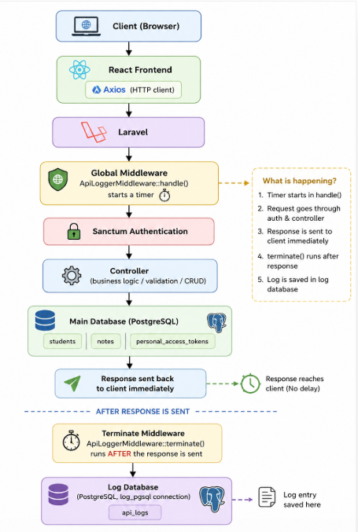
🖼️ SYSTEM ARCHITECTURE DIAGRAM
Visual representation of request flow through global middleware, dual databases, and zero-latency termination

Slide 7
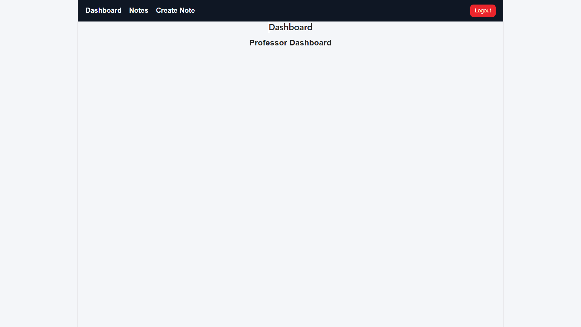
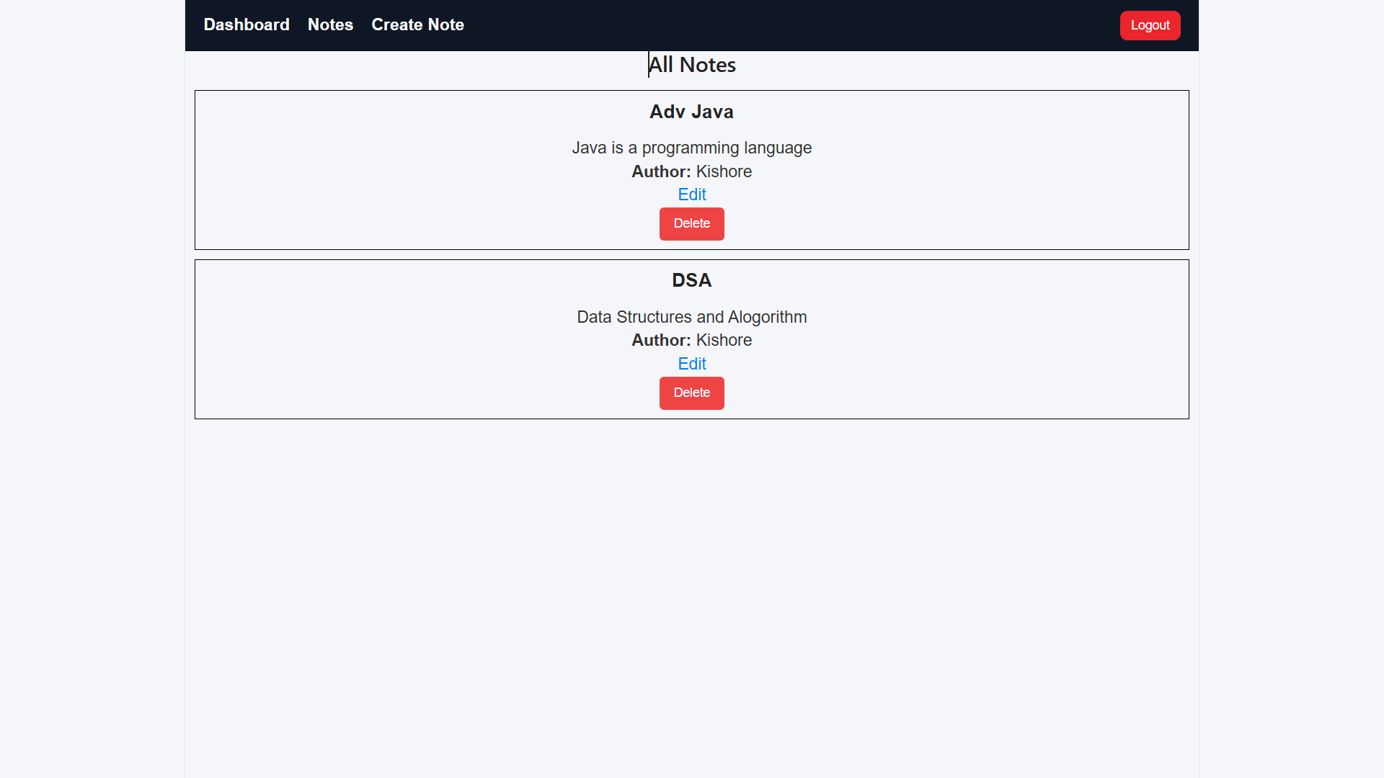

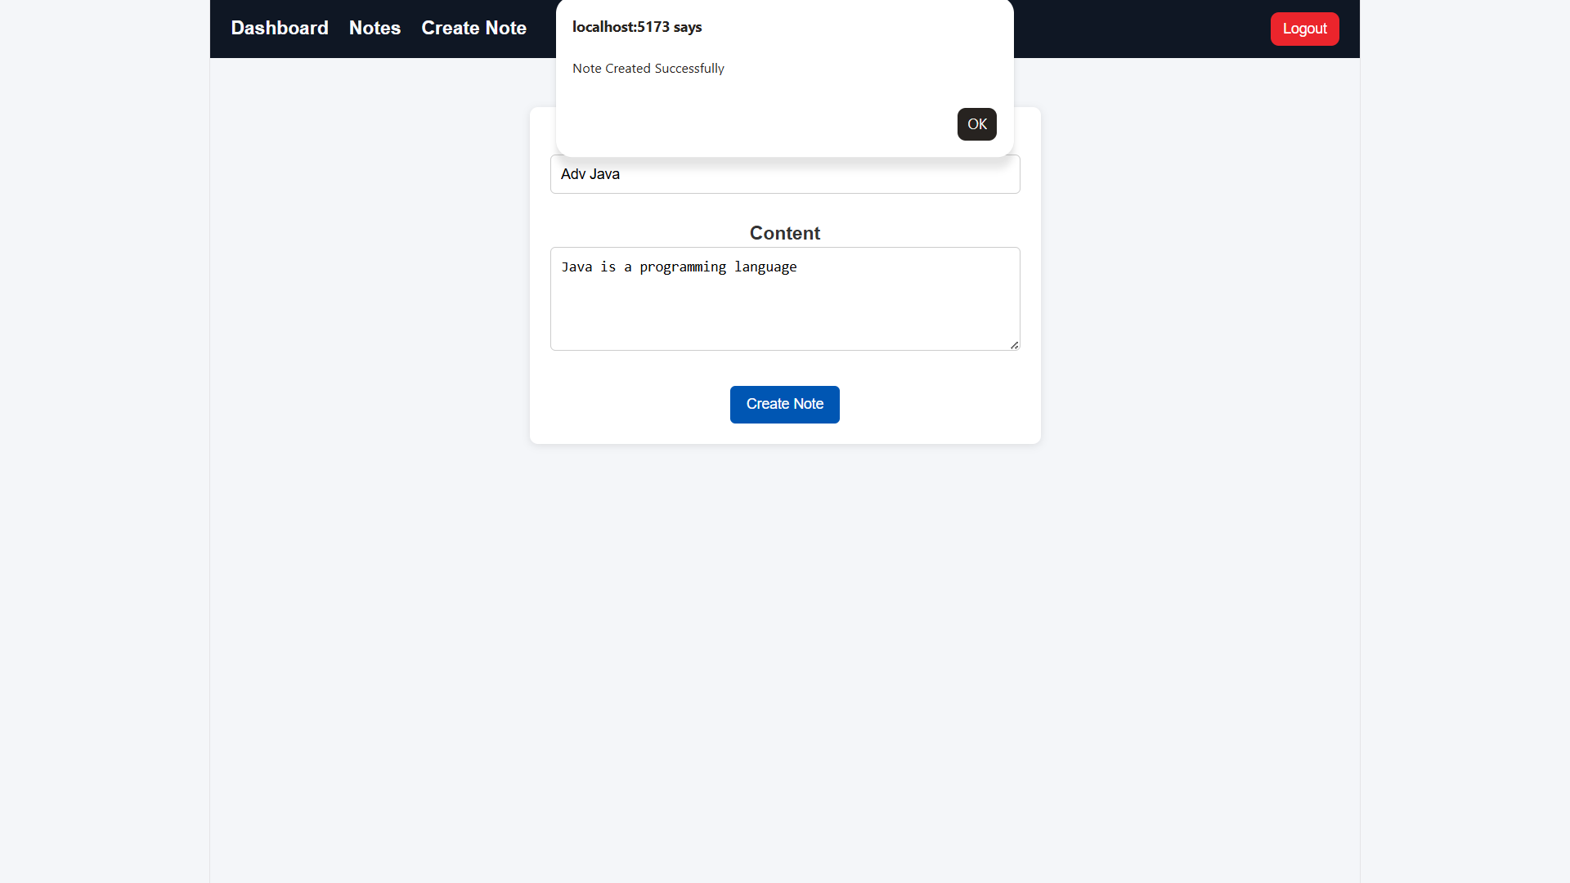
📸 SCREENSHOTS — Visual Walkthrough
Student Dashboard
Notes Dashboard
Student CRUD
Create Notes

Slide 8
🧩 MODULES — Feature Breakdown
🔐 Authentication
🛡️ Role-Based Access
👨‍🎓 Student CRUD
📝 Notes Management
Token-based login via Sanctum, Bcrypt hash, /me endpoint, login alert email
Professor vs Student, RoleMiddleware + controller-level checks, second line of defense
Full GET/POST/PUT/DELETE, Form Request validation, $fillable protection against mass-assignment
One-to-Many: Student hasMany Notes, belongsTo Student via user_id, write restricted to Professors
📡 API Logging Core
🔍 Log Filter API
💾 Dual-DB Arch
☁️ AWS Deployment
Global middleware, captures method, headers, bodies, IP, UA, status, response time — every outcome
Query by method, status_code, from/to date, endpoint partial, user_id — paginated
pgsql for app data, log_pgsql for api_logs, no lock contention, isolation
Ubuntu EC2 + Nginx reverse proxy + React static + PHP-FPM + AWS Backup vault

Slide 9
📡 API LOGGING MIDDLEWARE — The Core of the System
🔥 How It Works
Every request & response captured: authenticated user, role, HTTP method, endpoint, headers, request body, response body, IP, user-agent, status code, precise response time.
1️⃣ Global Registration
Registered as global middleware in Kernel.php $middleware array — not inside api group. Middleware groups only execute after router matches route, so 401/403/404 never reached logger before. Global guarantees every outcome captured.
2️⃣ handle() — Timer Start
ApiLoggerMiddleware::handle() starts microtime timer, lets request continue through pipeline.
3️⃣ terminate() — Zero-Latency Write
Laravel calls terminate() ONLY after response already sent to client. ApiLog::create() DB write happens behind scenes, zero perceived latency. Client never waits.
✅ Covers: 200, 201, 400, 401, 403, 404, 422, 500 — without exception.
Kernel.php
protected $middleware = [ // ... \App\Http\Middleware\ApiLoggerMiddleware::class, ];
ApiLoggerMiddleware.php
public function handle($req, $next){ $this->start = microtime(true); return $next($req); } public function terminate($req, $res){ ApiLog::create([...]); // log_pgsql }
⚡ Performance Win
Inline logging in handle(): client waits for DB write → slows every API call under load.
terminate() approach: client response sent FIRST, log write AFTER. Same request lifecycle, no extra infra, zero perceived latency.
Queue (ShouldQueue) was evaluated first but required worker, jobs table, operational complexity — overkill.

Slide 10
🔍 LOG FILTER API + 💾 DUAL-DB ARCHITECTURE
🔎 Log Filter API — Query Parameters (Paginated)
☁️ AWS DEPLOYMENT — Production Ready
Filter
Query Param
Description
Single Ubuntu EC2 Instance hosts entire stack:
• Nginx → static file server (React build) + reverse proxy (API → PHP-FPM)
• Laravel backend + both PostgreSQL DBs
• AWS Backup: vault, plan, recovery points for disaster recovery
Architecture: Client → Nginx → React / Laravel → Main DB → Response → Terminate → Log DB
Method
method
GET, POST, PUT, DELETE
Status Code
status_code
Exact — e.g. 404, 500
Date Range
from / to
Timestamp range
Endpoint
endpoint
Partial match against URI
User
user_id
Filter by authenticated user
GET /api/logs?method=POST&status_code=422&from=2024-01-01&user_id=5 → paginated JSON
💾 Dual PostgreSQL — Why Two DBs?
• pgsql (default) → students, notes, personal_access_tokens (core app data) • log_pgsql → api_logs table, dedicated connection in ApiLog model • Isolation prevents high-volume log writes from causing lock contention / perf degradation on business tables • Configured in config/database.php via two separate connection definitions
🔐 RBAC — Role Enforcement
Professor: Full CRUD on notes, full read, managed via Student CRUD Student: Read-only notes, Sanctum token auth Enforced via RoleMiddleware (route level) + controller logic (second line) Validation: Form Request + $fillable allow-list → prevents mass-assignment

Slide 11
⚙️ LOCAL SETUP — Get Full Stack Running
📋 Prerequisites
PHP 8.1+ • Composer 2.0+ Node.js 18+ • PostgreSQL 13+ Two DBs: main app + logging
1️⃣ Clone Repository
2️⃣ Backend Setup
3️⃣ Frontend Setup
git clone <repo-url> cd api-logging-framework
cd backend composer install cp .env.example .env php artisan key:generate php artisan migrate php artisan migrate --database=log_pgsql php artisan storage:link php artisan serve
cd frontend npm install npm run dev → http://localhost:5173
🔑 ENV VARIABLES: DB_CONNECTION, DB_HOST/DATABASE/USERNAME/PASSWORD, LOG_DB_* (log_pgsql), SANCTUM_STATEFUL_DOMAINS, MAIL_* for login alerts • .env is gitignored — never commit!

Slide 12
📁 PROJECT STRUCTURE
api-logging-framework/ ├── backend/ │ ├── app/Http/ │ │ ├── Controllers/ → Auth, Student, Note, LogController │ │ ├── Middleware/ │ │ │ ├── ApiLoggerMiddleware.php (global + terminate) │ │ │ └── RoleMiddleware.php (route-level RBAC) │ │ └── Kernel.php (global / group / route registration) │ ├── Models/ │ │ ├── Student.php (hasMany Note) │ │ ├── Note.php (belongsTo Student) │ │ └── ApiLog.php (uses log_pgsql) │ ├── config/database.php (pgsql + log_pgsql) │ ├── database/migrations/ │ ├── routes/api.php │ └── composer.json │ └── frontend/ ├── src/components/ + pages/ │ ├── LoginPage.jsx, NotesPage.jsx │ ├── StudentsPage.jsx, LogsPage.jsx (filterable) │ └── services/api.js (Axios + Sanctum token) └── package.json / vite.config.js
⭐ KEY FILES TO KNOW
ApiLoggerMiddleware.php
Global + terminate, zero latency
RoleMiddleware.php
Professor vs Student enforcement
ApiLog.php
Dedicated log_pgsql connection
database.php
Two PostgreSQL connections
LogsPage.jsx
Filterable viewer: method, status, date, user
api.js
Axios instance with token attached

Slide 13
🧠 KEY ENGINEERING DECISIONS — Reasoning Behind Choices
🌐 Why Global Middleware?
⚡ Why terminate() vs handle()?
Middleware groups (api) only run after router matches route. Requests failing auth 401, forbidden 403, not found 404 never reached logger → invisible failures. Global $middleware in Kernel.php runs unconditionally BEFORE routing, BEFORE auth, guaranteeing 100% visibility.
Logging inline in handle() = client waits for ApiLog::create() DB write → slowdown under load. terminate() runs AFTER response sent → write behind scenes, zero perceived latency. Same request lifecycle, no extra infra.
✅ Problem Solved: Complete error visibility
✅ Benefit: Zero-latency UX
📨 Why Not Queue (ShouldQueue)?
💾 Why Two PostgreSQL DBs?
Queue removes log from request cycle BUT requires permanently running worker, jobs table, added operational complexity disproportionate to problem. Terminable middleware achieves same non-blocking benefit with no extra infra to deploy/monitor.
Log writes on EVERY API call → very high write volume. Isolating api_logs in own log_pgsql connection ensures logging never causes lock contention / perf degradation on students, notes tables serving user-facing requests. Configured via Eloquent connection.
✅ Trade-off: Simplicity wins
✅ Benefit: Performance isolation

Slide 14
✅ FEATURE CHECKLIST — What Shipped
✅
Sanctum Token Authentication
Login, logout, /me, Bcrypt, email alerts
✅
Role-Based Access — Professor & Student
Middleware + controller second line
✅
Login Alert Emails
Dispatched on successful sign-in
✅
Student CRUD + Validation
GET POST PUT DELETE + mass-assignment protection
✅
Notes Management (One-to-Many)
hasMany / belongsTo via user_id
✅
Global Middleware Logging
Captures 200 201 400 401 403 404 422 500
✅
Terminate Middleware Zero-Latency
Response first, log after
✅
Dual PostgreSQL Architecture
pgsql + log_pgsql isolation
✅
Log Filter API
Method, status, date, endpoint, user — paginated
✅
AWS EC2 + Nginx Production
Ubuntu, reverse proxy, static serving
✅
AWS Backup Vault & Recovery
Disaster recovery ready
✅
Postman-Verified Errors
401/403/404/422/500 tested

Slide 15
🎉 THANK YOU
API Logging Framework
Production-Grade • Full-Stack • Observability Platform
Laravel • React • PostgreSQL Dual DB • Sanctum • AWS EC2 • Nginx
Built to capture every request & response without slowing it down Global middleware • terminate() zero-latency • dual-database isolation Role-based access • advanced log filters • production deployed
🚀 Ready for Production • 📊 Complete Visibility • 🔐 Secure & Scalable
Crafted with ❤️ using Laravel, React, PostgreSQL — Deployed on AWS EC2 + Nginx — v1.0 Production Ready

