Slide 1
MODULE - 3

Slide 2
OOP Concepts
Design Patterns:
  Basic concepts of Design patterns
  How to select a design pattern
Creational patterns
Structural patterns
Behavioural patterns
Concept of Anti-patterns

Slide 3
OOP Concepts

Slide 4
Object Oriented is a popular design approach for analyzing and designing an application
Most of the languages like C++, Java, .net use object oriented design concept
Object-oriented concepts are used in the design methods such as classes, objects, polymorphism, encapsulation, inheritance, dynamic binding, information hiding, interface, constructor, destructor

Slide 5
The main advantage of object oriented design is that improving the software development and maintainability
Another advantage is that faster and low cost development, and creates a high quality software
The disadvantage of the object-oriented design is that larger program size and it is not suitable for all types of program

Slide 6
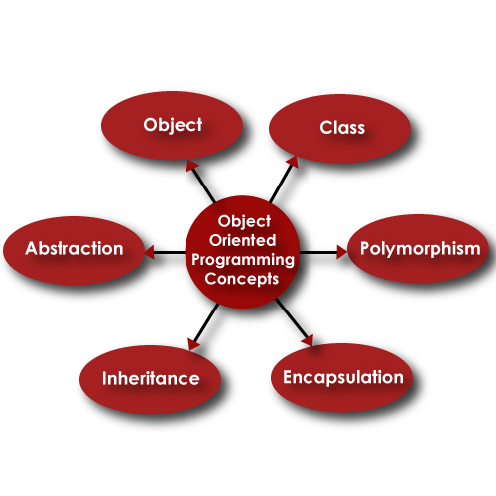
The different terms related to object design are:

Slide 7
Class :
  A class is a collection of method and variables
  It is a blueprint that defines the data and behavior of a type
  Let’s take HumanBeing as a class
  A class is a blueprint for any functional entity which defines its properties and its functions
  Like HumanBeing, having body parts, performing various actions

Slide 8
Inheritance :
  Inheritance is a feature of object-oriented programming that allows code reusability when a class includes property of another class
  Considering HumanBeing a class, which has properties like hands, legs, eyes, mouth, etc, and functions like walk, talk, eat, see, etc.
  Man and Woman are also classes, but most of the properties and functions are included in HumanBeing
  Hence, they can inherit everything from class HumanBeing using the concept of Inheritance

Slide 9
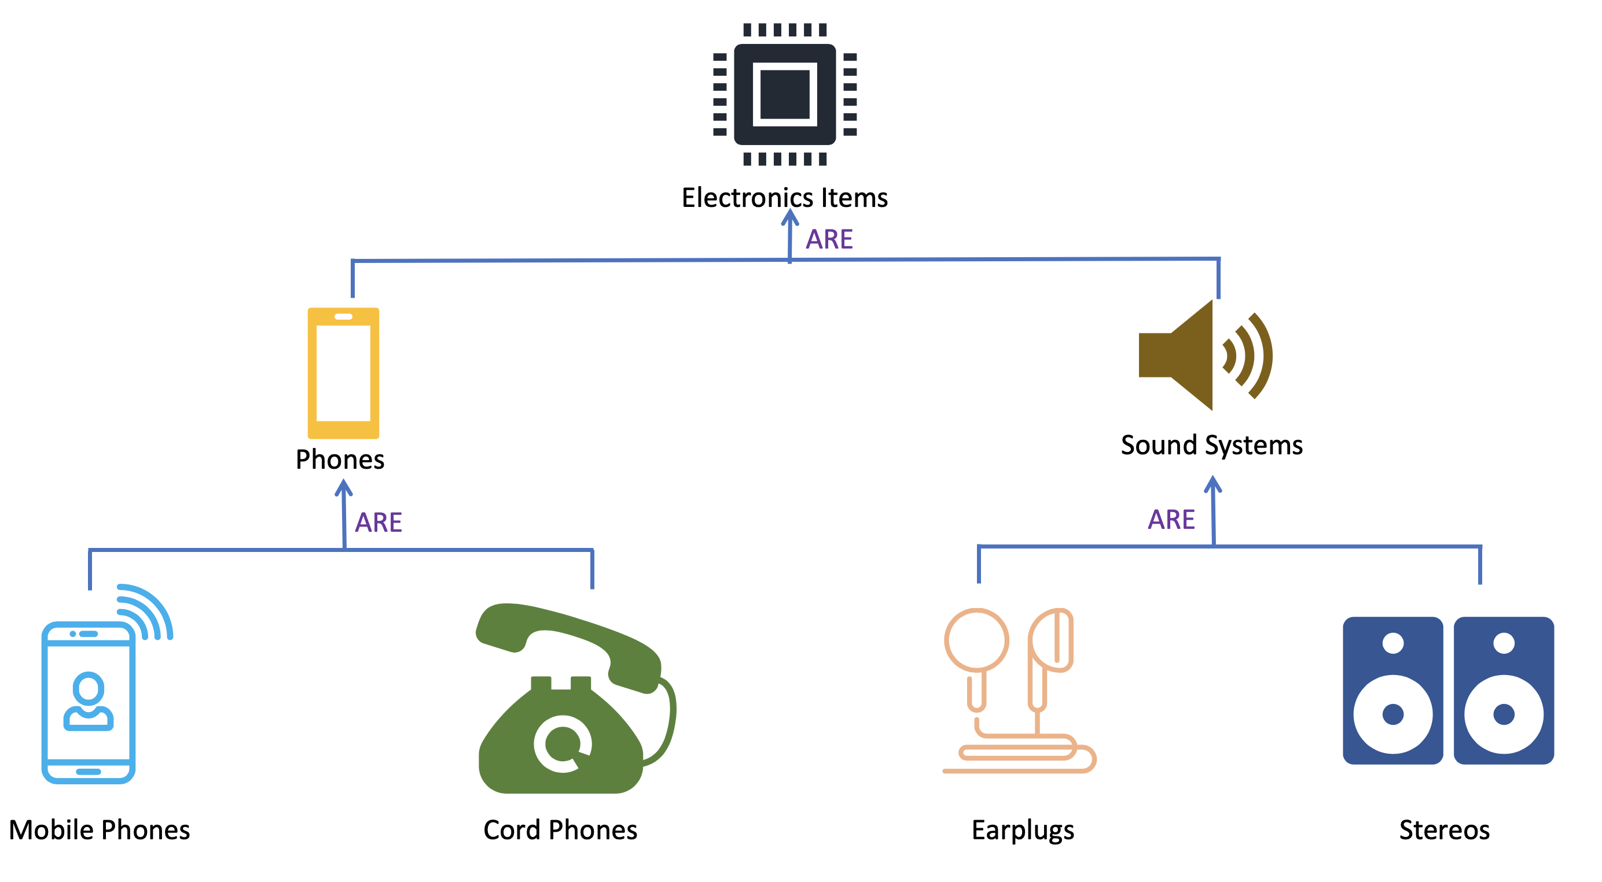

Slide 10
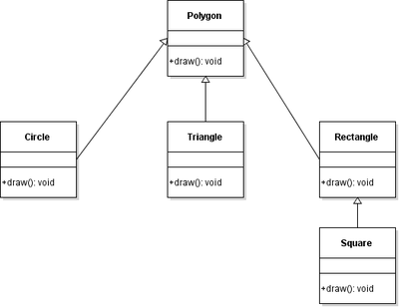

Slide 11
Objects :
  My name is Akhil, and I am an instance/object of class Man
Abstraction :
  Abstraction means, showcasing only the required things to the outside world while hiding the details
  Continuing our example, HumanBeing’s can talk, walk, hear, eat, but the details of the muscles mechanism and their connections to the brain are hidden from the outside world

Slide 12
Encapsulation :
  Encapsulation means that we want to hide unnecessary details from the user
  For example, when we call from our mobile phone, we select the number and press call button
  But the entire process of calling or what happens from the moment we press or touch the call button to the moment we start having a phone conversation is hidden from us

Slide 13
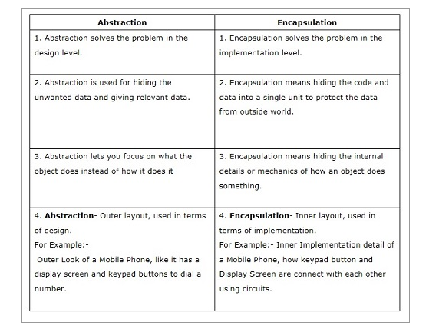

Slide 14
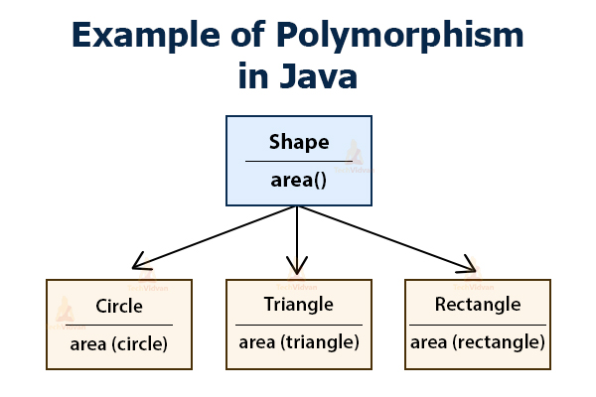
Polymorphism :
  Polymorphism is a feature of object-oriented programming languages that allows a specific routine to use variables of different types at different times

Slide 15
Design classes
A set of design classes refined the analysis class by providing design details
There are five different types of design classes and each type represents the layer of the design architecture these are as follows:
User interface classes :
  These classes are designed for Human Computer Interaction(HCI)
Business domain classes :
  These classes are required to implement the elements of the business domain

Slide 16
Process classes :
  Which is needed to completely manage the business domain class
Persistence classes :
  It shows data stores that will persist behind the execution of the software
System Classes :
  System classes implement software management and control functions

Slide 17
Design class characteristics
Complete and sufficient
Primitiveness : Fulfill one service for the class
High cohesion : A cohesion design class has a small and focused set of responsibilities
Low-coupling : The minimum acceptable of collaboration must be kept in the model. If a design model is highly coupled then the system is difficult to implement, to test and to maintain over time

