Slide 1
MODULE -2

Slide 2
Programming Style Guides and Coding Standards; Literate programming and Software documentation; Documentation generators, Javadoc, phpDocumentor.
Version control systems basic concepts; Concept of Distributed version control system and Git; Setting up Git; Core operations in Git version control system using command line interface (CLI): Clone a repository; View history; Modifying files; Branching; Push changes, Clone operation, add, commit, log, diff commands, conflict resolution. Pushing changes to the master; Using Git in IDEs and UI based tools.
Software Quality: Understanding and ensuring requirements specification quality, design quality, quality in software development, conformance quality.

Slide 3
Murali Chemuturi, Mastering Software Quality Assurance: Best Practices, Tools and Technique for Software Developers, J Ross Publishing
Ben Straub, Scott Chacon, Pro Git, 2nd Edition, Apress

Slide 4
Programming Style Guides and Coding Standards

Slide 5
A programming style guide is an opinionated guide of programming conventions, style, and best practices for a team or project.
Some teams call it their coding guidelines, coding standards, or coding conventions.
While these each have their own meaning in programming, they generally refer to the same thing.
A team following a style guide helps everyone write code in a consistent way.

Slide 6
Consistent code is easier to read and understand, making it faster to add new features.
Programming style, also known as code style, is a set of rules or guidelines used when writing the source code for a computer program.
It is often claimed that following a particular programming style will help programmers read and understand source code conforming to the style, and help to avoid introducing errors.

Slide 7
Widely accepted style guides that you should consider to start with:
    Google’s Style Guides
    JavaScript Standard Style
    GitHub’s Ruby Style Guide
    Python Foundation’s Style Guide
    Airbnb’s JavaScript Style Guide
    Angular’s Style Guide

Slide 8
Implementing one of these generally accepted style guides is a good start to helping your team write code consistently.
Make your style guide easy to reference.
Style guide acts as a basic code blueprint for your team during all parts of the software development lifecycle.
To keep relevant, it should be often discussed. Such as during a developers onboarding, when writing code, when writing tests, and during code review.

Slide 9
Literate Programming
Literate programming is writing out the program logic in a human language.
It is a methodology that combines a programming language with a documentation language, thereby making programs more robust, more portable, more easily maintained, and arguably more fun to write than programs that are written only in a high-level language.
The main idea is to treat a program as a piece of literature, addressed to human beings rather than to a computer.
The program is also viewed as a hypertext document, rather like the World Wide Web.

Slide 10
The key features of literate programming are the organization of source code into small sections and the production of a book quality program listing.
Literate programming is an excellent method for documenting the internals of software products especially applications with complex features.
Literate programming is useful for programs of all sizes.
Literate programming encourages meaningful documentation and the inclusion of details that are usually omitted in source code such as the description of algorithms, design decisions, and implementation strategy.
Literate programs are written to be read by other software developers.

Slide 11
The style of literate programming combines source code and documentation into a single source file.
The practitioner of literate programming can be regarded as an essayist.
Instead of writing code containing documentation, the literate programmer writes documentation containing code.
He or she strives for a program that is comprehensible because its concepts have been introduced in an order that is best for human understanding, using a mixture of formal and informal methods that reinforce each other.
Literate programs utilize sections which enable the developer to describe blocks of code in a convenient manner.

Slide 12
Software Documentation
Software documentation is a part of any software.
Appropriate details and description need to be in the documented to achieve the following goals:
  Resolve issue encountered by the developer during the development process
  Help end-user to understand the product
  Assist customers and the support team to find the information.

Slide 13
For a programmer reliable documentation is always a must.
Documentation increases the collective knowledge of everyone that you work with.
Successful documentation will make information easily accessible, provide a limited number of user entry points, help new users learn quickly, simplify the product and help cut support costs.
The main goal of effective documentation is to ensure that developers and stakeholders are headed in the same direction to accomplish the objectives of the project.

Slide 14
To achieve them, plenty of documentation types exist.
All software documentation can be divided into two main categories:
Product documentation
Process documentation
Product documentation describes the product that is being developed and provides instructions on how to perform various tasks with it. Product documentation can be broken down into System documentation and User documentation

Slide 15
System documentation represents documents that describe the system itself and its parts. It includes requirements documents, design decisions, architecture descriptions, program source code, and help guides.
User documentation covers manuals that are mainly prepared for end-users of the product and system administrators. User documentation includes tutorials, user guides, troubleshooting manuals, installation, and reference manuals.
Process documentation represents all documents produced during development and maintenance. The common examples of process documentation are project plans, test schedules, reports, standards, meeting notes, or even business correspondence.

Slide 16
The main difference between process and product documentation is that the first one record the process of development and the second one describes the product that is being developed.

Slide 17
Types of Program Documentation are:
User manuals- This is the how-to software to which users turn when they're figuring things out.
Project documentation.
Requirements documentation.
Architecture documentation.
Technical documentation.
The four kinds of documentation are:
learning-oriented tutorials.
goal-oriented how-to guides.
understanding-oriented discussions.
information-oriented reference material.

Slide 18
Javadoc
JavaDoc tool is a document generator tool in Java programming language for generating standard documentation in HTML format.
It generates API documentation.
Before using JavaDoc tool, you must include JavaDoc comments /**………………..*/ providing information about classes, methods, and constructors, etc.

Slide 19
For creating a good and understandable document API for any java file you must write better comments for every class, method, constructor.
By writing a number of comments, it does not affect the performance of the Java program as all the comments are removed at compile time.

Slide 20
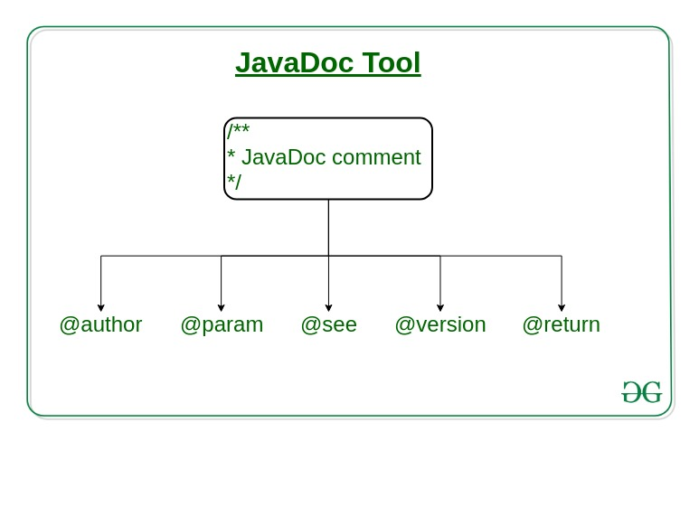

Slide 21
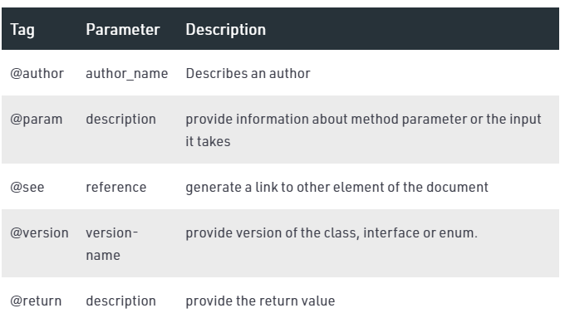

Slide 22
The JavaDoc comments is different from the normal comments because of the extra asterisk at the beginning of the comment.
It may contain the HTML tags as well.
// Single-Line Comment
/*
Multiple-Line comment
*/
/**
JavaDoc comment
*/

Slide 23
Generation of JavaDoc
To create a JavaDoc you do not need to compile the java file. To create the Java documentation API, you need to write Javadoc followed by file name.
javadoc file_name or javadoc package_name
After successful execution of the above command, a number of HTML files will be created, open the file named index to see all the information about classes.

Slide 24
phpDocumentor
phpDocumentor is an application that is capable of analyzing your PHP source code and DocBlock comments to generate a complete set of API Documentation.
phpDocumentor v3 (Stable)
v3 is the latest stable release.
The easiest way to run phpDocumentor is by running the following command:
$ phpdoc run -d <SOURCE_DIRECTORY> -t <TARGET_DIRECTORY>

