Slide 1

Abingdon Elementary PTA Survey 2021-22
February 8, 2022

Slide 2
PTA Survey
In November 2021, the Abingdon PTA published a survey to its membership and families to seek feedback on how families would like the PTA to impact and improve our school community. The survey was provided in both English and Spanish. The results are presented here.
Approximately 33 results, 32 in English and 1 in Spanish were received.
PTA thanks you for your responses!
T

Slide 3
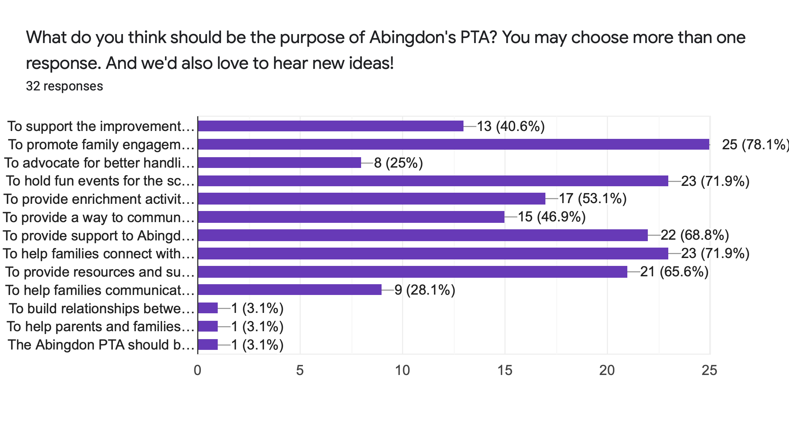
Notes:
Promoting family engagement, holding fun events for the school community, helping families connect with each other, providing support/resources to families who need it are the community’s biggest priorities.

Slide 4
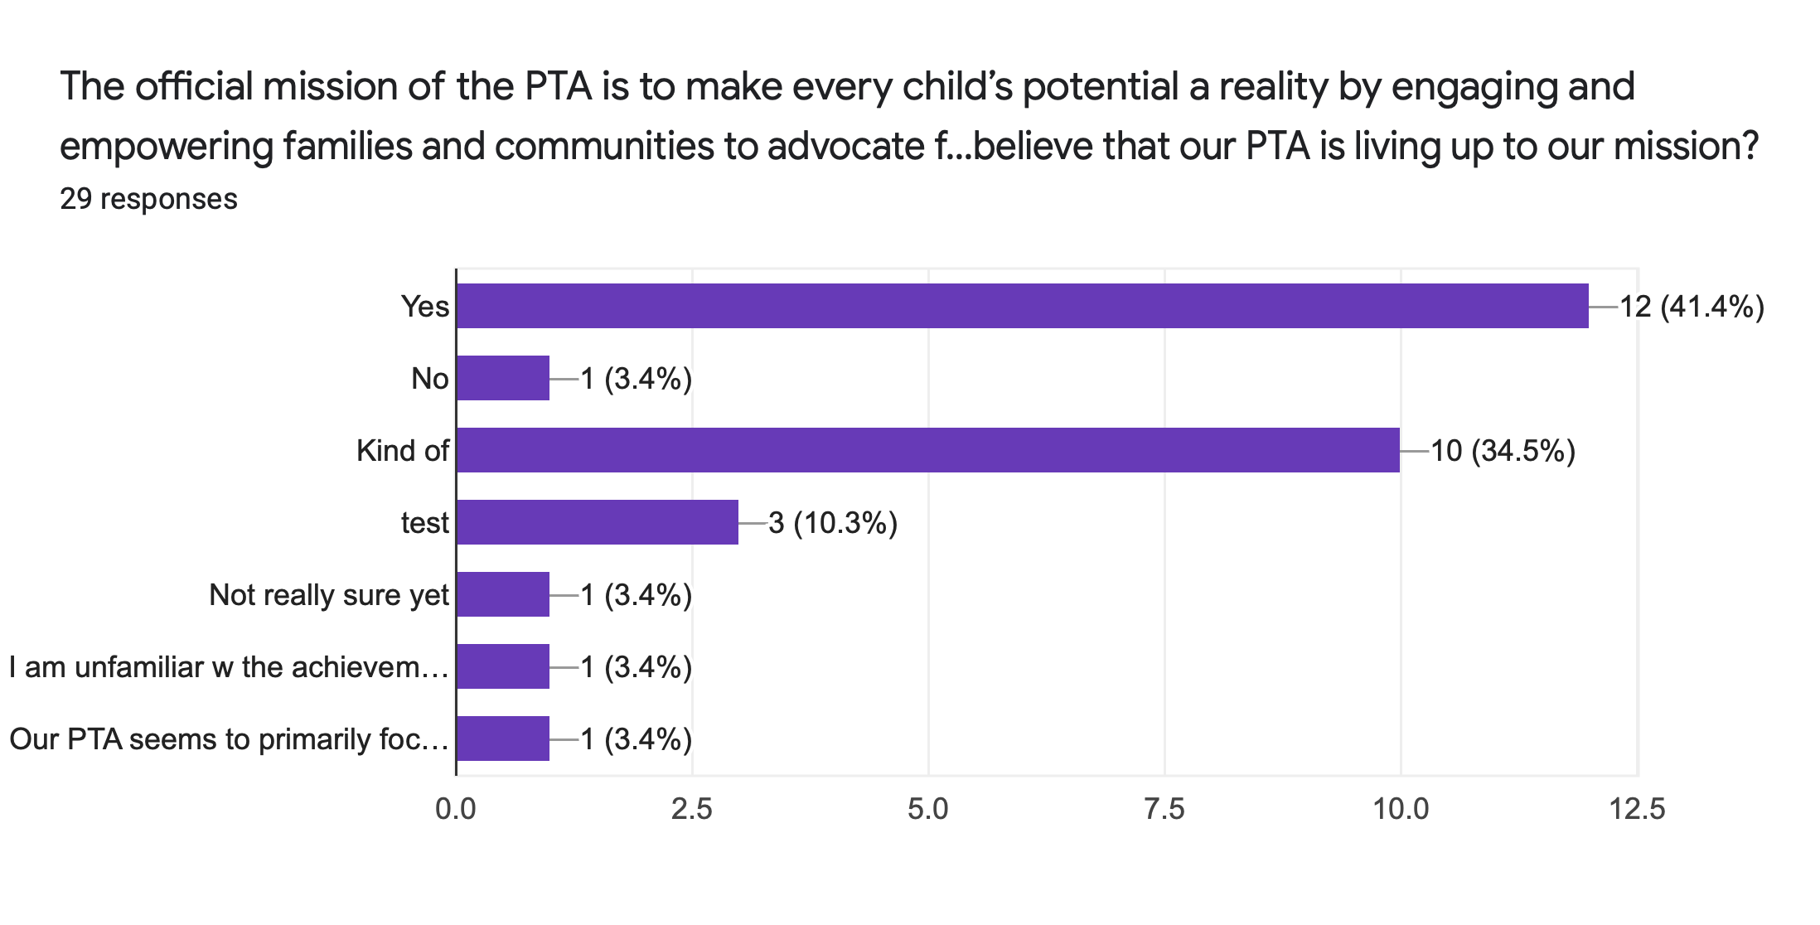
Notes:
Split results between yes and kind of, as to whether the PTA has been meeting the mission.

Slide 5
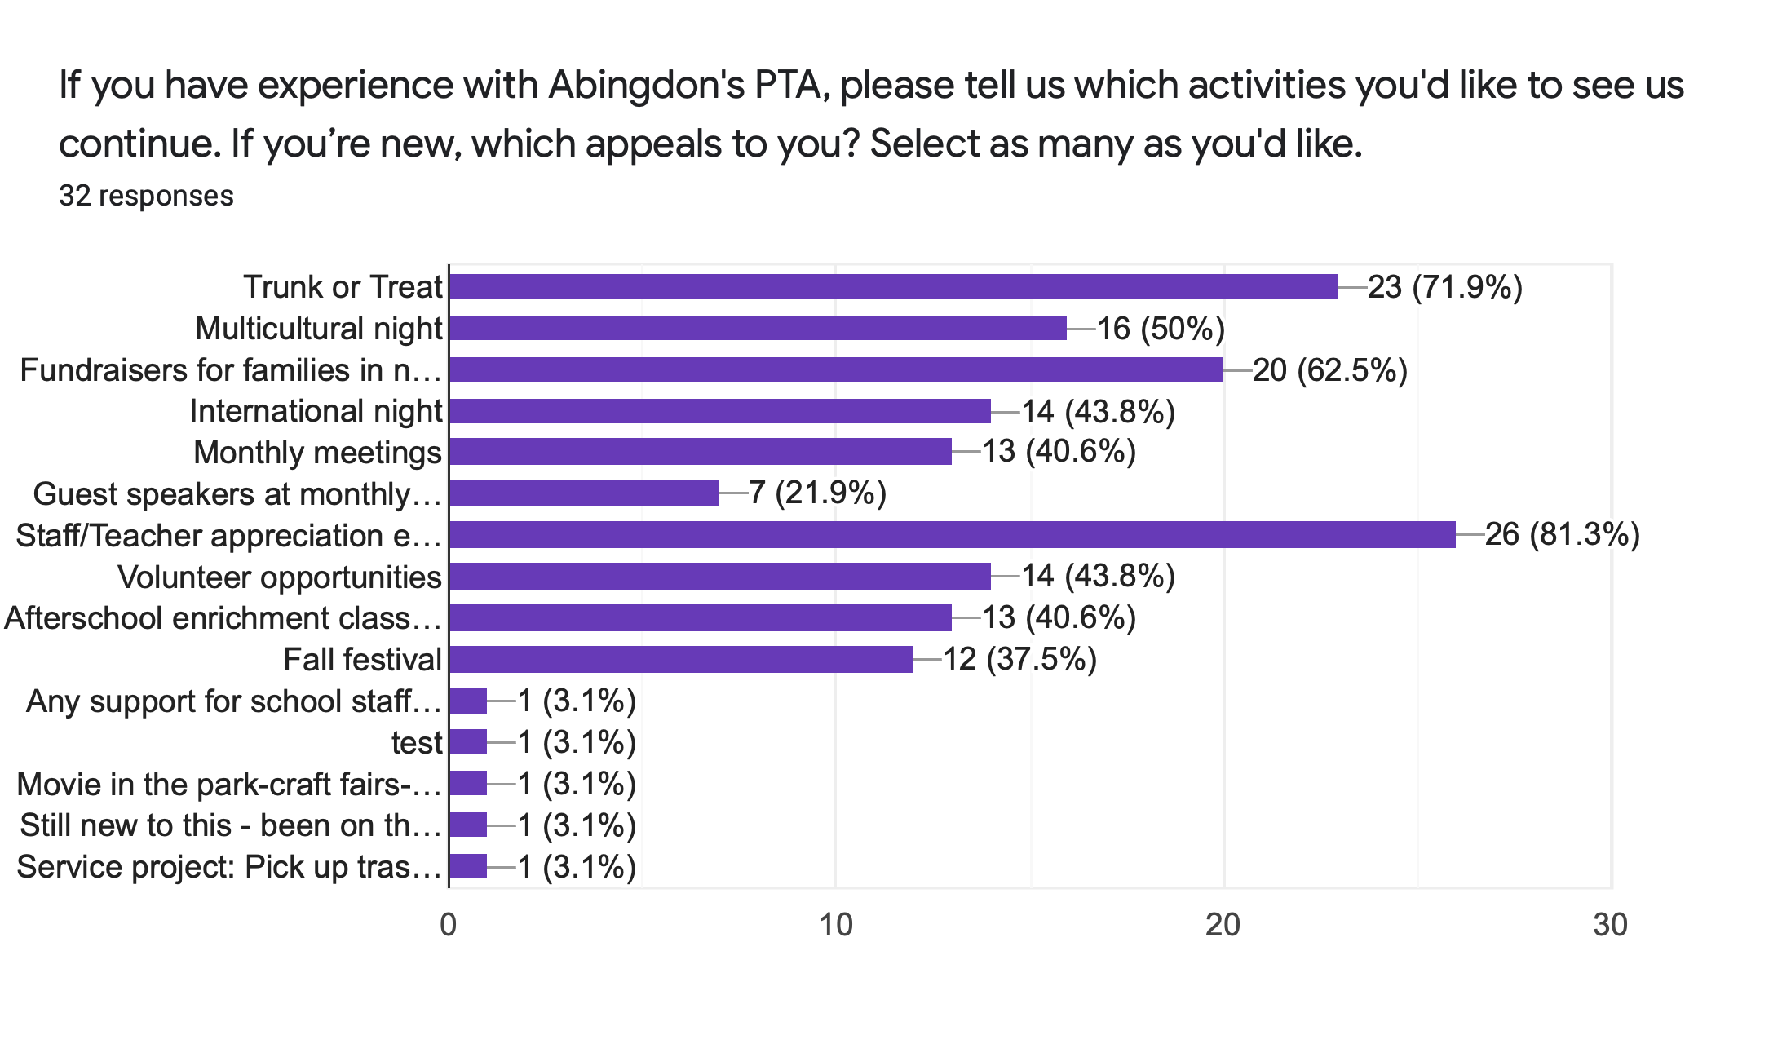
Notes:
The most popular events are the Staff/Teacher Appreciation events, Trunk or Treat, Fundraising for families in our community in need,
Multicultural events and International night, as well as split between volunteer opportunities, enrichment and meetings.

Slide 6
Ideas for events and projects
Bingo night
Earth day/trash clean up service project
Additional supplies for teachers
Literacy night
Science night
Pizza and movie night, outdoor movie night

Slide 7
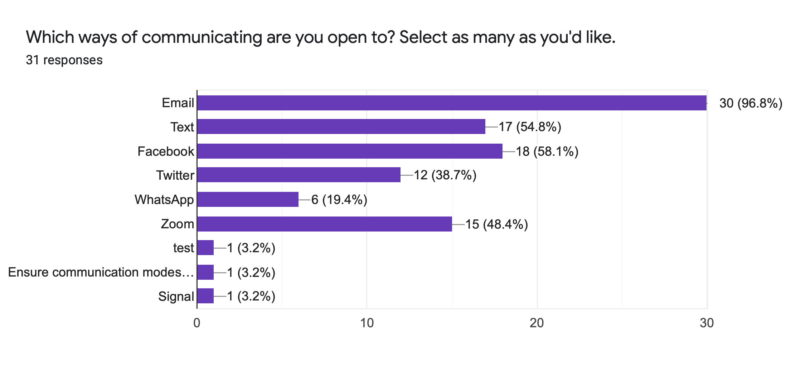
Notes:
Email, Facebook, Text and Zoom

Slide 8
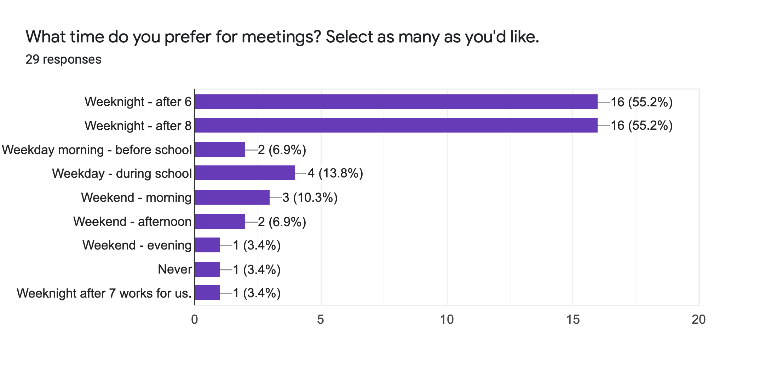
Notes:
Meeting preference is split between after 6pm and after 8pm

Slide 9
Other comments
Split between liking the convenience of Zoom meetings and wanting in-person meetings
More connection between families and between families staff
Clearly defined PTA roles for future PTA officer and volunteer recruitment
Cardinal Courier is appreciated and can be expanded upon

