Slide 1

EMAIL
CYBERSECURITY PROJECT REVIEW
GEO Cyber Threat
Detection System
URL
FILE
ENDPOINT
Correlate ordinary signals early enough to make the next defensive action clear.
GEO · THREAT CORRELATION · PROTOTYPE
Notes:
GEO is designed to connect signals that defenders already have, then turn that combined evidence into a decision they can act on.

Slide 2
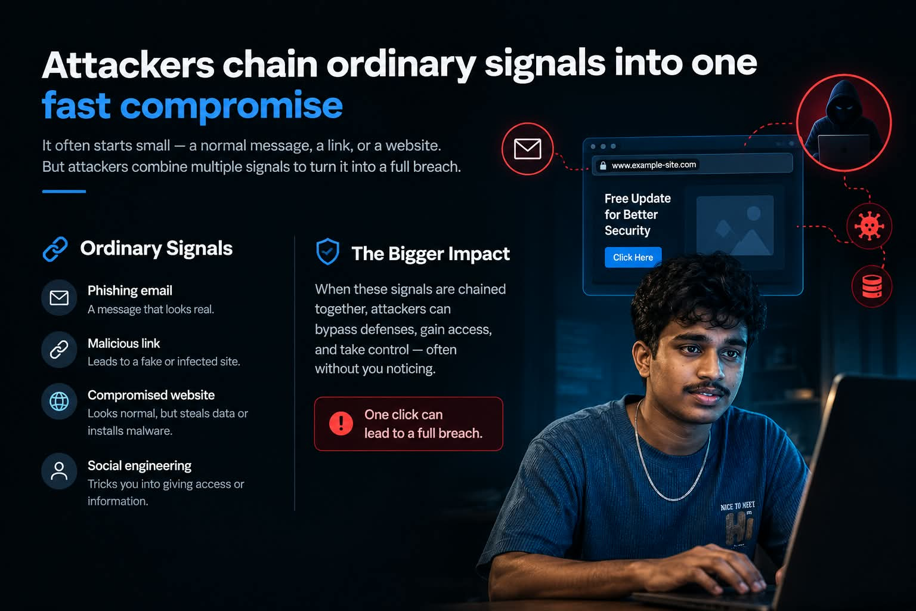

Slide 3

BEFORE — Normal User
The person is about to open a website/link.
🔒 example-login-site.test
Login to continue
CLICK LINK
⚠️ Illustrative link only — not a real malicious URL.

Slide 4

AFTER — Malicious Link Scenario
A deceptive link can lead to a phishing page or account compromise.
🚨 MALICIOUS LINK DETECTED
• Fake login page captures credentials
• Account may become compromised
• Sensitive information can be exposed
• Device/network may be at risk

Slide 5
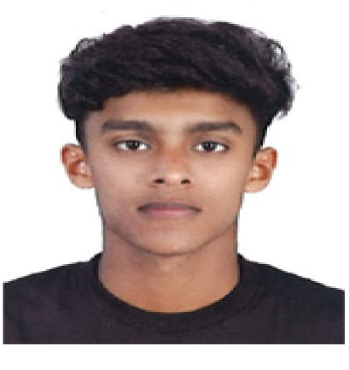
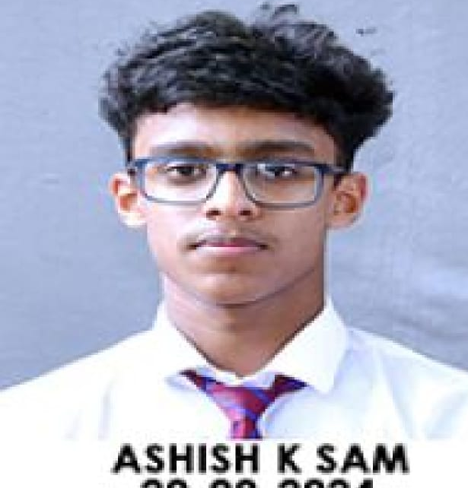
BEFORE vs AFTER — Stay Safe
A simple visual for cybersecurity awareness.
BEFORE CLICKING
AFTER A SUSPICIOUS CLICK
✓ Check the domain
✓ Close the page
✓ Look for HTTPS
✓ Don't enter credentials
✓ Verify the sender
✓ Change exposed passwords
✓ Report the phishing attempt

Slide 6

THE GEO DECISION LAYER
GEO turns scattered telemetry into a response decision
One analysis layer connects indicators, evidence, intelligence, confidence, and action.
1
2
3
4
Ingest
Validate
Analyze
Enrich
File, URL, email, and endpoint indicators enter one analysis layer.
Check type, format, sender alignment, redirects, and basic structure.
Inspect metadata, hashes, strings, entropy, suspicious patterns, and behavioral signals.
Compare hashes, domains, IPs, and other indicators with threat intelligence.
5
6
7
Score
Classify
Respond
Combine evidence into a unified risk score from 0–100.
Safe, suspicious, or malicious, with confidence and rationale.
Alert, recommend, quarantine, block, or escalate to investigation.
GEO complements antivirus, EDR, firewalls, email security, and SIEM by connecting their signals instead of replacing them.
Notes:
Walk the flow from left to right. GEO does not replace security controls. It gives their signals a shared analytical context and makes the resulting response decision visible.

Slide 7


GEO turns scattered telemetry into a response decision
NORMAL USER
ANALYZER

Slide 8
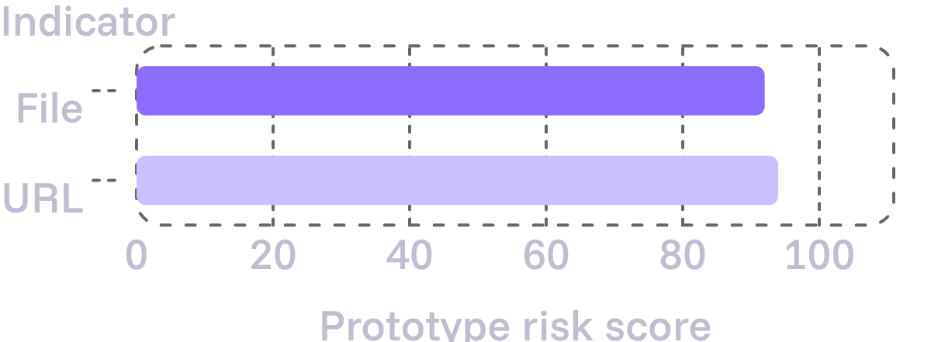
PROTOTYPE VIEW
EMAIL ANALYZER
The prototype makes the decision visible
Urgent account-verification message flagged for sender anomaly, malicious link, social engineering language, and credential-harvesting risk.
A dark SOC-style interface turns scan evidence into a clear operational state. Dashboard: scan history, threat trend, network indicators, and security status.
PROTOTYPE LOOP
Upload or enter → scan → analyze → score → classify → alert → respond
FILE SCANNER · malware_sample.exe
HIGH RISK · 92/100
Suspicious executable behavior · abnormal entropy · quarantine recommendation
URL ANALYZER · Suspicious domain
MALICIOUS URL · 94/100
Phishing characteristics · redirect anomaly · block action
IMPLEMENTATION PROOF
Python prototype demonstrates Shannon entropy calculation, canary tripwire monitoring, and automated process containment.
RISK SIGNALS · PROTOTYPE SCORES
Notes:
The prototype makes the decision legible at the point of use. The file and URL examples show the score, rationale, and recommended action, while the email analyzer demonstrates how the same decision model applies to a different signal type.

Slide 9
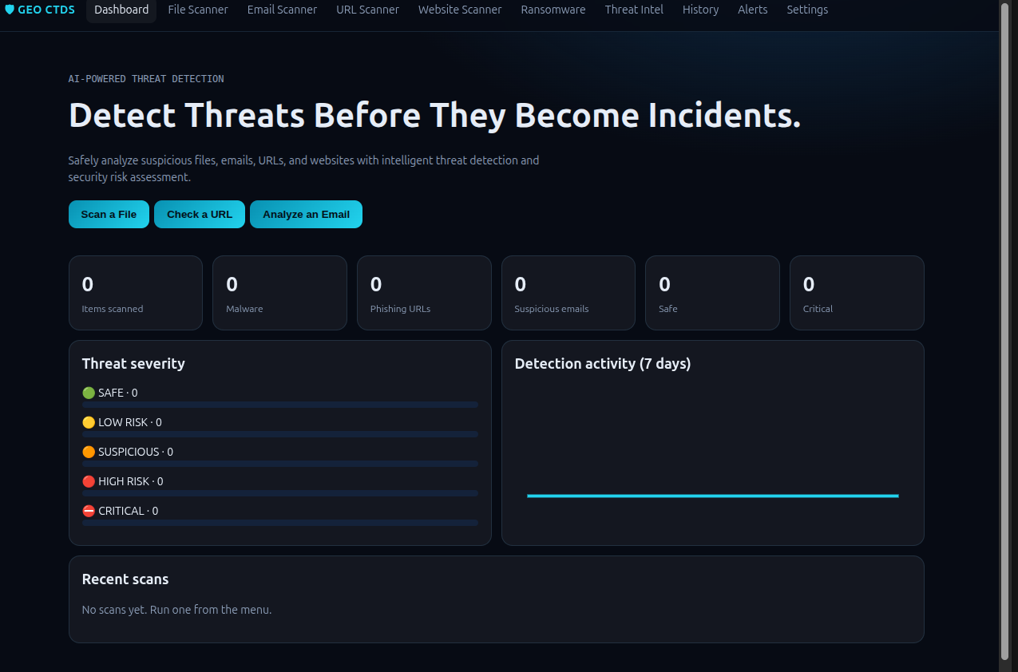
prototype home page

Slide 10

THANK YOU
BY ABINGEO

