Slide 1
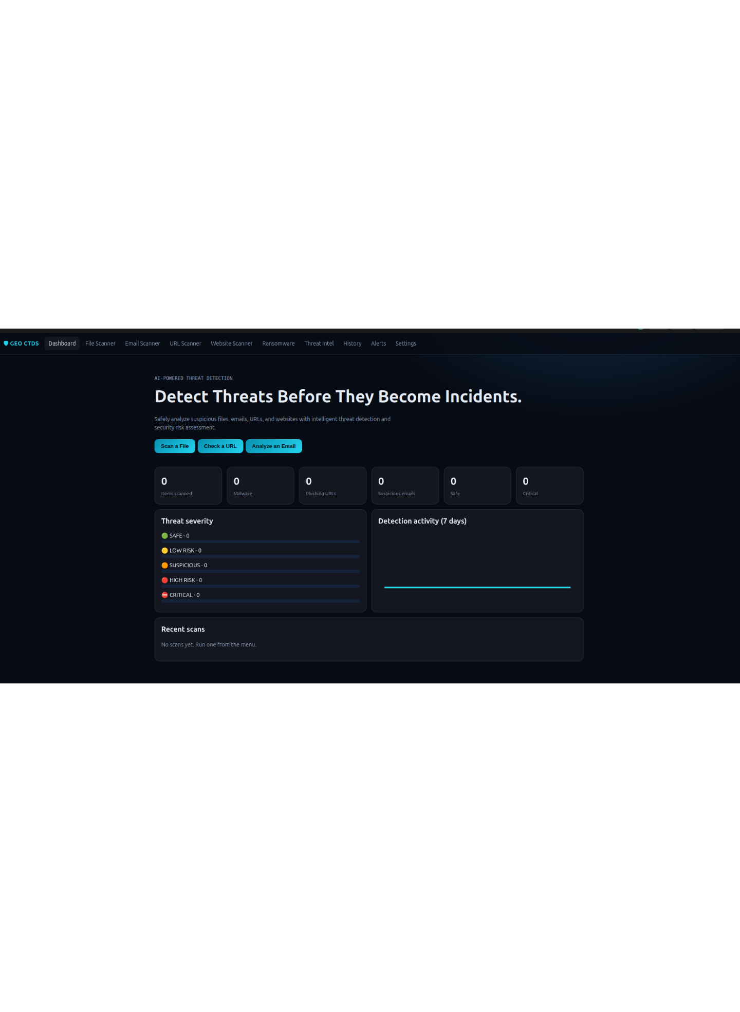
SECURITY OPERATIONS · PROTOTYPE
Geo Cyber Threat
Detective System
Detect suspicious activity before it becomes an incident.
A practical security app for earlier signals, clearer severity, and safer investigation.

Slide 2
THE OPERATING GAP
Security teams need earlier, clearer signals
Threat data arrives everywhere. The decision still has to happen somewhere.
Inputs multiply
Context fragments
Visibility lags
Threat data arrives through files, emails, URLs, and websites.
Analysts need one place to triage risk, understand severity, and decide what to do next.
For IT decision-makers, the gap is operational: too many checks, too little shared visibility.

Slide 3
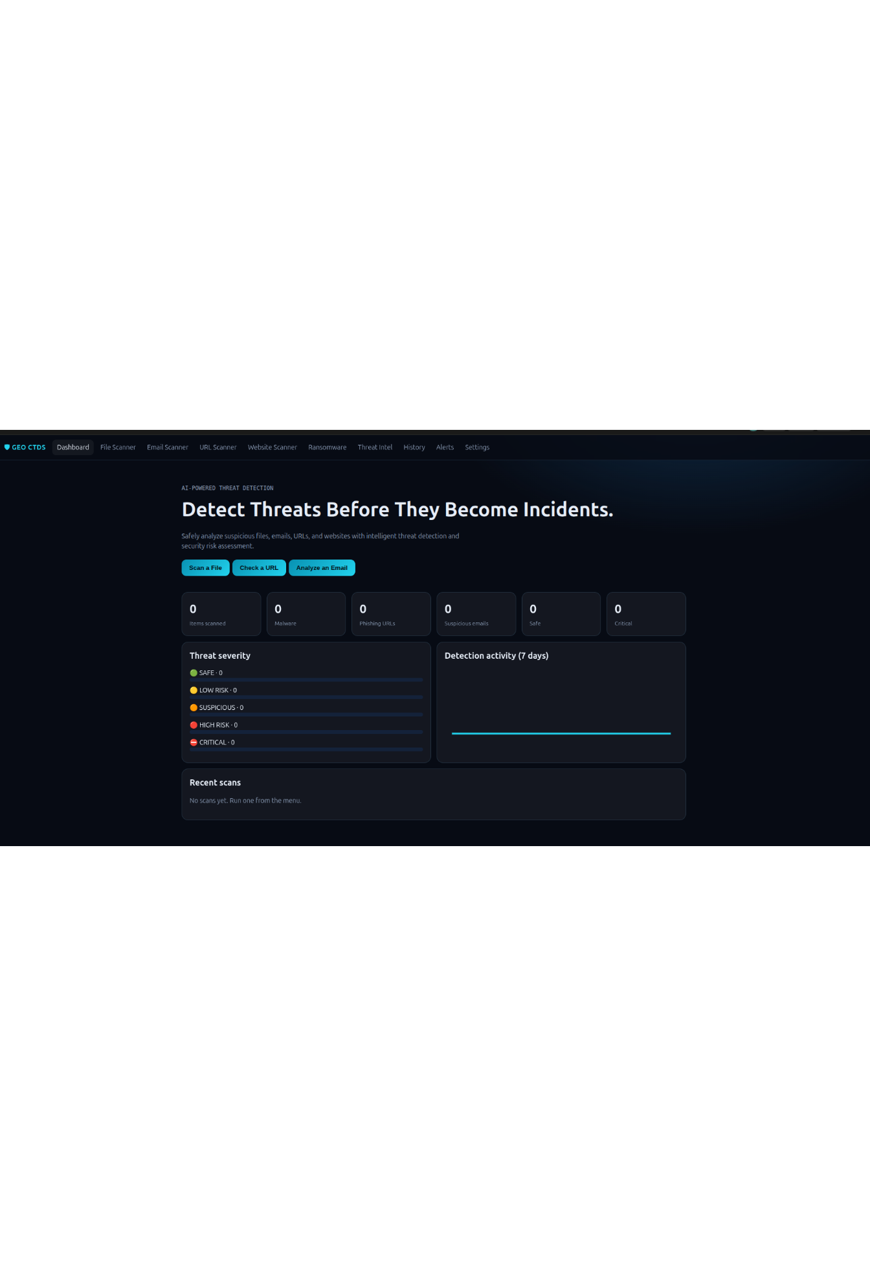
THE PRODUCT THESIS
One workspace for proactive threat investigation
Move from isolated checks to a shared risk picture across inputs.
Centralize
Connect
Act
Scanning and threat review in a single app experience.
Bring suspicious signals into one shared view.
Give teams a faster path from signal to informed action.

Slide 4



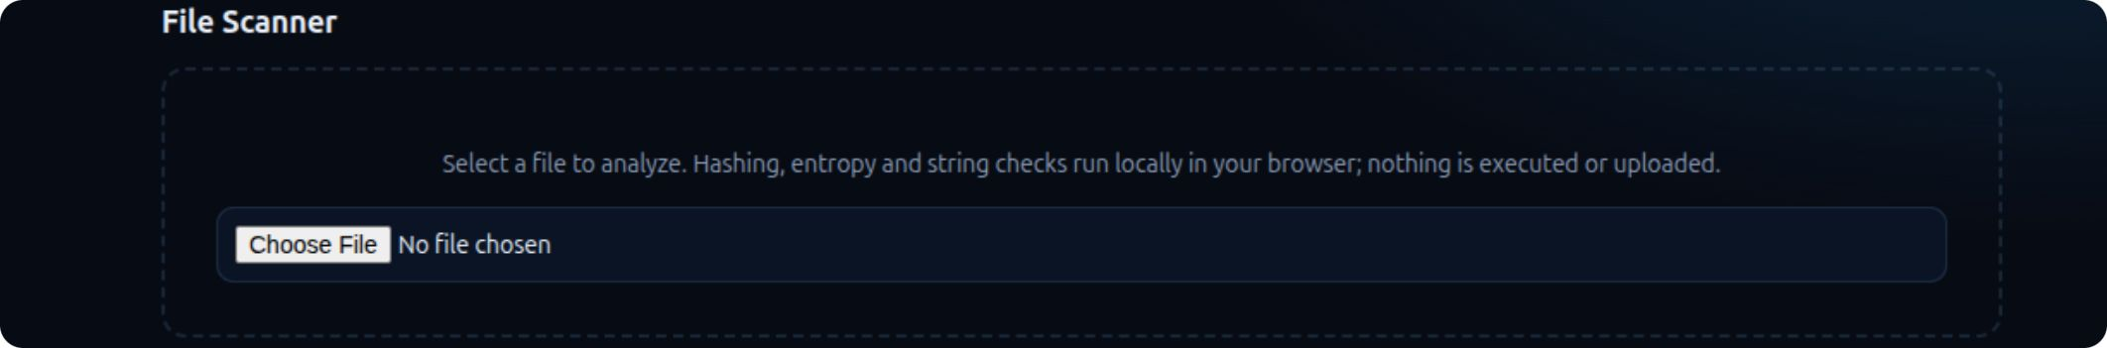
FIRST MILE OF DEFENSE
Key features cover the first mile of defense
Review and follow-up
File Scanner
URL Scanner
Email, website, ransomware
Threat Intel, history, alerts, and settings keep work connected.
Inspect local files with browser-side checks.
Analyze URL structure without opening the destination.
Extend the same investigation model across common attack surfaces.

Slide 5
DETECTION LOOP
Real-time detection turns inputs into risk signals
A transparent, explainable loop makes the result easier to trust and act on.
01
02
03
04
Collect
Analyze
Classify
Surface
A file, URL, email, or website input enters the workflow.
The appropriate analysis path runs against the input.
The result is normalized into severity bands from safe to critical.
The dashboard makes the result available for triage, history, and alerts.
Design principle: show how the signal was produced. Do not make detection a black box.

Slide 6
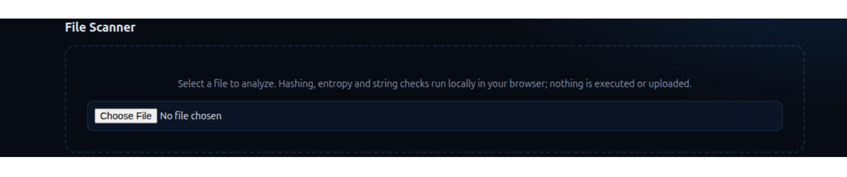
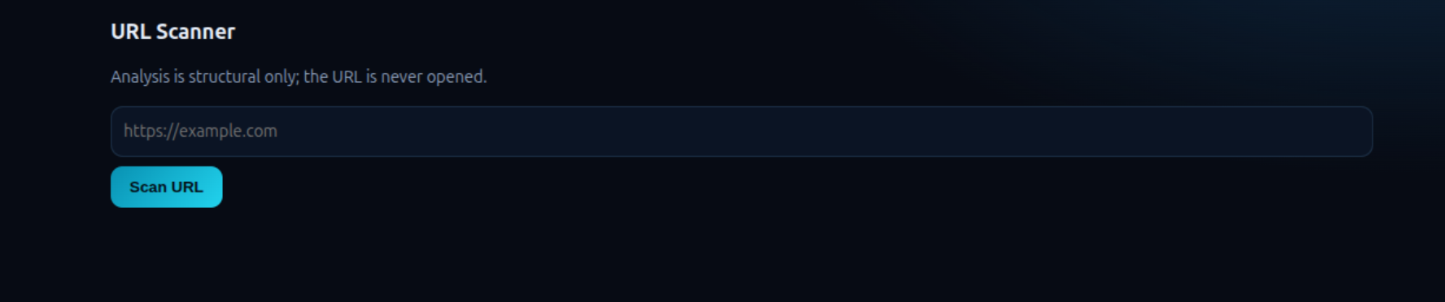
PRODUCT WALKTHROUGH
The interface makes investigation feel immediate
Common scans start from the dashboard, then open into focused analysis surfaces.
File Scanner · choose a file and analyze it locally in the browser.
URL Scanner · submit a URL for structural analysis without opening it.

Slide 7
BUYER VALUE
Buyers get visibility without adding workflow friction
The value is operational: faster first-pass decisions and a shared language for risk.
01
02
03
04
Faster triage
Shared severity
Clear handoffs
Operational foundation
Speed up first-pass review for common suspicious inputs.
Use one language, from safe to critical.
Connect analysts, IT, and leadership around the same signal.
Create a base for measurable security operations as usage grows.

Slide 8
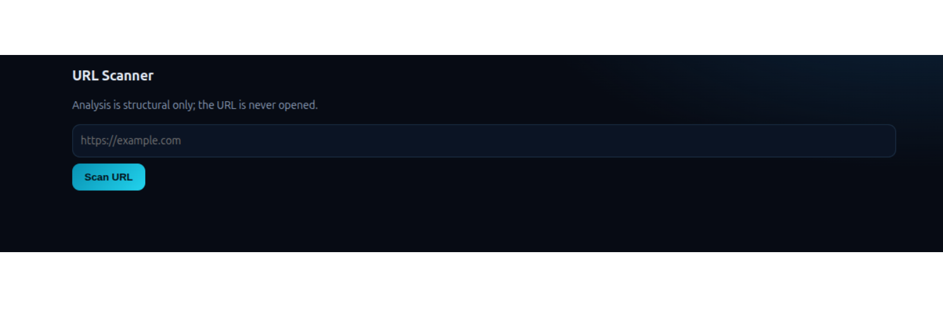
SAFE HANDLING BY DESIGN
Security protocols are visible in the product flow
The product makes safe handling and explainability part of the interaction, not an afterthought.
Analyze structure, not destination
The URL scanner never opens the URL.
Separate control surfaces
Prototype boundary: file analysis stays in the browser when possible, with no execution or upload implied by the prototype copy.
Detection, severity, history, alerts, and settings remain explicit.
Explain the result
Safe handling and explainability are product requirements.

Slide 9
ROADMAP DIRECTION
Roadmap: from prototype to operational platform
Future capabilities are direction, not current functionality.
01
02
03
Next
Then
Scale
Enrich detections
Coordinate teams
Operate with control
Add threat intelligence and actionable alert detail.
Add team workflows, case management, and integrations with existing security tools.
Deepen geospatial correlation, reporting, policy controls, and enterprise administration.
The prototype establishes the investigation model. Production readiness comes through validated workflows, integrations, and control depth.

Slide 10
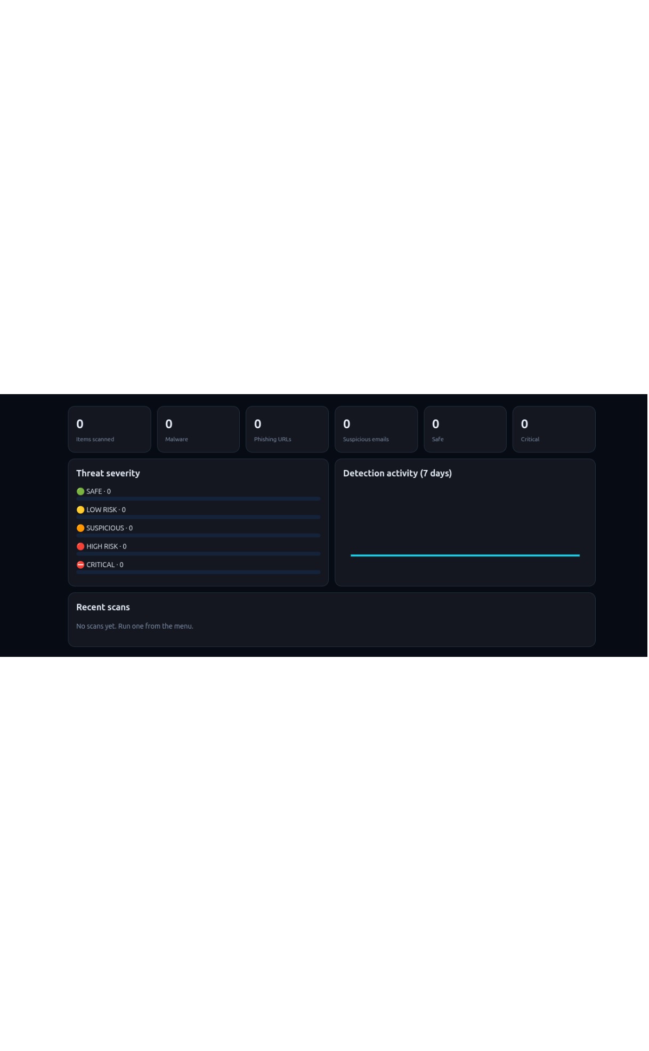
DECISION POINT
Make every suspicious signal easier to act on.
Geo Cyber Threat Detective System brings scanning, severity, and review into one coherent experience.
Validate the highest-value workflows with security teams and define the path to production readiness.
A credible foundation for proactive, explainable security operations.

