Slide 1

Object Detection
Bounding box prediction
deeplearning.ai

Slide 2
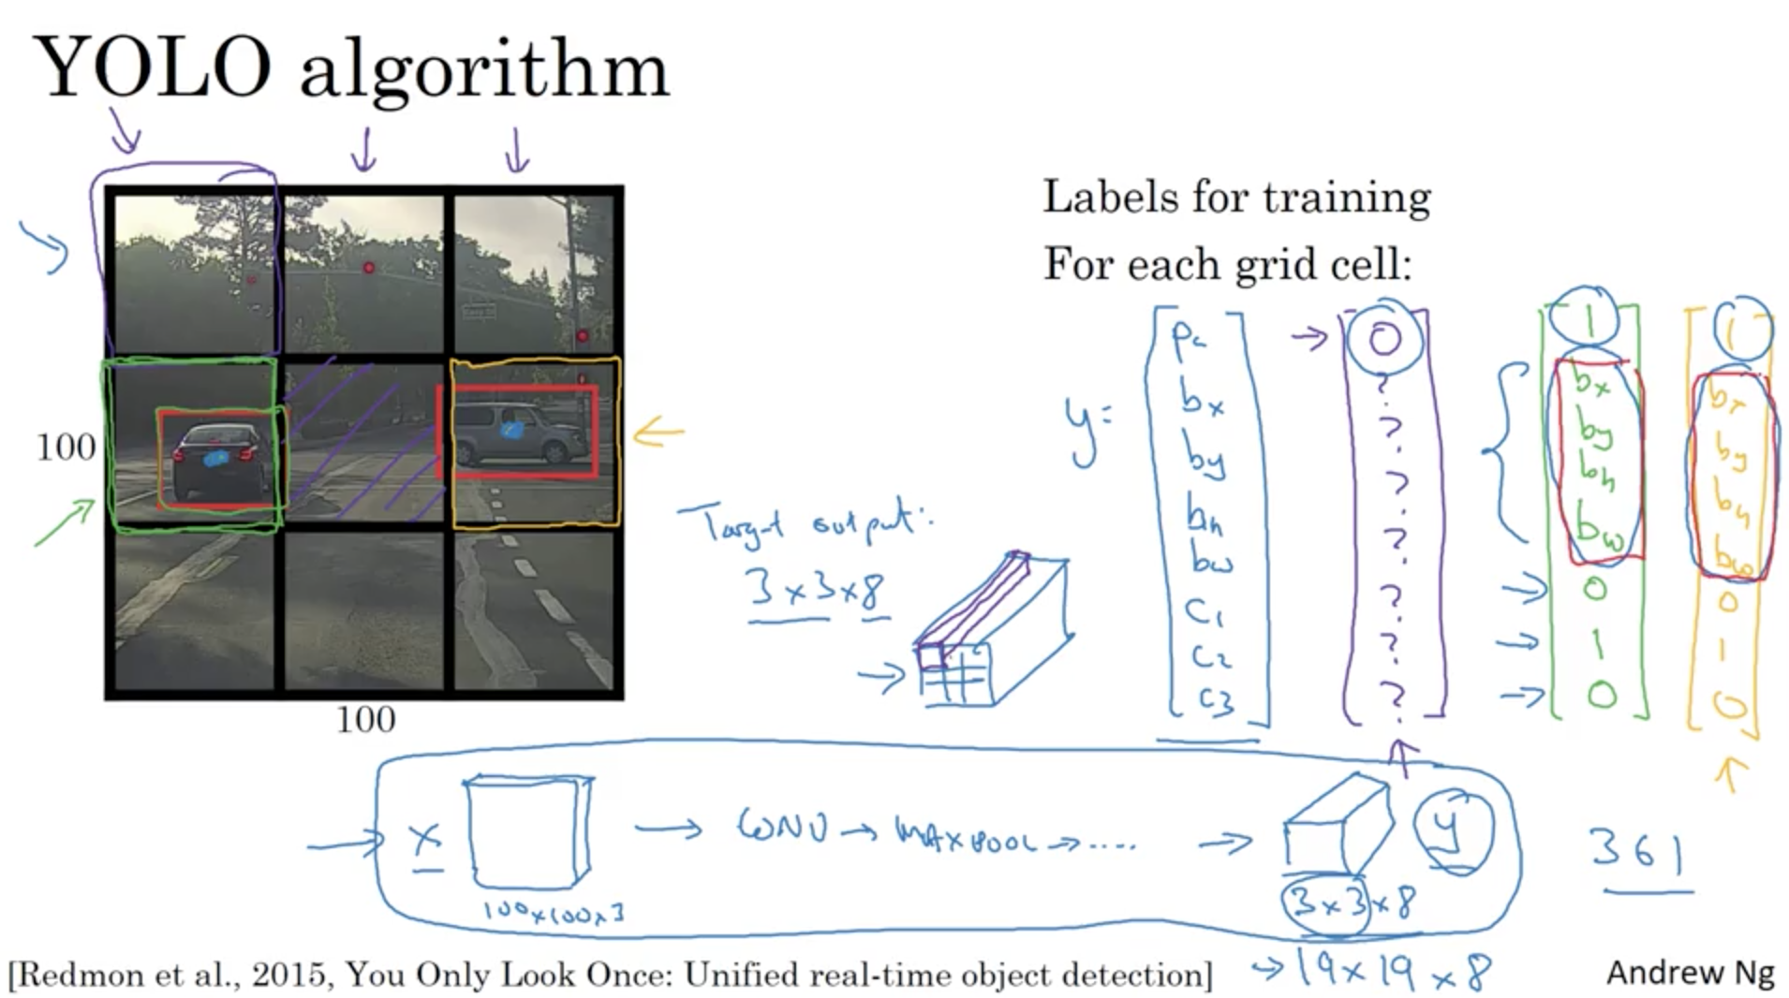

Slide 3
