Slide 1
The analysis of the courtship pulse song of male WT Drosophila
Abin Jacob & Yifan Pan
11.04.2025

Slide 2
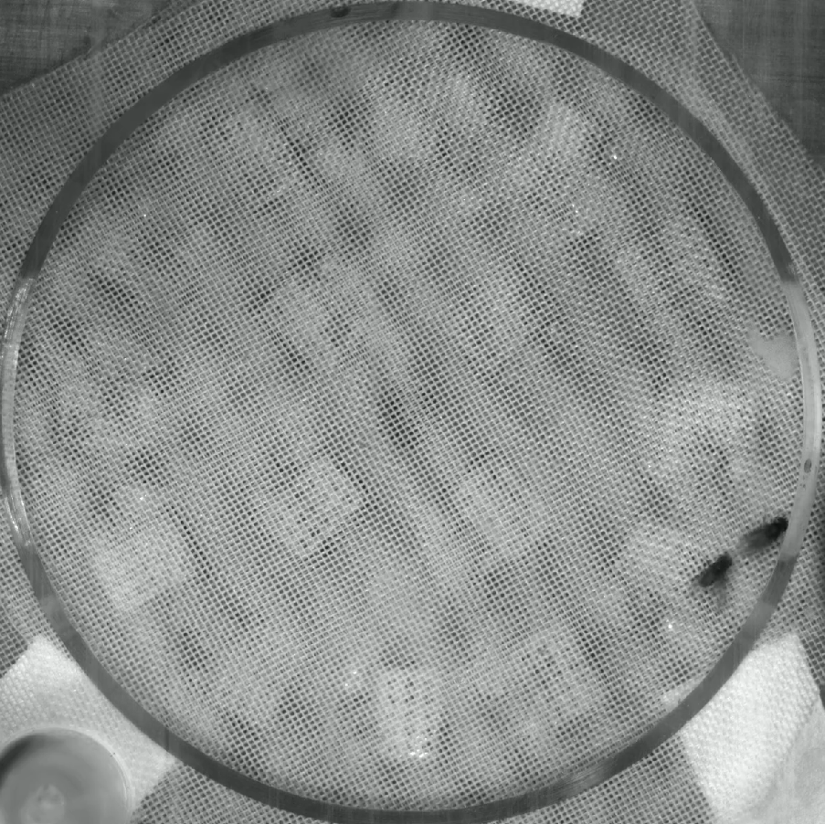
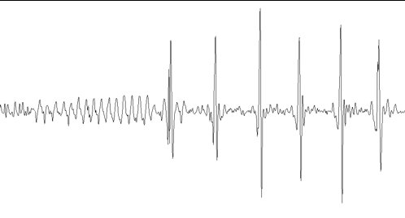
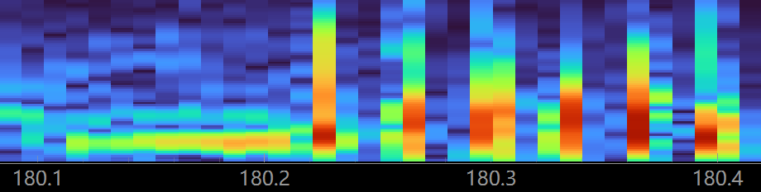
1000
Fequency (Hz)
0

Slide 3
15 male flies
Sapiro–Wilk test
Kruskal-Wallis test
Features | Normality | Significant difference
Carrier frequency | No | Yes
Duration | No | Yes
IPI (10-80 Hz) | No | Yes
Posthoc Dunn-Bonferroni test

Slide 4
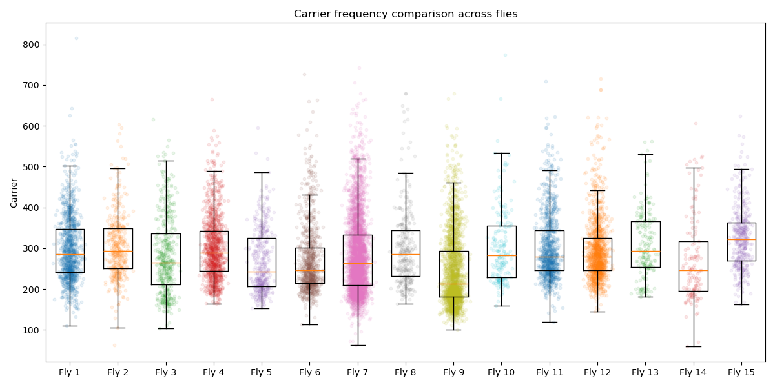
Carrier frequency (Hz)

Slide 5
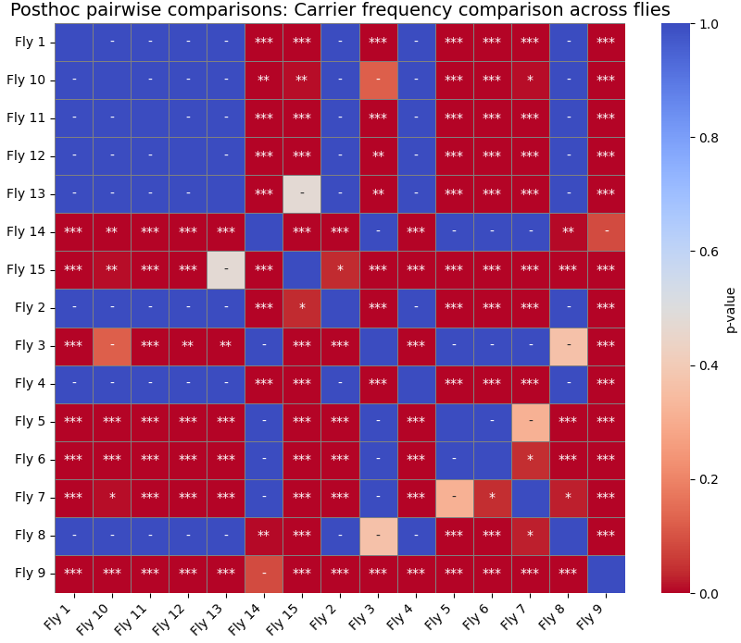

Slide 6
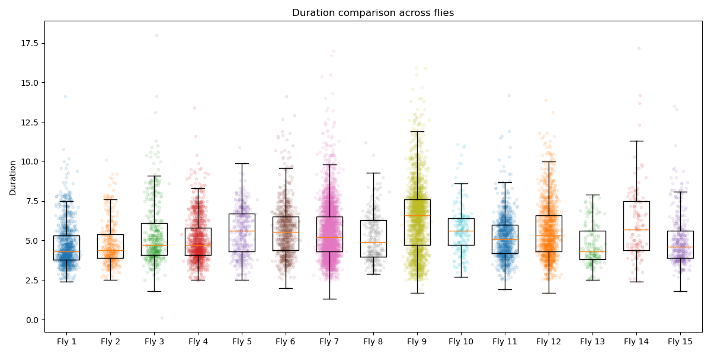
(ms)

Slide 7
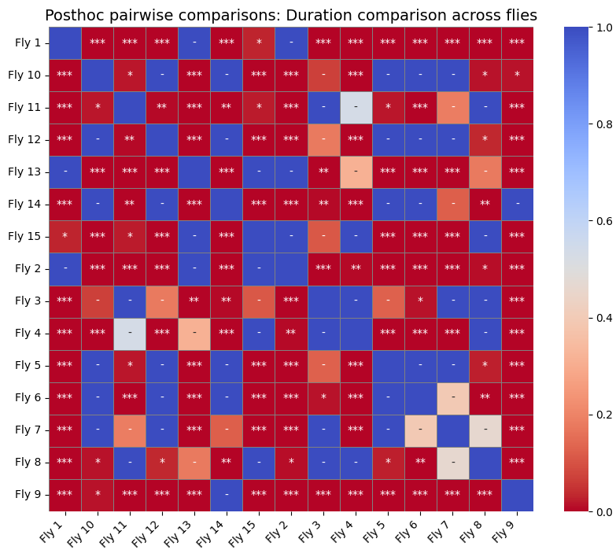

Slide 8
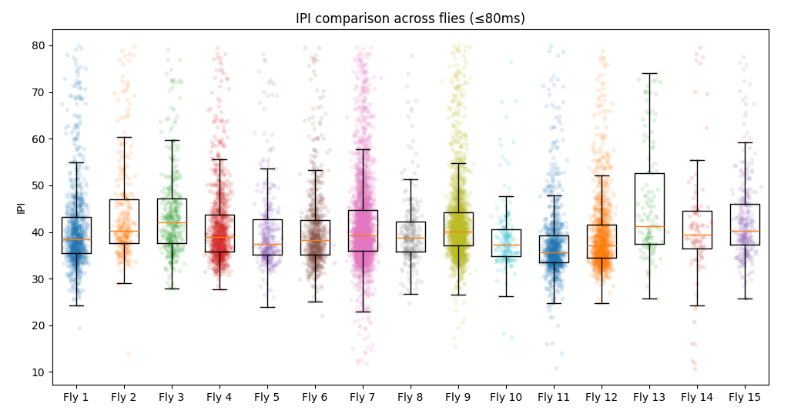
(ms)

Slide 9
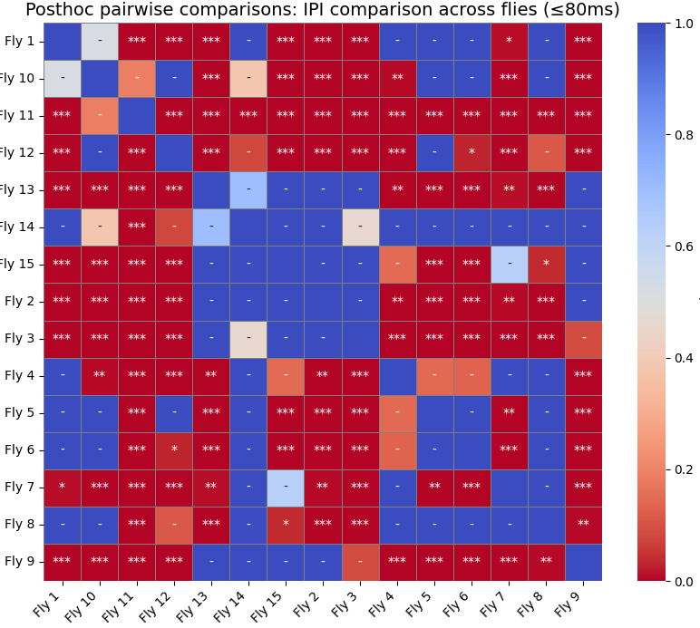

Slide 10
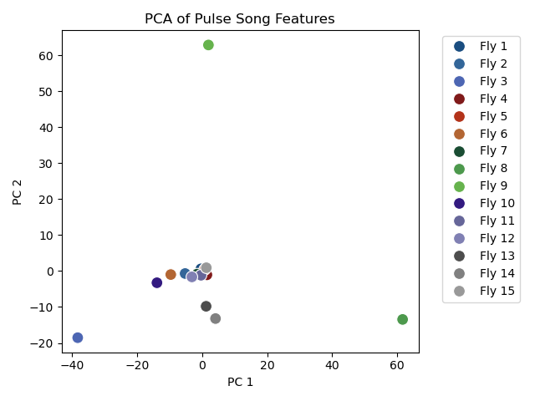
Principal component analysis (PCA)

