Slide 1
The effect of the activation of pC2 neurons on song productions
Abin Jacob, Laman Farajova, Yifan Pan
17.04.2025

Slide 2
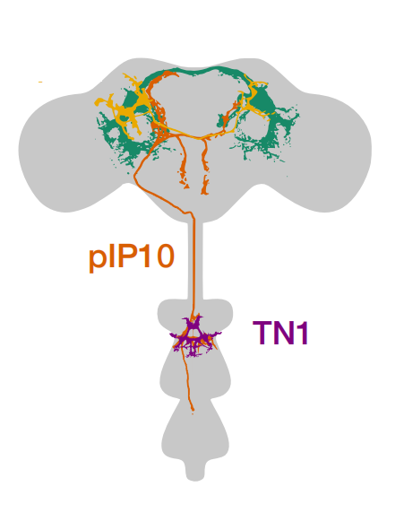

pC2
pIP10
TN1p
TN1s
Pulse
Sine

Slide 3
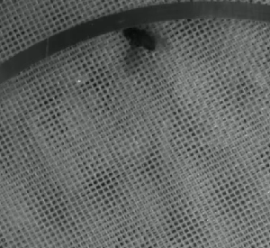
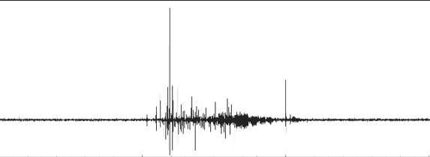
5 s
Red light
25 s
No light
5 s
5 s
10 s
pC2 neurons activated
1 s

Slide 4
5 s
25 s
1 s

Slide 5
1. Visualize the probability of pulse song and sine song
2. Find out the changes of probability of songs in different phases
• Mean of P(song) of each fly in each phase
• Normality test
• Wilcoxon signed-rank test

Slide 6
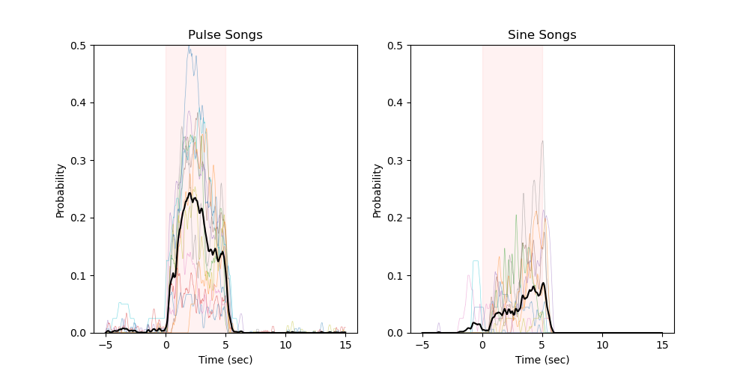
: Red light
: Mean trace
Male flies produced pulse song and sine song when pC2 neurons were activated

Slide 7
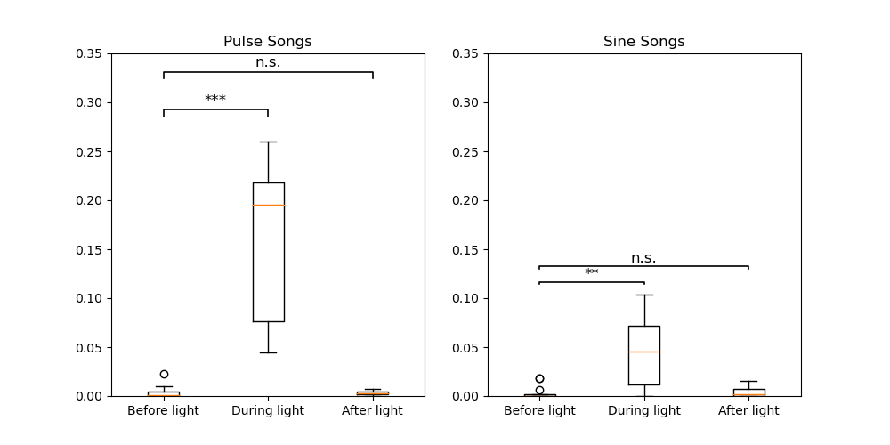
Probability
Male flies produced pulse song and sine song when pC2 neurons were activated

