Slide 1
Byte Rotation Algorithm
By
Abin Shaju T

Slide 2
Byte - Rotation Encryption Algorithm (BREA)
Byte Rotation Encryption Algorithm with Parallel Encryption Model enhances the security as well as speed of the encryption process.
This algorithm can be applied on different types of files like text, image, audio, video files etc.
The BREA is applied on different blocks of plaintext and executes in a parallel manner.
It uses a multithreading concept of a single processor system.

Slide 3
Why BREA ?
Cryptography is the study of transmitting secret messages securely from one party to another
There are three main forms of cryptosystems:
1.Symmetric Encryption System
2.Asymmetric Encryption System
3.Hash Functions
These models of encryption have been developed to provide security of information but each of them having some merits and demerits.

Slide 4
As a result researchers were working to remove this deficiency and finding a better solution.
Therefore an effort has been made to develop a new algorithm BREA.
It is a block cipher and used with Block Wise Parallel Encryption Model
This model consists of two steps:
1.The plaintext has been broken into number
of blocks. Each block is represented by a 2D
array.

Slide 5
2. The arrays of blocks are passed into BREA in parallel manner to execute simultaneously using multithreading.
This will allow all the blocks to process parallel in CPU .
The processing speed of the system will enhance because of parallel execution .
The number of blocks depends on the total input bytes of plaintext.
Here using BREA we introduce a new encryption model which is more secure and fast than others.

Slide 6
Features
It is a Symmetric Key Block Cipher Algorithm.
Each block size is of 16 bytes.
Size of Key matrix is 16 bytes.
Values of Key matrix are randomly selected and ranging from 1 to 26.
Mono alphabetic substitution concept is followed.
Byte - Rotation technique is used .

Slide 7
Steps for Encryption
The letters of alphabet are assigned numerical values from 1 to 26 in sequence.
The digits from 1 to 9 are assigned numerical values from 27 to 35 respectively.
Zero (0) remains as it is.
The plaintext is partitioned into fixed-length blocks (128 bits each ).
These blocks are represented by a matrix M_{p}.

Slide 8
6. We have a Key matrix (K) in BREA.
7. The values of Key matrix (K) are randomly selected from range 1 to 26.
Calculate the Transpose matrix of plaintext block matrix (M_{p}).
The Transpose matrix is denoted by M_{p}^{T}
10. Calculate the encrypted Key matrix (K_{e} )
K_{e} = K mod 2

Slide 9
11. Add both matrices M_{P}^{T} and K_{e} and the resultant matrix is denoted by C_{pk} .
C_{pk} = M_{p}^{T} + K_{e}
12. Rotate first three rows horizontally of C_{pk} matrix.
13. The resultant matrix is denoted by C_{hr} .
14. Similarly rotate first three columns vertically of C_{vr .}
15. Replace numeric values of C_{vr} matrix by theircorresponding letters and if 36 exist in C_{vr} ,it is replaced by the special character #.
16. The resultant matrix is denoted by C_{e} .

Slide 10
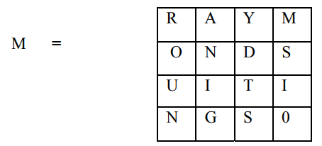
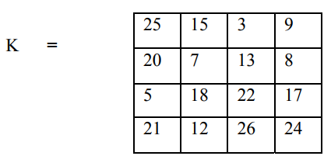
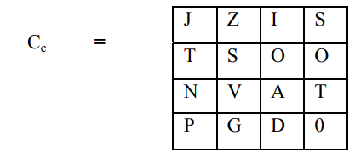
Example of BREA : Let the input plaintext is
RAYMONDS SUITINGS

Slide 11
References
Kalyani V. Gulhane , ”A Review on Low Latency for File Encryption and Decryption Using BRA Algorithm for Secure Transmission of Data” ,IJARECE vol-5,Issue 1,ISSN 2278-909X January 2016
S. Bhat, A. Bhati, S. K. Sharma ,”A New Approach towards Encryption schemes: Byte Rotation Encryption Algorithm.” World CECS, Vol-2, pp.24-26, 2012.
Naveen Kumar S K, Sharath Kumar H S, Panduranga H T, ”Encryption Approach for Images Using Bits Rotation Reversal and Extended Hill Cipher Techniques” International Journal of Computer Applications Vol-59, No. 16,December 2012.
Sonalina Chowdhury, “A New Combinational Approach Using Different Encryption Technique”, IJARCSSE, vol-3, Issue-8, ISSN 2777-128X PP.1022-1026, August 2013.
Nidhi Gouttam,”Implementation Of Simulation Of Byte Rotation Encryption Algorithm,”IJTEEE, vol-2,Issue 6 ,ISSN 2347-4289,2014
CSE Department, JECC

