Slide 1


Slide 2
Single Page Application?
Notes:
https://en.wikipedia.org/wiki/Single-page_application
Includes - Gmail, Google Drive etc Does not include – Blogs, Wiki etc

Slide 3
Framework?
Notes:
Example of paper

Slide 4
Clean
Reusable
Modular
Fast
Less Code
Notes:
Clean - simple DOM manipulations Reusable, Modular – Controllers, Directives
Fast – Routing(SPA)
Less Code – Data Binding

Slide 5
$lets code >

Slide 6
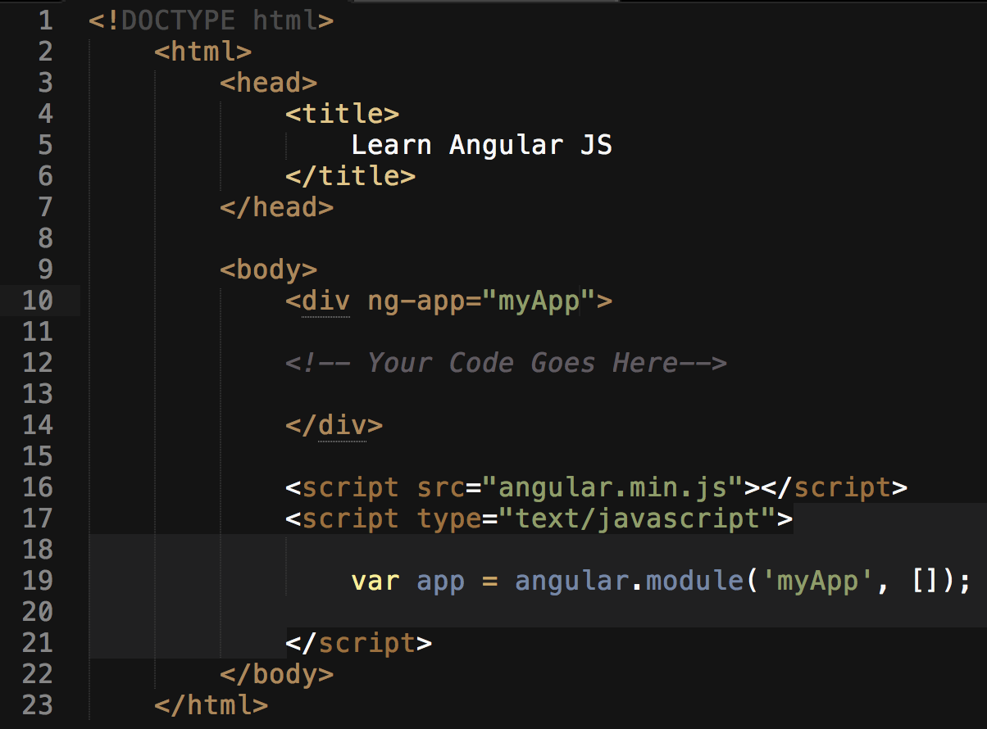

Slide 7
Expressions
{{Expression here}}
Eg : {{1+4}}

Slide 8
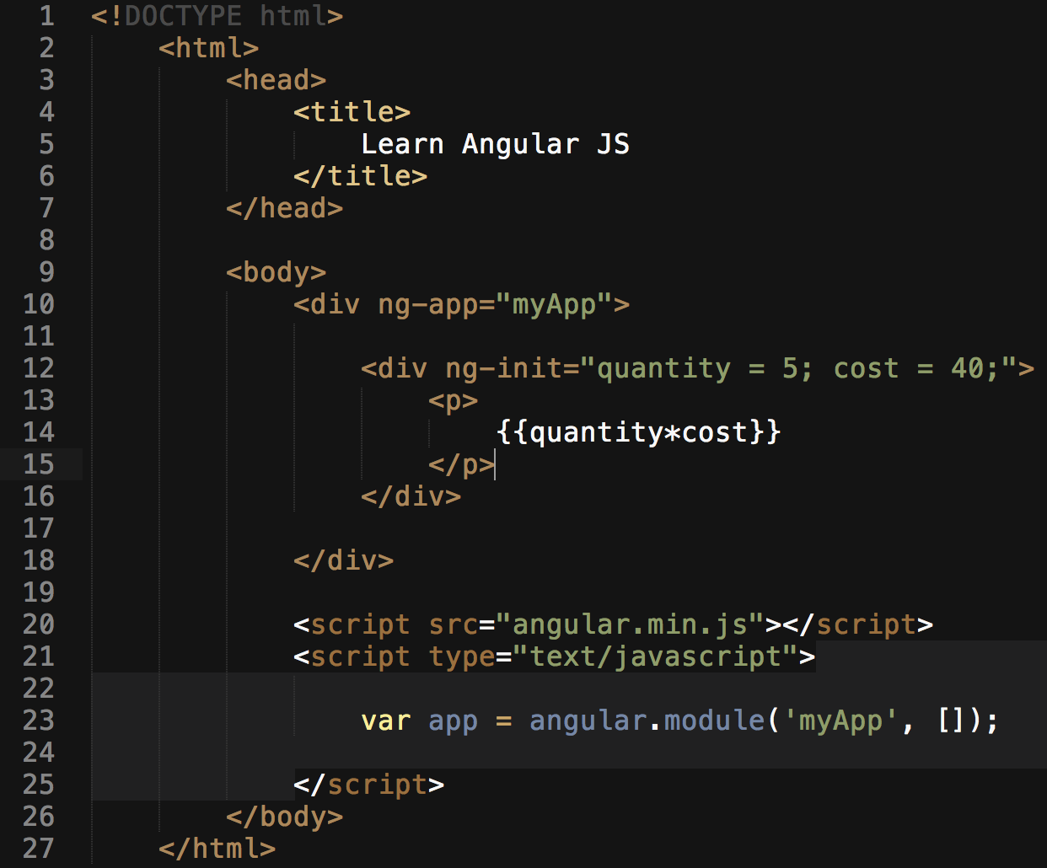

Slide 9
{{firstName + ‘ ‘ + secondName}}
{{ mark[4] }}
{{ person.Name }}

Slide 10
Directives
- Inbuilt Directives
ng-app ng-init
ng-model
ng-bind
ng-repeat
Notes:
Explain each with example

Slide 11
Events
ng-click
ng-dblclick
ng-mouseover
Notes:
Explain each with example

Slide 12
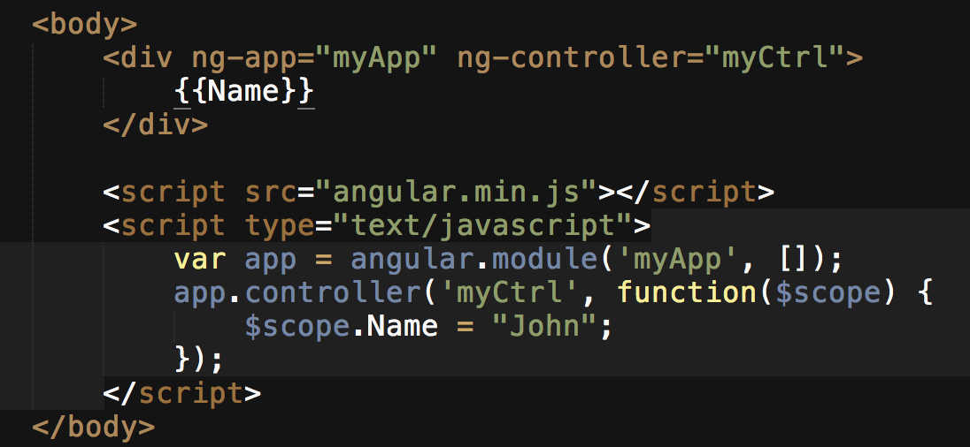
Controllers
ng-controller
Notes:
Explain with example

Slide 13
Filters
- Inbuilt Filters
lowercase
uppercase
orderBy
filter
Notes:
Explain each with example

Slide 14
Let’s Make a Shopping List App
Add Item to list
Remove Item from list
Validation
Notes:
http://www.w3schools.com/angular/angular_application.asp

