Slide 1
























$$n= (y, { t}_{x}+α, { b}_{x}+{\overline{w}}_{x})$$
$$t_{A1}=t_{x}+α$$
$$m=0$$
$t_{A2}=t_{x}+α+b_{x}$ $+{\overline{w}}_{x}$
$$t_{x}$$
$$b_{x}+{\overline{w}}_{x}$$
$$t_{A1}$$
$$t_{A2}$$
$$time$$
$$(a)$$
$$n=(y, { t}_{x}+∆t_{1}+β, { b}_{y})$$
$$μ$$
$$b_{y}=min⁡(∆t_{2}, { b}_{x}+{\overline{w}}_{x}−∆t_{1})$$
$$∆t_{1}$$
$$∆t_{2}$$
$$t_{A1}=t_{x}+β$$
$$m=1$$
$$t_{A2}=t_{x}+β+b_{y}$$
$$t_{x}$$
$$t_{D1}$$
$$t_{A1}$$
$$t_{A2}$$
$$time$$
$$(b)$$

Slide 2



















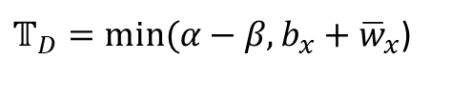




$$α≔τ\left(e_{xy},0\right)$$
$$n_{1}= (y, t_{D1}+α, Δt_{1})$$
$$a_{x}$$
$$= (y, { a}_{x}+α, { b}_{x}+{\overline{w}}_{x})$$
$$t_{D1}$$
$$t_{A1}$$
$$time$$
$${∆t_{1} =b}_{x}+{\overline{w}}_{x}$$
$$(a)$$
$$β≔τ\left(e_{xy},1\right)$$
$$μ$$
$$n_{2}=(y, { t}_{D2}+β,∆t_{2})$$
$$n_{3}=(y, { t}_{D3}+β,∆t_{3})$$
$$∆t_{2}$$
$$∆t_{3}$$
$𝕋_{D}=min⁡(α−β, b_{x}+{\overline{w}}_{x}$)
$$a_{x}$$
$$t_{D2}$$
$$t_{A2}$$
$$t_{D3}$$
$$t_{A3}$$
$$time$$
$$𝕋_{D}$$
$$(b)$$

Slide 3

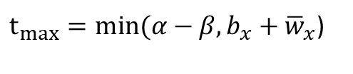


























$$α≔τ\left(e_{xy},0\right)$$
$$∆t_{1}$$
$arrival$-$y$
$$n_{1}= (y, t_{D1}+α, Δt_{1})$$
$departure$-$x$
$$= (y, { a}_{x}+α, { b}_{x}+{\overline{w}}_{x})$$
$arrival$-$x$
$$a_{x}$$
$$a_{x}+b_{x}$$
$$t_{A1}$$
$$a_{x}+b_{x}+{\overline{w}}_{x}$$
$$time$$
$$t_{D1}$$
$$(a)$$
$$β≔τ\left(e_{xy},1\right)$$
$$∆t_{2}$$
$$∆t_{3}$$
$arrival$-$y$
$$n_{2}=(y, { t}_{D2}+β,∆t_{2})$$
$feasible departure$-$x$
$$n_{3}=(y, { t}_{D3}+β,∆t_{3})$$
$$μ$$
$departure window$-$x$
$t_{max}=min⁡(α−β, b_{x}+{\overline{w}}_{x}$)
$arrival$-$x$
$$a_{x}$$
$$t_{D2}$$
$$a_{x}$$
$$+$$
$$b_{x}$$
$$t_{A2}$$
$$t_{D3}$$
$$t_{max}$$
$$t_{A3}$$
$$time$$
$$(b)$$

Slide 4
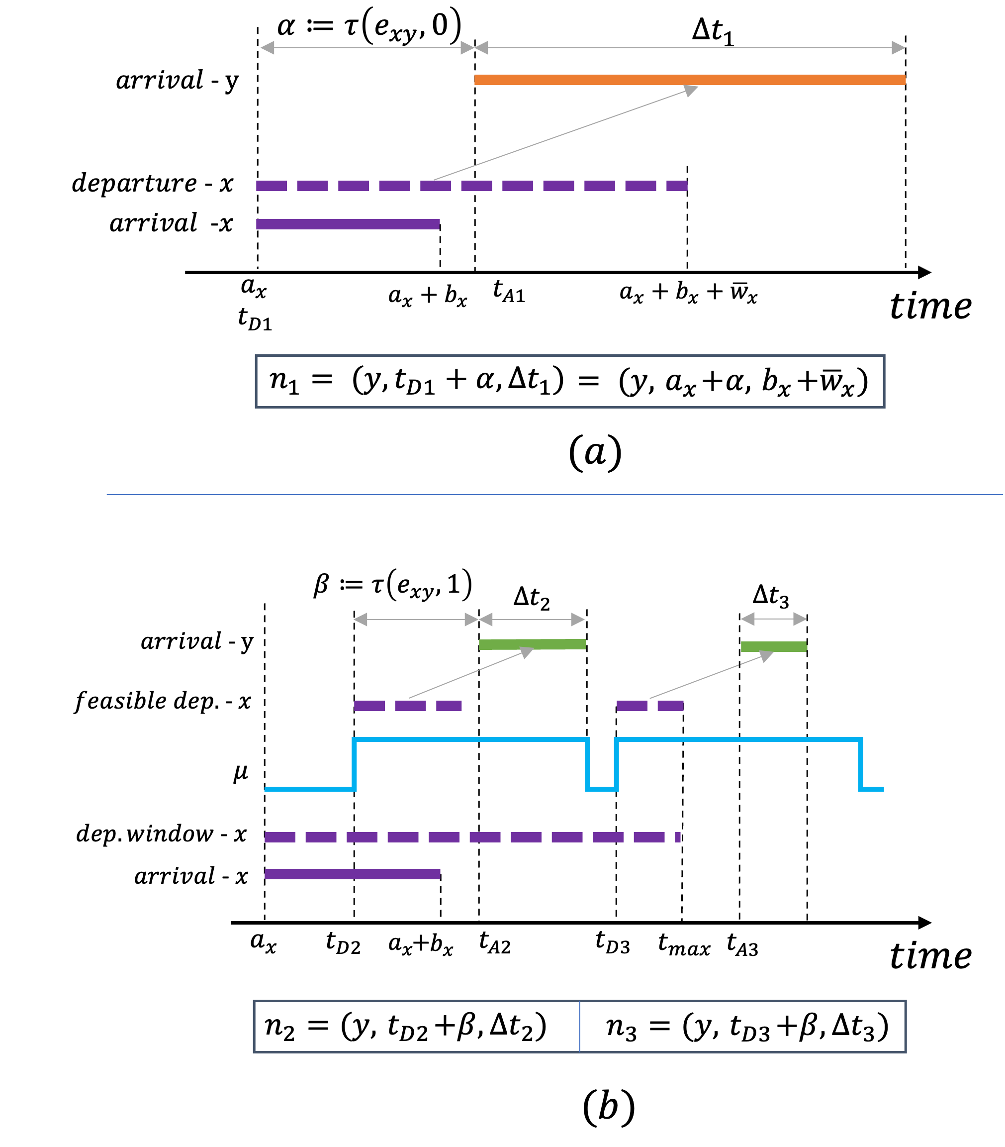

Slide 5


















$$α≔τ\left(e_{xy},0\right)$$
$$β≔τ\left(e_{xy},1\right)$$
$$n_{2}$$
$$a_{y}$$
$$a_{y}$$
$${ t}_{D2}+β$$
$$a_{x}+α$$
$${ t}_{D1}+β$$
$$b_{x}+{\overline{w}}_{x}$$
$$∆t_{1}$$
$$∆t_{2}$$
$$a_{x}$$
$$d_{x}$$
$$t_{D1}$$
$$t_{D2}$$
$$d_{x}$$
$$(a)$$
$$(b)$$

Slide 6


$$α≔τ\left(e_{xy},0\right)$$
$$β≔τ\left(e_{xy},1\right)$$

Slide 7












$$\overline{w}=0$$
$$\hat{v}$$
$$β$$
$$0$$
$$u$$
$$α,β$$
$$v$$
$$α$$
$$u$$
$$v$$
$${\overline{w}}_{u}$$
$${\overline{w}}_{u}$$

Slide 8
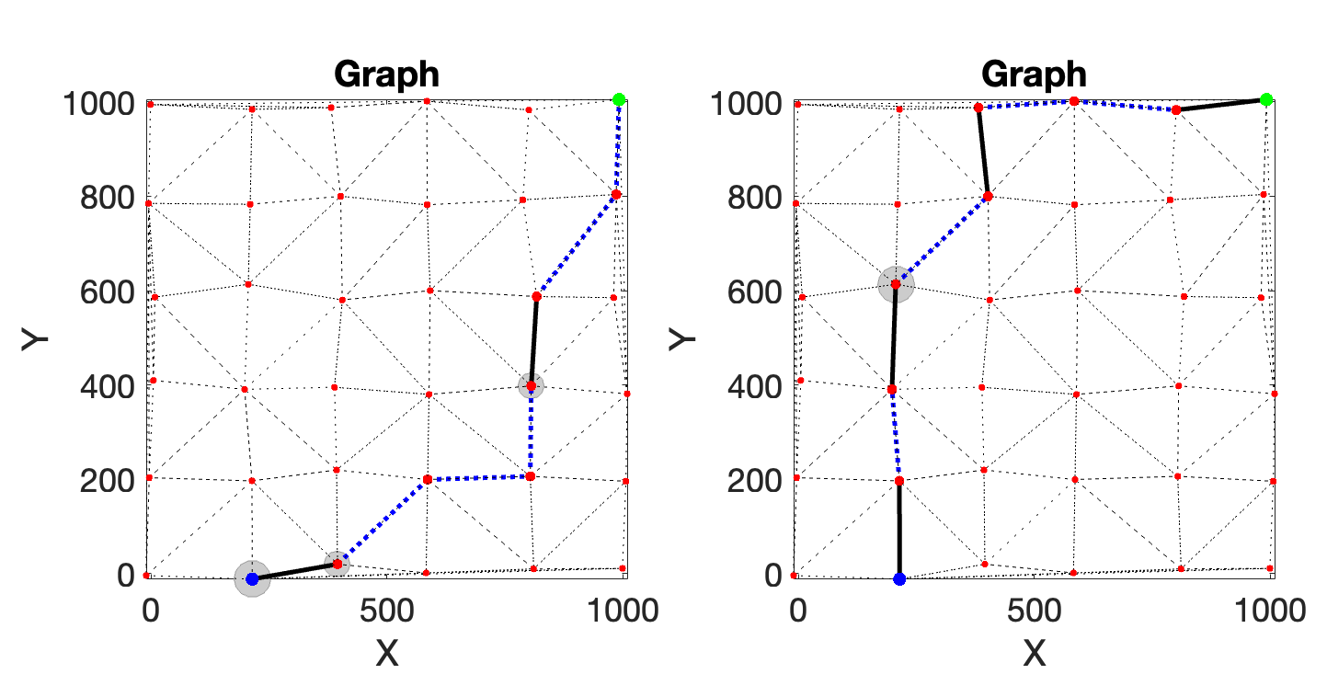
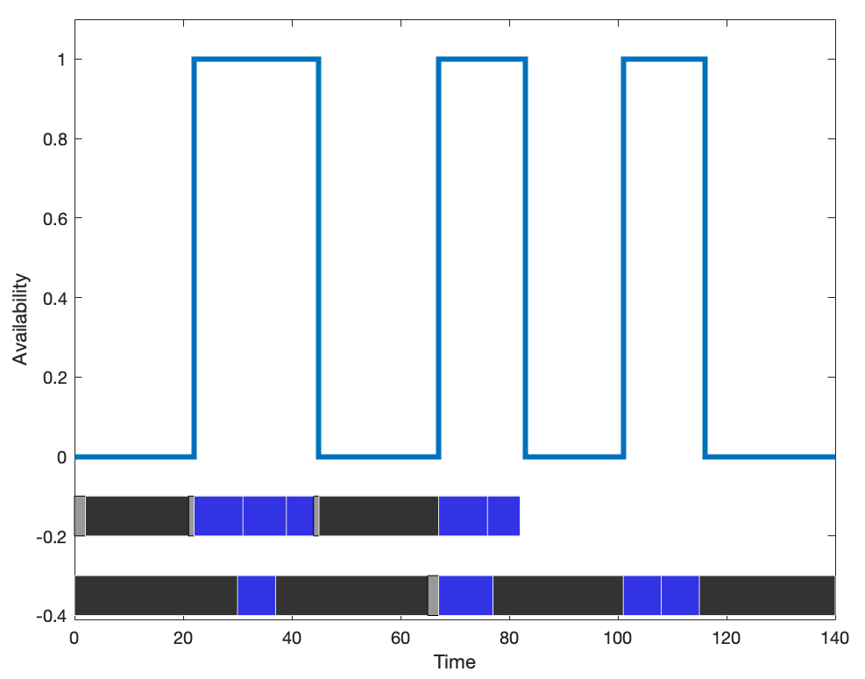

Slide 9
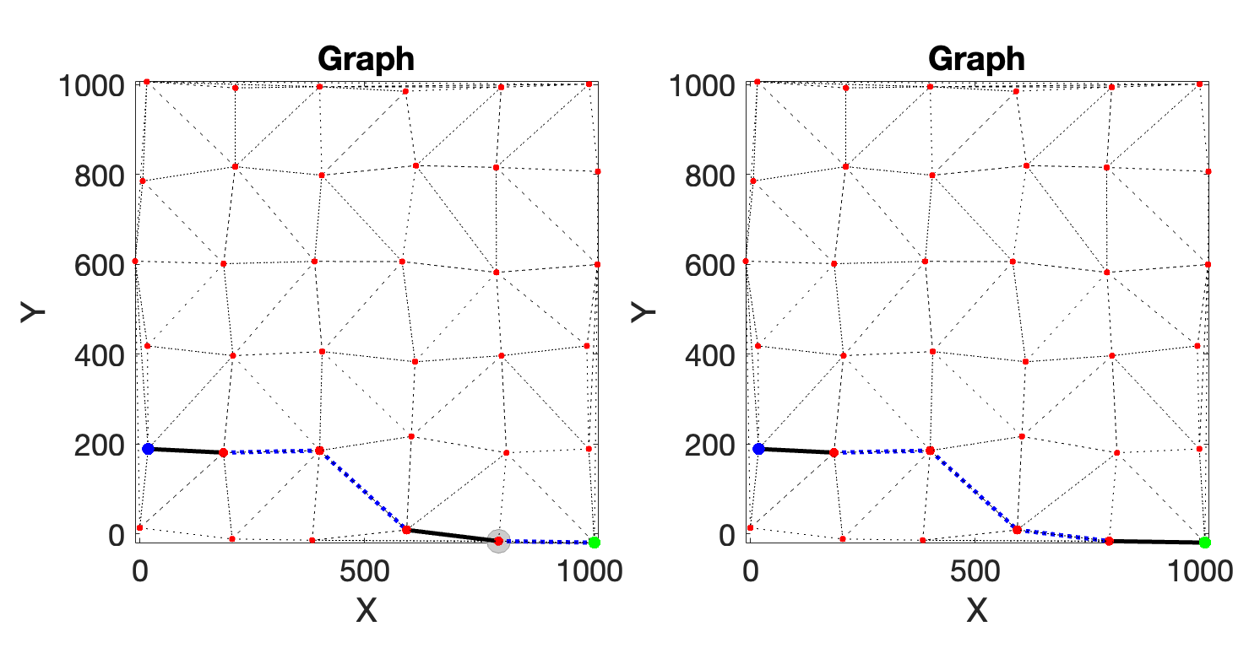
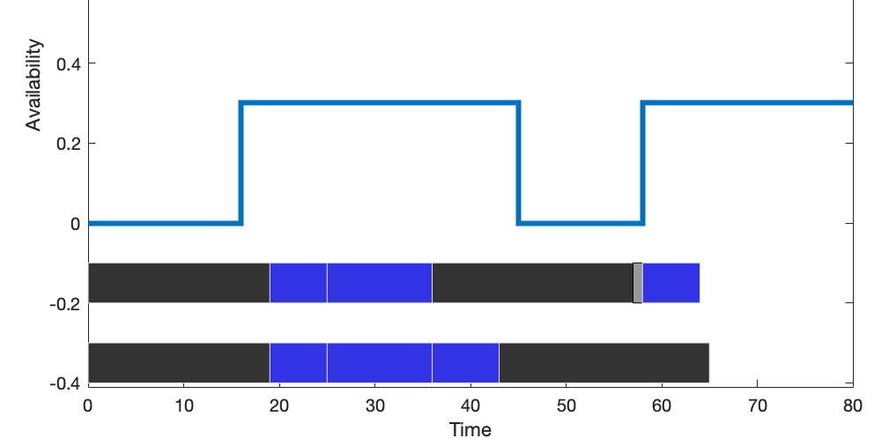

Slide 10
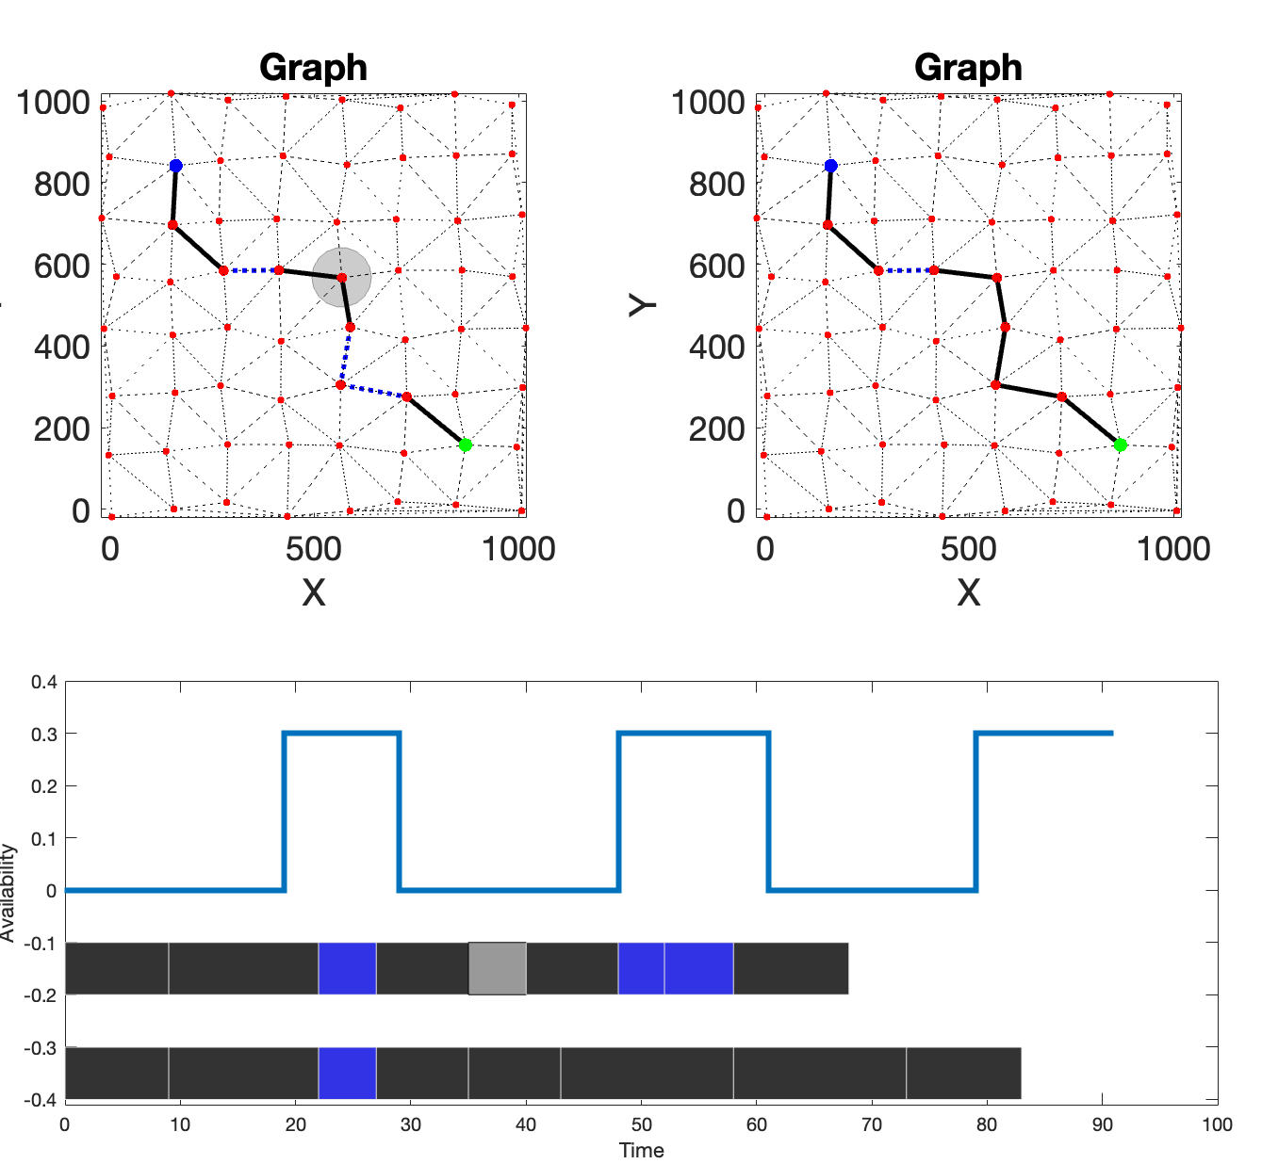
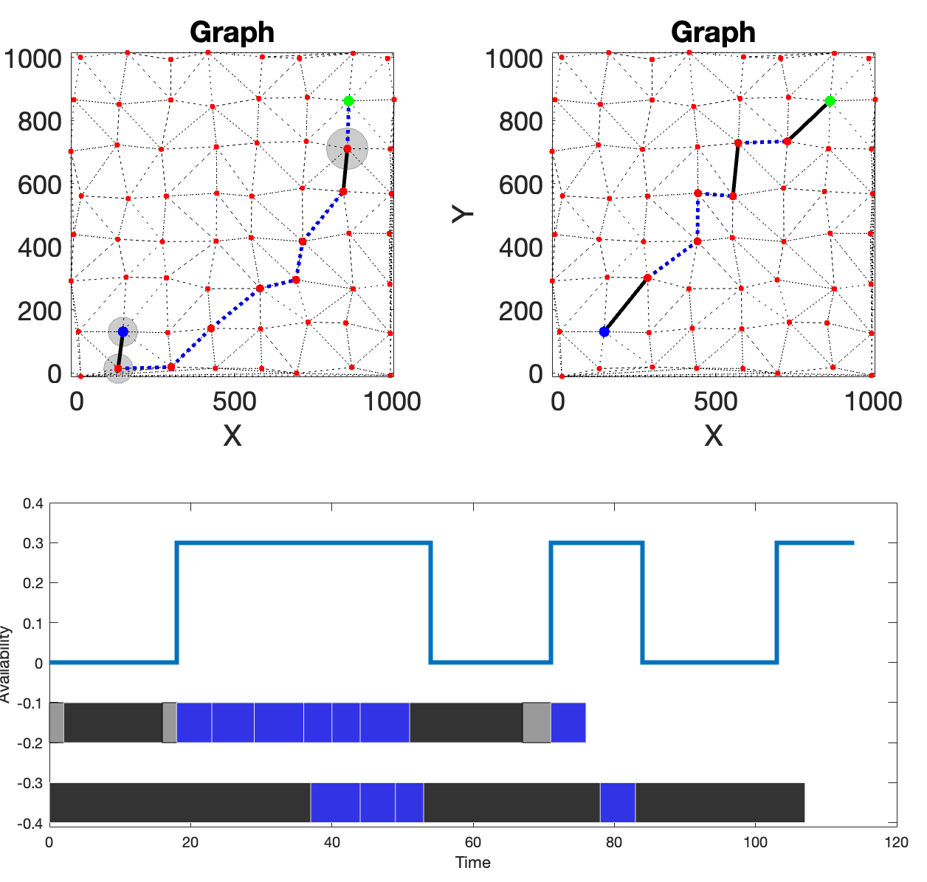
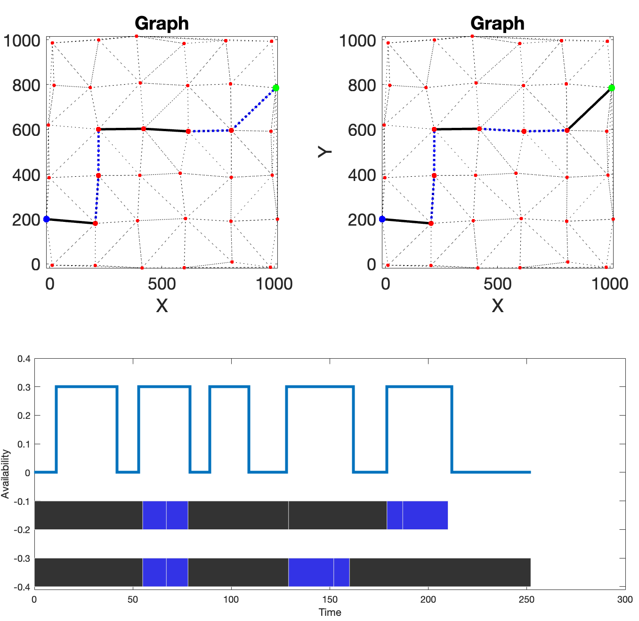

Slide 11
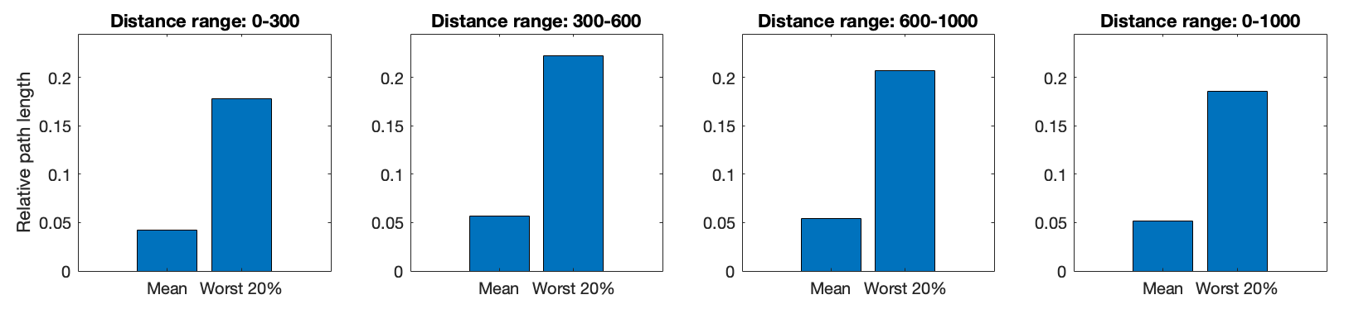
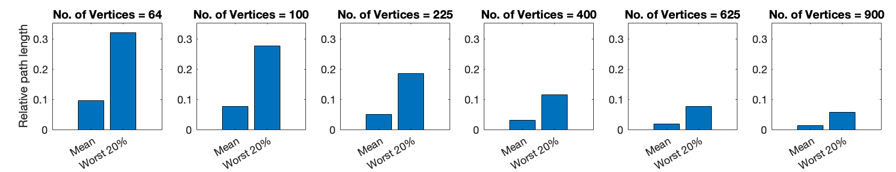

Slide 12
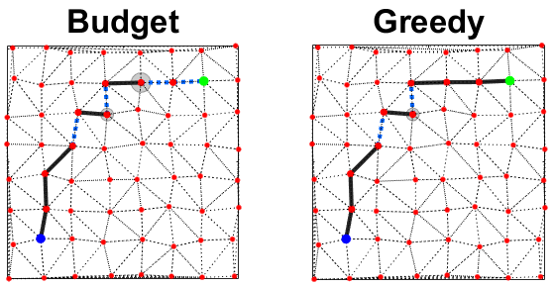
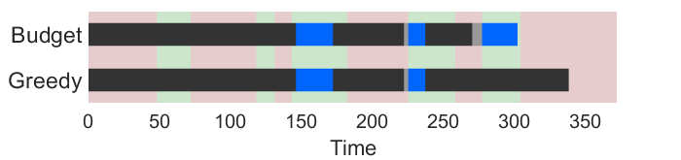

Slide 13
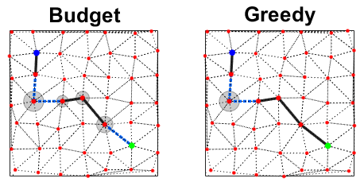
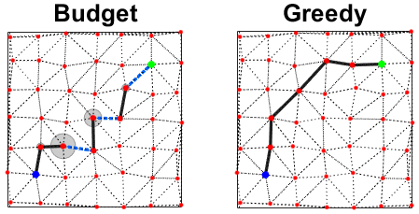
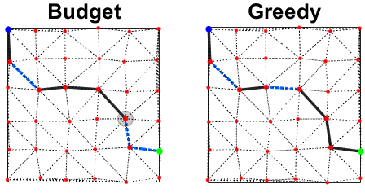
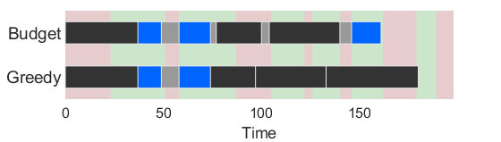
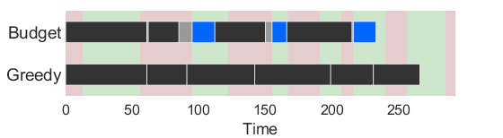
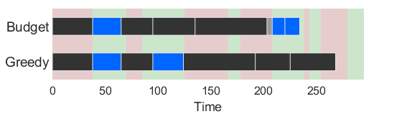

Slide 14
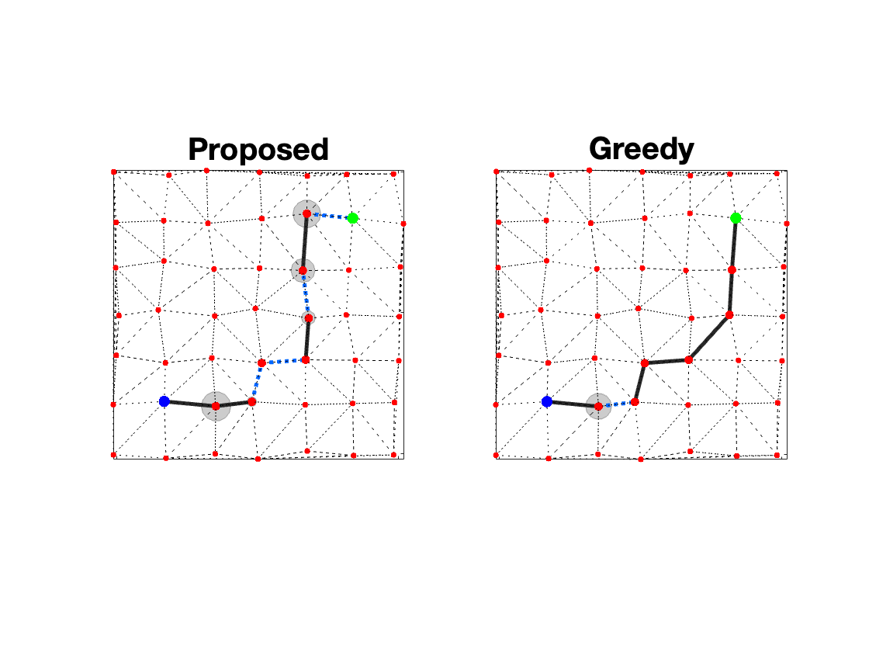
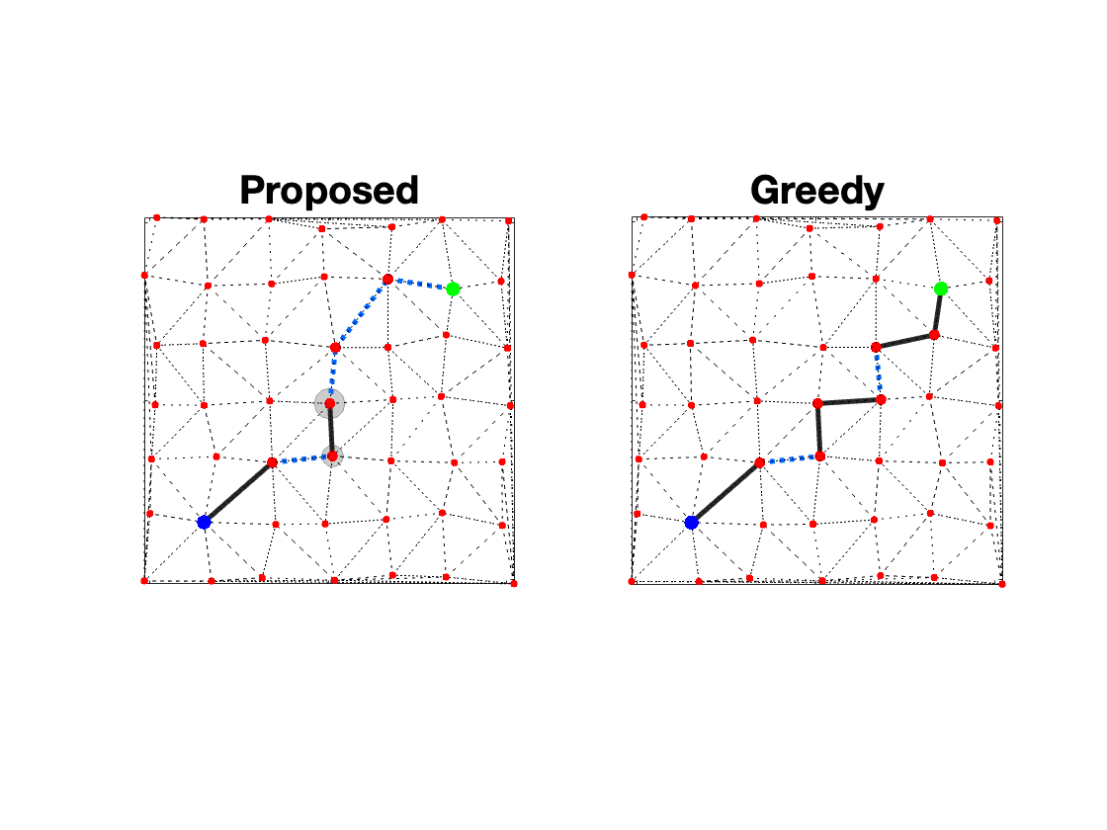
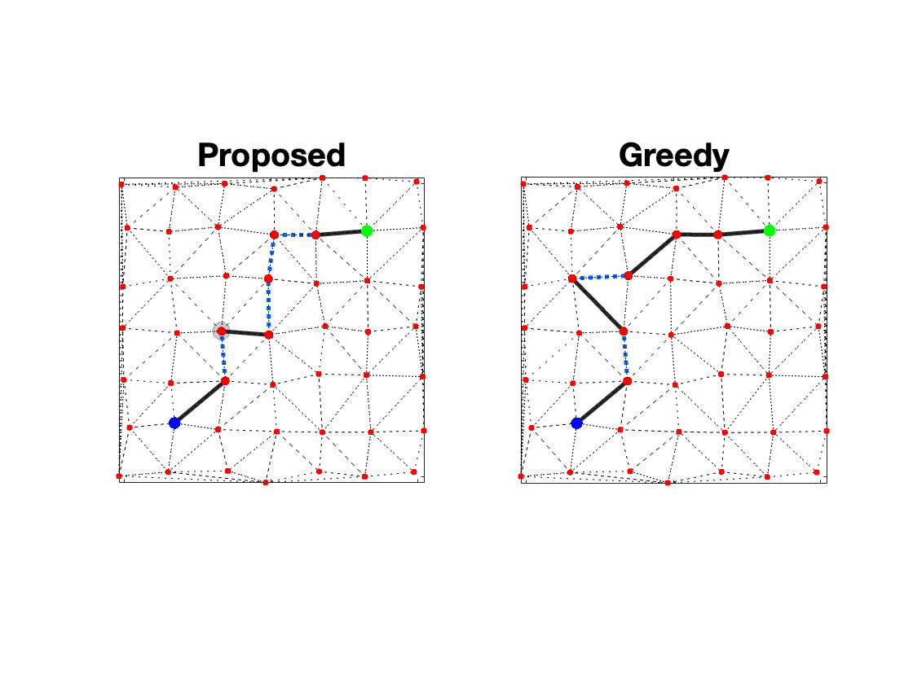
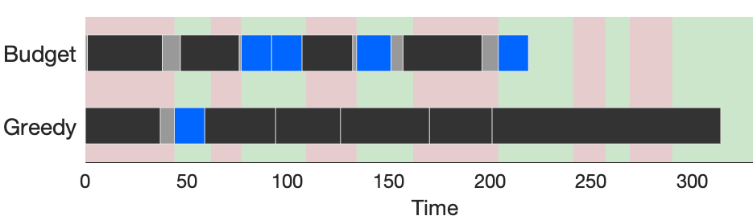
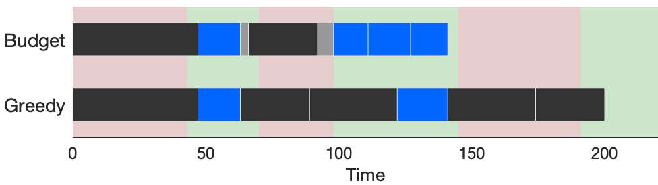
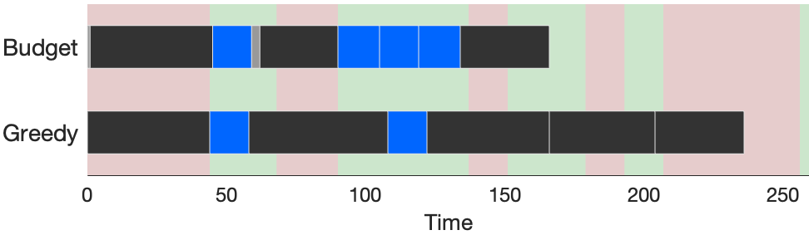

Slide 15
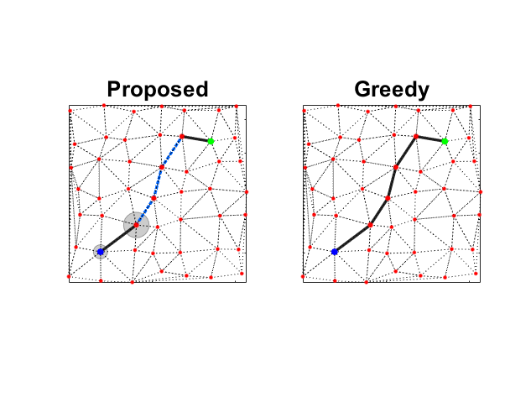
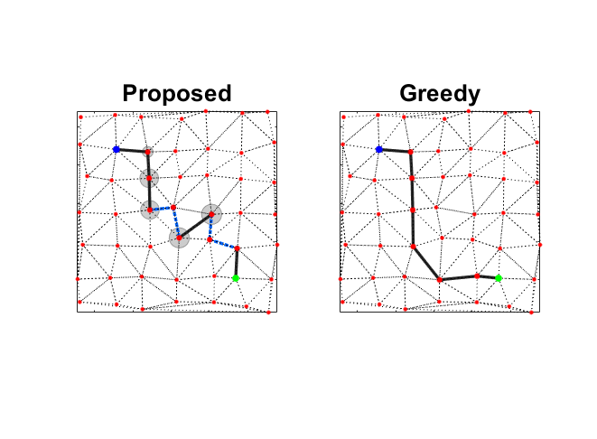
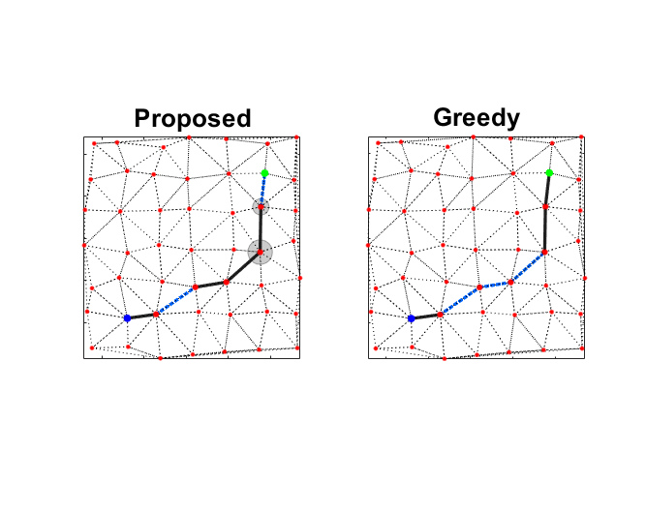
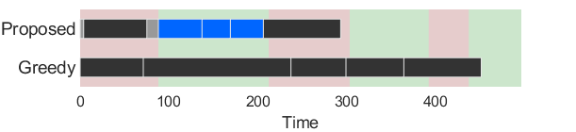
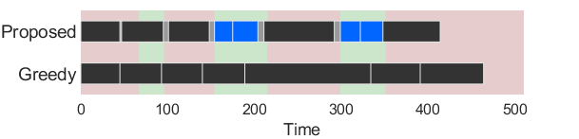
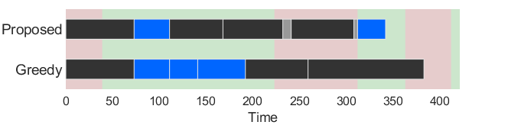

Slide 16
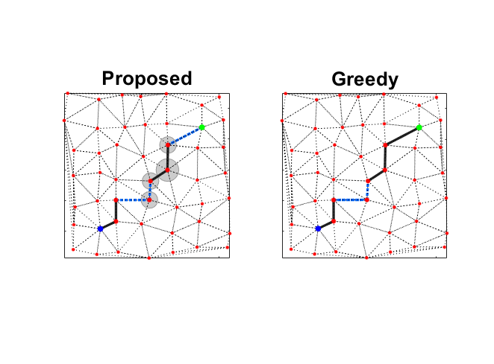
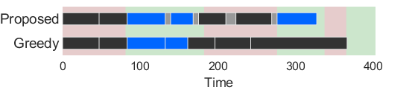

Slide 17
