Slide 1
BEGINNER DATA SCIENCE COURSE
Building Collaborative Filtering Engines
Recommending What Users May Like Based on Similar Behaviour
Time Series & Recommender Systems
Users
Preferences
Patterns
Recommendations
Collaborative Filtering Engines
1
Notes:
Welcome the class. This is a 2-hour session: Hour 1 is concepts (this deck), Hour 2 is hands-on Python. Frame it as building ONE recommendation engine together for a movie streaming platform, not a tour of separate algorithms. Ask: has anyone ever wondered how Netflix or Spotify seems to 'know' what they might like? That's exactly what we're demystifying today — no magic, just patterns in what similar people like.

Slide 2
INTRODUCTION
SLIDE 2
Learning Objectives
By the end of this session, you will be able to:
• Explain what a recommendation system is.
• Understand user-item interactions.
• Explain explicit and implicit feedback.
• Understand collaborative filtering.
• Explain user-based collaborative filtering.
• Explain item-based collaborative filtering.
• Understand similarity.
• Build a simple recommendation engine in Python.
• Generate recommendations.
• Evaluate basic recommendation results.
Collaborative Filtering Engines
2
Notes:
Walk down the list quickly — this is a map, not a lesson. Mention explicitly that we are deliberately NOT covering matrix factorization, SVD, ALS, or neural collaborative filtering in depth today — those are later-course territory. Today is entirely about building strong intuition for neighborhood-based collaborative filtering, plus one working, understandable engine.

Slide 3
SECTION 2 · THE REAL PROBLEM
SLIDE 3
Why Do We Need Recommendation Systems?
Netflix recommending movies
Spotify recommending songs
Amazon recommending products
YouTube recommending videos
Online stores recommending products
How does Netflix know what movie you may like?
It does not always know exactly. It learns from patterns in user behaviour.
Collaborative Filtering Engines
3
Notes:
Ask learners to name a platform's recommendation feature they've personally noticed working well (or badly!) before revealing these examples. The key reframe on this slide: these platforms are not reading minds — they're pattern-matching on behaviour, which is exactly what we'll build by hand in Hour 2.

Slide 4
SECTION 2 · THE REAL PROBLEM
SLIDE 4
The Movie Streaming Problem
1,000,000
users
50,000
movies
Millions of
interactions
How can we decide what movie to recommend to each user?
Showing every movie to every user is not practical
Collaborative Filtering Engines
4
Notes:
Make the scale concrete — a million users and 50,000 movies means personalization isn't a nice-to-have, it's the only way the platform stays usable. Ask: 'if Netflix just showed everyone the same homepage, what would happen?' (Answer: most users would never find anything relevant, and give up browsing.)

Slide 5
SECTION 3 · WHAT IS A RECOMMENDER?
SLIDE 5
What Is a Recommender System?
“A recommender system helps users discover items
they may be interested in.”
Movies
Songs
Products
Books
Courses
Jobs
News Articles
Collaborative Filtering Engines
5
Notes:
Emphasize the word 'ITEM' as the general umbrella term — it applies to anything a platform can recommend, not just movies. We'll use movies as our running example for the rest of the course because it's the most intuitive, but the exact same technique applies to any of these categories.

Slide 6
SECTION 3 · WHAT IS A RECOMMENDER?
SLIDE 6
The Basic Idea
User
Past Behaviour
Find Patterns
Predict Interest
Recommend Item
Collaborative Filtering Engines
6
Notes:
Recommendations are PREDICTIONS about possible user preferences — not certainties. Plant that seed early; it directly pre-empts Misconception 3 later (a recommendation does not guarantee the user will like the item).

Slide 7
SECTION 4 · USER-ITEM INTERACTIONS
SLIDE 7
Users and Items
USER
A person interacting
with the system.
e.g. John
ITEM
Something the system
can recommend.
e.g. Movie A, B, C, D
Collaborative Filtering Engines
7
Notes:
Simple vocabulary-setting slide — keep it brief. These two words (USER, ITEM) will appear constantly for the rest of the course, so make sure everyone's comfortable with them before moving on.

Slide 8
SECTION 4 · USER-ITEM INTERACTIONS
SLIDE 8
What Is an Interaction?
User
Interaction
Item
Examples of interactions:
• Watching a movie
• Rating a movie
• Buying a product
• Clicking a video
• Listening to a song
• Adding a product to a cart
Collaborative Filtering Engines
8
Notes:
Users interact with items in many different ways — this variety matters because it directly sets up the next two slides (explicit vs. implicit feedback). Ask: 'which of these examples tells us MOST clearly what the user thinks — and which tells us the LEAST?'

Slide 9
SECTION 5 · FEEDBACK TYPES
SLIDE 9
Explicit Feedback
“Explicit feedback happens when a user directly
tells us what they think.”
• Movie rating: 5 stars
• Product rating: 4 stars
• Like / dislike
John → Movie A → ★★★★★
Collaborative Filtering Engines
9
Notes:
This is the clearest, most direct kind of signal — the user is TELLING us their preference. Our movie ratings dataset in Hour 2 is entirely explicit feedback (1-5 star ratings), which is why it's a good first dataset for beginners to learn on.

Slide 10
SECTION 5 · FEEDBACK TYPES
SLIDE 10
Implicit Feedback
“Implicit feedback comes from user behaviour.”
• Clicks
• Purchases
• Watch history
• Listening history
• Search history
• Time spent on a product
User watched Movie A
User watched Movie B
User watched Movie C
Collaborative Filtering Engines
10
Notes:
The critical distinction: 'the user did not directly SAY "I like this" — but their behaviour gives us useful clues.' Most real-world recommendation data is actually implicit (few people bother to rate things, but everyone leaves behavioural traces) — flag that our course dataset uses explicit ratings for teaching simplicity, but production systems often lean heavily on implicit signals instead.

Slide 11
SECTION 6 · THE USER-ITEM MATRIX
SLIDE 11
Turn Behaviour Into Data
The User-Item Matrix
User | Movie A | Movie B | Movie C | Movie D
John | 5 | 4 | ? | 2
Mary | 5 | 4 | 5 | 1
David | 1 | 2 | 4 | 5
• Rows = Users
• Columns = Items
• Values = Ratings or interactions
• Missing values = Unknown preferences
Collaborative Filtering Engines
11
Notes:
This is one of the anchor slides for the whole course — the user-item matrix is the single data structure that everything else builds on. Point at the '?' for John/Movie C explicitly: that gap is exactly what we're trying to fill in. This same table appears again on the very next slide.

Slide 12
SECTION 6 · THE USER-ITEM MATRIX
SLIDE 12
The Big Question
“How can we fill in the missing preferences?”
For example: John + Movie C = ? — this becomes the recommendation problem.
Collaborative Filtering Engines
12
Notes:
Let this sit for a moment — it's the pivot slide into collaborative filtering. Everything from here forward in the course is really just different strategies for answering this one question.

Slide 13
SECTION 7 · COLLABORATIVE FILTERING
SLIDE 13
The Simple Idea
“People who behave similarly may like similar things.”
John likes:
Movie A
Movie B
Mary likes:
Movie A
Movie B
Movie C
Possible recommendation: Movie C → John
This idea is called COLLABORATIVE FILTERING.
Collaborative Filtering Engines
13
Notes:
Only reveal the term 'Collaborative Filtering' at the very end of this slide, after the intuition has landed — this matches the course's teaching philosophy exactly (simple idea before technical term). This is THE example that recurs throughout the entire course.

Slide 14
SECTION 7 · COLLABORATIVE FILTERING
SLIDE 14
Why Is It Called Collaborative?
“The system learns from the combined behaviour
of many users.”
It does not need to understand the movie description first. Instead, it learns from:
User Behaviour
+
Other Users' Behaviour
Collaborative Filtering Engines
14
Notes:
This directly contrasts collaborative filtering with content-based recommendation (which DOES need to understand what a movie is 'about' — genre, actors, keywords). We're deliberately not teaching content-based methods today — mention it exists, briefly, so learners know it's a different, complementary approach, not that collaborative filtering is the only technique.

Slide 15
SECTION 8 · USER-BASED FILTERING
SLIDE 15
Find Similar Users
If two users have similar preferences, we may use one person's behaviour
to recommend items to the other.
John
Movie A → ❤️
Movie B → ❤️
Mary
Movie A → ❤️
Movie B → ❤️
Movie C → ❤️
Recommendation: Movie C → John
Collaborative Filtering Engines
15
Notes:
This is user-based collaborative filtering, made concrete — 'people like you also liked...' is the plain-English summary worth writing on a whiteboard. We'll build this exact mechanic in Python in Hour 2, using cosine similarity to find users like John.

Slide 16
SECTION 8 · USER-BASED FILTERING
SLIDE 16
User-Based Filtering Workflow
User
Find Similar Users
Look at What They Like
Find Items the User Has Not Seen
Make Recommendations
Collaborative Filtering Engines
16
Notes:
This workflow is exactly what the recommend_movies() function will do in Notebook 02 — point that forward-reference out explicitly so learners recognize the code later as a direct translation of this diagram, not something new.

Slide 17
SECTION 9 · ITEM-BASED FILTERING
SLIDE 17
Find Similar Items
Instead of asking “Which users are similar?” we can ask:
“Which items are similar based on user behaviour?”
Users who like Movie A also frequently like Movie B.
Movie A
Movie B
...may be considered similar.
Collaborative Filtering Engines
17
Notes:
This is the conceptual flip from Slide 15 — instead of comparing PEOPLE, we compare ITEMS based on which people rated them similarly. This is exactly how our item-based similarity bar chart (from the notebook) found that 'Steel Vendetta' is most similar to other Action movies — not because a human tagged them as Action, but purely from co-rating patterns.

Slide 18
SECTION 9 · ITEM-BASED FILTERING
SLIDE 18
Item-Based Filtering Workflow
Item
Find Similar Items
Look at User History
Find Items Matching User History
Make Recommendation
Collaborative Filtering Engines
18
Notes:
Notice the structural symmetry with Slide 16 — same shape, different axis (items instead of users). This parallel structure is worth pointing out explicitly; it's why the two approaches feel so similar in code, just with the matrix compared along a different dimension (rows vs. columns).

Slide 19
SECTION 10 · USER VS. ITEM
SLIDE 19
User-Based vs. Item-Based
User-Based | Item-Based
Finds similar users | Finds similar items
Uses user behaviour | Uses item relationships
“People like you...” | “People who liked this...”
Collaborative Filtering Engines
19
Notes:
This table is the single-slide summary of the whole first half of the course — consider leaving it up a little longer while taking questions. Common question: 'which one is better?' Honest answer: it depends on the platform — item-based tends to be more stable (items don't change taste overnight the way trending user bases can), which is part of why Amazon popularized item-based filtering for e-commerce specifically.

Slide 20
SECTION 11 · SIMILARITY
SLIDE 20
What Does Similarity Mean?
“Similarity measures how closely two users or two items behave.”
John and Mary
Both like:
Movie A, Movie B
Similarity = High
Collaborative Filtering Engines
20
Notes:
Keep this abstract-but-friendly — the concrete mechanics (cosine similarity) come next. The word 'similarity' will map directly onto a NUMBER in the next slide and in the notebooks — a value between -1 and 1 (in practice, usually 0 to 1 for rating data), where higher means more alike.

Slide 21
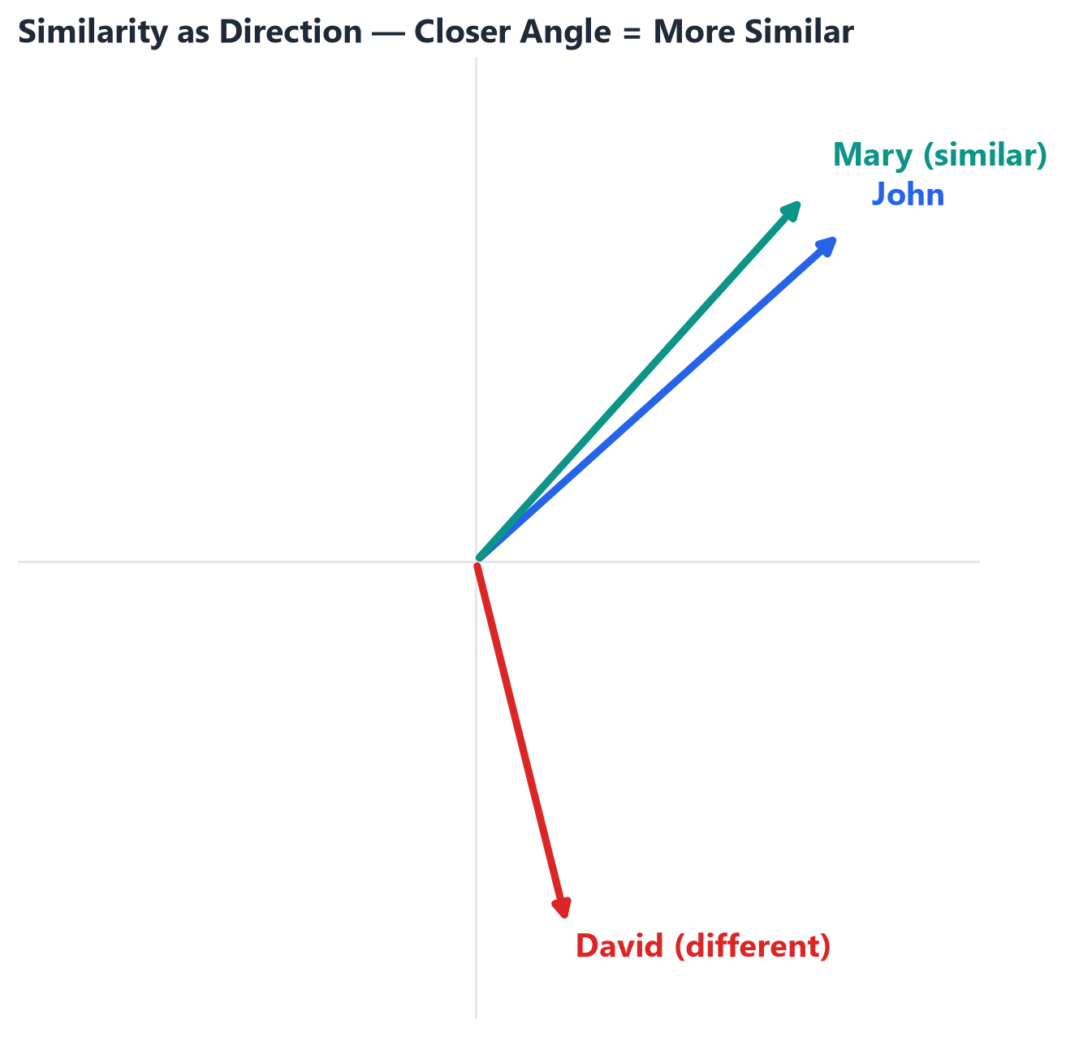
SECTION 11 · SIMILARITY
SLIDE 21
Cosine Similarity
• Imagine each user's preferences as a DIRECTION.
• If the directions point roughly the same way → HIGH similarity.
• If the directions point very differently → LOW similarity.
• We won't dwell on the formula — the intuition is what matters. (For the curious: cosine similarity is the cosine of the angle between two preference vectors.)
Collaborative Filtering Engines
21
Notes:
Point at the picture: John and Mary's arrows point almost the same direction (small angle → high similarity), while David's arrow points somewhere completely different (large angle → low similarity). This is literally what sklearn's cosine_similarity() computes when we feed it rows of the user-item matrix in Hour 2.

Slide 22
SECTION 12 · BUILDING THE ENGINE
SLIDE 22
The Recommendation Pipeline
User Data
User-Item Interactions
User-Item Matrix
Calculate Similarity
Find Similar Users or Items
Generate Scores
Rank Items
Recommend Top Items
Collaborative Filtering Engines
22
Notes:
This is the master workflow slide for the whole course — everything maps onto one of these eight boxes. Worth returning to a simplified version of this at the very end (Slide 29) so learners see the full circle from raw data to a ranked recommendation list.

Slide 23
SECTION 13 · MAKING RECOMMENDATIONS
SLIDE 23
Making a Recommendation — Example
• John has watched: Movie A, Movie B
• Users similar to John also watched: Movie C, Movie D
1. Movie C
2. Movie D
We usually recommend the highest-ranked items that the user has NOT already interacted with.
Collaborative Filtering Engines
23
Notes:
This 'exclude already-seen items' rule is easy to forget but essential — ask: 'why would it be a bad idea to recommend John a movie he's already watched and rated?' This exact filtering step appears explicitly in our recommend_movies() function in Notebook 02.

Slide 24
SECTION 14 · EVALUATION
SLIDE 24
How Do We Know Our Recommendations Are Good?
PRECISION
“Out of the items we
recommended, how many
were relevant?”
RECALL
“Out of the relevant items,
how many did we
successfully recommend?”
Collaborative Filtering Engines
24
Notes:
Use a simple analogy: imagine a teacher recommending 5 books to a student. Precision asks 'how many of those 5 did the student actually enjoy?' Recall asks 'out of ALL the books that student would have enjoyed, how many did we manage to suggest?' You can have high precision with low recall (a few perfect picks, but missed many other good ones) or vice versa.

Slide 25
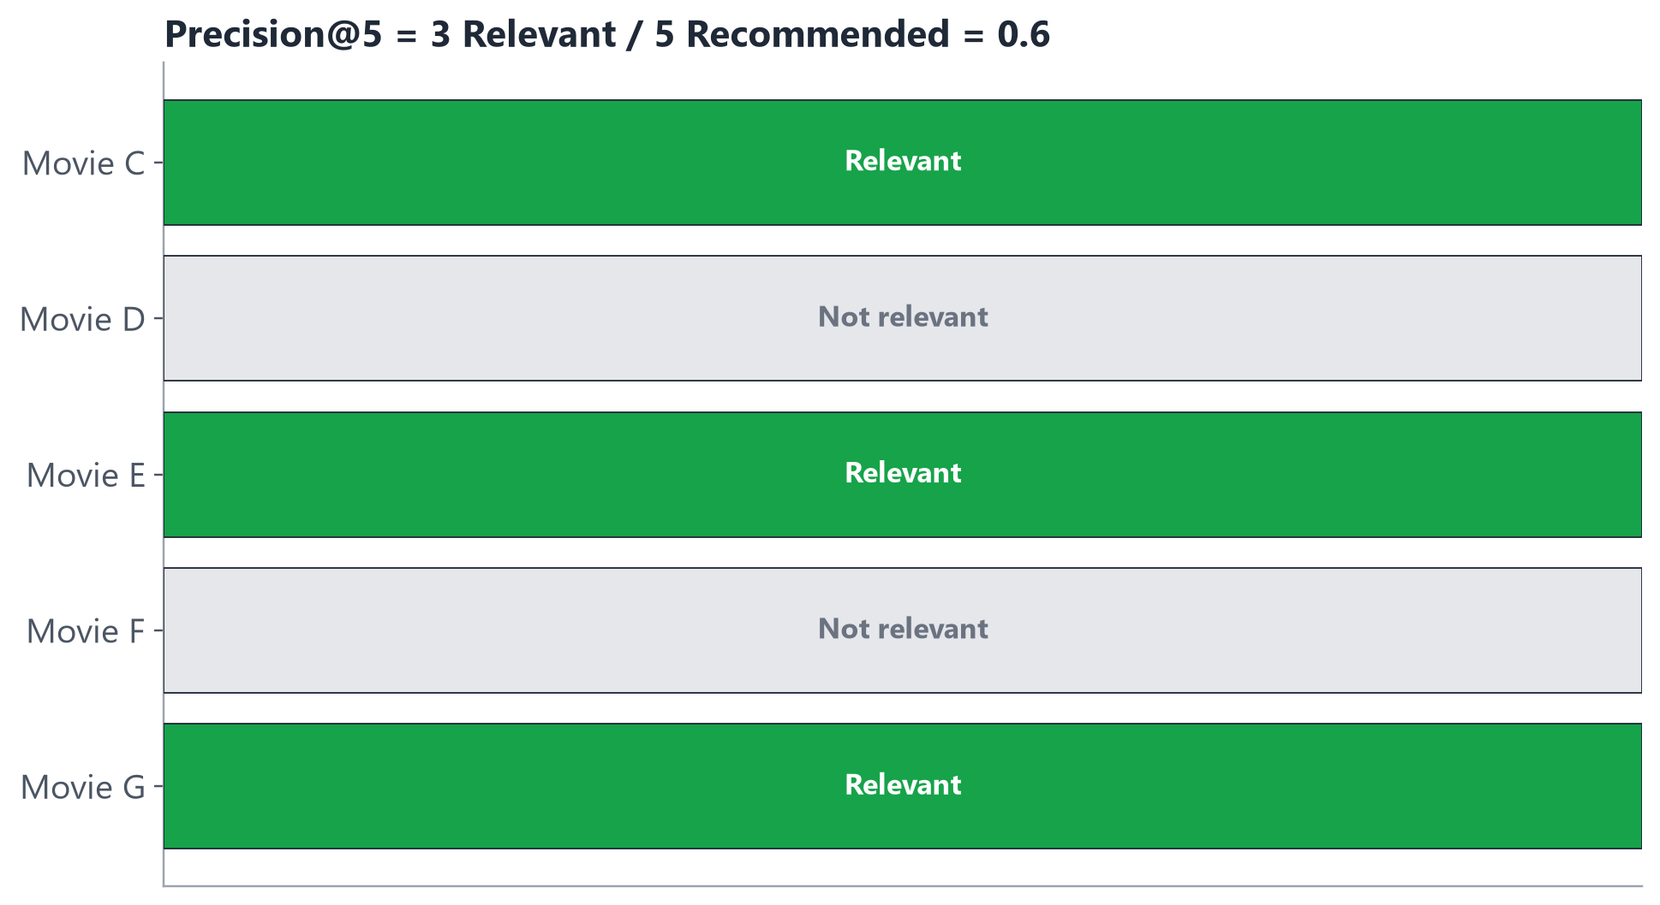
SECTION 14 · EVALUATION
SLIDE 25
Top-K Recommendations
• In practice, we only show a TOP-K list (e.g. the top 5 recommendations), not every possible item.
• Precision@5 = of the 5 items we recommended, how many were relevant?
• Recall@5 = of all the relevant items, how many appeared in our top 5?
• In this example: 3 of 5 recommended items were relevant, so Precision@5 = 0.6.
Collaborative Filtering Engines
25
Notes:
Keep the math informal, as instructed — the picture does the explaining. Note the general trade-off pattern (mention only if there's time): a bigger K tends to raise recall (more chances to include relevant items) but often lowers precision (the list gets diluted with less-relevant picks).

Slide 26
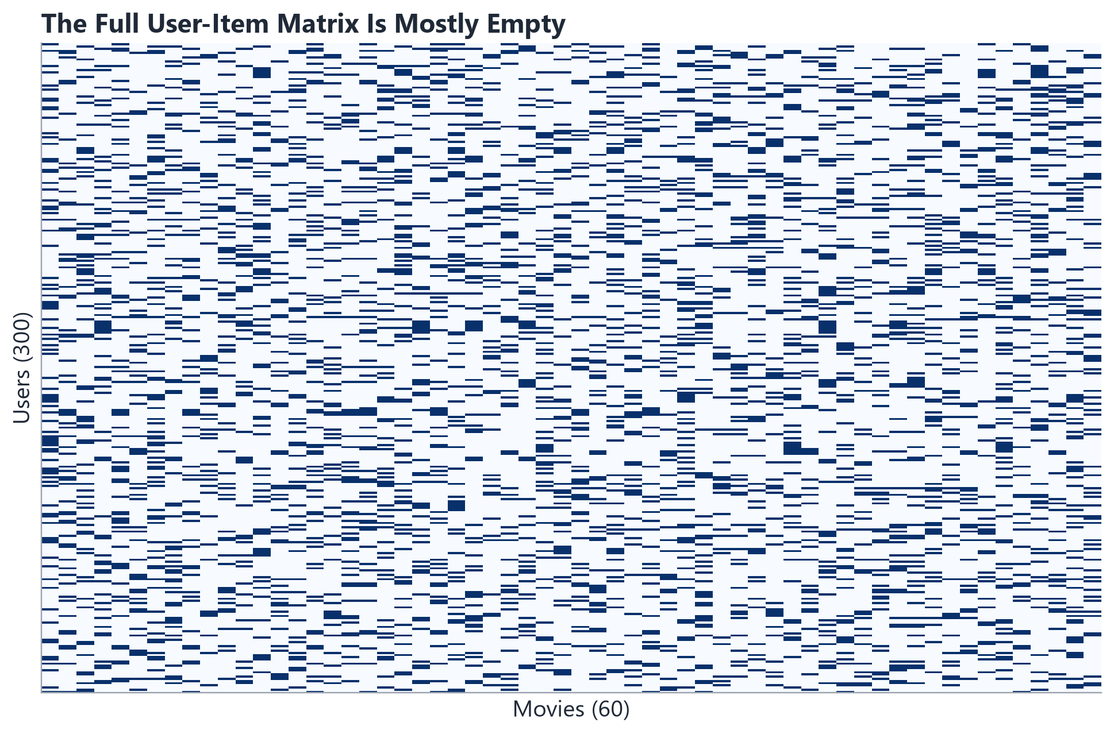
SECTION 15 · REAL-WORLD CHALLENGES
SLIDE 26
Challenges With Collaborative Filtering
COLD START
New users or items
have little or
no history.
SPARSE DATA
Most users interact
with only a small
number of items.
SCALABILITY
Large platforms have
millions of users
and items.
Collaborative Filtering Engines
26
Notes:
The sparsity heatmap below is from OUR OWN course dataset — 78.7% of the user-movie matrix is empty, on just 300 users and 60 movies. Emphasize: real platforms are FAR sparser than this (sometimes 99.9%+ empty), which is exactly why cold start and sparsity are such persistent, real challenges, not academic curiosities.

Slide 27
SECTION 16 · MISCONCEPTIONS
SLIDE 27
Common Mistakes
• Similar users are not always identical.
• Recommendations are predictions, not guarantees.
• A recommendation does not mean the user will definitely like the item.
• More complex models are not always better.
• User behaviour can change over time.
Collaborative Filtering Engines
27
Notes:
Quick-fire slide — five short, important corrections. If time is short, this is one of the safest slides to read briskly, since a fuller misconceptions table appears again near the end for instructor reference and the quiz.

Slide 28
SECTION 17 · BUSINESS VALUE
SLIDE 28
Why Do Businesses Use Recommendation Systems?
• Better user experience
• Personalization
• Product discovery
• Increased engagement
• Increased sales
• Customer retention
Used across industries:
Streaming
E-commerce
Music
Education
Banking
Collaborative Filtering Engines
28
Notes:
This is the payoff slide — recommendation quality only matters once it changes business outcomes. Ask: 'can anyone think of a bank or education example?' (Banking: recommending relevant financial products; Education: recommending the next course a student is likely to complete successfully.)

Slide 29
SECTION 18 · RECAP
SLIDE 29
The Complete Mental Model
Users + Items
Interactions
User-Item Matrix
Find Similarity
User-Based or Item-Based
Predict Interest
Rank Items
Top Recommendations
Collaborative Filtering Engines
29
Notes:
This is the single-slide summary of the ENTIRE conceptual hour — consider lingering here for questions before the coding break. Every slide in Hour 1 maps to one box in this chain.

Slide 30
SECTION 18 · RECAP
SLIDE 30
Transition to Coding
“Now that we understand how collaborative filtering works,
how do we build a simple recommendation engine in Python?”
Let's open the notebooks.
Collaborative Filtering Engines
30
Notes:
Short, energetic transition slide. Take a 2-3 minute break here if the room needs it before diving into Hour 2's hands-on notebooks.

Slide 31
INSTRUCTOR REFERENCE
SLIDE 31
Important Distinctions
Myth | Reality
A recommendation system knows exactly what users want. | It PREDICTS what users may be interested in — it does not know for certain.
Similar users are exactly the same. | Similarity means users have SOME patterns in common, not identical taste.
A recommendation guarantees the user will like something. | Recommendations are predictions, with uncertainty.
Missing ratings mean the user dislikes the item. | Missing information usually just means the user has not interacted with that item yet.
More data automatically solves the cold-start problem. | A brand-new user can still have zero history, no matter how much data exists for OTHER users.
Collaborative Filtering Engines
31
Notes:
Consider running this as a rapid true/false check with the class before the quiz — these five distinctions are the ones beginners misstate most often in follow-up conversations.

Slide 32
KNOWLEDGE CHECK
SLIDE 32
Quick Quiz
1. What is a recommender system?
2. What is the difference between explicit and implicit feedback?
3. What is a user-item matrix?
4. What is collaborative filtering?
5. What is user-based collaborative filtering?
6. What is item-based collaborative filtering?
7. What is the cold-start problem?
8. Does a recommendation guarantee that a user will like an item?
Collaborative Filtering Engines
32
Notes:
ANSWER KEY (for instructor use):
1. A system that helps users discover items they may be interested in, based on patterns in behaviour rather than explicit rules.
2. Explicit feedback is when a user directly tells us their preference (a star rating, a like/dislike). Implicit feedback is inferred from behaviour (clicks, purchases, watch history) without the user directly stating an opinion.
3. A table where rows are users, columns are items, and values are ratings or interactions — missing entries represent unknown preferences.
4. Using patterns in the combined behaviour of many users to make recommendations, without needing to understand item descriptions or content.
5. Finding users with similar preferences to a target user, and recommending items those similar users liked that the target user hasn't seen yet.
6. Finding items that tend to be liked by the same users (similar rating patterns), and recommending items similar to ones a user already likes.
7. The problem of making good recommendations for new users or new items that have little or no interaction history yet.
8. No. A recommendation is a PREDICTION of possible interest, not a guarantee — the user may still dislike it.

Slide 33
APPENDIX
SLIDE 33
References / Sources
Textbook
• Aggarwal, C. C. (2015). Data Mining: The Textbook. Springer. — Section 18.5, “Recommender Systems” (utility matrices, neighborhood-based user-based and item-based collaborative filtering).
Official Documentation (verified for current syntax)
• scikit-learn: sklearn.metrics.pairwise.cosine_similarity (scikit-learn.org/stable/modules/generated/ ...)
• pandas API Reference: DataFrame.pivot_table() (pandas.pydata.org/docs/reference/ ...)
• Every code snippet in this deck and the notebooks was checked against these pages during development.
Evaluation Concepts
• Precision@K and Recall@K definitions cross-checked against standard recommender-systems evaluation references (not covered explicitly in the primary textbook).
Data
• All ratings data used in this course is SYNTHETIC (data/generate_data.py). Movie titles are entirely invented.
Collaborative Filtering Engines
33
Notes:
All scikit-learn and pandas syntax in this deck (cosine_similarity, pivot_table) was checked against the official documentation during course development to ensure it reflects current, non-deprecated APIs.

