Slide 1
BEGINNER DATA SCIENCE COURSE
Time Series Forecasting
Predicting the Future Using Historical Data
Understanding Time Series Data, Patterns, and Forecasting
Past Data
Find Patterns
Forecast Forward
Time Series Forecasting
1
Notes:
Welcome the class. This is a 2-hour session: Hour 1 is concepts (this deck), Hour 2 is hands-on Python. Frame it as building ONE forecasting system together for a bank's daily cash withdrawals, not a tour of separate techniques. Ask: has anyone ever tried to guess tomorrow's weather, traffic, or a store's busy period based on what usually happens? That everyday instinct — using the past to guess the future — is exactly what we're formalizing today.

Slide 2
INTRODUCTION
SLIDE 2
What Will We Learn?
• What Time Series data is
• Why time order matters
• Trend
• Seasonality
• Cycles
• Noise
• Lag
• Moving averages
• Forecasting
• Time-based train/test split
• Baseline forecasting
• A simple forecasting model
• Forecast evaluation (MAE, RMSE, MAPE)
• Building a forecast in Python
• Data leakage
• Turning a forecast into a business decision
Time Series Forecasting
2
Notes:
Walk down the list quickly — this is a map, not a lesson. Mention explicitly that we are deliberately NOT covering ARIMA mathematics, SARIMA, Prophet, or deep learning today — those are later-course territory. Today is entirely about building solid intuition and one working, simple forecasting pipeline.

Slide 3
SECTION 2 · THE REAL PROBLEM
SLIDE 3
Start With a Real Business Question
Date | Withdrawal Amount
Monday | ₦25,000,000
Tuesday | ₦28,000,000
Wednesday | ₦30,000,000
Thursday | ₦27,000,000
Friday | ₦45,000,000
A bank records daily ATM withdrawals.
Can we predict tomorrow's withdrawal demand?
Can we predict next week's demand?
Time Series Forecasting
3
Notes:
This is the running example for the ENTIRE course — a bank forecasting daily cash demand. Let the class react to the jump on Friday before explaining anything. Ask: 'if you were the bank's cash operations manager, why would knowing tomorrow's number matter?' (Answer, if needed: too little cash = angry customers and reputational damage; too much idle cash = wasted opportunity cost and security risk.)

Slide 4
SECTION 2 · THE REAL PROBLEM
SLIDE 4
What Makes This Different?
Normal dataset:
Time Series dataset:
Row 1
Row 2
Row 3
(order may not matter)
Yesterday
Today
Tomorrow
Time is one of the most important pieces of information here
Time Series Forecasting
4
Notes:
This contrast is worth slowing down for — it's the single strongest concept in the whole course. In a normal supervised ML dataset, shuffling rows changes nothing about what the model can learn. In a time series, shuffling destroys the very information (the sequence) we're trying to use. Say the word TIME MATTERS out loud, more than once.

Slide 5
SECTION 3 · WHAT IS TIME SERIES DATA?
SLIDE 5
What Is Time Series Data?
“A Time Series is a sequence of observations
recorded over time.”
Daily sales
Monthly revenue
Stock prices
Bank transactions
Temperature
Website visitors
Exchange rates
Electricity demand
Cash withdrawals
Time Series Forecasting
5
Notes:
Ask learners to shout out their own example before you reveal these. Almost anything measured repeatedly over time qualifies — that's the point. The bank's ATM withdrawal series is just one instance of a pattern that shows up across virtually every industry, which the next slide makes explicit.

Slide 6
SECTION 3 · WHAT IS TIME SERIES DATA?
SLIDE 6
Real-Life Examples
Industry | Forecasting Example
Banking | Cash demand
Retail | Product sales
Healthcare | Patient visits
Transport | Passenger demand
Energy | Electricity consumption
Agriculture | Crop production
Technology | Website traffic
Time Series Forecasting
6
Notes:
Emphasize: the same forecasting PRINCIPLES apply across every one of these rows — trend, seasonality, lag, train/test split, evaluation. Once you've learned to forecast bank cash demand, you have 80% of what you need to forecast hospital patient visits or electricity consumption too.

Slide 7
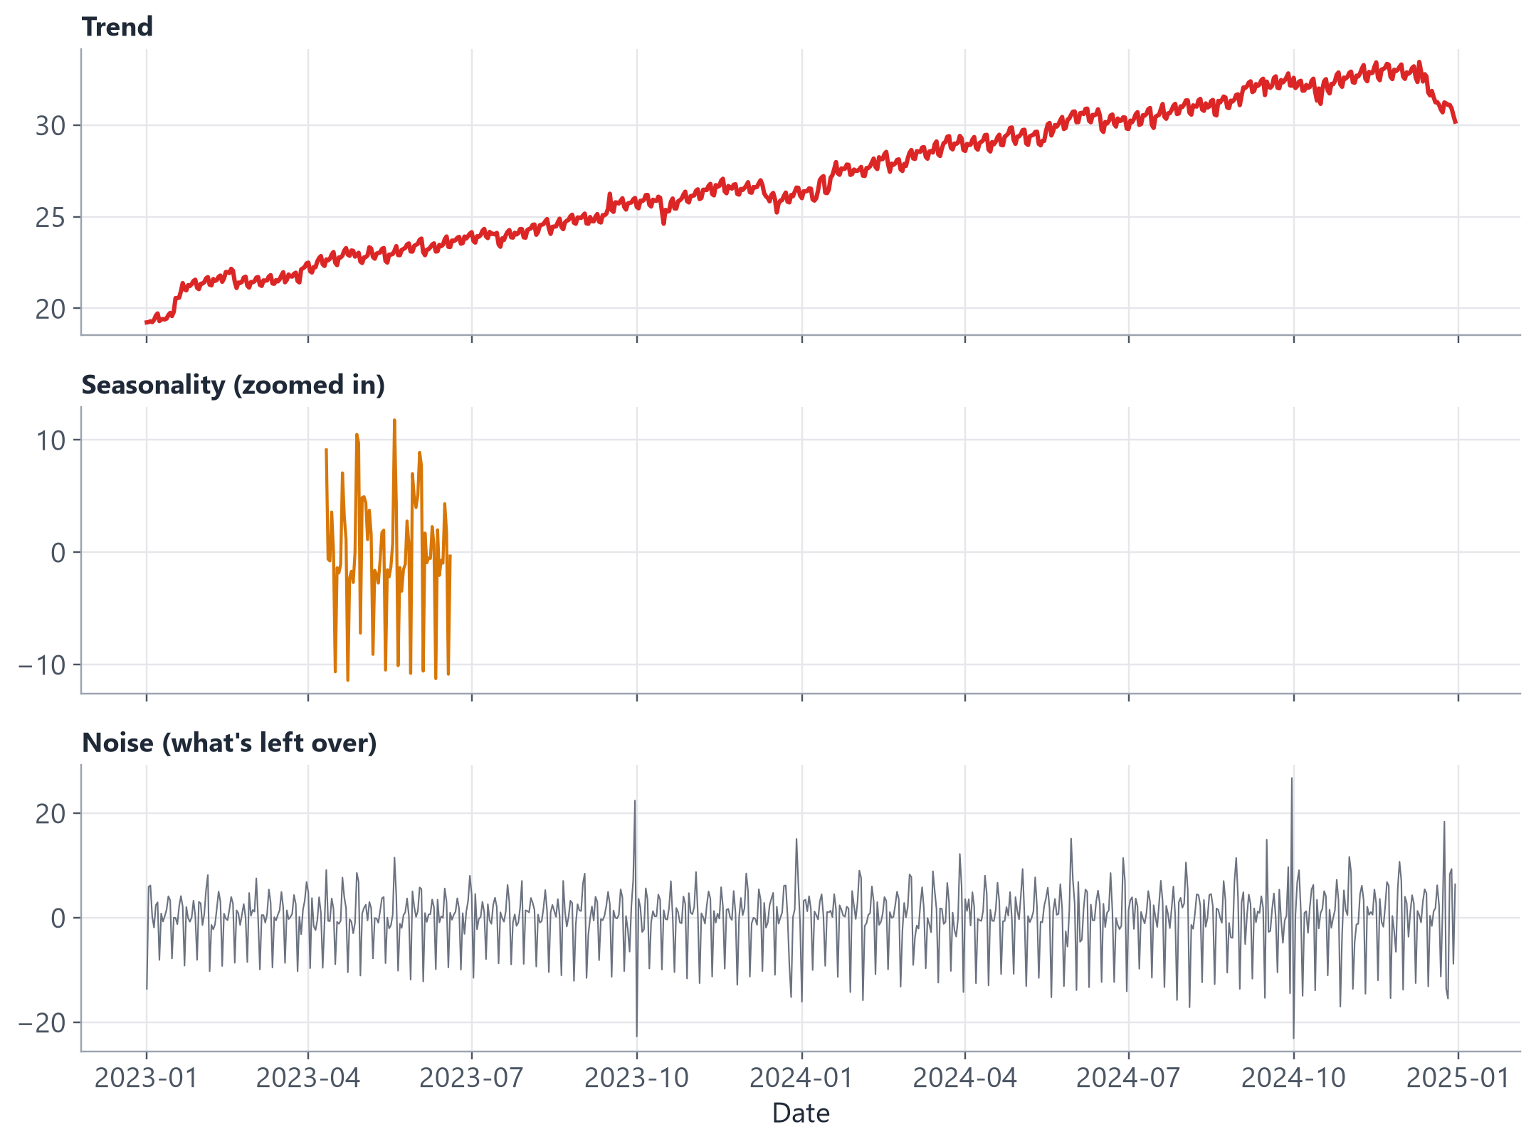
SECTION 4 · UNDERSTANDING PATTERNS
SLIDE 7
A Time Series Is Not Just Numbers
Real-world data often contains several patterns layered on top of each other.
Time Series Forecasting
7
Notes:
This chart splits our own ATM series into its three layers: a smooth Trend, a repeating weekly Seasonality (zoomed in so the wiggle is visible), and leftover Noise. Don't explain the math behind this decomposition — just use it to preview the next four slides, which cover Trend, Seasonality, Cycles, and Noise one at a time.

Slide 8
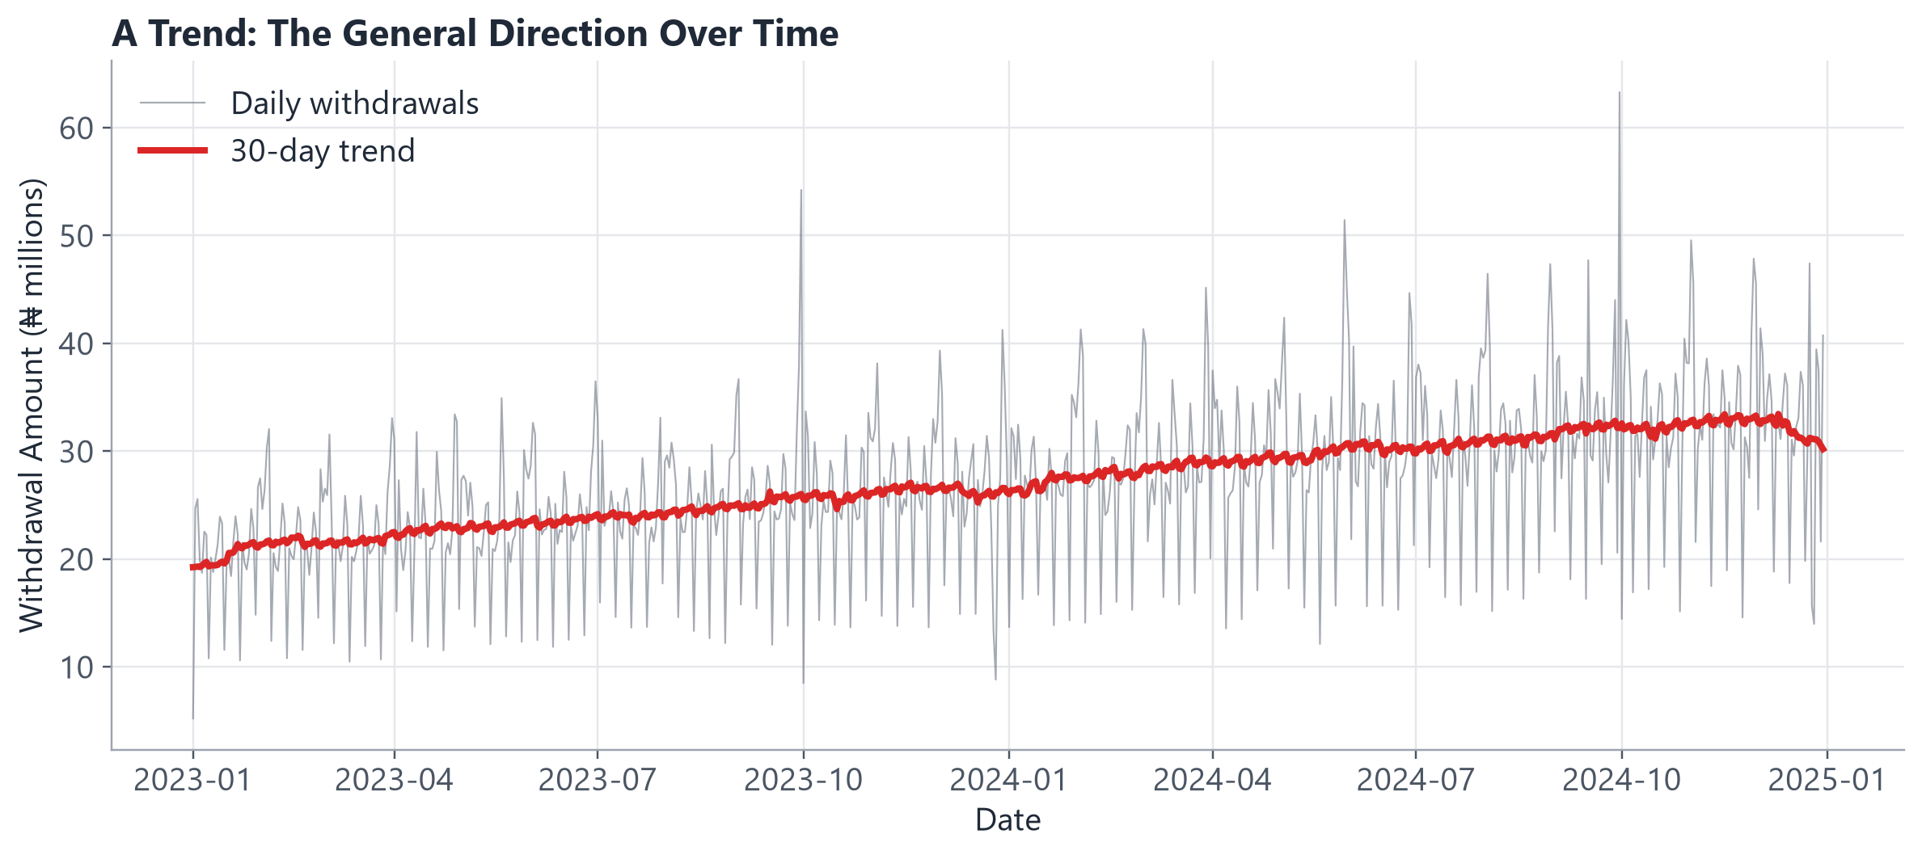
SECTION 4 · UNDERSTANDING PATTERNS
SLIDE 8
Trend
• “A trend shows the general direction of data over a long period of time.”
• Can be upward, downward, or show no clear direction.
• Our bank's withdrawals trend gently upward over the two years — more customers, more cash activity over time.
• A trend tells you WHERE the series is heading in general, not what happens day to day.
Time Series Forecasting
8
Notes:
Point at the red 30-day trend line riding on top of the noisy daily data — that's exactly what a trend represents: the slow-moving signal underneath the day-to-day noise. Ask: 'is this trend obvious from the raw daily line alone, or does it help to smooth it first?' (Preview of moving averages, coming in Section 7.)

Slide 9
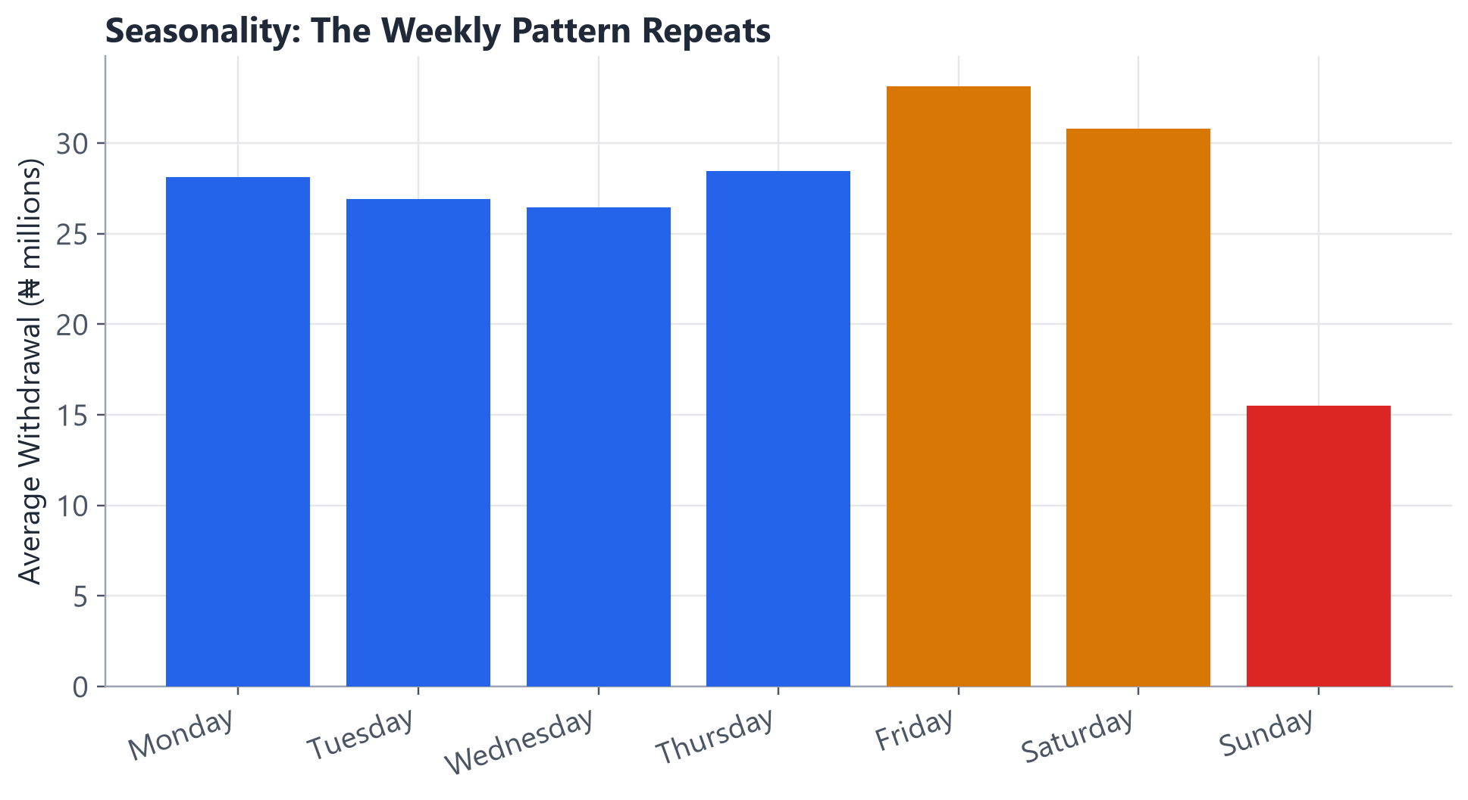
SECTION 4 · UNDERSTANDING PATTERNS
SLIDE 9
Seasonality
• “Seasonality is a pattern that repeats at regular intervals.”
• Higher sales during Christmas.
• Higher ATM withdrawals at month-end (payday).
• Higher transactions on Fridays.
• Higher electricity use during hot seasons.
• In our data: withdrawals spike on Fridays and drop sharply every Sunday, every single week.
Time Series Forecasting
9
Notes:
This chart is the average withdrawal BY day of week, across the entire 2-year dataset — the pattern is remarkably consistent. Follow up with the zoomed-in 6-week chart (next few slides in the notebook) if you want to show the SAME shape repeating visually over real dates, not just an average.

Slide 10
SECTION 4 · UNDERSTANDING PATTERNS
SLIDE 10
Cycles
Cycles are patterns that rise and fall over longer periods, but may NOT repeat at
perfectly regular intervals.
Seasonality
Usually follows a regular,
predictable interval
(every week, every month)
Cycles
May not occur at fixed
intervals (e.g. economic
boom-and-bust cycles)
Time Series Forecasting
10
Notes:
Keep this simple, as instructed — cycles are a beginner-relevant concept but not a slide worth dwelling on. Example: an economic recession affecting bank withdrawals might last 18 months one time and 3 years the next — unlike seasonality, you can't set your watch by it. Our own dataset does not contain a strong cycle (2 years is too short to show one) — flag that honestly if asked.

Slide 11
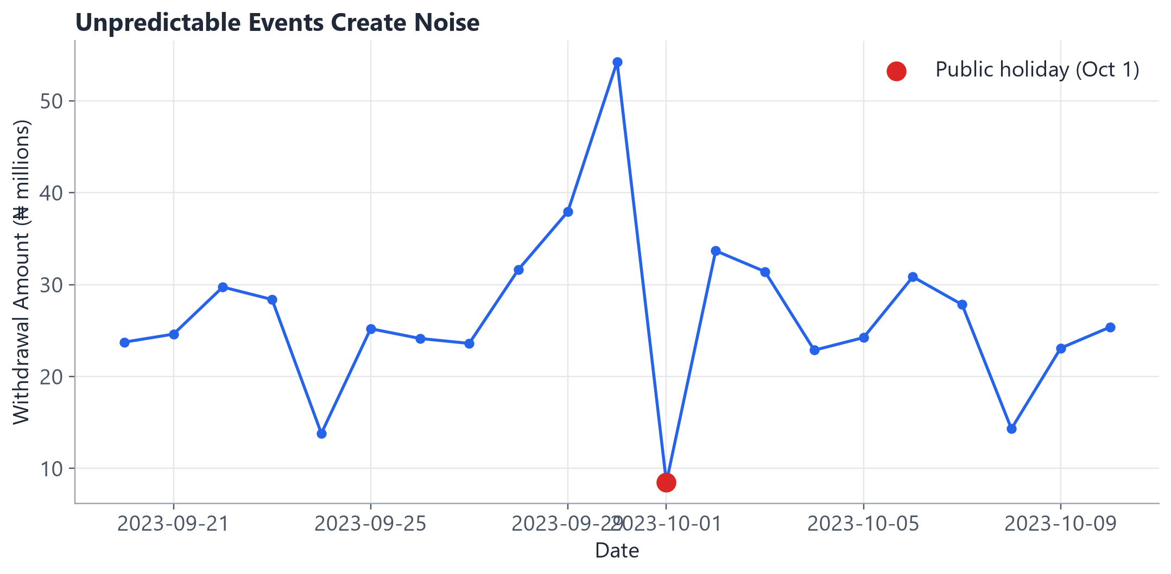
SECTION 4 · UNDERSTANDING PATTERNS
SLIDE 11
Noise
• “Noise represents random variation that is difficult to predict.”
• An unexpected ATM failure.
• An unexpected public holiday.
• An unexpected economic event.
• Not every movement in a Time Series can be predicted — and that's OK.
Time Series Forecasting
11
Notes:
This chart shows a real public holiday (Oct 1) in our dataset — withdrawals spike the day BEFORE (people stocking up on cash) and drop sharply ON the holiday itself (most branches closed). A model that doesn't know about holidays will treat this as pure noise; one important lesson for later is that some 'noise' can actually be explained with the right feature (a holiday indicator, which our dataset includes).

Slide 12
SECTION 5 · VISUALIZE FIRST
SLIDE 12
The First Rule of Time Series
“Before forecasting, visualize the data.”
Visualization helps you spot trend, seasonality, spikes, outliers, missing periods, and sudden changes.
Time Series Forecasting
12
Notes:
Make this genuinely memorable — some instructors have learners repeat it back. This is not just good practice, it's a direct segue into the hands-on notebook, where Step 1 after loading data is always 'plot it and look at it' before any modeling begins.

Slide 13
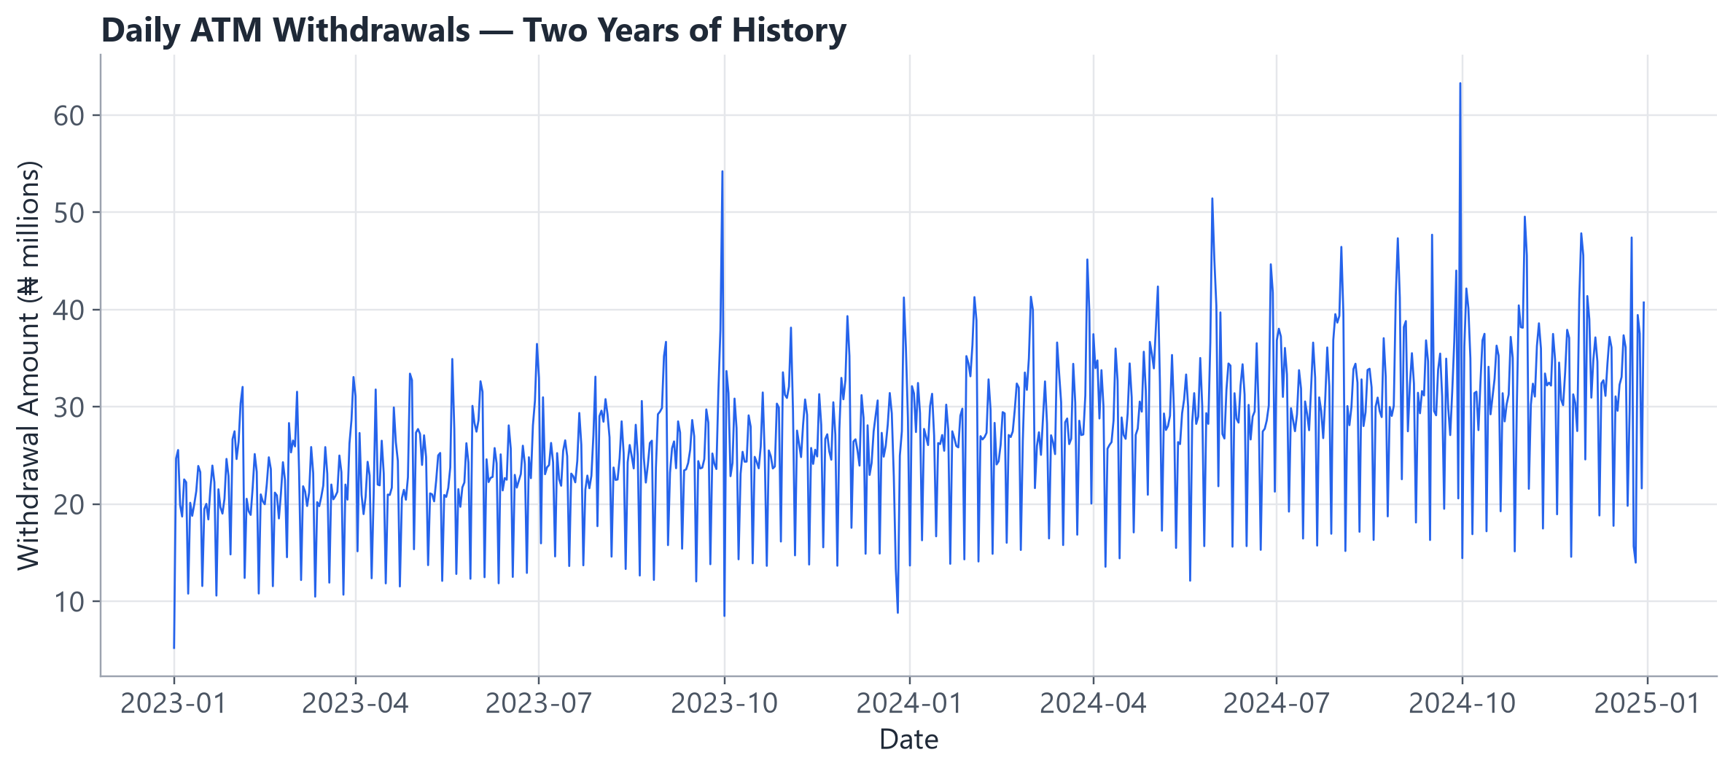
SECTION 5 · VISUALIZE FIRST
SLIDE 13
Look at the Data
What patterns can you see? Look for: increase, decrease, a repeating shape, sudden spikes.
Time Series Forecasting
13
Notes:
Let learners call out what they see BEFORE you explain it — most will spot the upward drift and the regular spiky rhythm without prompting, and a few will notice the taller spikes (holidays) scattered through the series. Do not reveal the trend/seasonality explanation yet if you haven't already — let this be a genuine 'what do YOU see' moment.

Slide 14
SECTION 6 · LAGS
SLIDE 14
What Is a Lag?
Today
Look Back
Yesterday
Last Week
Last Month
“A lag is a previous value of a variable.”
e.g. Sales Today, Sales Yesterday, Sales 7 Days Ago, Sales 30 Days Ago
Time Series Forecasting
14
Notes:
Keep this concrete: a 'lag' is just a fancy word for 'a value from some point in the past, lined up next to today's row.' We'll turn this into actual code (`.shift()`) in the next hour. Preview: Lag_1 = yesterday, Lag_7 = same day last week.

Slide 15
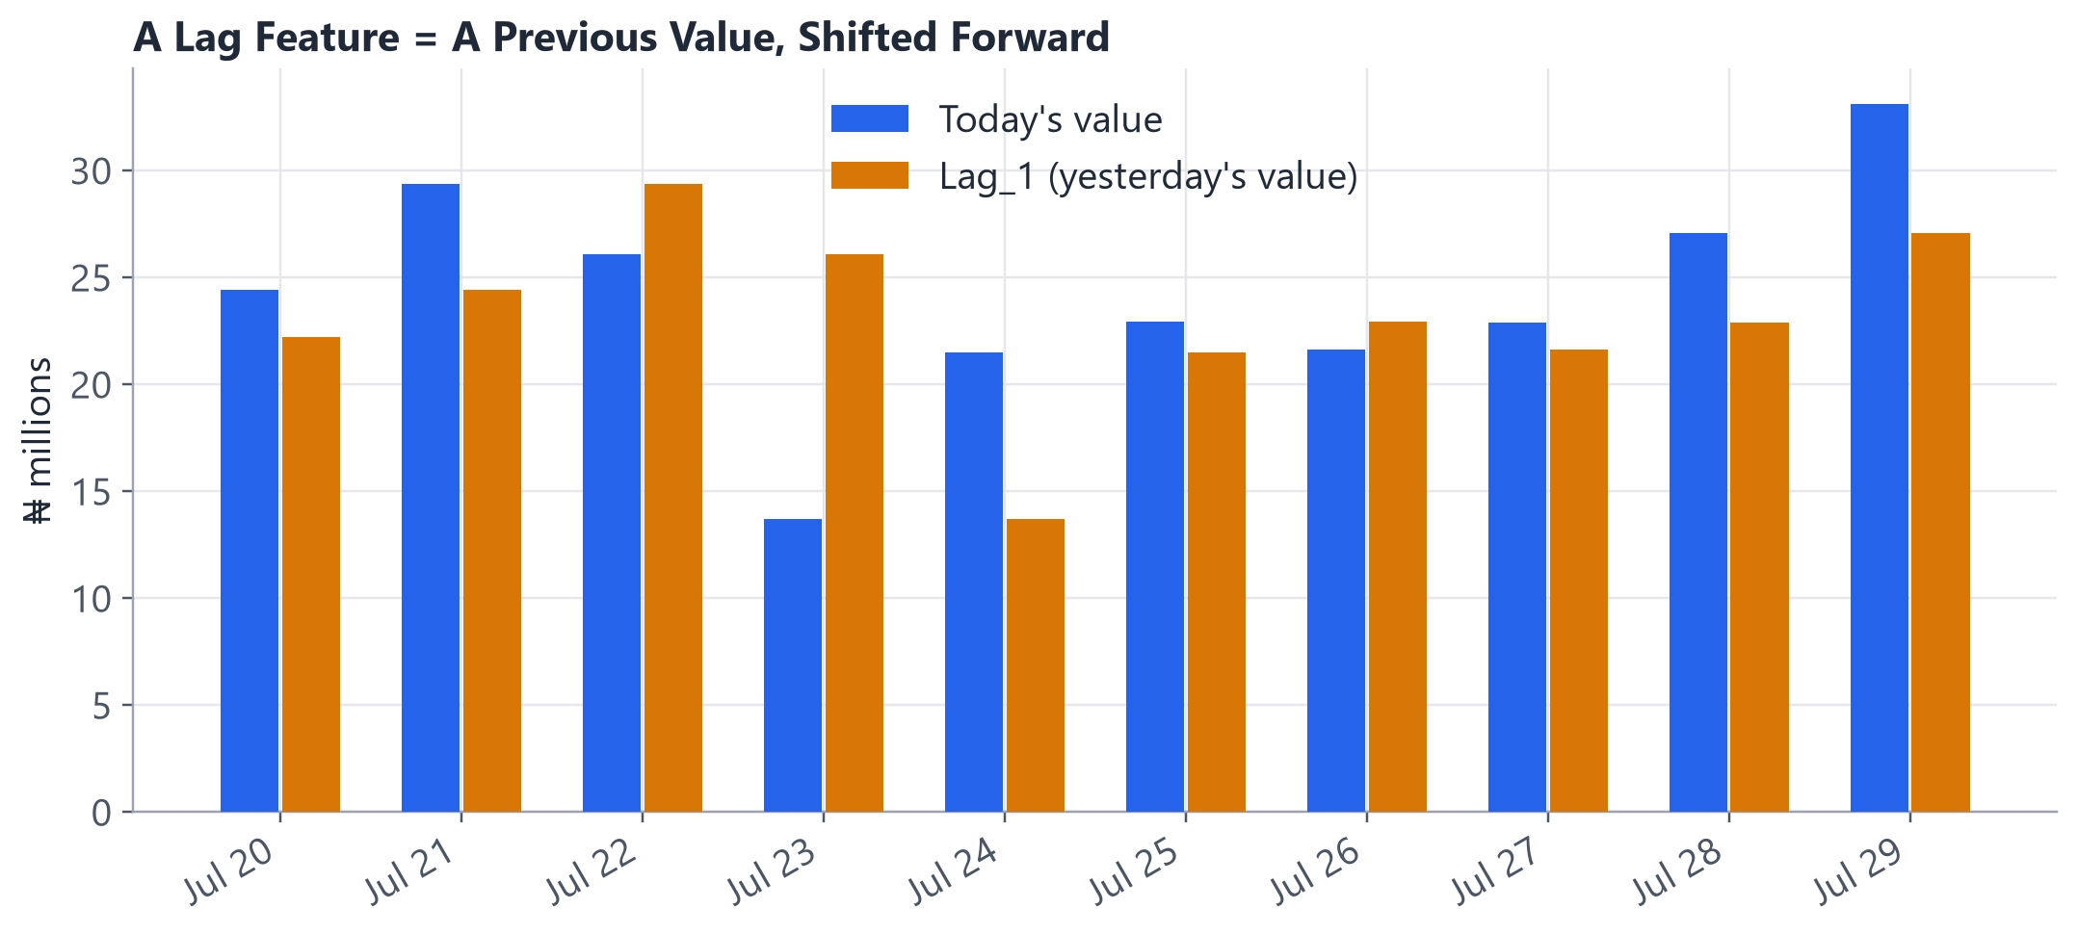
SECTION 6 · LAGS
SLIDE 15
Why Lags Matter
• “Yesterday's sales may contain useful information about today's sales.”
• Today's withdrawal total may depend partly on yesterday's, last week's, and last month's totals.
• This is called TIME DEPENDENCY — values close together in time tend to be related.
• Lag features are how we hand that time dependency to a regular Machine Learning model.
Time Series Forecasting
15
Notes:
This chart shows real values from our dataset next to their own Lag_1 (yesterday's value) — notice they're often close, but not identical. That gap between 'today' and 'yesterday' is exactly the kind of thing a forecasting model tries to learn from.

Slide 16
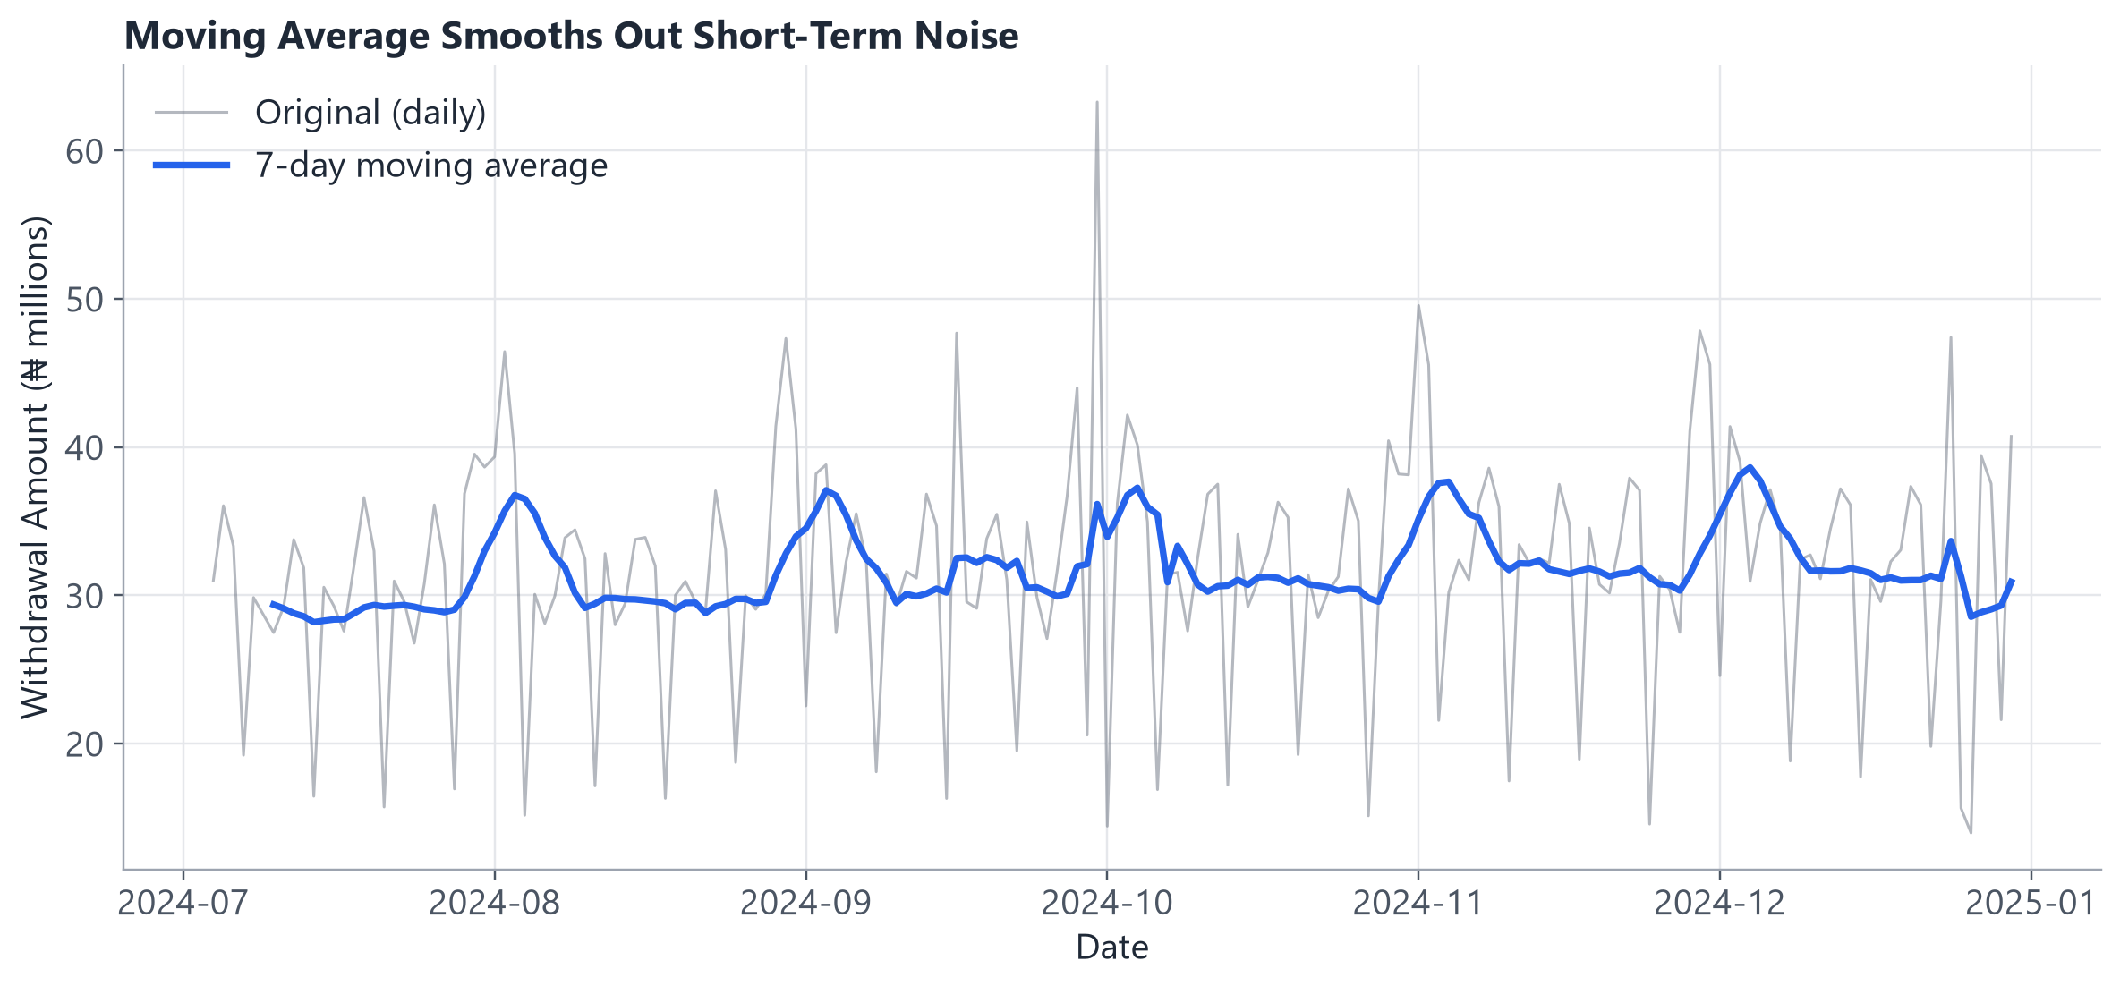
SECTION 7 · MOVING AVERAGES
SLIDE 16
What Is a Moving Average?
• “A moving average smooths short-term fluctuations so we can see the bigger pattern.”
• A 7-day moving average replaces each day's value with the average of the last 7 days.
• Original data: noisy, day-to-day.
• Moving average: a smoother, clearer pattern.
Time Series Forecasting
16
Notes:
Point directly at the chart: the grey line is the noisy original, the blue line is its 7-day moving average — visibly calmer, and the underlying rhythm (including the gentle upward trend) is much easier to see.

Slide 17
SECTION 7 · MOVING AVERAGES
SLIDE 17
Why Use Moving Averages?
• Reduce noise
• Identify trends
• Smooth fluctuations
• Understand overall behaviour
• A moving average is useful for UNDERSTANDING the data — it does not automatically solve every forecasting problem.
Time Series Forecasting
17
Notes:
This last bullet matters — a common beginner mistake is thinking 'compute a moving average' IS the forecasting model. It's a descriptive/exploration tool first; we'll see in Hour 2 that it can also become a FEATURE inside a real forecasting model, which is a more sophisticated use of the same idea.

Slide 18
SECTION 8 · FORECASTING
SLIDE 18
What Is Forecasting?
“Forecasting means using historical data to estimate future values.”
2024
Historical Data
2025
? ? ?
Forecast
Time Series Forecasting
18
Notes:
Simple, deliberately bare-bones slide — the definition is the whole point. Everything from here forward in the course builds toward actually producing that '???' box with real numbers, using Python, in Hour 2.

Slide 19
SECTION 8 · FORECASTING
SLIDE 19
Simple Forecasting Baseline
“Tomorrow will be similar to today.”
“Next week's value will be similar to last week's value.”
This is called a NAIVE forecast — deliberately simple. A more advanced Machine Learning model must be COMPARED against something this simple to prove it's actually adding value.
Time Series Forecasting
19
Notes:
This is one of the most important practical habits in the entire course: always build the dumbest possible baseline FIRST. On our dataset, the naive forecast (today = tomorrow) has an MAE of about ₦8.2 million; we'll use that number directly in Hour 2 to judge whether our real model is actually worth the extra complexity.

Slide 20
SECTION 8 · FORECASTING
SLIDE 20
The Forecasting Workflow
Collect Data
Clean Data
Visualize
Understand Patterns
Create Features
Train Model
Forecast
Evaluate
Business Decision
Time Series Forecasting
20
Notes:
This is the master workflow slide — everything else in the course maps onto one of these nine boxes. Consider returning to a simplified version of this diagram at the very end (Slide 29) so learners see the full circle.

Slide 21
SECTION 9 · TRAIN / TEST SPLIT
SLIDE 21
Time Series Data Cannot Be Shuffled
INCORRECT
CORRECT
2024
2022
2025
2023
Past Data
Training Data
Test Data
Future
Time Series Forecasting
21
Notes:
This directly attacks Misconception 1 head-on — some learners' instinct from ordinary ML is to randomly shuffle before train/test splitting (`train_test_split(shuffle=True)` is even the scikit-learn DEFAULT!). Say explicitly: for time series, that default is WRONG, and we'll show exactly how to split correctly in the next slide and in code.

Slide 22
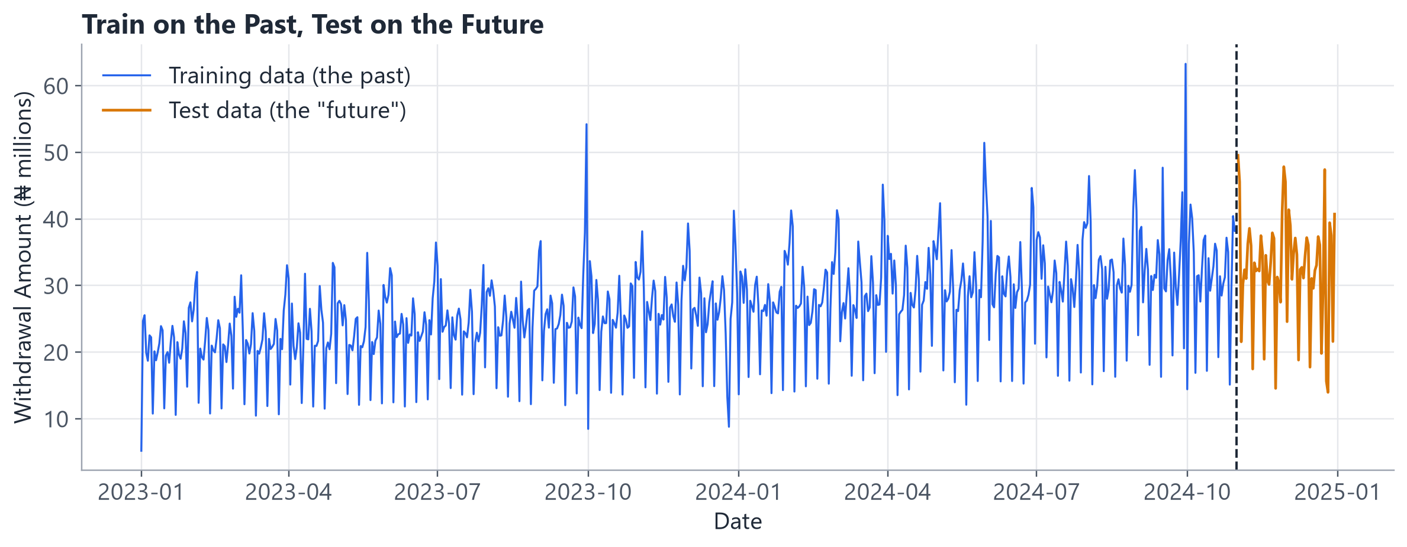
SECTION 9 · TRAIN / TEST SPLIT
SLIDE 22
Time-Based Splitting
We train using the past and test on the future — never the other way around.
Time Series Forecasting
22
Notes:
This is one of the most important beginner concepts in the whole course — call that out explicitly. Point at the vertical dashed line: everything to the left trains the model, everything to the right is held out to test it, and the split point respects time — no test-period information leaks backward into training.

Slide 23
SECTION 10 · EVALUATION
SLIDE 23
How Do We Know Our Forecast Is Good?
MAE
“On average, how far
away were our
predictions?”
RMSE
“Gives more attention
to large errors.”
MAPE
“The average error as
a percentage of the
actual value.”
We won't dwell on the formulas — the intuition matters far more.
Time Series Forecasting
23
Notes:
Keep the formulas off this slide entirely, as instructed — the plain-language framing IS the lesson. If asked for the formula: MAE = average of |actual - predicted|; RMSE = square root of the average of (actual - predicted)² (penalizes big misses more); MAPE = average of |actual - predicted| / actual, expressed as a percentage.

Slide 24
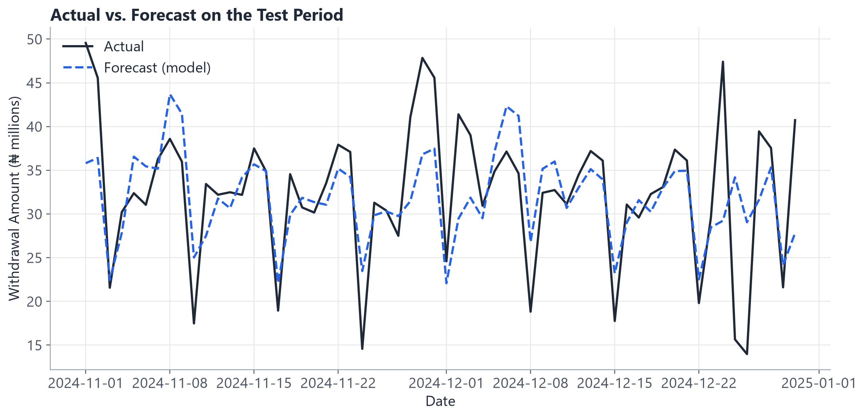
SECTION 10 · EVALUATION
SLIDE 24
Actual vs. Forecast
• Naive baseline MAE: ₦8.2M
• Our model MAE: ₦4.7M
• The model tracks the weekly rhythm well but still misses some sharp spikes.
• The goal is not a perfect forecast — it's a USEFUL forecast with acceptable error for the business problem.
Time Series Forecasting
24
Notes:
These are real numbers computed on our own held-out test period in Hour 2 — not idealized textbook figures. Point out honestly where the dashed forecast line lags behind sharp actual spikes (holidays, unexplained events) — a good instructor moment to reinforce that 'noise' by definition can't be perfectly predicted.

Slide 25
SECTION 11 · SIMPLE MODELS
SLIDE 25
Where Do We Start?
1. Naive Forecast
2. Moving Average
3. Lag Features
4. Simple Forecasting Model
5. Advanced Models (later courses)
Time Series Forecasting
25
Notes:
This progression is deliberately capped at step 4 for today — step 5 (ARIMA, SARIMA, Prophet, LSTM) is explicitly out of scope, as stated on Slide 2. Reassure learners: steps 1-4 alone are genuinely useful and are what most real forecasting work actually starts with.

Slide 26
SECTION 11 · SIMPLE MODELS
SLIDE 26
Simple Model Approach
We can use previous values (and simple calendar facts) to predict future values.
Yesterday's Sales, Last Week's Sales,
Day of Week, Month
Prediction
Tomorrow's Sales
This connects Time Series Forecasting directly to familiar Machine Learning: it's really just regression with the right features.
Time Series Forecasting
26
Notes:
This is the big 'aha' moment for learners with an existing ML background: forecasting doesn't require an entirely new toolkit. Once you've built lag and calendar features, you can hand the problem to a completely ordinary regression model — which is exactly what we do in Notebook 03.

Slide 27
SECTION 12 · BUSINESS INTERPRETATION
SLIDE 27
Forecasting Is Not Just About the Model
Forecast
Business Interpretation
Action
Example: predicted ATM withdrawals increase.
• Supply more cash to affected branches/ATMs
• Improve ATM cash-loading planning
• Reduce the risk of cash shortages during peak demand
Time Series Forecasting
27
Notes:
This is the payoff slide — the forecast only matters once it changes what the bank actually DOES. Ask: 'what's the cost of under-forecasting cash demand? What's the cost of over-forecasting it?' (Under: angry customers, reputational damage. Over: idle cash, opportunity cost, security risk.) Both errors are real costs — a good forecast helps balance them.

Slide 28
SECTION 12 · BUSINESS INTERPRETATION
SLIDE 28
Common Mistakes
• Randomly shuffling Time Series data
• Ignoring missing dates
• Ignoring seasonality
• Using future information to predict the past
• Not comparing against a baseline
• Looking only at model accuracy
• Forgetting business context
The 4th one has a name: DATA LEAKAGE
Time Series Forecasting
28
Notes:
Spend extra time on data leakage — it's the single most damaging and most common beginner mistake in time series work, and it can make a model look GREAT in testing while being useless in production. Simple example: accidentally including 'this month's total sales' as a feature to predict 'today's sales' — at prediction time, in the real world, you would NOT yet know the month's total (it includes days that haven't happened yet).

Slide 29
SECTION 12 · BUSINESS INTERPRETATION
SLIDE 29
Final Recap
Time Series
Time Order Matters
Visualize
Find Patterns (Trend, Seasonality, Noise)
Create Lags
Train on the Past
Test on the Future
Forecast
Evaluate
Business Action
Time Series Forecasting
29
Notes:
This is the single-slide summary of the ENTIRE conceptual hour — consider lingering here for questions before the coding break. Every slide in Hour 1 maps to one box in this chain.

Slide 30
SECTION 12 · BUSINESS INTERPRETATION
SLIDE 30
Transition to Coding
“Now that we understand how forecasting works,
how do we build one in Python?”
Let's open the notebooks.
Time Series Forecasting
30
Notes:
Short, energetic transition slide. Take a 2-3 minute break here if the room needs it before diving into Hour 2's hands-on notebooks.

Slide 31
INSTRUCTOR REFERENCE
SLIDE 31
Important Distinctions
Myth | Reality
Time Series data can be randomly shuffled. | The order of observations matters — shuffling destroys the time dependency we're trying to model.
A good ML model automatically produces a good forecast. | Forecasting depends on data quality, patterns, features, model choice, validation, and business context.
More complex models are always better. | A simple baseline may perform surprisingly well — always compare against one.
Forecasting means predicting perfectly. | Forecasting means estimating the future WITH uncertainty.
High accuracy is the only thing that matters. | The forecast must also be USEFUL for the business decision at hand.
Future information can be used as a feature. | Using information not yet available at prediction time causes DATA LEAKAGE.
Time Series Forecasting
31
Notes:
Consider running this as a rapid true/false check with the class before the quiz — these six distinctions are the ones beginners misstate most often in follow-up conversations.

Slide 32
KNOWLEDGE CHECK
SLIDE 32
Quick Quiz
1. What is Time Series data?
2. Why is randomly shuffling Time Series data usually a problem?
3. What is a trend?
4. What is seasonality?
5. What is a lag?
6. Why should we create a baseline forecast?
7. What does MAE measure?
8. What is data leakage in Time Series Forecasting?
Time Series Forecasting
32
Notes:
ANSWER KEY (for instructor use):
1. A sequence of observations recorded over time, where the order of observations matters.
2. Because it destroys the time dependency in the data — training and testing must respect the natural order (train on the past, test on the future), otherwise the model could 'see' future information during training that would not be available at real prediction time.
3. The general direction of the data over a long period of time (upward, downward, or none).
4. A pattern that repeats at regular intervals (e.g. every week, every month, every year).
5. A previous value of a variable (e.g. Lag_1 = yesterday's value, Lag_7 = the value from 7 days ago).
6. So we have something simple to compare a more advanced model against — if the advanced model can't beat the baseline, its extra complexity isn't paying off.
7. Mean Absolute Error — on average, how far away were our predictions from the actual values.
8. Using information that would not actually have been available at the time of prediction as a feature — this makes a model look artificially accurate during testing but fail in the real world.

Slide 33
APPENDIX
SLIDE 33
References / Sources
Textbook
• Brockwell, P. J., & Davis, R. A. (2016). Introduction to Time Series and Forecasting (3rd ed.). Springer Texts in Statistics. — Chapter 1, foundational examples of trend, seasonality, and moving-average smoothing.
Official Documentation (verified for current syntax)
• pandas API Reference — DataFrame.rolling(), DataFrame.shift() (pandas.pydata.org/docs/reference/ ...)
• scikit-learn API Reference — mean_absolute_error, root_mean_squared_error, mean_absolute_percentage_error, LinearRegression (scikit-learn.org/stable/modules/generated/ ...)
• scikit-learn User Guide — Regression metrics (scikit-learn.org/stable/modules/model_evaluation.html)
• Every code snippet in this deck and the notebooks was checked against these pages during development.
Data
• All withdrawal data used in this course is SYNTHETIC (data/generate_data.py). It does not represent any real bank, customer, or transaction.
Time Series Forecasting
33
Notes:
All pandas and scikit-learn syntax in this deck (rolling, shift, LinearRegression, the three regression metrics) was checked against the official documentation during course development to ensure it reflects current, non-deprecated APIs — including root_mean_squared_error, added in scikit-learn 1.4 as the modern replacement for mean_squared_error(squared=False).

