Slide 1
BEGINNER DATA SCIENCE SESSION
Unsupervised Learning
Anomaly Detection Systems
Finding Unusual Patterns When We Don't Have Labels
No Fraud Labels
Learn Normal
Flag Unusual
Unsupervised Learning · Anomaly Detection Systems
1
Notes:
Welcome the class. This is a 2-hour session: Hour 1 is concepts (this deck), Hour 2 is hands-on Python in the notebooks. Frame it as building ONE thing together — a working fraud-detection system for a bank — rather than a tour of separate algorithms. Ask: has anyone dealt with fraud, spam, or quality-control alerts before? Their intuition already knows what 'unusual' means; today we teach a machine to share that intuition without ever being told what fraud looks like.

Slide 2
INTRODUCTION
SLIDE 2
By the End of This Session, You Will Be Able To...
• Explain what anomaly detection means.
• Explain why anomaly detection can be an unsupervised learning problem.
• Distinguish between normal observations and anomalies.
• Explain point, contextual, and collective anomalies.
• Understand the basic approaches to anomaly detection.
• Explain the intuition behind Isolation Forest.
• Train an Isolation Forest model using Python.
• Interpret anomaly predictions and anomaly scores.
• Visualize detected anomalies.
• Understand false positives and false negatives.
• Explain why an anomaly does not automatically mean fraud.
• Build a simple anomaly detection workflow, end to end.
Unsupervised Learning · Anomaly Detection Systems
2
Notes:
Read through quickly — this is a map learners can check themselves against at the end. Mention explicitly: nothing here requires advanced math. The goal is that they leave able to build and explain a working system, not recite formulas.

Slide 3
SECTION 1 · THE PROBLEM
SLIDE 3
A Real-Life Scenario
Transaction | Amount | Location | Time
1 | ₦25,000 | Abuja | 10:05
2 | ₦30,000 | Abuja | 11:15
3 | ₦28,000 | Abuja | 13:20
4 | ₦1,500,000 | Lagos | 13:25
Which transaction looks suspicious?
Most people immediately point at Transaction 4 — much larger, different city, minutes after three small, local transactions. Nobody had to teach you a rule to notice that.
Unsupervised Learning · Anomaly Detection Systems
3
Notes:
Let the class actually answer out loud before revealing anything. Everyone will say Transaction 4. Ask: 'HOW did you know? Nobody gave you a fraud/not-fraud label for these four rows.' That question is the entire hook for the session — we're about to teach a machine to do what they just did instinctively.

Slide 4
SECTION 1 · THE PROBLEM
SLIDE 4
The Challenge
What if the bank doesn't have a label telling us which transaction is fraudulent?
• No column says “this transaction is fraud.”
• No historical record of confirmed fraud cases exists yet.
• Millions of transactions happen daily — a human can't review them all.
• We need the DATA ITSELF to reveal what's unusual.
This is a classic unlabelled-data problem
Unsupervised Learning · Anomaly Detection Systems
4
Notes:
This is the pivot into unsupervised learning, though don't use that term yet — let it emerge naturally in a couple of slides. Key point: in most real fraud systems, labels DO eventually show up (a customer disputes a charge, an investigator confirms fraud) but they arrive late, are incomplete, and are expensive to get. So the day-one problem is genuinely unlabelled.

Slide 5
SECTION 1 · THE PROBLEM
SLIDE 5
What Is an Anomaly?
“An anomaly is a data point that behaves very differently
from what is normal.”
• An unusually large transaction
• An unusually frequent login attempt
• An unusual spike in server temperature
• Unusual network traffic volume
• Unusual credit card activity for a specific customer
Unsupervised Learning · Anomaly Detection Systems
5
Notes:
Deliberately give examples OUTSIDE banking too (temperature, network traffic) — this shows anomaly detection is a general pattern, not a banking-only trick, while we keep using the bank story as our throughline. Ask: 'can anyone think of an anomaly they've personally noticed in their own life — a utility bill, a fitness tracker reading, anything?'

Slide 6
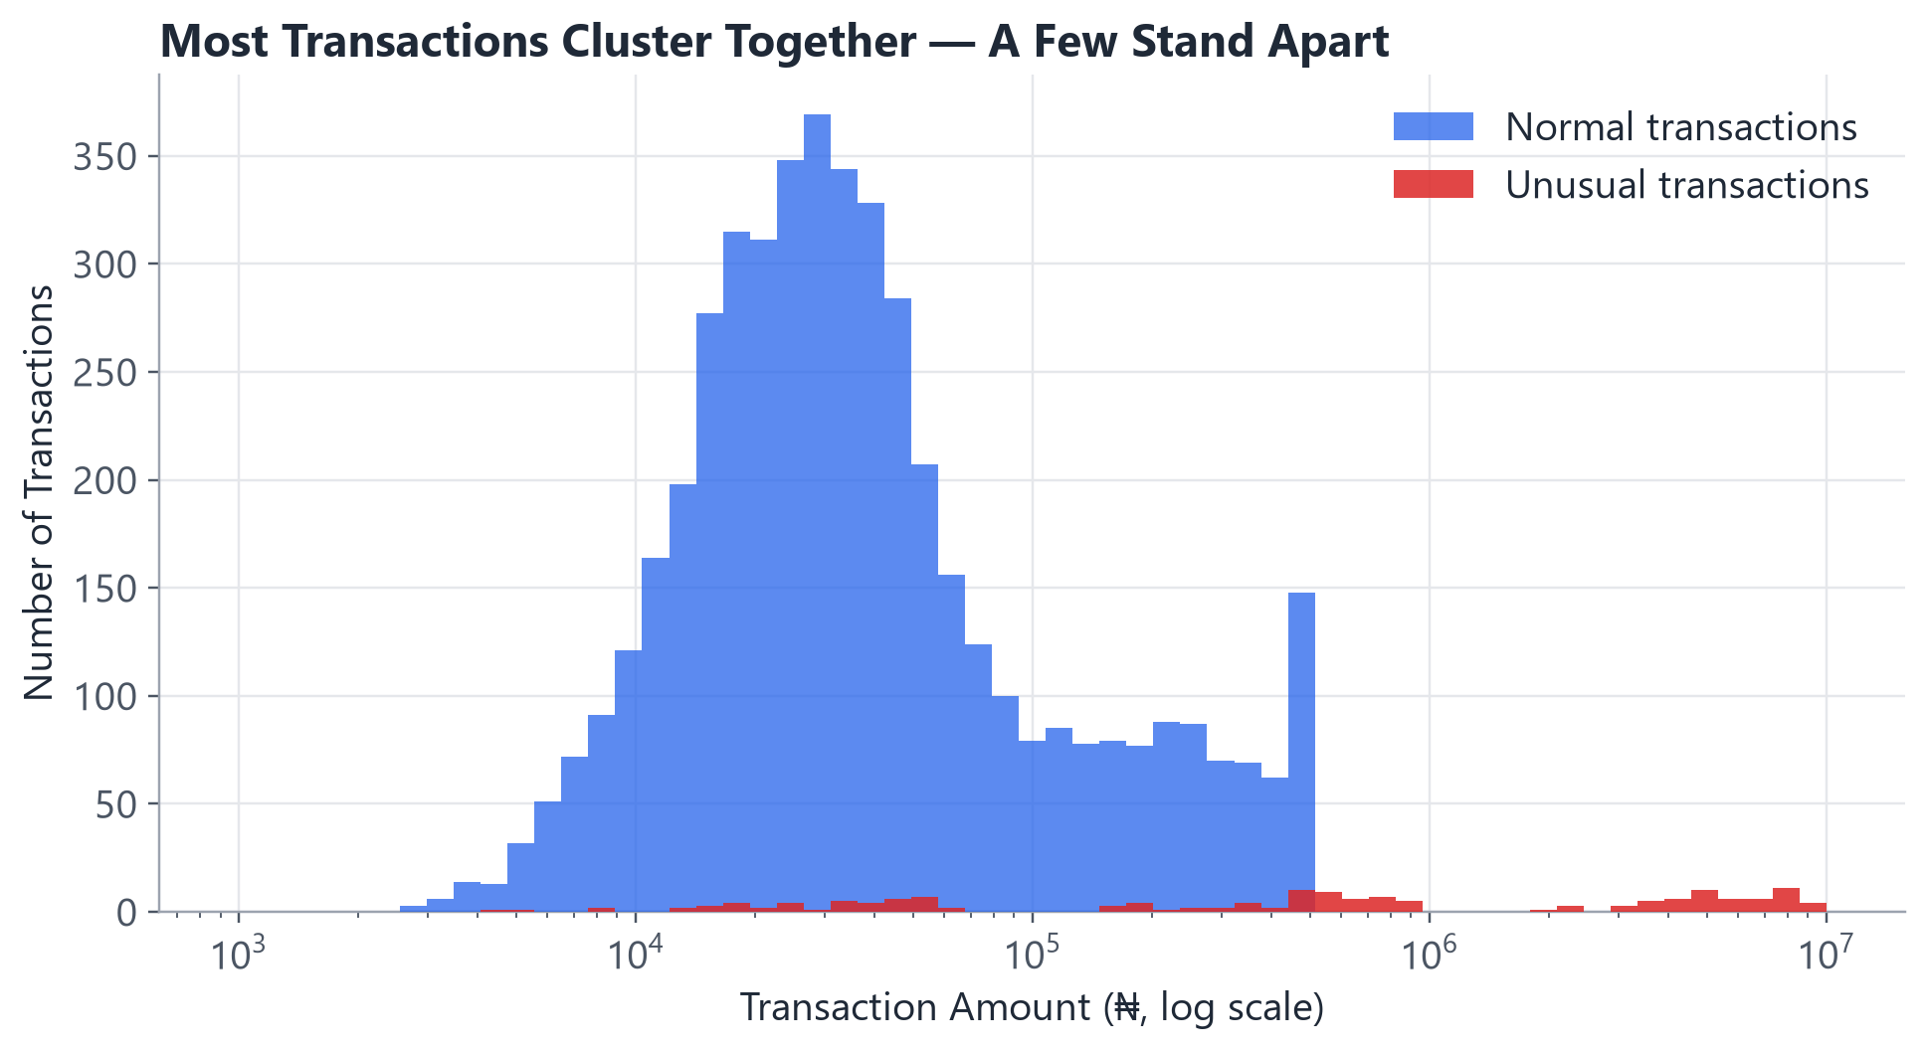
SECTION 1 · THE PROBLEM
SLIDE 6
Normal vs. Anomalous
Real (synthetic) transaction amounts from our bank dataset — most cluster tightly together.
Unsupervised Learning · Anomaly Detection Systems
6
Notes:
Point out the x-axis is log-scaled — without that, the huge outlier transactions would squash the whole 'normal' cluster into an unreadable sliver on the left. This is itself a useful practical lesson: always LOOK at your data's scale before deciding how to plot or model it.

Slide 7
SECTION 2 · UNSUPERVISED LEARNING
SLIDE 7
Supervised vs. Unsupervised
Supervised | Unsupervised
Has labels | No labels
Learns from known outcomes | Finds patterns
Classification | Clustering / anomaly detection
Unsupervised Learning · Anomaly Detection Systems
7
Notes:
Anchor slide for the whole conceptual half. Explicitly say: anomaly detection is USUALLY unsupervised in practice, precisely because confirmed fraud labels are rare, delayed, or simply don't exist yet for new kinds of fraud. If labels DO exist and are trustworthy, you'd actually prefer plain classification — unsupervised anomaly detection is a fallback for when labels are missing, not a universally 'better' choice.

Slide 8
SECTION 2 · UNSUPERVISED LEARNING
SLIDE 8
How Do We Learn “Normal”?
If nobody tells the machine what fraud looks like,
how can it find fraud?
Learn what NORMAL
looks like
Identify observations
that don't fit
Unsupervised Learning · Anomaly Detection Systems
8
Notes:
This reframing is the single most important idea in the whole session: the machine never learns 'fraud' directly — it learns what NORMAL looks like, and flags whatever doesn't match. That's what makes it unsupervised: no fraud examples are required, only a large pool of (mostly normal) transactions.

Slide 9
SECTION 2 · UNSUPERVISED LEARNING
SLIDE 9
Different Types of Anomalies
1. Point Anomaly
A single observation that is unusual all by itself.
2. Contextual Anomaly
Normal in one context, unusual in another.
3. Collective Anomaly
A group of observations that's unusual TOGETHER.
Unsupervised Learning · Anomaly Detection Systems
9
Notes:
Preview slide — each type gets its own dedicated example on the next three slides. Beginners often only think of point anomalies ('one big weird number'); the contextual and collective types are usually the more surprising, memorable ones, so give them proper room.

Slide 10
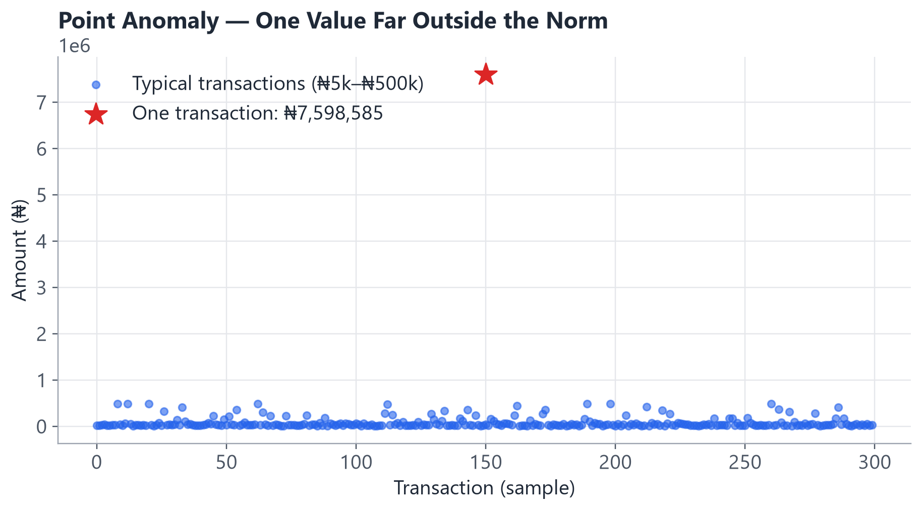
SECTION 2 · UNSUPERVISED LEARNING
SLIDE 10
Point Anomaly
• Most transactions in our dataset sit between ₦5,000 and ₦500,000.
• One transaction is worth several million naira.
• It's unusual entirely on its own — no other context is needed to spot it.
• This is the easiest kind of anomaly to imagine, but real fraud is often subtler than this.
Unsupervised Learning · Anomaly Detection Systems
10
Notes:
Keep this one quick — it's the intuitive baseline case everyone already grasps from Slide 3. Use it to set up the contrast with the next two slides, which are less obvious.

Slide 11
SECTION 2 · UNSUPERVISED LEARNING
SLIDE 11
Contextual Anomaly
Something may be normal in one context, but unusual in another.
₦500,000 transaction
NORMAL for a business
customer
₦500,000 transaction
UNUSUAL for a student
account
Same amount. Same currency. Completely different meaning depending on WHO made the transaction.
Unsupervised Learning · Anomaly Detection Systems
11
Notes:
This is a genuinely important beginner concept — flag it as such explicitly. Common misconception to pre-empt here: students often assume 'unusual' means a single global threshold applies to everyone. In practice, good anomaly detection compares each observation to ITS OWN relevant context (e.g. its customer's own history), not just the whole population.

Slide 12
SECTION 2 · UNSUPERVISED LEARNING
SLIDE 12
Collective Anomaly
One login attempt
Looks completely normal
500 login attempts
in 2 minutes
An unusual PATTERN
No single login in that burst is individually suspicious. It's the COMBINATION — many attempts, tightly clustered in time — that reveals the anomaly. Our own dataset includes a version of this: a handful of customers with a burst of 15-35 transactions inside one hour.
Unsupervised Learning · Anomaly Detection Systems
12
Notes:
Tie this explicitly back to our synthetic dataset's transaction_frequency feature — that's exactly how we represent collective anomalies later in the coding session. This is a nice moment to preview Hour 2 without going into code yet.

Slide 13
SECTION 3 · HOW DETECTION WORKS
SLIDE 13
The Basic Idea
Every approach we're about to cover follows this same basic shape.
Data
Learn Normal
Pattern
Calculate
Unusualness
Flag
Anomalies
Unsupervised Learning · Anomaly Detection Systems
13
Notes:
This four-box flow is the skeleton the rest of Hour 1 hangs on. Point out that different algorithms differ mainly in HOW they do step 2 (learn normal) and step 3 (calculate unusualness) — the overall shape stays the same.

Slide 14
SECTION 3 · HOW DETECTION WORKS
SLIDE 14
Approaches to Anomaly Detection
• Statistical methods — how far is a value from what's typically expected?
• Distance-based methods — how far is this point from its neighbours?
• Density-based methods — does this point sit in a crowded or a sparse region?
• Isolation Forest — how easily can this point be separated from the rest?
• One-Class SVM — does this point fall inside or outside the learned boundary of normal data?
Unsupervised Learning · Anomaly Detection Systems
14
Notes:
Explicitly say: there is no single 'best' way to define unusual — these are five different lenses on the same question. We'll go one level deeper on the first three (they build intuition), then spend most of our time on Isolation Forest, which is the main algorithm for today's hands-on session.

Slide 15
SECTION 3 · HOW DETECTION WORKS
SLIDE 15
Statistical Approach
Illustrative example — one customer's typical transaction behaviour:
Typical mean | Typical std. deviation | This transaction
₦45,000 | ₦15,000 | ₦150,000
A z-score measures how many standard deviations a value sits from the mean.
z ≈ 7 means this transaction is about 7 standard deviations above what's typical — extremely rare if this customer's spending followed a normal pattern.
z = (150,000 - 45,000) / 15,000
z ≈ 7
Unsupervised Learning · Anomaly Detection Systems
15
Notes:
Introduce the INTUITION before the formula: 'how many typical steps away from average is this value?' Then show the formula, then compute it together. Keep this example customer-specific (their own mean/std) rather than population-wide — this connects back to the contextual anomaly idea from Slide 11. Limitation to mention briefly: z-scores assume roughly bell-shaped data and only look at one feature at a time — real transactions have several features at once, which is exactly why we need more powerful methods.

Slide 16
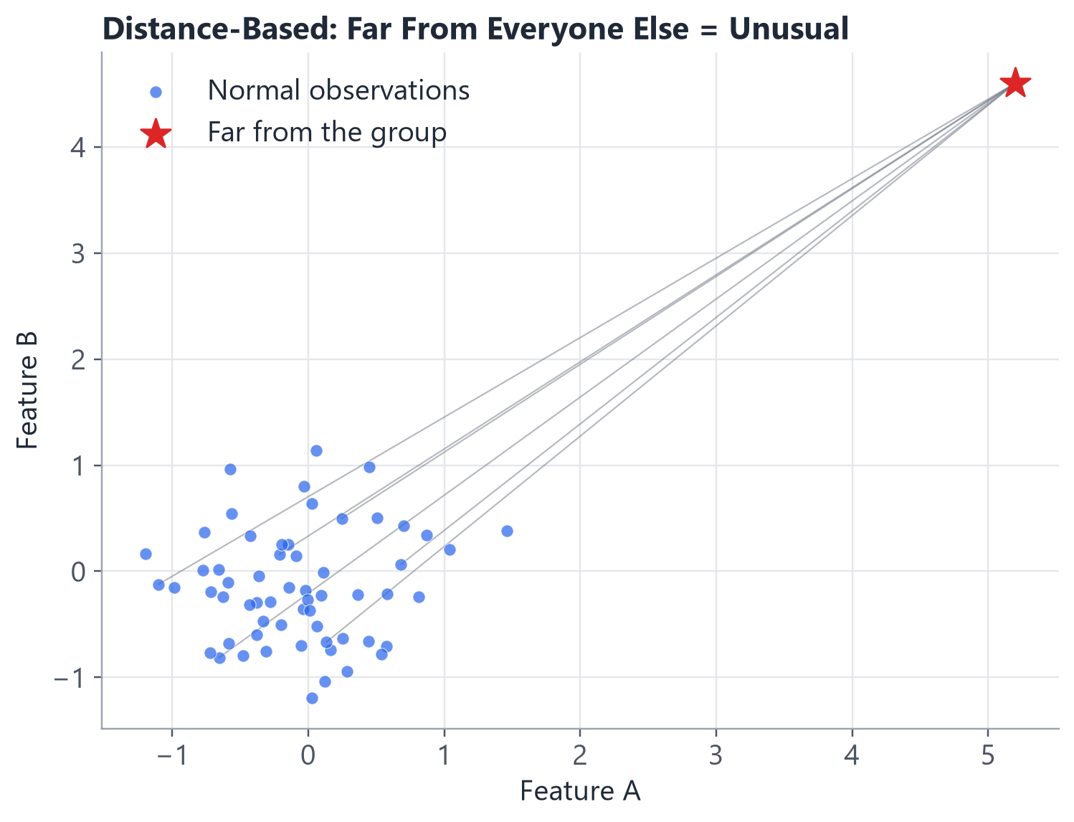
SECTION 3 · HOW DETECTION WORKS
SLIDE 16
Distance-Based Approach
• If an observation is far away from most other observations, it may be unusual.
• We measure “far” using distance across all the features together (like we do in K-Means).
• Simple and intuitive — but can struggle when data has many features, or clusters of very different sizes.
Unsupervised Learning · Anomaly Detection Systems
16
Notes:
If your class already took the K-Means/PCA session, call that out explicitly — this is literally the same distance intuition, just used for a different purpose (flagging outliers instead of finding groups).

Slide 17
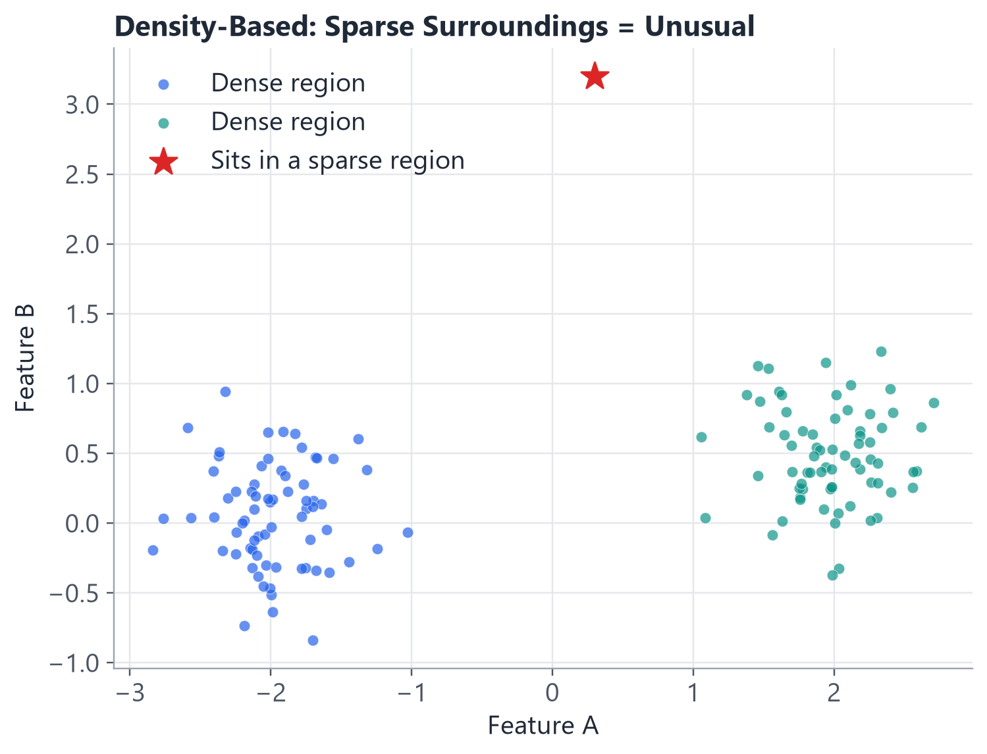
SECTION 3 · HOW DETECTION WORKS
SLIDE 17
Density-Based Approach
• If most observations are packed together and one sits in a very sparse region, it may be an anomaly.
• This adapts well when different groups naturally have different densities.
• Local Outlier Factor (LOF) is the classic algorithm built on this idea — we'll return to it in Section 5.
Unsupervised Learning · Anomaly Detection Systems
17
Notes:
Contrast with the previous slide: distance-based methods use a single global notion of 'far'; density-based methods adapt locally — a point can be 'close' in absolute distance but still unusual if it sits in a region nobody else visits.

Slide 18
SECTION 4 · ISOLATION FOREST
SLIDE 18
Meet Isolation Forest
“Anomalies are easier to isolate than
normal observations.”
• Practical — fast, even on large datasets.
• Widely used in real fraud and intrusion detection systems.
• Available directly in scikit-learn.
• Intuitive enough to explain without heavy mathematics.
• This is the MAIN algorithm for today's hands-on session.
Unsupervised Learning · Anomaly Detection Systems
18
Notes:
This is the pivot into the algorithm the rest of the course centres on. State plainly why we chose it over One-Class SVM or LOF for a first, beginner-friendly session: it needs almost no tuning, handles multiple features naturally, and its core idea ('easy to isolate = unusual') can be explained with a picture, not a formula.

Slide 19
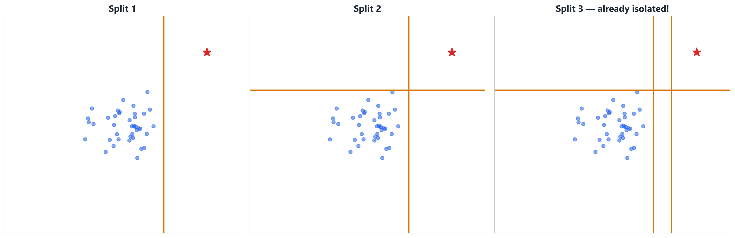
SECTION 4 · ISOLATION FOREST
SLIDE 19
What Does “Isolation” Mean?
Keep drawing random lines that split the data in half. Watch how quickly the red point gets cut off from everyone else.
Unsupervised Learning · Anomaly Detection Systems
19
Notes:
Walk through the three panels left to right. By the very first random split, the outlier is already separated from the main group — that's the entire intuition. Ask: 'if I kept drawing random lines through the crowded blue group, would ANY of them separate a single point that quickly?' (Answer: no — see the next slide.)

Slide 20
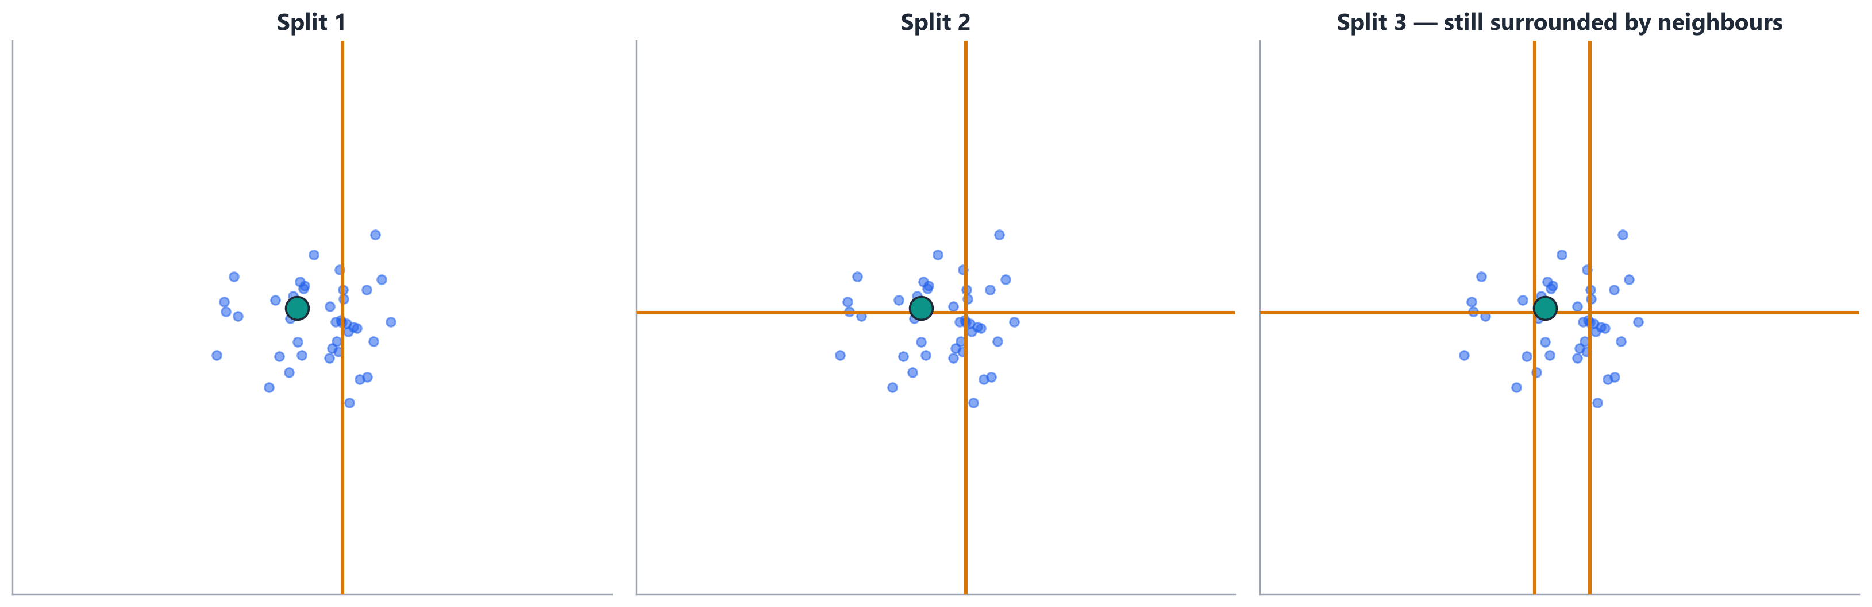
SECTION 4 · ISOLATION FOREST
SLIDE 20
Normal Point vs. Anomaly
Now watch a NORMAL point (the teal circle, buried inside the crowd) go through the same process.
Unsupervised Learning · Anomaly Detection Systems
20
Notes:
Direct visual contrast with the previous slide. After 3 splits, this point is STILL boxed in with several neighbours — it took many more cuts and still isn't fully alone. Summarize with the key line: normal points need MANY splits to isolate; anomalies need very FEW. That split count is essentially the anomaly score.

Slide 21
SECTION 4 · ISOLATION FOREST
SLIDE 21
How Isolation Forest Works
1. Randomly select a feature
2. Randomly select a split point
3. Split the data
4. Continue splitting
5. Observe how quickly each point becomes isolated
6. Repeat many times (many trees)
7. Calculate anomaly scores
Unsupervised Learning · Anomaly Detection Systems
21
Notes:
This is the central mechanics slide for Isolation Forest — take your time here. Emphasize 'randomly' twice: unlike a decision tree built to predict a label, these splits have no target to optimize for — they're genuinely random, which is exactly what makes the isolation signal meaningful.

Slide 22
SECTION 4 · ISOLATION FOREST
SLIDE 22
Why Use Many Trees?
“One random tree may give a poor decision.
Many trees give us a more reliable picture.”
• Isolation Forest builds many independent random trees (an ENSEMBLE).
• Each tree gives its own opinion about how easily a point isolates.
• The final anomaly score AVERAGES this across all the trees.
• This averaging smooths out the luck of any single random tree's split choices.
Unsupervised Learning · Anomaly Detection Systems
22
Notes:
Analogy: asking one person for a snap judgment vs. averaging the judgment of 100 people — the average is more stable and less influenced by one person's odd guess. This is the same principle behind Random Forest, if your class has already seen that.

Slide 23
SECTION 4 · ISOLATION FOREST
SLIDE 23
Important Parameters
from sklearn.ensemble import IsolationForest
model = IsolationForest(
n_estimators=100,
contamination="auto",
random_state=42
)
• n_estimators — how many random trees to build (100 is a solid beginner default).
• contamination — our estimate of what fraction of the data is anomalous.
• random_state — makes the result reproducible.
• We're deliberately NOT covering every available parameter — these three are enough to get a working model.
Unsupervised Learning · Anomaly Detection Systems
23
Notes:
This exact syntax was verified against the current scikit-learn documentation. Reassure beginners: scikit-learn's defaults for n_estimators and max_samples are sensible for most problems — contamination is really the only one worth thinking hard about, which is why it gets its own slide next.

Slide 24
SECTION 4 · ISOLATION FOREST
SLIDE 24
What Is Contamination?
“Contamination is an estimate of how much of the data
may be anomalous.”
• If we set contamination=0.03, we're telling the model: “I expect roughly 3% of transactions to be unusual.”
• This directly controls HOW MANY points get flagged — it's essentially a threshold in disguise.
• "auto" uses a default from the original research paper — a reasonable starting point, not a guarantee.
We'll experiment with different contamination values in Hour 2
Unsupervised Learning · Anomaly Detection Systems
24
Notes:
This slide sets up the Hour 2 mini-challenge directly — flag that explicitly. Common beginner mistake to pre-empt: contamination is NOT something the model discovers from the data; it's an ASSUMPTION we feed in, and getting it wrong changes the results a lot (we'll see exact numbers later: our own dataset goes from 51 flagged transactions at contamination=0.01 to 456 at 'auto').

Slide 25
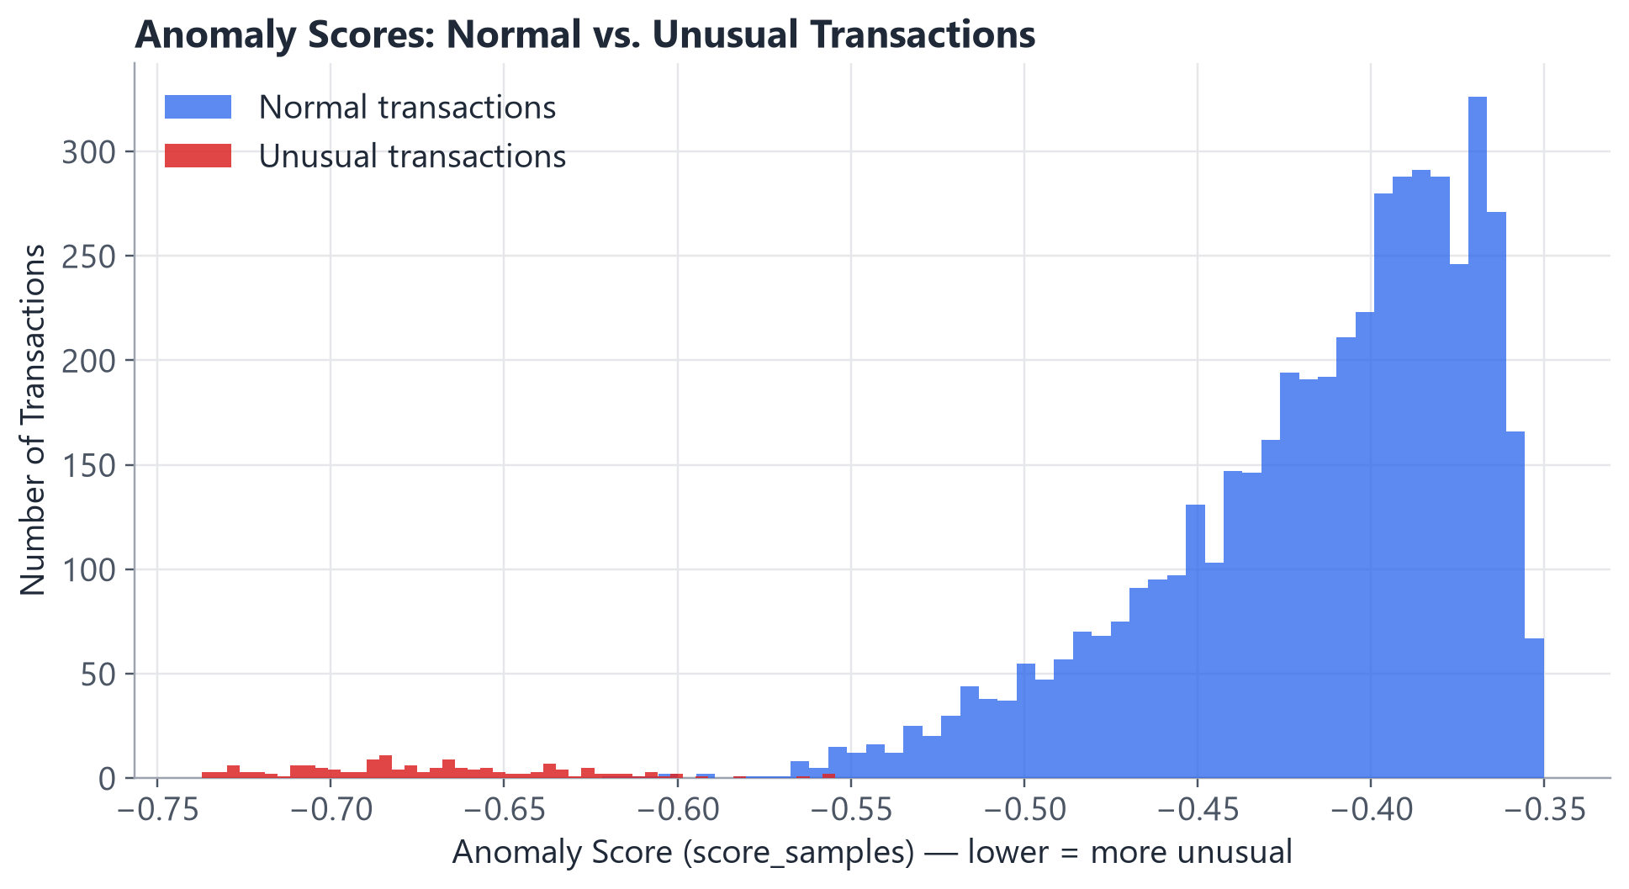
SECTION 4 · ISOLATION FOREST
SLIDE 25
Anomaly Score
• Every transaction gets a continuous anomaly score, not just a yes/no flag.
• In scikit-learn's Isolation Forest, LOWER scores mean MORE unusual.
• This lets us rank transactions by how unusual they are — not just sort them into two bins.
• Notice how cleanly the two distributions separate in our own dataset.
Unsupervised Learning · Anomaly Detection Systems
25
Notes:
Flag this explicitly as a place where beginners get tripped up: 'higher = more normal' is the opposite of what some people expect. Double-check this matches whatever scoring function you show in the notebook (score_samples / decision_function) — we verified against the current scikit-learn docs that lower values are more anomalous for both.

Slide 26
SECTION 4 · ISOLATION FOREST
SLIDE 26
Prediction: Normal or Anomaly?
>>> model.predict(X)
array([ 1, 1, 1, -1, 1, -1, ...])
• 1 → normal observation (an “inlier”).
• -1 → anomaly (an “outlier”).
• predict() converts the continuous anomaly score into this simple yes/no flag, using the contamination setting as the cutoff.
• Verified against the current scikit-learn documentation.
Unsupervised Learning · Anomaly Detection Systems
26
Notes:
Make the 1 / -1 convention very visually clear — write it big if you're on a whiteboard too. This exact convention (1 = normal, -1 = anomaly) is shared across IsolationForest, LocalOutlierFactor, and OneClassSVM in scikit-learn, which is a nice consistency to point out.

Slide 27
SECTION 4 · ISOLATION FOREST
SLIDE 27
From Model Output to Business Action
Transaction
Model
Anomaly
Investigation
Human Decision
An anomaly does NOT automatically mean fraud.
• A false positive is a normal transaction wrongly flagged as unusual.
• A flagged transaction should trigger investigation, not an automatic block or account freeze.
• The model's job is to narrow down WHERE a human should look — not to make the final call.
Unsupervised Learning · Anomaly Detection Systems
27
Notes:
This is one of the most important business-literacy points in the whole session — don't rush it. Ask: 'what happens to customer trust if the bank blocks every flagged transaction automatically, and 2 out of 3 of them turn out to be legitimate?' Anomaly detection is a triage tool, not a verdict.

Slide 28
SECTION 5 · OTHER METHODS
SLIDE 28
When Would We Use Other Algorithms?
Method | Basic Idea
Isolation Forest | Easy-to-isolate points are suspicious
One-Class SVM | Learn the boundary of normal data
Local Outlier Factor (LOF) | Identify observations in unusually low-density regions
Statistical methods | Flag observations far from expected behaviour
Unsupervised Learning · Anomaly Detection Systems
28
Notes:
Keep this genuinely high-level, as instructed — no deep dive today. If a student asks 'which is best?', the honest answer is: it depends on the data and the problem, which is exactly what the next slide addresses.

Slide 29
SECTION 5 · OTHER METHODS
SLIDE 29
Choosing an Approach
Beginner guidance for picking an approach in practice.
Start
Simple
Understand
the Data
Choose a
Method
Validate
Results
Monitor
Unsupervised Learning · Anomaly Detection Systems
29
Notes:
This is a practical decision framework students can actually reuse on the job. Emphasize 'Monitor' at the end — anomaly detection isn't a one-time model you train and forget; customer behaviour and fraud patterns both drift over time.

Slide 30
SECTION 6 · EVALUATION & REAL-WORLD USE
SLIDE 30
How Do We Know It Works?
• Precision — of the transactions we flagged, how many were actually anomalous?
• Recall — of the actual anomalies out there, how many did we successfully catch?
• False positives — normal transactions wrongly flagged (annoys customers, wastes investigator time).
• False negatives — real anomalies we missed entirely (the more dangerous kind of mistake).
• Domain / business validation — ultimately, a human investigator's judgment matters too.
• Anomaly detection can be HARD to evaluate when true labels aren't available at all — which is often the whole reason we're using it in the first place.
Unsupervised Learning · Anomaly Detection Systems
30
Notes:
This last bullet is a genuinely important, slightly uncomfortable truth: in a real unlabeled setting, you often can't compute precision/recall at all until much later (when disputes or investigations eventually confirm ground truth). In our notebooks, we use a synthetic dataset WITH known ground truth specifically so you can see these metrics in action — make that distinction explicit so students don't assume they'll always have this luxury in a real job.

Slide 31
SECTION 6 · EVALUATION & REAL-WORLD USE
SLIDE 31
Final Mental Model
No labels
Understand normal behaviour
Find unusual observations
Calculate anomaly score
Set / interpret a threshold
Investigate
Take business action
Unsupervised Learning · Anomaly Detection Systems
31
Notes:
This is the single-slide summary of the ENTIRE conceptual hour — consider lingering here for questions before the coding break. Every slide in Hour 1 maps to one box in this chain.

Slide 32
INSTRUCTOR REFERENCE
SLIDE 32
Important Distinctions
Myth | Reality
An anomaly means fraud. | An anomaly is simply unusual — it may be legitimate, a data error, fraud, or a new but genuine customer behaviour.
An outlier should always be removed. | An outlier may be an error, a legitimate extreme value, an important event, or fraud — never remove automatically.
Anomaly detection is the same as classification. | Classification learns from labelled categories; anomaly detection identifies unusual behaviour without complete labels.
Detection = a final decision. | The model flags something; a human or business process then decides what action to take.
Unsupervised Learning · Anomaly Detection Systems
32
Notes:
Consider running this as a rapid true/false check with the class before moving to the quiz — these four distinctions are the ones beginners misstate most often in follow-up conversations.

Slide 33
KNOWLEDGE CHECK
SLIDE 33
Quick Quiz
1. What is an anomaly?
2. Why can anomaly detection be an unsupervised learning problem?
3. What does Isolation Forest try to do?
4. What does -1 represent in the Isolation Forest predict() output?
5. Does an anomaly automatically mean fraud?
6. What is the risk of setting the anomaly threshold too aggressively?
Unsupervised Learning · Anomaly Detection Systems
33
Notes:
ANSWER KEY (for instructor use):
1. A data point that behaves very differently from what is normal/expected.
2. Because we don't need labelled fraud examples — the model learns what NORMAL looks like from mostly-unlabeled data, then flags whatever doesn't fit; no target column is required.
3. It tries to isolate each observation using random splits, and measures how FEW splits it takes — anomalies isolate quickly, normal points take many more splits.
4. -1 means the model has flagged that observation as an anomaly/outlier (1 means normal/inlier).
5. No. An anomaly is simply unusual. It could be fraud, a data entry error, or a legitimate but rare event (e.g. a big genuine purchase). It requires investigation, not an automatic verdict.
6. Setting the threshold too aggressively (e.g. a high contamination value, or an overly low score cutoff) flags too many normal transactions as anomalies — many false positives, wasted investigation time, and frustrated customers. Too LOOSE a threshold has the opposite risk: missing real anomalies (false negatives).

Slide 34
APPENDIX
SLIDE 34
References / Sources
Textbook
• Aggarwal, C. C. (2015). Data Mining: The Textbook. Springer. — Chapter 8, “Outlier Analysis” (extreme value analysis, distance-based and density-based / LOF methods).
Original Research
• Liu, F. T., Ting, K. M., & Zhou, Z.-H. (2008). Isolation Forest. IEEE ICDM.
Official Documentation (verified for current syntax)
• scikit-learn API Reference — IsolationForest, LocalOutlierFactor, OneClassSVM, StandardScaler (scikit-learn.org/stable/modules/generated/ ...)
• scikit-learn User Guide — Novelty and Outlier Detection (scikit-learn.org/stable/modules/outlier_detection.html)
• Every code snippet in this deck was checked against these pages during development.
Data
• All transaction data used in this course is SYNTHETIC (data/generate_data.py). It does not represent any real bank, customer, or transaction.
Unsupervised Learning · Anomaly Detection Systems
34
Notes:
All scikit-learn syntax in this deck (IsolationForest, predict, score_samples, decision_function) was checked against the official documentation during course development to ensure it reflects current, non-deprecated APIs.

