Slide 1


Regex Denial of Service (ReDoS)
Abir Taheer

Slide 2
What Are Regular Expressions?
^[a-zA-Z0-9\? ]+$
They are often referred to as “state machines”
Their most common use cases include text search/validation
The example above would match a string that contains at least one letter (uppercase or lowercase), number, question mark, or space.

Slide 3
Common Selection Rules
Use brackets to indicate a range of characters: [a-z] (any lowercase letter)
Prefixing the inside of a bracket will negate the set and select only characters not in the range [^a-z] (anything not a lowercase letter will match)
Starting the RegExp with a ^ indicates that the expression should start searching at the beginning of the string
Ending the RegExp with a $ indicates that the pattern should be matched until the end of the string
^abc$ will match if the entire string is “abc”

Slide 4
Quantifiers
These are used for “indeterminate selection” and refer to the preceding token
They specify how many of a character group should be selected
+ means at least one or more
* means zero or more
? means exactly zero or one instance
Brackets can be used to find an exact number or a range {5} (exactly 5) or {1, 2} (between one and two)
^ab+c$ will match “abc” as well as “abbbbbbc” but not “ac”

Slide 5
How are they like a state machine?
Consider the regex: abc
Given the string “ababc” The following will happen
a (success, index 0) -> b (success, index 1) -> a (fail, index 2)
Restart pattern from index 1,
b (fail, index 1),
Restart from index 2
a (success, index 2) -> b (success, index 3) -> c (success, index 4)
Match verified
Think of it like recursive back tracking

Slide 6
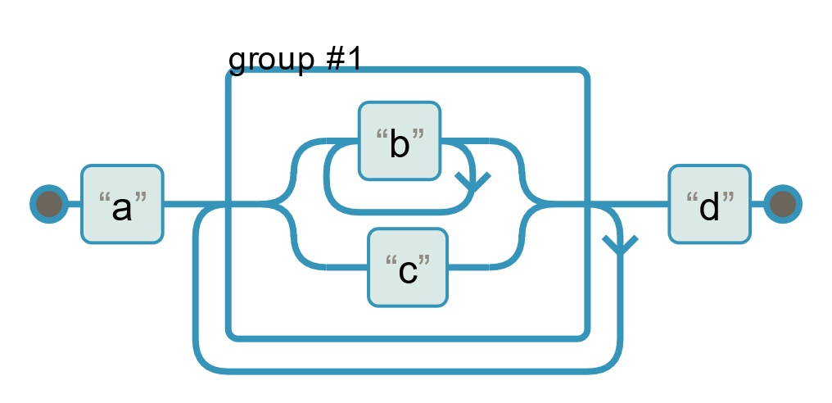
When does this become an issue?
When a regular expression is defined in a way that requires excessive back tracking, large invalid strings will take long amounts of time to evaluate
For example: a(b+|c)+d
Example String:
“abbbbbbbbbbbbbbbcccx”

Slide 7
What does that have to do with DoS?
Denial of service happens when the server is overloaded and unable to respond to other legitimate requests
If you can give the server a string that has many permutations with a given regex, the server will be busy trying to match the regex and may not be able to respond to other requests
Time for the server experiment: redos-demo.herokuapp.com

