Slide 1
QCi GLOBAL INDUSTRY CHALLENGE 2026 · PHASE 3 · ENERGY INFRASTRUCTURE
eQoSystem
Cost Optimization in Resilient Power Grids
Two-stage stochastic microgrid design with Dirac-3-native integer Hamiltonians
0
50
1.005×
critical outage hours
qudits
of MILP optimum
across 20 + 40 scenarios
vs 149 binary qubits
certified near-optimal cost
Notes:
Pitch: grids are trees; cut a branch and everything past it dies. We pre-place solar/battery/diesel so neighborhoods island through failures, solved as three Hamiltonians on Dirac-3. Headline: zero critical outage hours, half the qubits, within 0.5% of classical optimum.

Slide 2
THE PROBLEM
A distribution grid is a tree — one cut goes dark
Power enters at one substation (root) and flows outward through feeders to every bus (junction).
Radial operation: no loops. Efficient and safe — but fragile.
A single line failure de-energizes everything downstream of the break.
Weather-driven outages cost tens of billions of dollars per year.
substation
✕
dark
dark
served
served
One failed line (✕) blacks out its entire downstream subtree.
Notes:
Radial = tree. Red X = failed line; grey nodes go dark. This fragility is the whole motivation.

Slide 3
THE IDEA
Islanding: neighborhoods that survive on their own
MG
Microgrid
☼
DER
A grid section with local generation + switches so it can run detached.
Distributed Energy Resources: solar (PV), battery (BESS), diesel (DG). Each has different 'firm' output you can rely on when islanded.
⇄
Tie switch
◈
Islanding
A normally-open spare link, closed remotely after a failure to reroute power around the break.
Deliberately disconnecting a section and running it on its own DERs until repair.
Notes:
Four terms to own. Firmness is the subtlety: diesel 100%, battery ~50% & energy-limited, solar ~25% & useless at night.

Slide 4
THE PIPELINE
Three coupled stages, one Hamiltonian family
1
DESIGN
2
ISLANDING
3
DISPATCH
Invest once
Per contingency
Per island · per hour
Which islands to build, how many PV/BESS/DG units, which tie switches.
For each failure: which built islands energize, which ties close.
Generator setpoints — critical load first, then customers.
50 qudits · degree 3
≤9 qudits · degree 2
2–4 qudits · degree 3
Uncertainty (which line fails, when, how long, load & sun) is sampled by Latin-Hypercube into 20 scenarios. Invest before knowing the disaster; evaluate across all of them — a two-stage stochastic problem.
Notes:
Spine of the talk: all three stages are the same object — a bounded-integer polynomial — so one machine solves all of them.

Slide 5
THE MACHINE
Hamiltonians on an entropy quantum computer
What we hand the machine
Why it fits THIS problem
A Hamiltonian = a polynomial whose minimum encodes the best decision. 'Solving' = finding the values with lowest value.
Dirac-3 physically relaxes photonic states toward that minimum — photon shot noise is the fuel, not the enemy.
Native integer 'qudits' (0…d), not just 0/1 qubits.
Native polynomials up to degree 5 — no auxiliary variables.
Unit counts (0–8 PV, 0–6 DG…)
one qudit each, not 3 qubits
Gated capacity b·(cap−dem)²
native degree-3 term
Diesel fuel curve
native cubic term
On a qubit machine these need binary expansion + quadratization — more variables, more noise.
Notes:
Hamiltonian = cost landscape; solving = lowest point. The three 'fit' rows are the quantum-rationale in miniature.

Slide 6
THE CLASSICAL ENGINE
Simulated annealing: how we search the landscape
A blindfolded hiker seeking the lowest valley.
'Always downhill' gets stuck in the first dip (local minimum).
Annealing starts 'hot': sometimes steps uphill to escape dips. Then cools — uphill moves get rarer — until it settles in a deep valley.
Name from metallurgy: cool metal slowly and atoms find a low-energy crystal.
Under the hood
Accept a worse move with probability exp(−ΔE / T).
Temperature T cools geometrically 2.5 → 0.001.
6 restarts · greedy warm start · ±1 polish.
Delta evaluation: only re-score terms touching the moved variable → 5–15× faster.
Algorithmic twin of what Dirac-3 does physically — and our fair yardstick in E5.
Notes:
Two roles: runs-anywhere classical solver for judges, and the honest baseline in E5 run identically on both encodings.

Slide 7
THE BRIEF
What Phase 3 required — and where we stand
Three-stage formulation
DONE
Run on Dirac-3 via qBraid
READY
✓
→
Design → islanding → dispatch as Hamiltonians
Verified submission format; token-gated run
Reproducible by judges
DONE
Metrics M1 / M2 / M3
DONE
✓
✓
One command, fixed seeds, <1 min
Computed exactly as defined
Classical baseline
DONE
Robust under stress
DONE
✓
✓
Exact MILP + brute-force certification
M2 = 0 even at load ×1.5 and 20 h outages
Notes:
The single 'Ready' is the hardware run — needs the team qBraid token. Everything else complete and reproducible.

Slide 8
THE REBUILD
From an inherited prototype to a working solution
Phase 2 prototype — what we found
Phase 3 rebuild — what changed
The quantum path NEVER ran — eqc-models calls crash; all solving was classical SciPy.
Islanding degenerate: every island always ON, in every scenario — contingencies ignored.
Candidates disjoint (no shared buses) → no coupling, so no real optimization.
Coefficient range ≈ 80 dB — unusable on analog hardware.
Reported results NOT producible by the code (no baseline, no time loop, crashes first).
Verified Dirac-3 converter, bit-exact vs eqc-models; no silent fallback.
Genuine coupled islanding QUBO; failures truly de-energize.
Gated degree-3 capacity + cubic fuel; dual DER hubs (M2 → 0).
Coefficients conditioned to 19–57 dB (E3 proves why).
Every number regenerates in <1 min, with baselines + certification.
Notes:
Matter-of-fact, not disparaging — we inherited it. Point: the current submission is real, reproducible, honest.

Slide 9
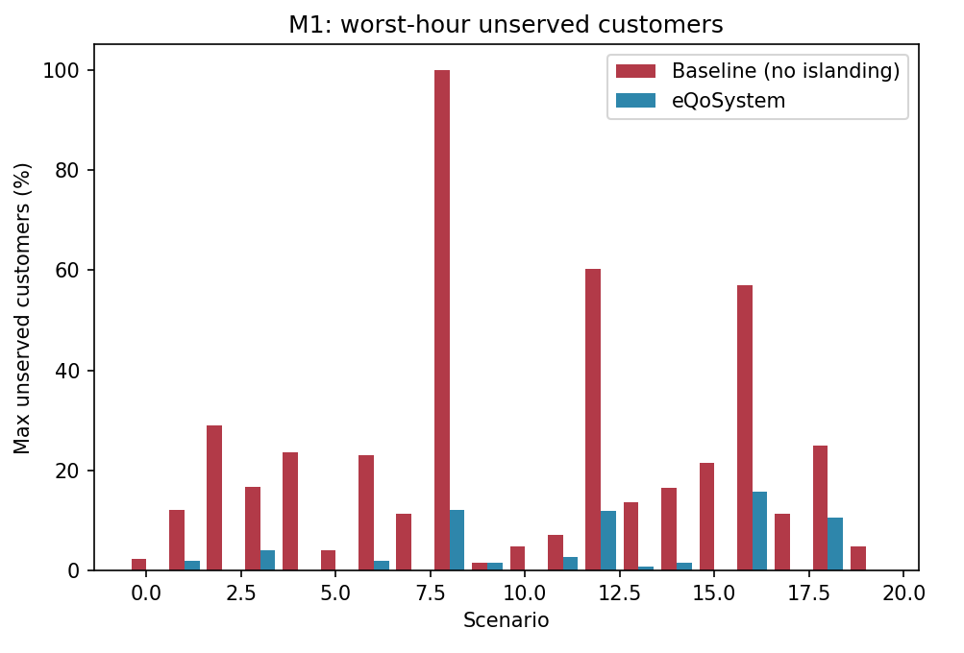
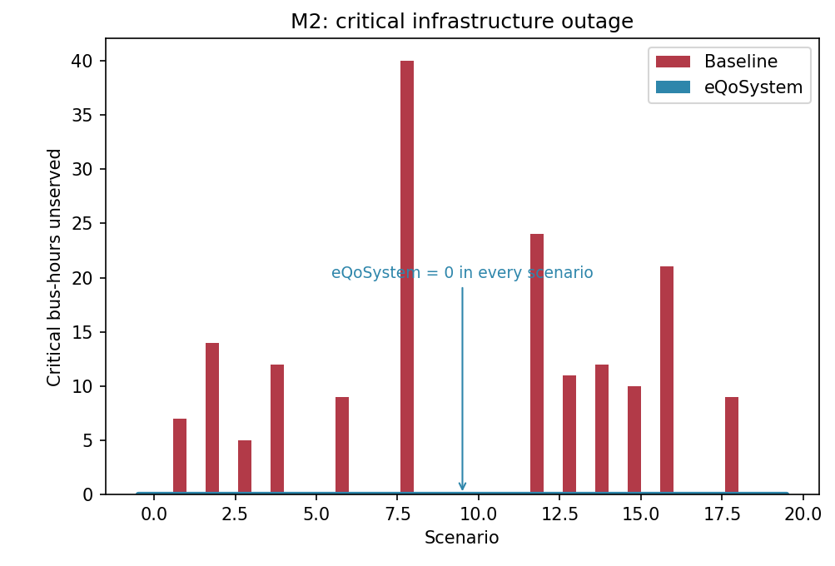
RESULTS
Customers stay powered — critical loads never drop
M1 — worst-hour unserved: 15.8% vs 100% baseline
M2 — critical-infra hours: 0 vs 174 baseline
The flat blue line is the headline: critical infrastructure loses zero hours in every scenario — an arithmetic consequence of the 1.25× sizing margin, held under 40 out-of-sample scenarios. Every island-hour also passes LinDistFlow voltage/thermal validation (Vmin 0.986 pu) with hourly battery state-of-charge simulated.
Notes:
Pre-empt 'zero looks fake': it's designed and proven, not tuned. Baseline reaches 40 h; ours is zero because we spent M3 to buy it down.

Slide 10
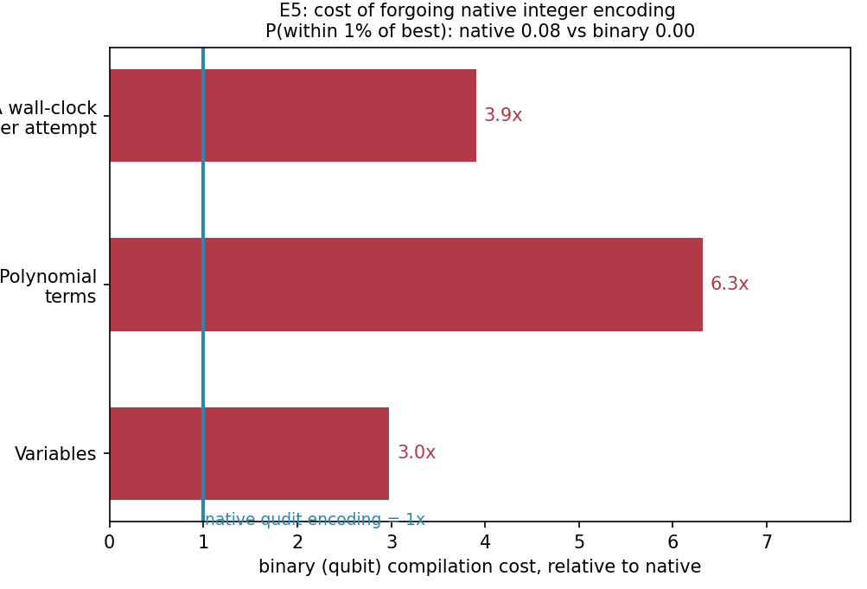
QUANTUM RATIONALE
Measured, not asserted — native encoding pays off
E5 — same problem, two encodings
Variables
50 → 149
3.0×
Poly. terms
196 → 1,238
6.3×
SA wall-clock
1× → 4×
4.0×
Native qudits reach within 1% of the best solution at equal budget; the binary compilation never does. Degree-3 terms would also need quadratization on qubit hardware — worsening analog noise (E3).
We claim certified parity with classical MILP (1.005×) and a measured encoding advantage — not a fake speedup.
Notes:
Rubric: 'clear advantage OR rationale'. At 33-bus nobody honestly beats HiGHS; credible story is representational economy, which E5 measures. Say parity out loud.

Slide 11
WHERE WE ARE · WHAT’S NEXT
eQoSystem
pip install -e .
eqosystem-experiments --backend sa # runs anywhere
eqosystem-experiments --backend dirac3 # on qBraid, with token
NEXT STEPS
Write the 5-page report (draft ready, §5 awaits hardware numbers).
Run on Dirac-3 once organizers grant access — code is submission-ready, one command.
Package + submit on Aqora.
0 h
20/20
1.005×
50
critical outage
certified optimal
of MILP
qudits
Team eQoSystem · ESI-SBA, Algeria · QCi Global Industry Challenge 2026 — Phase 3
Notes:
Close on reproducibility + four numbers. Next steps: report writing, Dirac-3 run pending organizer access, Aqora submission.

