Slide 1
Building chatbots with rasa
Abhinav Ravi
Anupam Mukherjee
Vibhor Jain

Slide 2
AGENDA
Architecture
Commands to setup Chatbot
Flows covered:
Sending mail if asked
Not sending mail if denied
Handling typos for location using Spell Checker
Tier 3 city condition handled
Synonyms for major cities like Mumbai / Kolkata / Chennai / Bangalore
Various ways to handle budget input
Top 10 restaurant list sorted on user rating
Slack Integration
YouTube Video

Slide 3
Architecture
CHATBOT
models/nlu
models/dialogue
Action Server
nlu_config.yml
domain.yml
stories.md
data.json
NLU TRAIN
CORE TRAIN
KerasPolicy
policies.yml
MemoizationPolicy
Custom Fallback
Policy

Slide 4
COMMANDS
Training NLU: python -m rasa_nlu.train -c nlu_config.yml --data data/data.json -o models --fixed_model_name nlu --project current –verbose
Training Core: python -m rasa_core.train -d domain.yml -s data/stories.md -o models/current/dialogue -c policies.yml
Running Action Server: python -m rasa_core_sdk.endpoint --actions actions
Launching Chatbot CLI: python -m rasa_core.run -d models/current/dialogue -u models/current/nlu --endpoints endpoints.yml
*Action server is a pre-requisite for running chatbot CLI as we need to communicate with Zomato APIs.

Slide 5
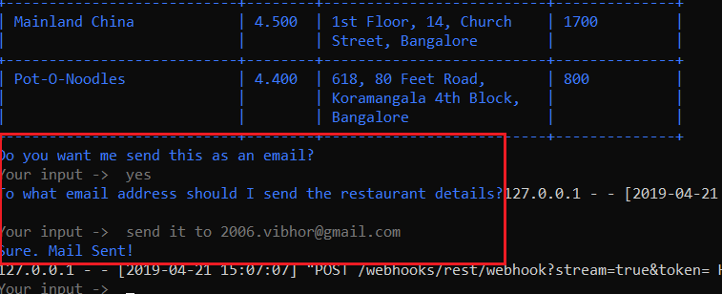
FLOW 1- Customer asking for mail

Slide 6
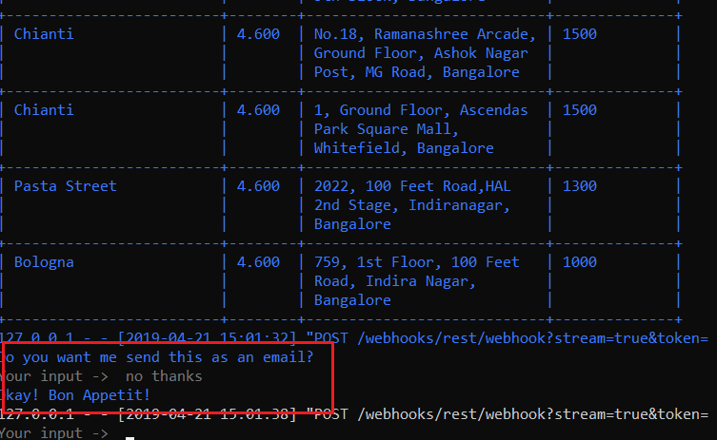
Flow 2- Customer denial for mail

Slide 7
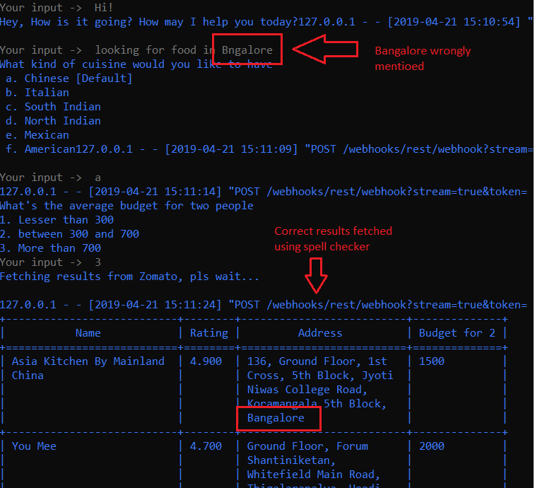
Flow 3- Wrong spelling for city
We have added a spell checker utility based on Edit Distance.

Slide 8
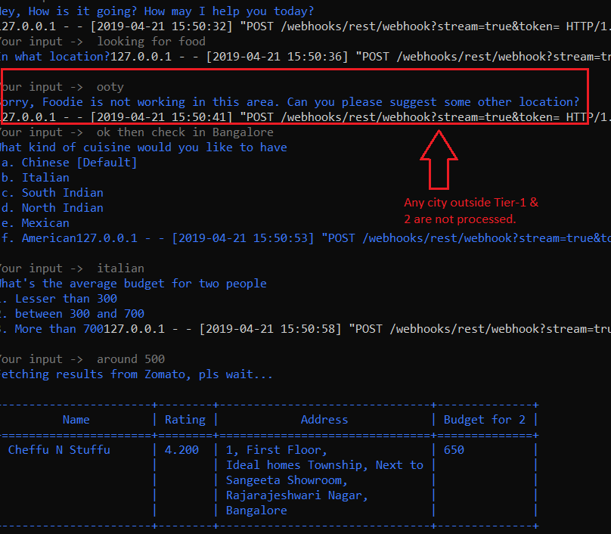
Flow 4- TIER 3 CITY NOT Processed

Slide 9
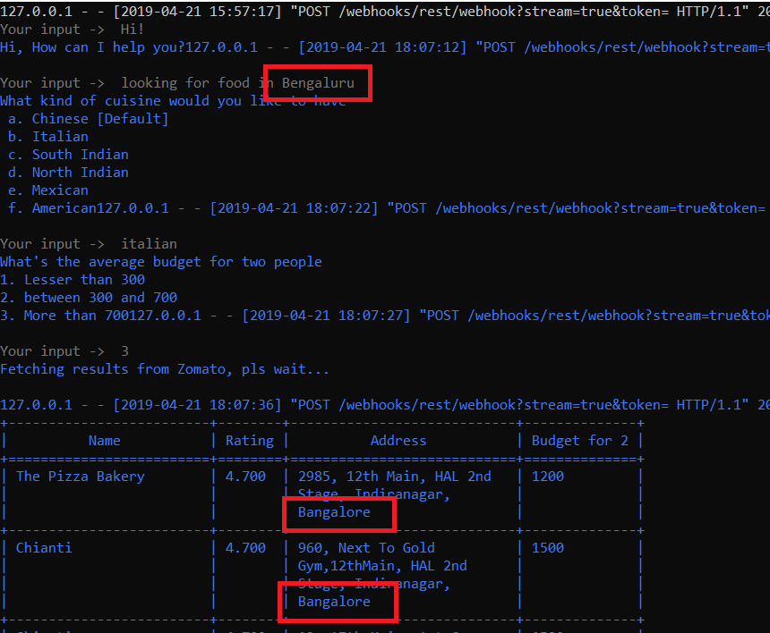
Flow 5- Synonyms for major cities
Synonym has been provided for Delhi, Mumbai, Kolkata, Chennai and Bangalore

Slide 10
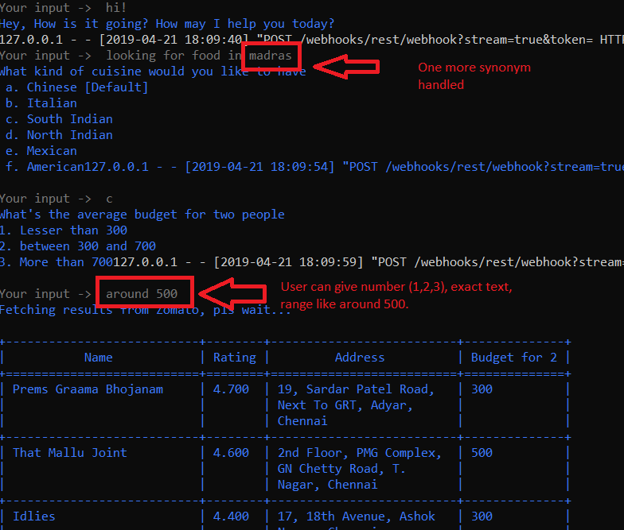
Flow 6- various ways to handle budget input
User may give budget as numbers (1/2/3), or as amount (200/600/850) or exact string (more than 700), or random string (around 500).
Also, for cuisine, user may give bullet number (a/b/c/d/e/f), or shorthand (ch/it, etc.) or full text.

Slide 11
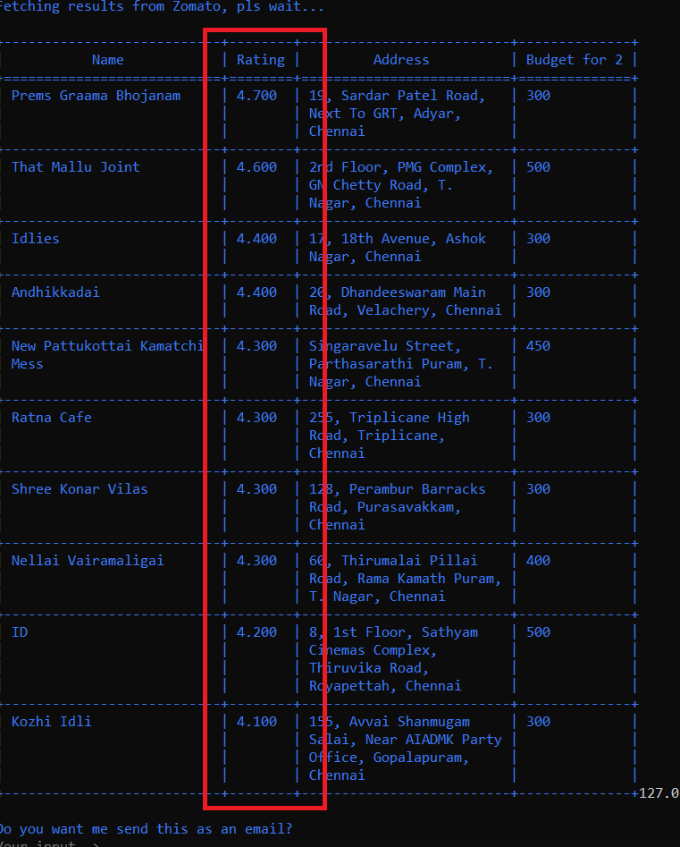
Flow 7- top 10 restaurants sorted on rating

Slide 12
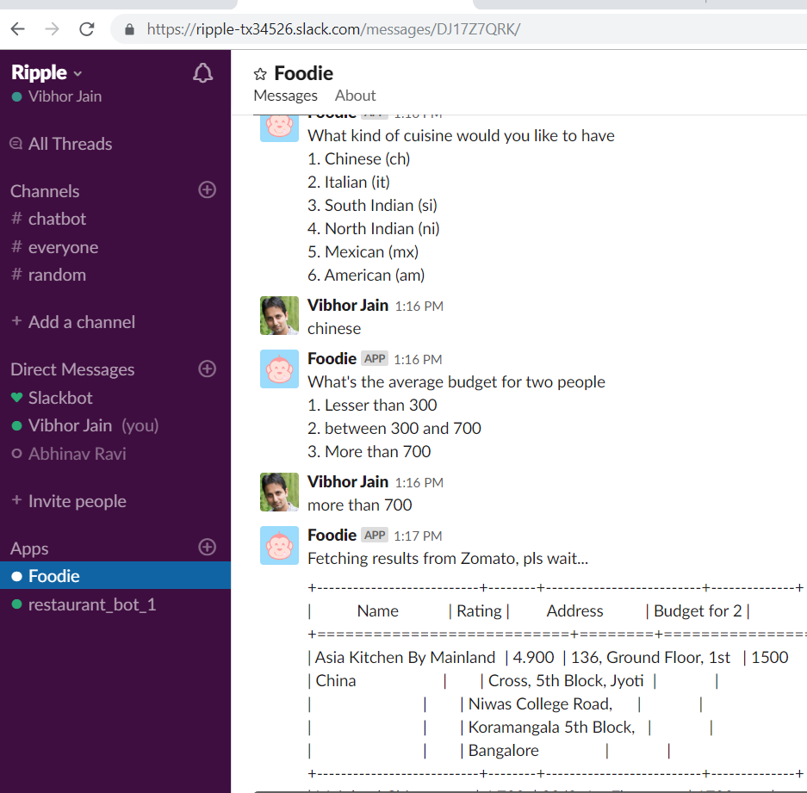
Flow 8- slack integration

Slide 13
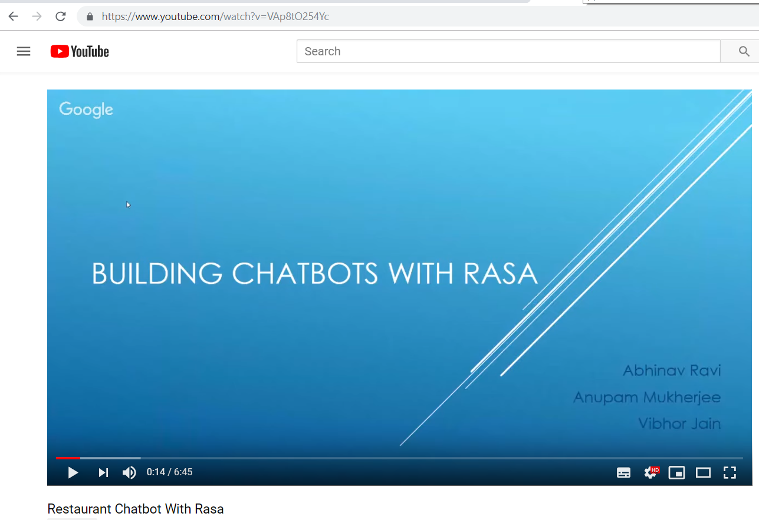
Flow 9- youtube demo
https://www.youtube.com/watch?v=VAp8tO254Yc

Slide 14
Extra Info
Some webhook logs are seen on chatbot CLI, looks like it is coming from RASA library. We have raised an issue on RASA for disabling this.
https://github.com/RasaHQ/rasa/issues/3291
For setting up environment, Pls use requirements.txt followed by below commands:
pip install rasa_nlu[spacy]
python -m spacy download en_core_web_md
python -m spacy link en_core_web_md en

